Slide 1
AutoViz
Alex Fichtner

Slide 2

Agenda
Introduction
Installation
Code
Importing
Parameters
Full Sequence
Demonstration

Slide 3

Introduction
AutoViz (Automatic Visualization) is a Python library designed to simplify data visualization and exploratory data analysis (EDA). It uses a single line of code to automatically generate visualizations for datasets of any size.
It supports CSV, TXT, and JSON files.
AutoViz creates various plots, such as scatter plots, distribution plots, heatmaps, etc.

Slide 4
Summary from the Creators
The motivation behind the creation of AutoViz is to provide a more efficient, user-friendly, and automated approach to exploratory data analysis (EDA) through quick and easy data visualization plus data quality. The library is designed to help users understand patterns, trends, and relationships in the data by creating insightful visualizations with minimal effort. AutoViz is particularly useful for beginners in data analysis as it abstracts away the complexities of various plotting libraries and techniques. For experts, it provides another expert tool that they can use to provide insights into data that they may have missed.
Ease of use: AutoViz is designed to be user-friendly and accessible to beginners in data analysis, abstracting away the complexities of various plotting libraries
Speed: AutoViz is optimized for speed and can generate multiple insightful plots with just a single line of code
Scalability: AutoViz is designed to work with datasets of any size and can handle large datasets efficiently
Automation: AutoViz automates the visualization process, requiring just a single line of code to generate multiple insightful plots
Customization: AutoViz provides several options for customizing the visualizations, such as changing the chart type, color palette, etc.
Data Quality: AutoViz now provides data quality assessment by default and helps you fix DQ issues with a single line of code using the FixDQ() function
"Seshadri, Ram (2020). GitHub - AutoViML/AutoViz: Automatically Visualize any dataset, any size with a single line of code. source code: https://github.com/AutoViML/AutoViz"

Slide 5
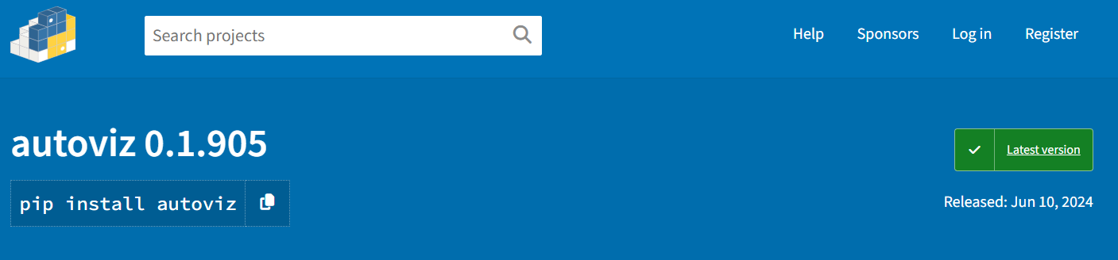
Installation
https://pypi.org/project/autoviz/

Slide 6
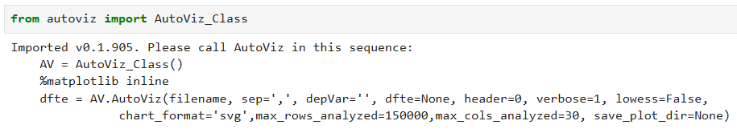
Importing the AutoViz Class

Slide 7
AutoViz Parameters
filename
File path to your CSV, TXT, or JSON file.
sep
Separator to define the delimiter in the data file
‘,’ for comma separated or ‘\t’ for tab separated
depVar
Dependent variable
dfte
Use a data frame instead of a file.
header
Define the row with the headings.
verbose
Controls the amount of detail of analysis progress (0-2).
lowess
Use LOWESS smoothing in plots.
chart_format
Select the file format of the plots (svg, png, jpg, bokeh, server, or html).
max_rows_analyzed
Set limits for the number of rows to be analyzed.
max_cols_analyzed
Set limits for the number columns to be analyzed.
save_plot_dir
Specify a directory to save the plots to a file instead of displaying them within the notebook.

Slide 8
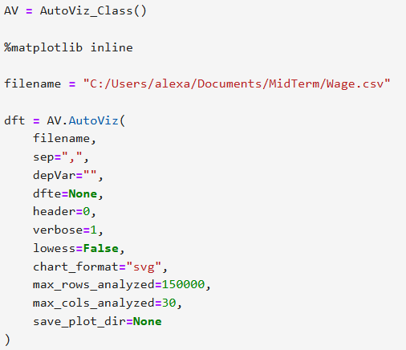

Running the AutoViz Sequence

Slide 9
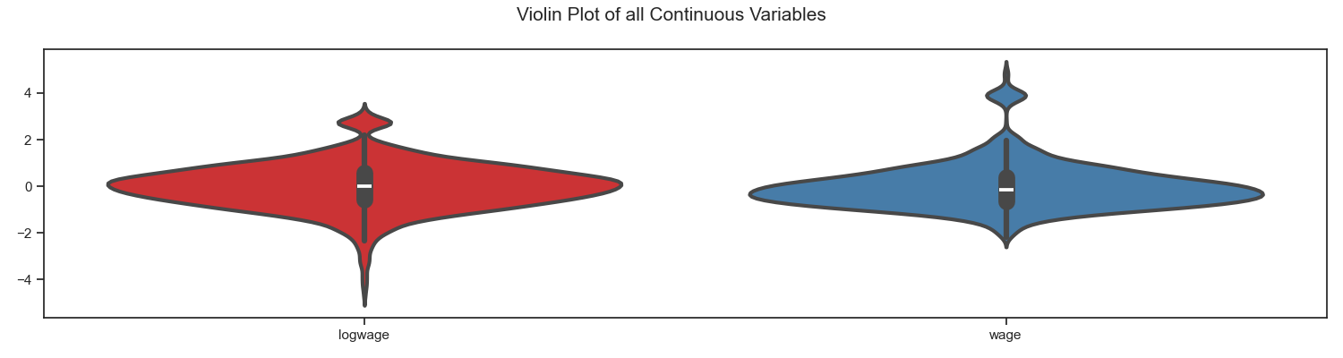
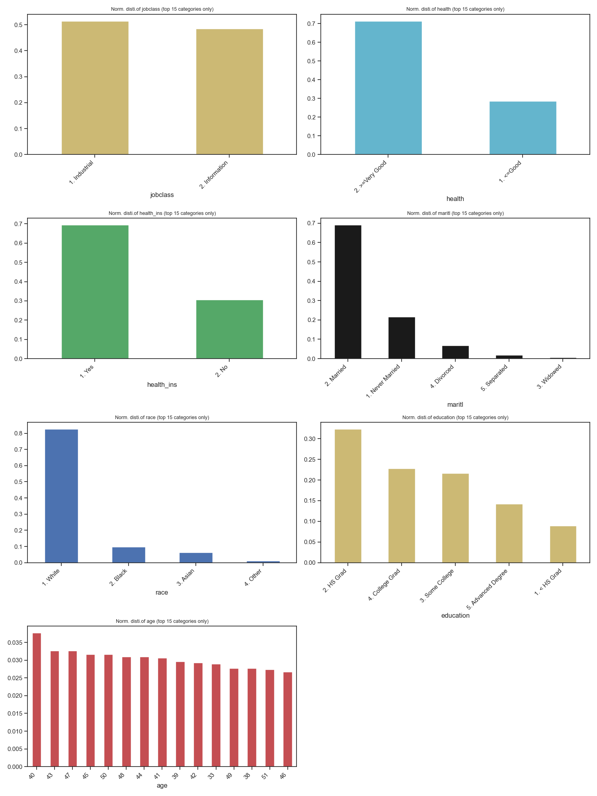
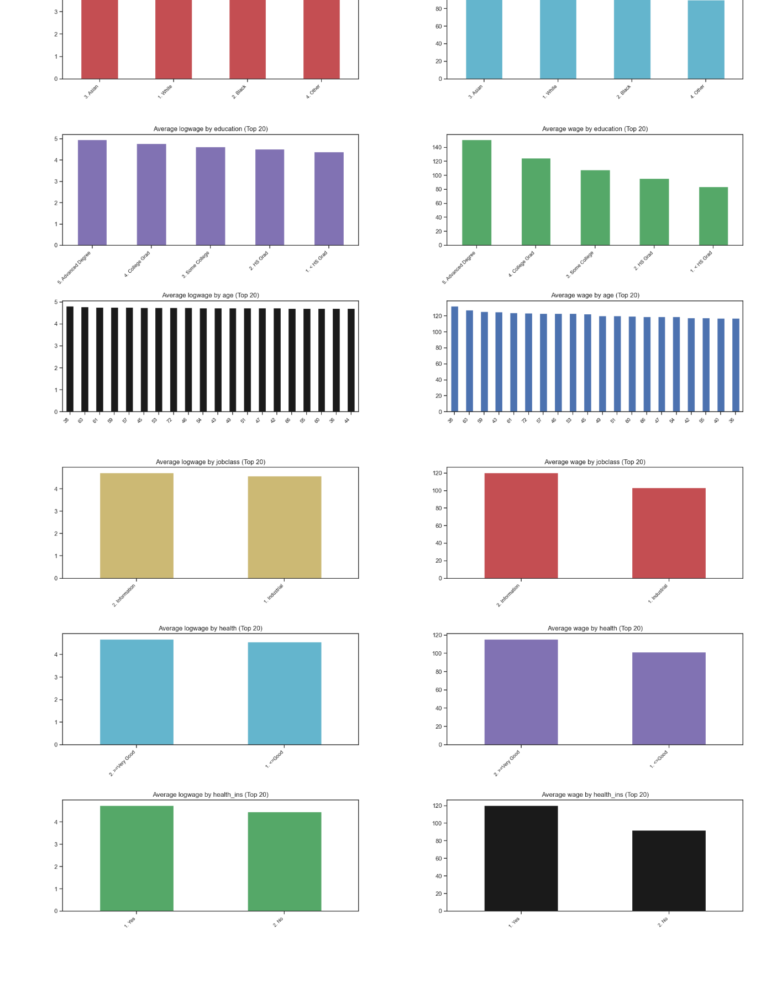
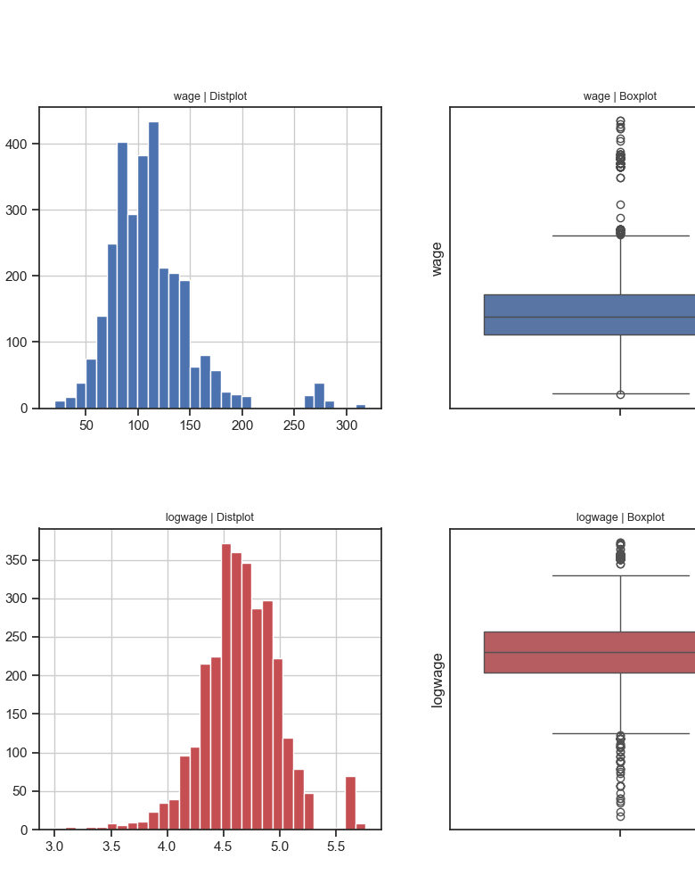
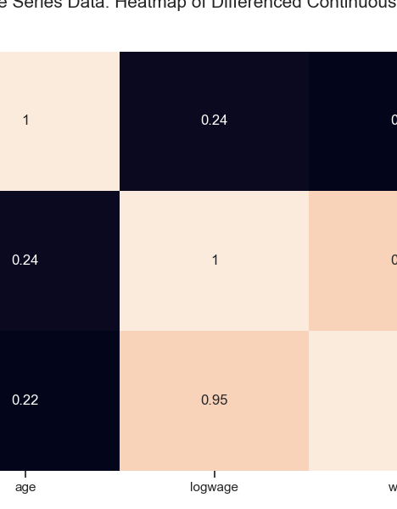
Plot Examples

Slide 10

Live Demonstration

