Slide 1
CS 298 Advanced Object Oriented techniques using C# and .NET
Arrays and Array Lists
Dr. Gancho Ganchev
Dept. of Computer Science
Western Connecticut State University
G. Ganchev Advanced C#

Slide 2
Overview
Arrays
Array Initializers
Multidimensional Arrays
Arrays as Method Parameters
Arrays as Return Types
params Parameter – methods with variable number of Parameters
Array Lists
G. Ganchev Advanced C#

Slide 3
Arrays
All arrays inherit from the abstract base class System.Array that inherits from System.Object
Example declaration
  int [] data = new int[1000];
  The index range of this array goes from 0 to 999
Example use
data[129] = 23;
An attempt to refer to an index outside the bounds range will produce an IndexOutOfBounds exception
Array elements are automatically initialized by default values
  0 for numbers
System.Array class defines a number of useful properties and methods
  Program ArrayMethods.cs
G. Ganchev Advanced C#

Slide 4
Array Initializers
Compile-time initialization
General form of initialization follows:
  type[ ] identifier = new type[ ] {value1, value2,
  …valueN};
Values are separated by commas
Values assigned must be compatible with the element type
  E.g., implicit conversion from int to double
Array length is determined by number of initialization values placed inside curly braces
Examples
  int [] anArray = {100, 200, 400, 600};
  char [] grade = new char[] { ‘A’, ‘B’, ‘C’, ‘D’,
  ‘F’};
  double [] depth = new double [2] {2.5, 3};
No length specifier
G. Ganchev Advanced C#

Slide 5
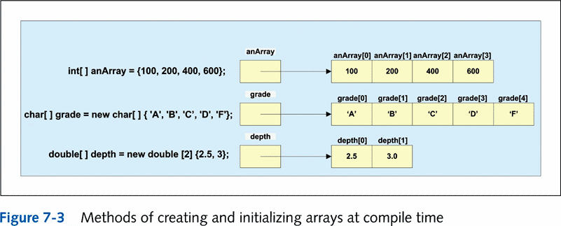
Array Initializers . . .
G. Ganchev Advanced C#

Slide 6
Example Method to Input Values into an Array
// Instead of doing compile time initialization, input values
public static void InputValues(int [ ] temp)
{
string inValue;
for(int i = 0; i < temp.Length; i++)
{
Console.Write("Enter Temperature {0}: ", i + 1);
inValue = Console.ReadLine( );
temp[i] = int.Parse(inValue);
}
}
To call InputValues(int [ ] temp) method
  int [ ] temperature = new int[5];
  InputValues(temperature);
G. Ganchev Advanced C#

Slide 7
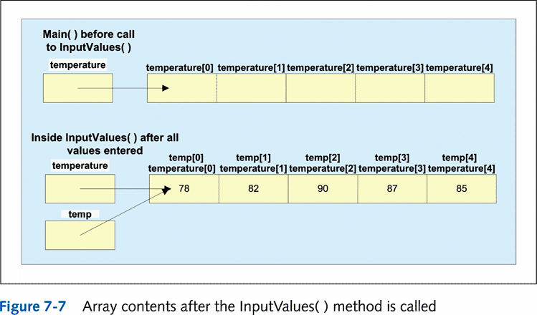
Input Values into an Array (continued)
G. Ganchev Advanced C#

Slide 8
Multidimensional Arrays
Data is stored in row major format
Declaration format
  type [ , ] identifier = new type [integral value,
  integral value];
  Two integral values are required for a two-dimensional array
    Number of rows listed first
Data values placed in array must be of the same base type
Example (create a 7x3 matrix)
  int [ , ] calories = new int[7, 3];
Length property gets total number of elements in all dimensions
  Console.WriteLine(calories.Length); // Returns 21
GetLength( ) - returns the number of rows or columns
  GetLength(0) returns number of rows
  GetLength(1) returns number of columns
    Console.WriteLine(calories.GetLength(1));
    //Display 3 (# of columns)
    Console.WriteLine(calories.GetLength(0));
    //Display 7 (rows)
    Console.WriteLine(calories.Rank);
    // returns 2 (dimensions)
G. Ganchev Advanced C#

Slide 9
Multidimensional Arrays
There are two distinct types of multidimensional arrays in C#
  rectangular
  double [,] matrix = new double[20, 40];
  matrix[3, 5] = 1.25;
  Jagged (Also called ragged, or array of arrays)
  Example
    int [][] data = new int[2][];
    data[0] = new int[50];
    data[1] = new int[100];
  Example
      int[ ] [ ] anArray = new int[4] [ ];
      anArray [0] = new int[] {100, 200};
      anArray [1] = new int[] {11, 22, 37};
      anArray [2] = new int[] {16, 72, 83, 99, 106};
      anArray [3] = new int[] {1, 2, 3, 4};
Example: JaggedArrays.cs
Program StudentGrades in folder Sort uses both rectangular and jagged arrays
G. Ganchev Advanced C#

Slide 10
Arrays as Method Parameters
Can send arrays as arguments to methods
Heading for method that includes array as a parameter
  modifiers returnType identifier (type [ ]
  arrayIdentifier...)
  Open and closed square brackets are required
  Length or size of the array is not included
Example
  void DisplayArrayContents (double [ ] anArray)
Actual call to the method sends the address
  Call does not include the array size
  Call does not include the square brackets
Example
    DisplayArrayContents (waterDepth);
Reminder: arrays are reference variables
  No copy is made of the contents
  Array identifier memory location does contains the address of the first element
G. Ganchev Advanced C#

Slide 11
Arrays as Return Types
Methods can have arrays as their return type
Example method heading
    public static int [ ] GetScores(int gameCnt)
Example call to the method
    int [ ] points = new int [1000];
    points = GetScores(gameCnt);
  Method would include a return statement with an array
G. Ganchev Advanced C#

Slide 12
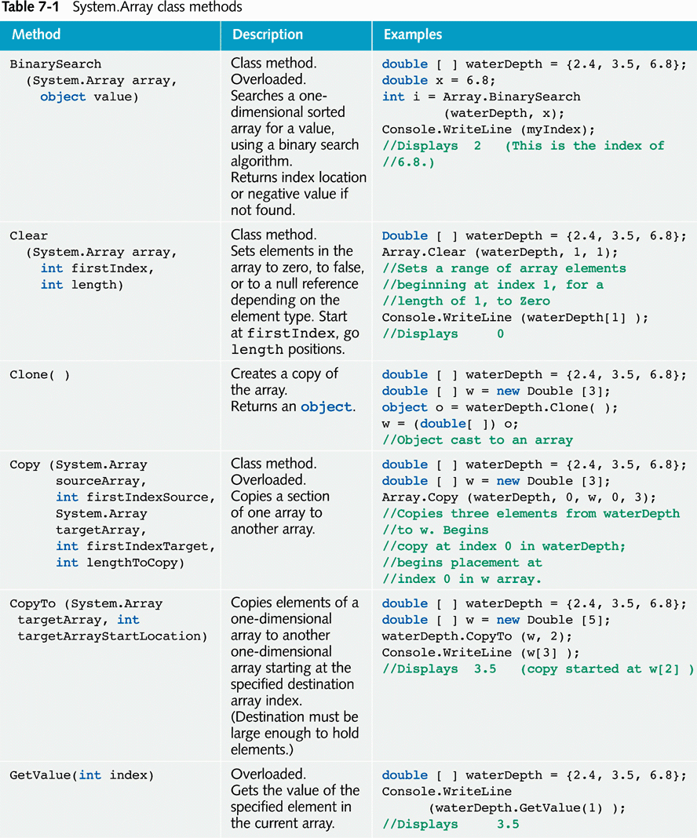
Array Class . . .
G. Ganchev Advanced C#

Slide 13
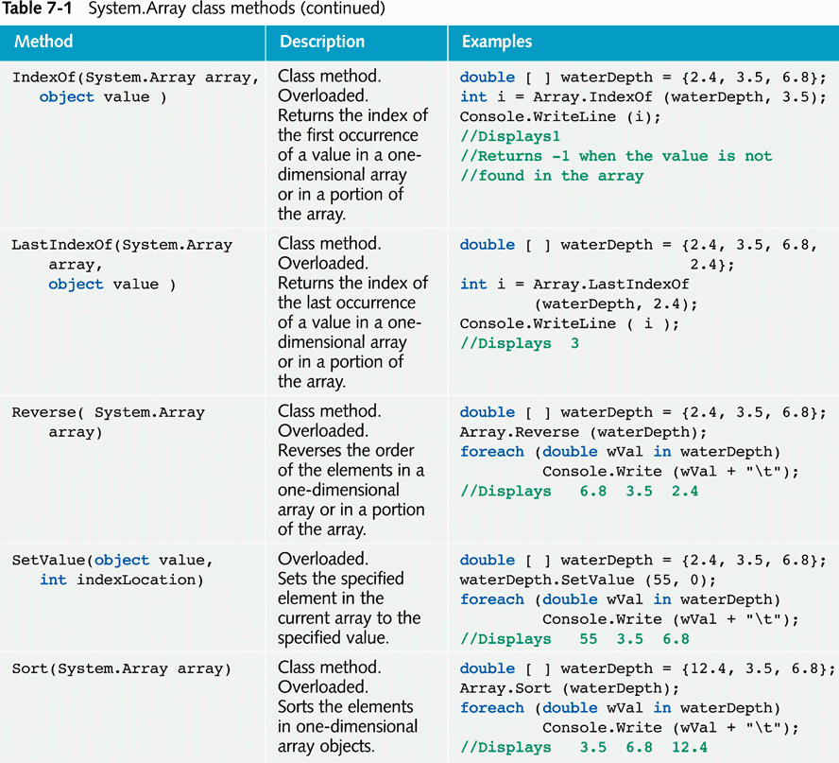
Array Class . . .
G. Ganchev Advanced C#

Slide 14
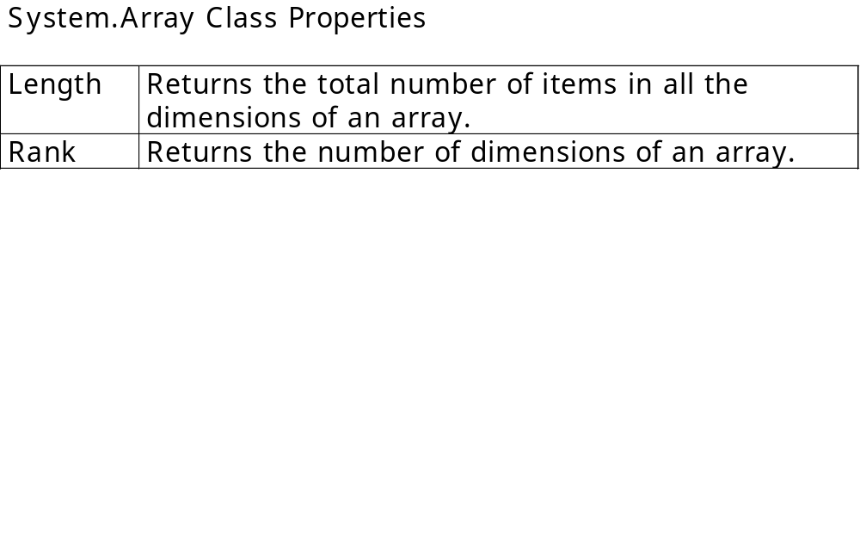
Array Class . . .
Program StudentGrades in folder Arrays\Sort uses both rectangular and jagged arrays, and method Sort
A larger example in folder Arrays\Player
G. Ganchev Advanced C#

Slide 15
params parameter
The array notation is used to denote that a method has a variable number of arguments
Keyword params used
  Appears in formal parameter list
  Must be last parameter listed in the method heading
  public static void DisplayItems(params int[] item)
The calls may have different numbers of arguments:
DisplayItems(1,2,3,4);
DisplayItems(myArray); // the actual arguments are
// the array elements
DisplayItems(1500, myArray[1]+myArray[2]);
Example program: VaryingArguments.cs
G. Ganchev Advanced C#

Slide 16
ArrayList Class
Limitations of traditional array:
  Cannot change the size or length of an array after it is created
ArrayList class facilitates creating list-like structure, BUT it can dynamically increase or decrease in length
Includes large number of predefined methods
Example program: ArrayList\ArrayListExample.cs
ArrayList\SamplesArrayList.cs
G. Ganchev Advanced C#

Slide 17
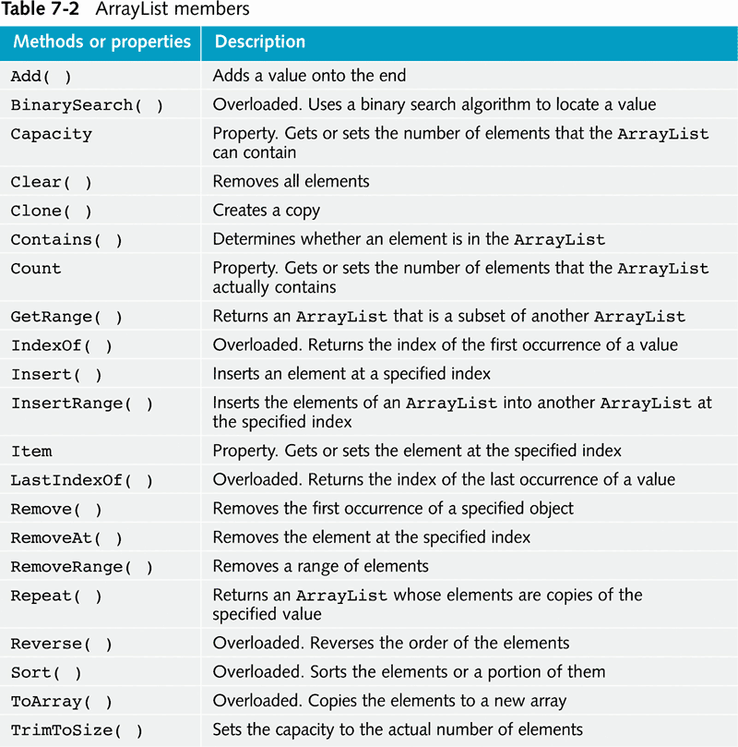
ArrayList Class
G. Ganchev Advanced C#

Slide 18
Homework Exercises
Add the following methods to the Purse class:
  ToString - prints the coins in the purse in the format:
    Purse[Quarter,Dime,Nickel,Dime]
  Reverse - reverses the order of coins in the purse
  Transfer(Purse other) – transfers the contents of the other purse into the receiver purse. After that the other purse is empty
  bool SameContents(Purse other) – checks wheter the two purses have the same coins in the same order
  bool SameCoins (Purse other) –checks whether the two purses have the same coins, perhaps in different order
G. Ganchev Advanced C#

Slide 19
Homework Exercises
Add the following methods to the Bank class:
  void AddAccount(int accountNumber, double initialBalance)
  void Deposit(int accountNumber, double amount)
  void Withdraw(int accountNumber, double amount)
  double GetBalance(int accountNumber)
G. Ganchev Advanced C#

