Slide 1
Task Tracker
CS341 Project I
Alexander Goda and Amanda Cabrera
Professor Trish Cornez
Notes:
Task Tracker is a standalone Java desktop application with local accounts and shared task data. Sources: README.md and the Requirements Analysis.

Slide 2
Project scope
Local accounts support registration, login, and logout.
Users manage tasks they create or receive.
Creators control editing, deletion, and assignment.
Due dates and priority levels are the selected extra feature.
Notes:
Explain that collaboration occurs through accounts sharing one local SQLite file. No cloud synchronization is included. Source: docs/Requirements/CS341_Project_I_Requirements_Analysis_Alexander_Goda_Amanda_Cabrera.docx, UR-01 through UR-12.

Slide 3
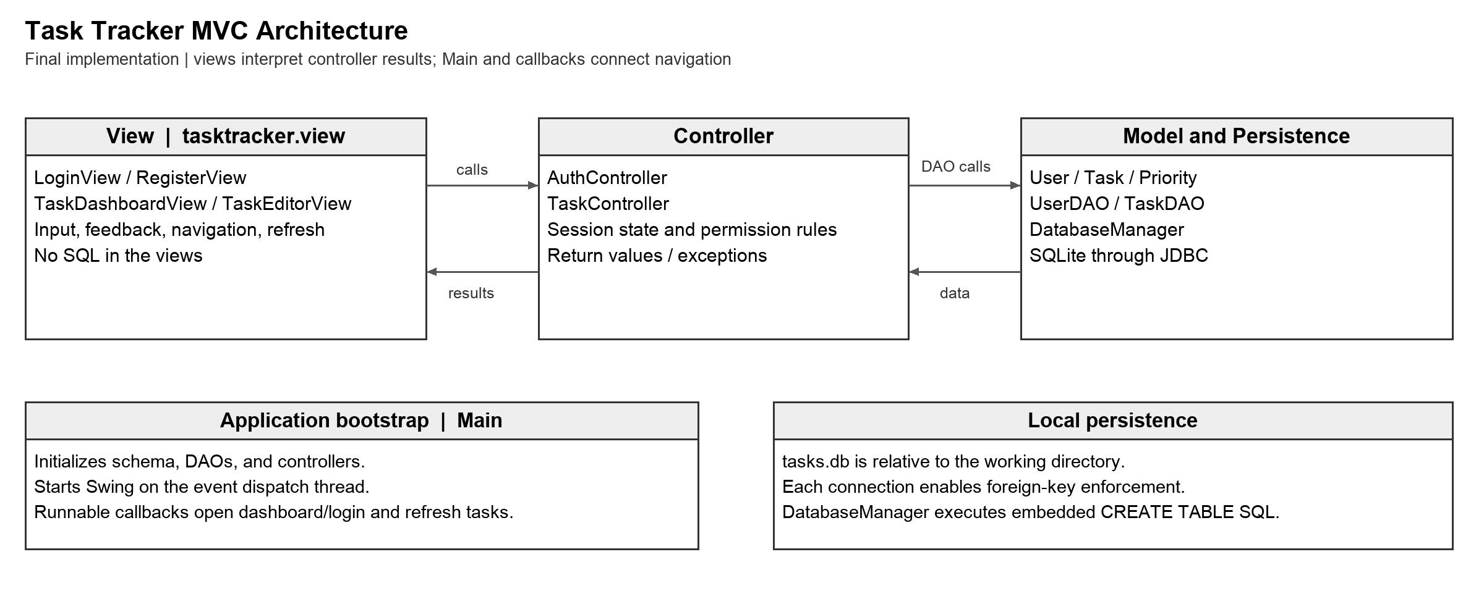
MVC architecture
Notes:
Explain one create-task request: TaskEditorView sends input to TaskController, which checks the current user, constructs Task, and calls TaskDAO. DatabaseManager supplies a JDBC connection. The callback refreshes the dashboard. Main starts Swing with EventQueue.invokeLater. SQL stays out of the views. Source: docs/Design/CS341_Project_I_MVC_Architecture_Alexander_Goda_Amanda_Cabrera.png

Slide 4
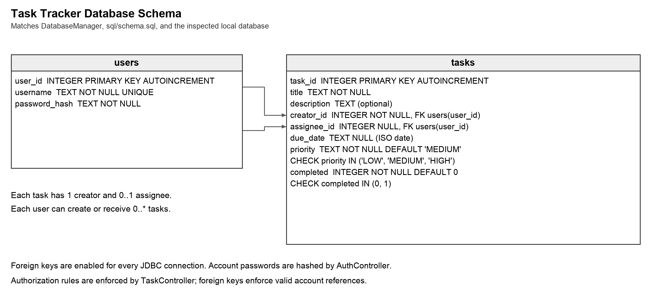
Local SQLite persistence
Notes:
Explain users and tasks. creator_id is required, assignee_id and due_date are optional. Each connection enables foreign keys. DatabaseManager executes embedded CREATE TABLE IF NOT EXISTS statements. tasks.db resolves relative to the working directory. sql/schema.sql is a matching reference. Source: docs/Design/CS341_Project_I_Database_Schema_Alexander_Goda_Amanda_Cabrera.png

Slide 5
Task permissions
Creator: edit, delete, assign, and remove assignment.
Creator or assignee: complete and reopen a task.
Unrelated account: task excluded from its dashboard.
Logged-out account: controller rejects task operations.
Notes:
Amanda can explain TaskController and why authorization is checked before persistence changes. Self-assignment is valid and the relevant-task query returns the task once. Source: src/tasktracker/controller/TaskController.java and test/tester/TaskControllerTest.java.

Slide 6
Verification results
28 of 28 JUnit 5 tests passed in Eclipse.
0 errors and 0 failures, elapsed time 0.444 seconds.
Java 11 compilation completed without diagnostics.
10 earlier manual checks remain recorded separately.
Notes:
The latest recorded October 16, 2026 suite passed 28/28 tests: DatabaseManagerTest 2, UserDAOTest 5, TaskDAOTest 6, AuthControllerTest 6, TaskControllerTest 9. The tests use temporary SQLite databases and exercise controllers and persistence. The ten manual M01–M10 checks are separate recorded evidence and were not repeated during that automated run. The suite does not automate Swing interaction. Source: the Testing Report and test/tester/.

Slide 7
Logout regression
Issue: task editor windows remained after logout.
The dashboard now tracks every editor it opens.
Disposing the dashboard closes its remaining editors.
M10 records manual verification of editor cleanup.
Notes:
Explain showTaskEditor, windowClosed removal, and the snapshot used during dispose. Logout disposes windows before clearing the authenticated session and opening the next login screen. The new logged-out controller test supports the session boundary but does not automate editor cleanup. Source: TaskDashboardView.java and testing report M10.

Slide 8
Live demonstration
Create a task with a due date and HIGH priority.
Assign it to the second account and show visibility.
Show edit denial, completion, and reopening.
Restart to show persistence, then demonstrate logout cleanup.
Notes:
Demonstrate creator and assignee accounts: create an assigned task, show the assignee dashboard, attempt creator-only editing, complete and reopen the task, restart to show saved data, and log out with task editors open. Sources: TaskDashboardView.java, TaskController.java, and the Testing Report.

Slide 9
Team contributions
Amanda’s TaskController commit remains in main.
Commit 63d8ae6 implements task operations and permissions.
Alexander’s history includes integration, UI, tests, and docs.
Git history records the implementation contributions.
Notes:
Amanda authored TaskController commit 63d8ae6, implementing task operations and permission checks. Alexander’s history includes integration, user interface, tests, and documentation. Commit counts alone do not capture all project work. Source: repository Git history and https://github.com/alexandergoda/CS341-Project-I-TaskTracker-Alexander-Goda-Amanda-Cabrera/commit/63d8ae6

Slide 10
Limitations and future improvements
The application shares one local SQLite database.
Password hashing uses unsalted SHA-256.
Swing layouts are fixed and JDBC runs on the UI thread.
Future work: stronger password storage and responsive UI.
Notes:
The local account model shares one SQLite file and does not synchronize across devices. The implementation uses unsalted SHA-256 hashes, fixed Swing layouts, and synchronous JDBC calls on the UI thread. Future improvements include salted adaptive password hashing, resizable layouts, and background database operations. The recorded tests cover representative workflows rather than exhaustive security, concurrency, or accessibility behavior. Sources: AuthController.java, the Swing views, and the Testing Report.

