Slide 1
What this experiment is all about
This experiment deals with laser beams and optical resonators, or cavities for short. The goal of the experiment is to align a gaussian beam to a confocal cavity and to study the different modes supported by the cavity.
The experience is divided into three parts:
Characterization of the beam coming out of the laser
Mode matching of the beam shape to the confocal cavity geometry
Cavity alignment and study of the output cavity modes
Each step is propaedeutic to the next one, that is, you cannot align the cavity without first having characterized the beam.
Ideally, each of this points should not take more than ~1h

Slide 2
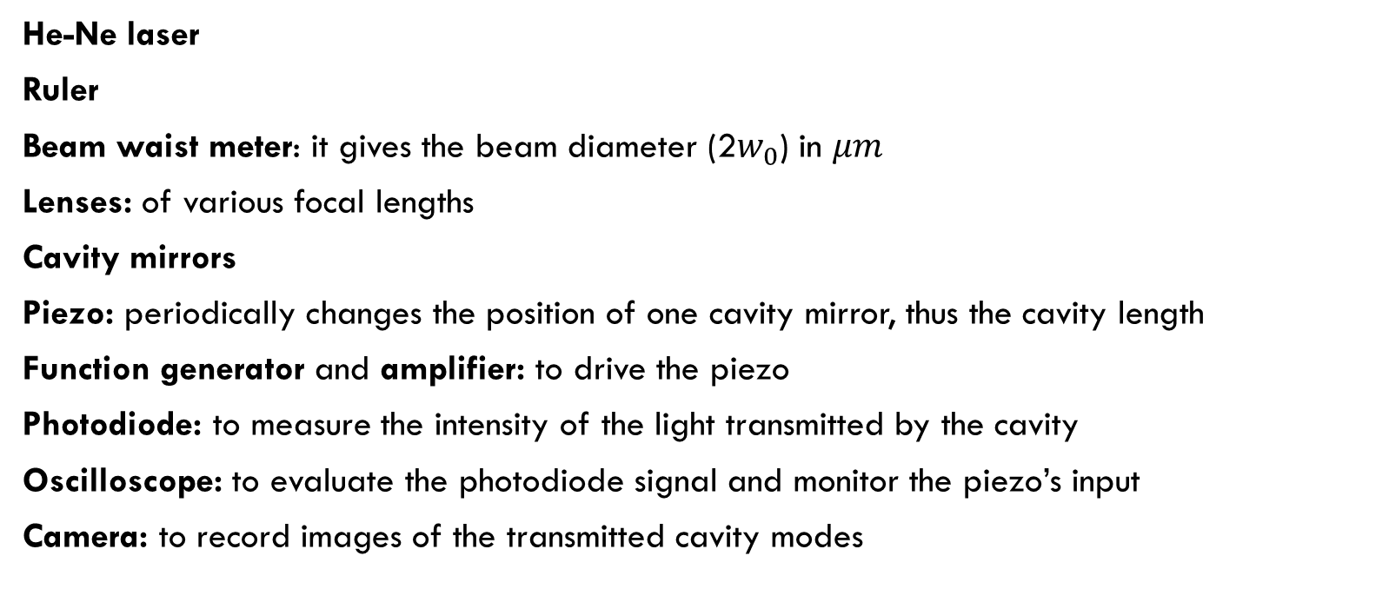
Experimental Equipment
He-Ne laser
Ruler
Beam waist meter: it gives the beam diameter (2$w_{0}$) in $μm$
Lenses: of various focal lengths
Cavity mirrors
Piezo: periodically changes the position of one cavity mirror, thus the cavity length
Function generator and amplifier: to drive the piezo
Photodiode: to measure the intensity of the light transmitted by the cavity
Oscilloscope: to evaluate the photodiode signal and monitor the piezo’s input
Camera: to record images of the transmitted cavity modes

Slide 3


1) Beam characterization
Measure beam waist as function of z
Fit the experimental data with the theoretical relation
Extract the beam waist and ist position from to the fit

Slide 4
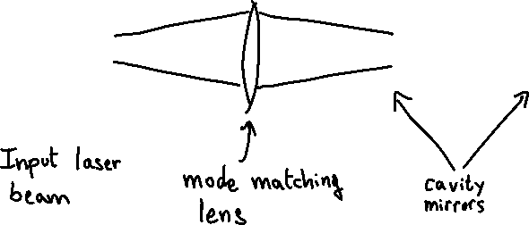

2) Mode match
Calculate: 1) cavity waist
2) mode-matching the lens‘ focal length
Measure: waist of the beam after the lens. Will this beam fit well into the cavity? If not, what else can you use to
change the beam size to match it with the cavity?

Slide 5
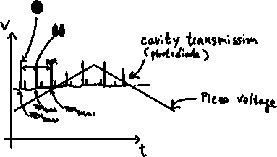
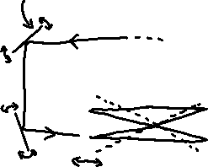

3) Cavity alignment and characterization
Find the cavity mirrors‘ position to build the wanted confocal configuration. What is the signature of a perfect confocal alignment?
Analize the cavity output by using the oscilloscope. Peaks on the transmission signal are associated with one or more cavity modes (degeneracy). Which mode is which? How to isolate different modes?

Slide 6
What a student should know before stepping into the lab
Please, don’t come to the lab without first fully understanding the basics of the experiment. The student should be able to answer the following questions before coming to the lab:
- How does the divergence of a Gaussian beam depend on the laser beam parameters (waist, wavelength)?
How does a lens transform a Gaussian beam?
What is a confocal cavity?
How does the waist of a confocal cavity depend on the mirrors’ radius and separation? What is the value of the cavity waist in our case?
What is a “cavity mode”?
Which are the cavity modes and their respective frequencies in a confocal/near-confocal cavity?
The script of the experiment contains almost all the answers to these questions. Please, read it carefully: in the lab you will not have time to study, just for taking data!

