Slide 1
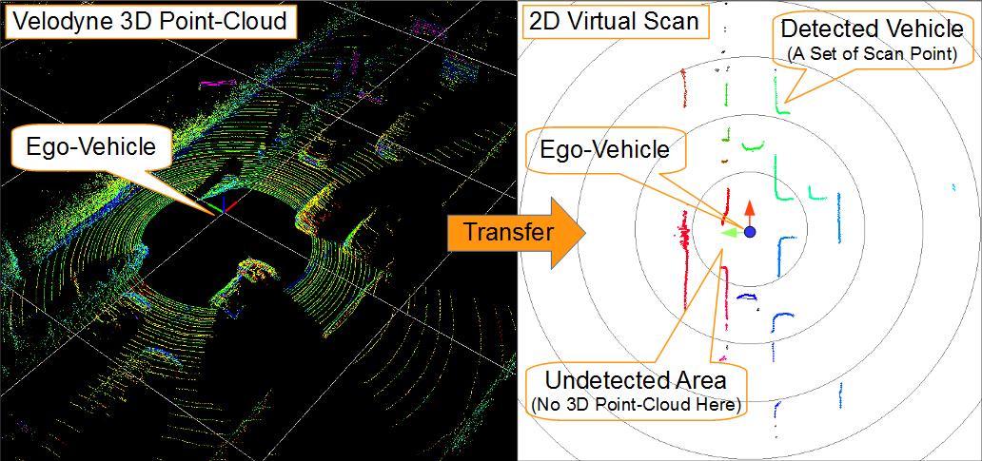
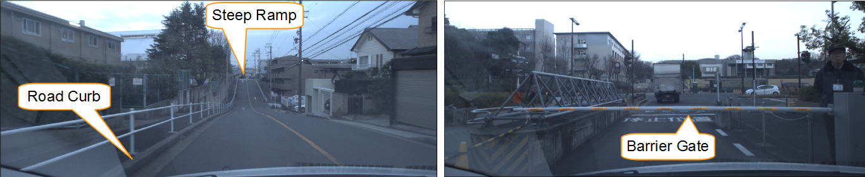
Robust Virtual Scan for Obstacle Detection in Urban Environments
He Mengwen^{1,3}, Eijiro Takeuchi¹, Yoshiki Ninomiya^{2,3}, and Shinpei Kato^{1,3}
¹Graudate School of Information Science, Nagoya University
²Institute of Innovation for Future Society (MIRAI), Nagoya University
³JST/COI, Nagoya
Objectives:
Develop a robust and real-time algorithm to transfer a 3D point-cloud to a compact 2D virtual scan
Handle the challenges in urban environment:
sloped roads (e.g. steep ramp)
small objects (e.g. road curb)
overhung obstacles (e.g. barrier gate)
Key words:
point-cloud, virtual scan, obstacle detection

