Slide 1
Comparative Analysis of
Data Structures

Slide 2
Purpose
Compare efficicacy & efficiency of data structures
Big-O notation vs. real-world performance
Gain experience implementing more complex structures

Slide 3
Language: Java
Natively object-oriented
Static typing
More control over data manipulation
Lots of reference material
I like Java
The JVM is cool

Slide 4
Methods
Naive implementations of many structures
Avoid using built-ins or libraries where possible
Custom testing classes
4 basic operations: Insert, Access, Search, Delete
Measure time and memory usage
Relative performance, not absolute

Slide 5
Structures
Array
Singly Linked List
Doubly Linked List
Chaining Hashtable
Open Addressing Hashtable
  linear probing
  quadratic probing
  periodic probing
Binary Search Tree
Trie
Min Heap
Fibonacci Heap
Adelson-Velskii-Landis Tree
Red-Black Tree
Proto van Emde Boas Tree
van Emde Boas Tree

Slide 6
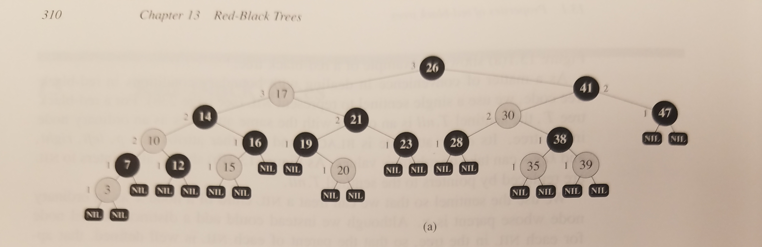
Red Black Trees

Slide 7
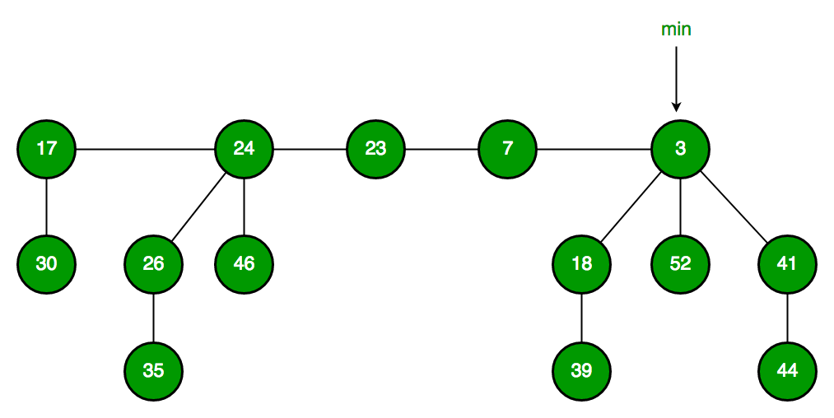
Fibonacci Heaps

Slide 8
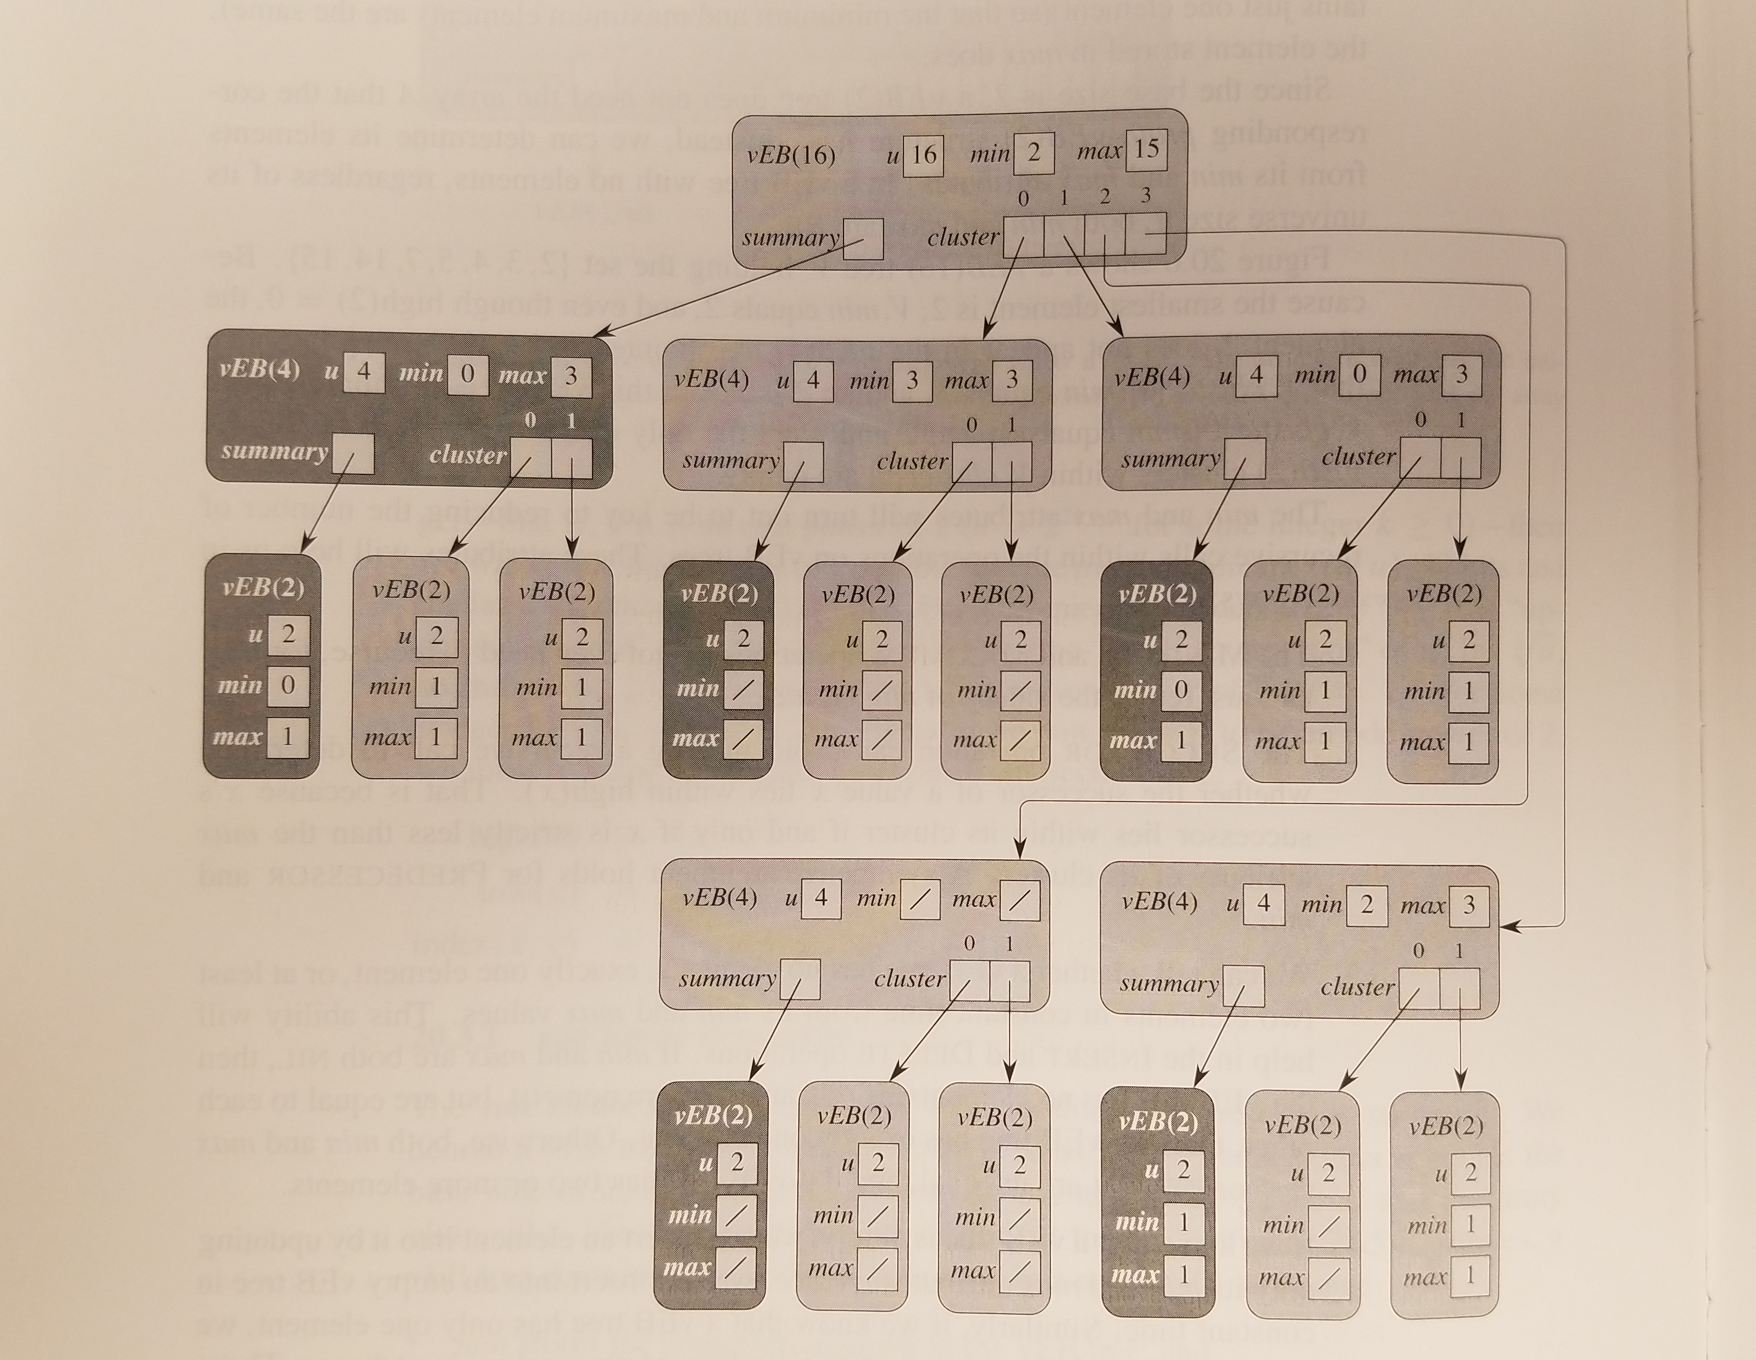
van Emde Boas Trees

Slide 9
Testing Specifics
Test A: 10,000 3-character strings
Test B: 20,000 3-character strings
Test C: 10,000 9-character strings
Each test run 3 times, results averaged

Slide 10
Expectations

Slide 11
Results

Slide 12
Results (Double Quantity)

Slide 13
Results Δ (Double Quantity)

Slide 14
Results (Triple Size)

Slide 15
Results Δ (Triple Size)

Slide 16
Conclusions
?

Slide 17
Conclusions
The time-space tradeoff is real
Dictionaries are great, use dictionaries everywhere
Binary trees suck
Import libraries whenever you can

