Slide 1
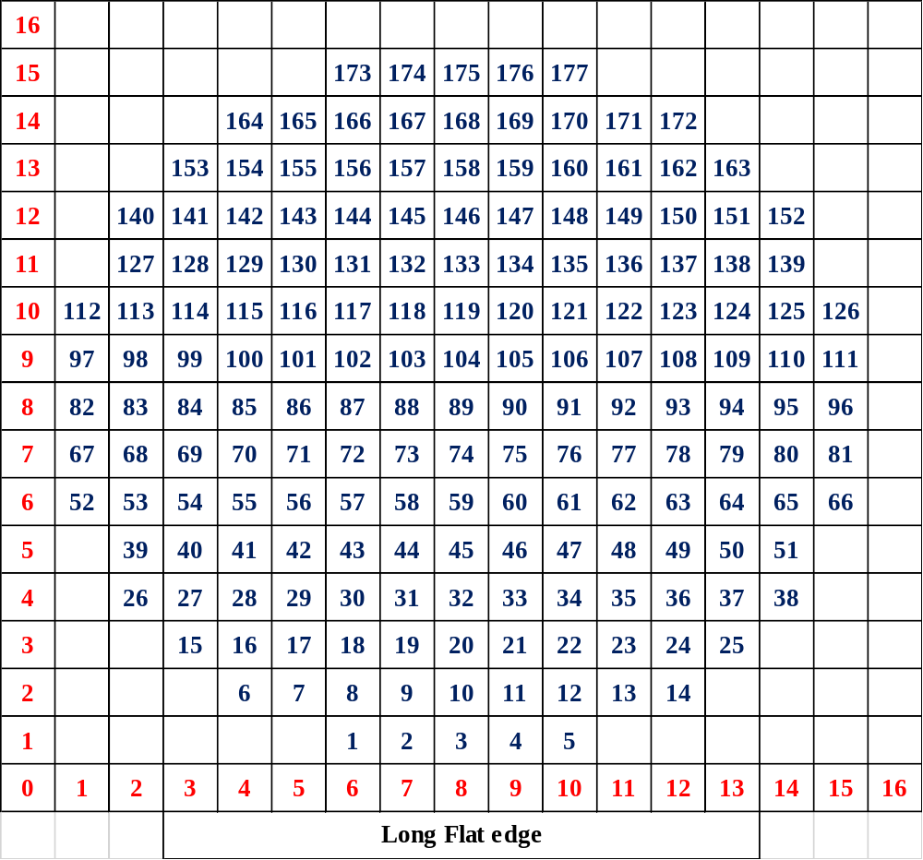
Grid_number
Ni element will be added when the composition of the entire library is measured.

