Slide 1
Efficient SIMD Code Generation for Irregular Kernels
Authors: Seonggun Kim, Hwansoo Han
Presented by: Alex Powell
Notes:
This paper discussed the challenges that SIMD instructions face when attempting to compile on systems using array indirection.
As you’ll see, there are a number of problems that arise from such behavior. The goal of the paper is to propose a new method to handle these challenges.
The paper was published in 2012 in the ACM symposium on Principles and Practice of Parallel Programming.

Slide 2
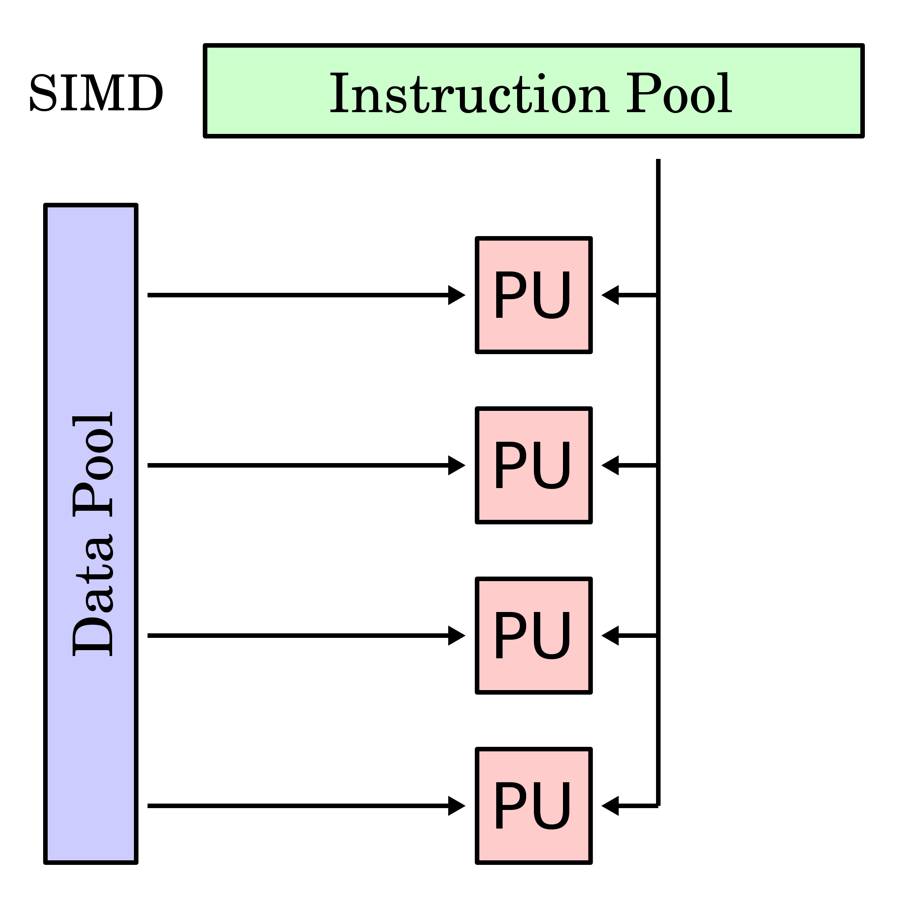
Introduction and Motivation
SIMD – Single Instruction, Multiple Data
Data level parallelism
Power efficiency
Multimedia Processing
Existing Techniques
Problems
Notes:
Most modern processor architectures currently use single instruction, multiple data units. By utilizing these instructions we are able to execute the same instruction simultaneously at an instruction level on multiple elements of data. SIMD computing is one of the most important and efficient ways to exploit data level parallelism. Correct utilization means we can develop applications with both low power and low complexity processor design. This is important because power efficiency is becoming more and more a significant issue in computing.
SIMD is particularly applicable to tasks related to multimedia processing, such as adjusting the contrast of an image, or volume of digital audio. Optimizing compilers need to transform high level programming languages into low level machine code that can utilize any underlying SIMD architecture. There are a number of techniques that are already able to generate SIMD code and handle difficulties like interleaved data, data alignment and permutations, etc. However, array indirection remains a big challenge to SIMD compilers.

Slide 3
Array Indirection
0
1
2
3
Common in scientific application
Computational Fluid dynamics
Molecular dynamics
Compute-intensive kernels
Example:
x[i] vs x[idx[i]]
Shortcomings of existing techniques
Fixed stride accesses, static alignments
Disjoint references
Notes:
Before we even get into why it’s a problem, it should be noted that array indirection is common in many fields, notably the natural sciences like computational fluid dynamics and molecular dynamics. SHOW THE EXAMPLE OF ARRAY INDIRECTION.

Slide 4
Array Indirection
0
1
2
3
Common in scientific application
Computational Fluid dynamics
Molecular dynamics
Compute-intensive kernels
Example:
x[i] vs x[idx[i]]
Shortcomings of existing techniques
Fixed stride accesses, static alignments
Disjoint references
Notes:
Before we even get into why it’s a problem, it should be noted that array indirection is common in many fields, notably the natural sciences like computational fluid dynamics and molecular dynamics. SHOW THE EXAMPLE OF ARRAY INDIRECTION.
Array indirection causes a problem because of the irregularity of their access patterns. For example, in direct array access techniques, an index variable is commonly used, and this index variable is incremented (or decremented) by a constant amount on each iteration. However, with array indirection, the index of the element in the array is unknown at compile time. Therefore, compilers have a hard time making anything useful of the access patterns. Because the access patterns are so irregular, the references are treated as disjoint, or noncontiguous, from each other and this makes it difficult to aggregate them into a single vector memory reference that the SIMD architecture can use. In fact, in most SIMD compilers today, code with array indirection is automatically treated as unvectorizable.
In addition to the location in memory, the alignment of each reference inside a loop varies from iteration to iteration. There are some recent works trying to solve this problem but for the most part they are limited to fix stride addresses, which we might not always have the luxury of encountering.

Slide 5
Background and Existing Techniques
Existing compilation methods
Loop tiling, scalar expansion, loop distribution, etc.
Differenced between vector processes and SIMD extensions
Memory units
Vectorization of misaligned stride-one references
Statically misaligned data
What about arbitrary strides?
Notes:
SIMD extensions are similar to vector processes, but there are a few key differences. The most significant of these is that SIMD extensions have weaker memory units. While vector processes can use scatter-style operations to grab pieces of data in different locations, SIMD has to rely on memory locations that are aligned at vector register length boundaries. There have been a number of prior works that propose methods for vectorizing loops with static stride data. However, none of these works addresses vectorization for a arbitrary length stride memory references.
Other SIMD research has been based on exploiting instruction level parallelism from within a basic block. The most important of these algorithms is superword level parallelism

Slide 6
Background
Superword Level Parallelism (SLP)
Packs instructions within a basic block starting from adjacent references
Loop unrolling for inter-iteration parallelism
Problems with disjoint data
Some operations unvectorizable → loop distribution
Added complexity
SLP outputs mix of vector and scalar operations
Notes:
Superword level parallelism is an algorithm that packs instructions within a basic block starting from adjacent memory references. The SLP algorithm usually performs loop unrolling before packing the instructions so as to get the most out of intra and inter-iteration parallelism. However, disjoint data and indirect array access still remains a problem for these techniques.
Others still have applied these basic block approaches with loop-based algorithms. For example, one researcher proposed a simdization framework based on virtual vectors which can use contiguous data elements with no alignment or length constraints. In this example, individual elements are collected together into virtual vectors at multiple phases. This method was successful at using SIMD parallelism, but it only applies to regular accesses which are contiguous or interleaved with static strides with a length of a power-of-2. Ideally, a solution would exist where both inter and intra iteration parallelism with arbitrary stride memory references were used.
Additionally, some operations are just plain unvectorizable, either because of dependence cycles or because of the operations themselves. Most loop based techniques handle this problem by using loop fission or distribution, which is breaking one loop into multiple over the same index range, where each new loop takes only a part of the original loops body. However, loop distribution often requires additional overhead like scalar expansion or strip mining(another term for loop tiling), they can become very complex which makes it difficult to change into a vectorized form.
The SLP algorithm deals with this by only combining vectorizable statements and leaving the rest in their scalar form. By doing this, mixed scalar and vector code is generated

Slide 7
Objectives
Exploit intra and inter-iteration parallelism
Extract parallelism at various scopes
Generate mixed scalar and SIMD operations
Dealing with dependence cycles
Loop distribution/fission
Minimize data reorganization overhead
Restrictive memory units
Constantly realigning data
Notes:
Data level parallelism can exist in many scopes simultaneously. Fore example, it can reside both within the body of a loop, and across loop iterations. This means that compilers should extract parallelism from as many scopes as possible. While existing techniques exist that do this simultaneously, they don’t work well with indirect memory references.
A common way of dealing with dependence cycles, or loop carried dependencies is to distribute these loops into a number of separate loops. However, this can hurt the reuse distance of memory accesses that can hurt instruction level parallelism. We want a technique to generate mixed scalar and SIMD instructions within the same loop body. This will also be useful to preserve inherently sequential operations like function calls or operations that might not be supported by SIMD architectures.
Finally, we want a method that optimally minimizes the data reorganization overhead since most SIMD units have relatively restrictive memory units and can only access continous and properly aligned data. This places the burden of aggregating and realigning the data on the software. This is probably the most significant reason why SIMD compilers that exist today are unsuccessful with compiling systems with indirect memory references. An ideal solution would have a number of heuristics to find the optimal placement of data reorganization code, based on comparing costs of overhead with performance gains.
So, in order to tackle this problem of array indirection for SIMD compilers, we need to start looking at possible parallelizations at different scopes (both inside each loop iteration, and from one iteration of a loop to another).
Also, as we’ll discuss in more detail later, performance is not always increased just by adding more vectorization into the process, and also it’s not always possible. Therefore, we need to devise a method that generates a hybrid instruction set that incorporates both scalar and SIMD vector operations. Data reorganization refers to the costs associated with converting scalar operations to their vectorized forms and vice versa. This can make a program inefficient.

Slide 8
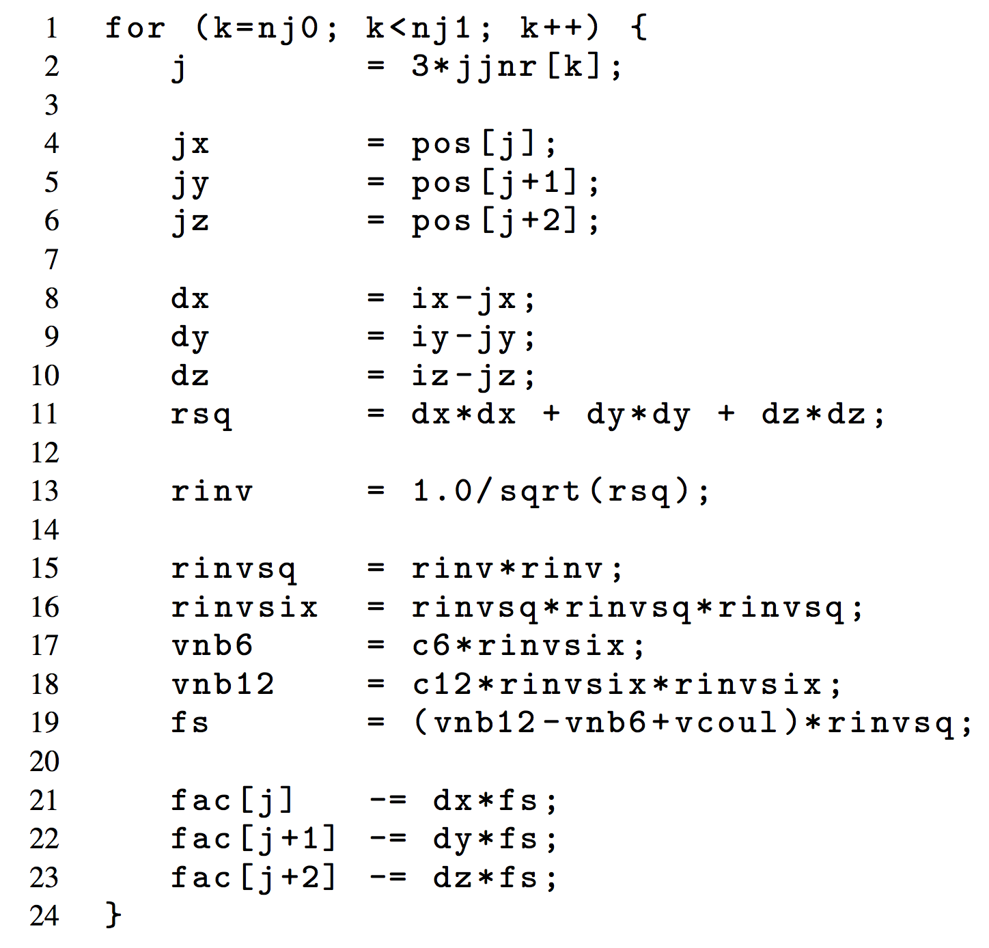
Motivating Example
Inner-most loop of irregular kernel
Arbitrary stride memory access
Loop carried dependence
Function call
Indirect array access
Compile time limitations
Notes:
So, we have seen that there is a need for SIMD parallelization for code that includes indirect array access, and we have seen that there have been a number of works that attempted similar problems but weren’t able to address arbitrary length stride array indirection. Before we propose a solution to the problem, lets look at an example that will act as motivation for what we’re trying to achieve. The code displayed is the abbreviated inner-most loop of an irregular kernel, and it has several obstacles to SIMD compilation.

Slide 9
Arbitrary stride memory accesses
Notes:
The first thing we notice is that the loop has two regions where arbitrary stride memory accesses are performed. Since j is determined based on jjnr, and the pos and fac arrays are indirectly accessed by j, this can be a challenge. The value of j is unknown at compile time, and therefore the access patterns of the references to pos and fac are also unknown. These access patterns are assumed by the compiler to be disjoint and arbitrarily misaligned across iterations. Current strategies use extremely inefficient data reorganization code to consider all possible cases of alignments. This is not ideal. Also, compilers must assume that line 21-23 could cause loop carried dependence. A loop carried dependence exists when a statement in one iteration of a loop depends in some way on a statement in a different iteration of the same loop.
This is different from what is called a loop independent dependence, which exists when a statement in one iteration of a loop depends only on a statement in the same iteration of the loop. (line 15 and 16)
Note that because of the loop carried dependence in lines 21-23, the possibility of writing data to the same location exists because of the indirect array access from j.
Loop carried dependencies generally prevent the loop from being parallelized.

Slide 10
Function Call
Notes:
Additionally, it is usually the case that function calls are inherently unvectorizable because no parallel implementation exists, so line 13 is also treated as a region that must rely on sequential execution.
Note: a square root function is actually recognized by most SIMD compilers as vectorizable, but for the purposed of this example we’ll treat it as a sequential operation.
So, using loop based vectorization, this loop would have to be split into 4 separate loops, 2-11, 15-19 are vectorizable, and 13, 21-23 are sequential. Loop distribution can be harmful to instruction level parallelism since smaller loop bodies make it difficult to find instruction schedules that exploit instruction level parallelism efficiently. This also leads to increased scalar expansion which further increases the number of instructions as well as the overall memory footprint.

Slide 12
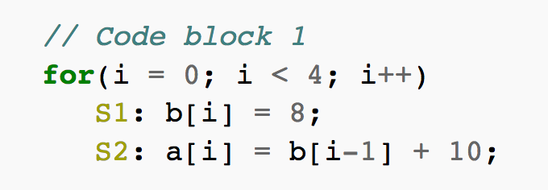
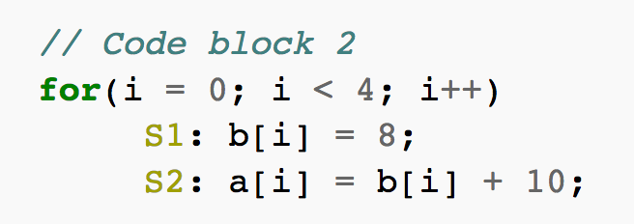
Loop-Carried Dependence vs. Loop Independent Dependence
Notes:
In this example, code block 1 shows loop-carried dependence between statement S2 iteration i and statement S1 iteration i+1. This is to say that statement S2 cannot proceed until statement S1 in the previous iteration finishes.
Code block 2 show loop independent dependence between statements S1 and S2 in the same iteration
Dependence cycles and loop carried dependence are synonymous

Slide 13
A New Solution
Notes:
So, we’ve seen a number of reasons why this code example is a challenge to SIMD compilers as they exist today. The authors of the paper propose a new solution for handling these problems. They have developed a process that examines the data flow graph of a loop body to exploit both inter and intra-level parallelism. By doing this, it’s clear where data carried dependencies are formed and therefore which parts are candidates for vectorizing. Additionally, heuristics are evaluated to determine if the overhead of packing and unpacking are worth the time saved in execution. The final output of the new process will be code that contains both scalar and vectorized components.

Slide 14
Preprocessing (parsing, if-conversions)
DFG construction
Identifying vectorizable operations
Optimized Insertion of data reorganization codes
SLP Extraction from scalar operations
Code generation
Notes:
There are 6 main steps to the proposed solution. At a high level, initially the front end of the LLVM compiler is used to parse source code, perform per-optimization and finally generate the intermediate code, which is in the form of three address static single assignment. Next, for each innermost loop, a data flow graph is constructed. Data dependencies are represented with a directed edge. Once the DFG is made, it is examined to find all possible vectorizable operations. Dependence cycles are also searched for. Operations that are part of a dependence cycle are unvectorizable. Also, some instructions are inherently unvectorizable. The output of the third step is a list of all “candidates” for vectorization. In the fourth step these candidates are evaluated against a number of heuristics to determine if they should actually become vectorized. This is mainly determined based on overhead of data reorganization. Intra-iteration parallelism is then extracted from the remaining scalar operations by using an algorithm similar to the SLP algorithm. In the end, the final output of the proposed solution is a code that had mixed scalar and SIMD instructions.

Slide 15
Building the Data-flow Graph
G = (V, E)
V = Set of operations
E = Set of ordered pairs (v_{i}, v_{j})
3A-SSA
One-to-one mapping between instruction and DFG Node
3
DIV
MULT
Notes:
Construction of the data flow graph is the first step after initially running the high level language through the LLVM compiler to generate the three address static single assignment code. Of course the DFG is composed of vertexes and edges; each vertex corresponds to an operation so we say there exists a one-to-one mapping between the instruction and the node, and each edge represents the ordered pairs, v_i, and v_j which indicates the operation v_j uses the result of the operation v_i. Also, if its possible for two operations to access the same memory location and one of them is a write operation, then an edge is inserted between the two nodes.
Defining the set of nodes is easy because of the 1-1 mapping. The set of edges requires def-use information and memory dependence. Because only one operation can define a variable in SSA form, def-use is naturally encoded.
SHOW THE EXAMPLE

Slide 16
Identifying Vectorizable Operations
Inter-iteration parallelism is evaluated.
Can multiple instances from consecutive iterations be grouped into a vector
Some operations are inherently unvectorizable on certain types
Functions calls problematic
Memory Operations
Dependence cycles imply sequential execution
Strongly connected components usually mean unvectorizable, but not always
Induction
Reduction
Notes:
This is the step where focus is placed on inter-iteration, or cross-iteration parallelism. That is, parallelism between different iterations of the same loop. To do this, we go through every operation and determine whether its possible for that operation to be vectorized. That is, can multiple instances from consecutive iterations be grouped into a vector for parallel execution. Operations without valid vector counterparts are marked as unvectorizable. An example of this would be the AltiVec SIMD instruction set which doesn’t support double precision floating point vector operations. Also, as I mentioned earlier, most function calls cannot be easily vectorized. To do this, the algorithm has a list of available SIMD instructiond and libraries to determine if vectorization is a possibility. Memory operations can go both ways, as unit stride operations are generally vectorizable and non-unit stride ops are not. Also, for operations that are part of a dependence cycle, the original sequential order must be preserved in order to not change the program’s behavior. There are a number of common algorithms that exist to find dependence cycles in DFGs by first finding strongly connected components. In this case, Tarjan’s algorithm was used. Again, these operations that are part of a dependence cycle are marked as unvectorizable.
However, there are some types of strongly connected components that can be parallelized. For example, it is possible to vectorize induction variables as they increase or decrease by a fixed amount for each iteration. Reduction is another example of a strongly connected component that can be vectorized. Even though it forms a dependence cycle, reduction is associative so the order of the reduction is irrelevant.
It’s important to node that the purpose of this step is only to generate a set of nodes where vectorization is a possibility. In future steps where vectorization is actually performed, we may decide that the cost of vectorizing outweighs the performance boost, so a node that was previously marked as vectorizable becomes unvectorizable. However, if a node is marked as unvectorizable in this step it has no chance of being vectorized at a later time. Although superword level parallelism may affect these nodes later on.

Slide 17
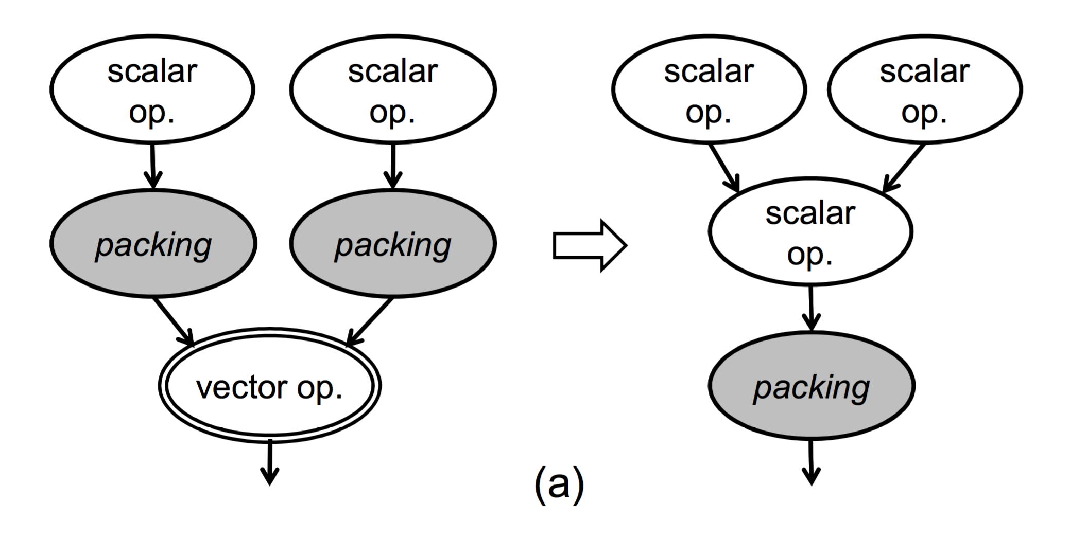
Optimized Insertion of Data Reorganization
Reduce data reorganization overhead
Packing and unpacking
Lazy Packing
Multiple packing nodes into one vector node
Notes:
The point of this step is to reduce the data reorganization overhead by optimizing the insertion of packing and unpacking code in non-contiguous data. In order for a vector operation to perform on scalar data, that data must be “packed” into a vector register before it’s even operated on. Also, in order for a scalar operation to execute on a vector, that vector must be unpacked back into several scalar values. Because of this behavior, a packing node is placed on each edge from a scalar node to a vector node, and an unpacking node is place on each edge from a vector node back to a scalar. Eventually the packing nodes will be translated into a sequence of shuffling instructions and the unpacking nodes will become rotate instructions. In general, the rule of thumb is that packing or unpacking n elements in a vector requires n-1 shuffle or rotate operations. Because of this fact, it’s not always guaranteed to be beneficial to always immediately vectorize an operation if possible. It’s possible that vectoring could increase the total number of executed instructions. We use a number of heuristics to determine the best placement for packing and unpacking nodes.
The first of these heuristics is called lazy packing. This occurs when a vector node is pointed to by multiple scalar nodes.
As you can see in the example, the number of added instructions in 2 packing nodes is greater than the number of reduced instructions due to one vector operation.
PATTERN ON RIGHT SAVES N-1 INSTRUCTIONS BY PACKING ONLY ONCE

Slide 18
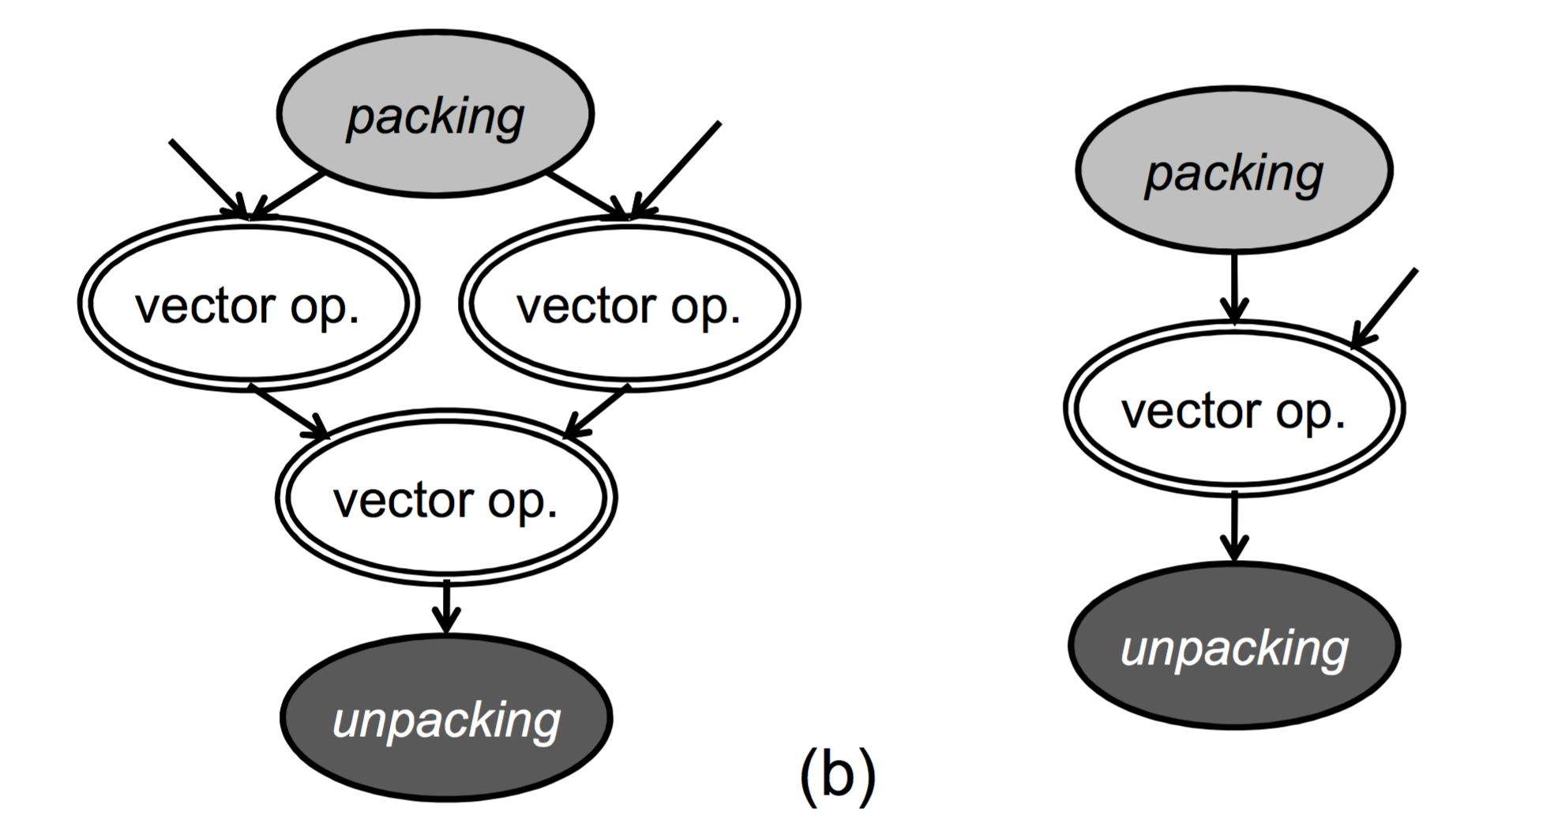
Optimized Insertion of Data Reorganization
Effective Range of Packing
Packing result used multiple times
Does savings exceed the packing cost?
Packing First
No packing means no unpacking
Notes:
Another heuristic is titled effective range of packing. This is used when the result of one packing node is used multiple times, which can be beneficial to reducing the overall number of instructions executed. For example, the image on the left shows three operations using the same packing node (1 directly and 2 indirectly). Since both the packing and unpacking cost is n-1, the cost of the image on the left is offset by the multiple vector operations. However, since the figure on the right only has one vector operation along with packing and unpacking, the cost ends up equaling the savings achieved from the vectorization. By eliminating unprofitable packing the overall performance in terms of instructions will improve.
Additionally, the packing first heuristic refers to the fact that unpacking is dependent on packing and unpacking is not needed if no packing exists in the first place. This is simple enough but it’s important to note that eliminating packing nodes will also eliminate unpacking nodes down the line, potentially increasing the performance of the program.
Using these three heuristics, the authors developed an algorithm to determine which vectorizable operations might actually be vectorized. The algorithm begins by initializing the set of potentially vectorizable nodes to vectorized. It then iterates through the nodes and either reverts a node from vectorizable back to scalar or keeps them the same. Again, it never changes a scalar node to vectorizable. It’s decisions one whether to parallelize a node are determine based on the cost of reorganization overhead.
The algorithm is one big loop with the stopping condition being the set of vectorizable nodes equal to the previous iteration. Because the process repeats and the reverting process can only convert vector to scalar nodes, the algorithm is guaranteed to finish (since the DFG has a finite number of nodes) and it is monotonic.

Slide 19
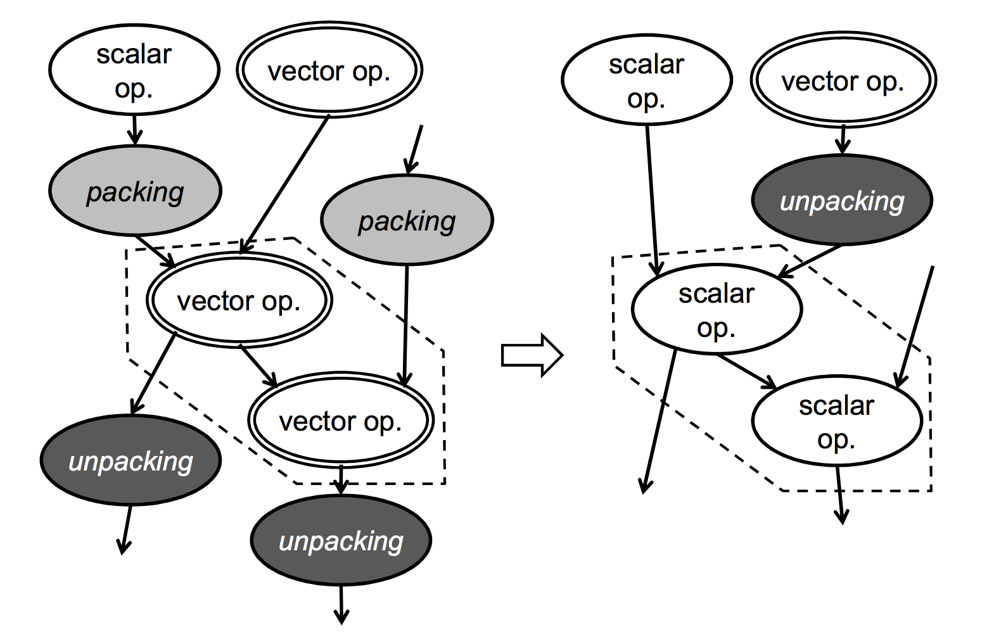
Cost Estimation Function
Notes:
This is an example of how the cost estimation function works. You can see on the left there are are two vector operations inside the dashed lines. Since they each require a packing and an unpacking node, it’s possible that these vectorizations are unprofitable. By reverting back to their scalar operations, on the right, only one unpacking node is needed.

Slide 20
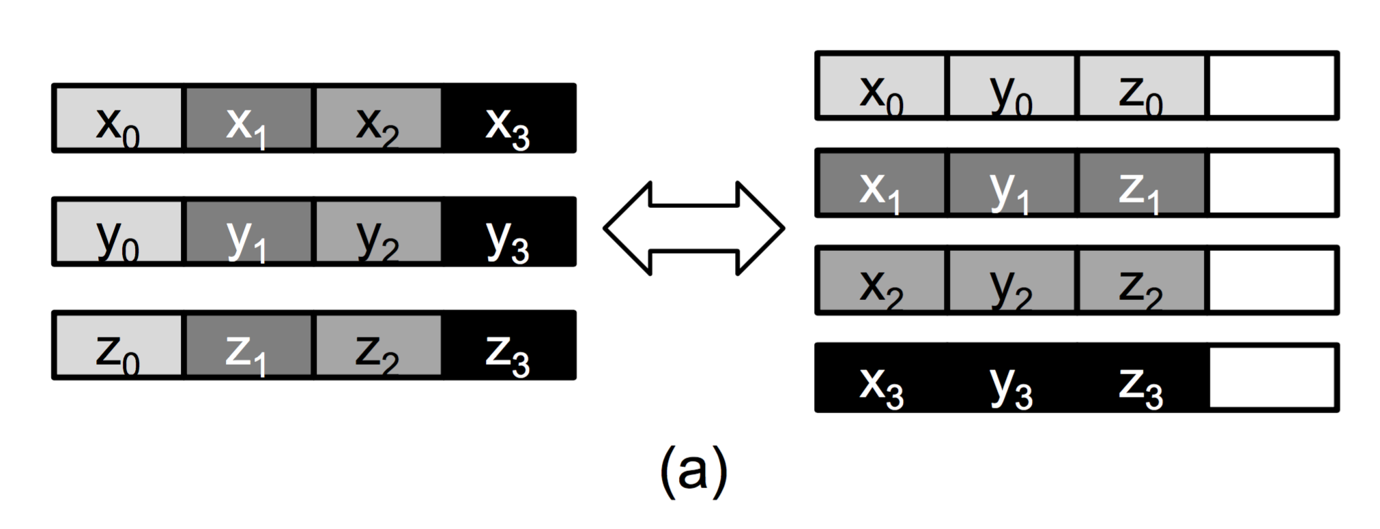
Extracting SLP from Remaining Scalar Operations
Intra-iteration parallelism
Superword vs Vector
Modification to original algorithm
Memory alignment
Conversion
Data reorganization and shuffling
Notes:
The previous step of identifying and optimizing vector operations was a way of extracting inter-iteration parallelism; that is, parallelism from one iteration of the same loop to another. This next step is an attempt to extract intra-iteration parallelism from the remaining scalar operations. To do this, we use superword level parallelism. Superword is used to denote wide length data packed for intra-iteration parallelism, and vector is used for inter-iteration parallelism. With the remaining scalar operations, its possible for some of these to be combined. To do this, we use a modification of the SLP algorithm. As opposed to the original, this modified version does not take the memory alignment into account during packing. Instead, we simply pack any pair of adjacent memory references into the initial superword pack set. Once all these sets have been collected, the superword operations are divided at the alignment boundaries. With indirect references, these alignment boundaries will be unavailable. Just like with inter-iteration parallelism, if superword operations are found to not be profitable, then we revert them back to their scalar operations.
Sometimes it is the case that when superword operations take their operands from the output of vector operations, we must unpack the vector output and repack it in superword format. This is done by transposing the data, AS SHOWN ABOVE.

Slide 21
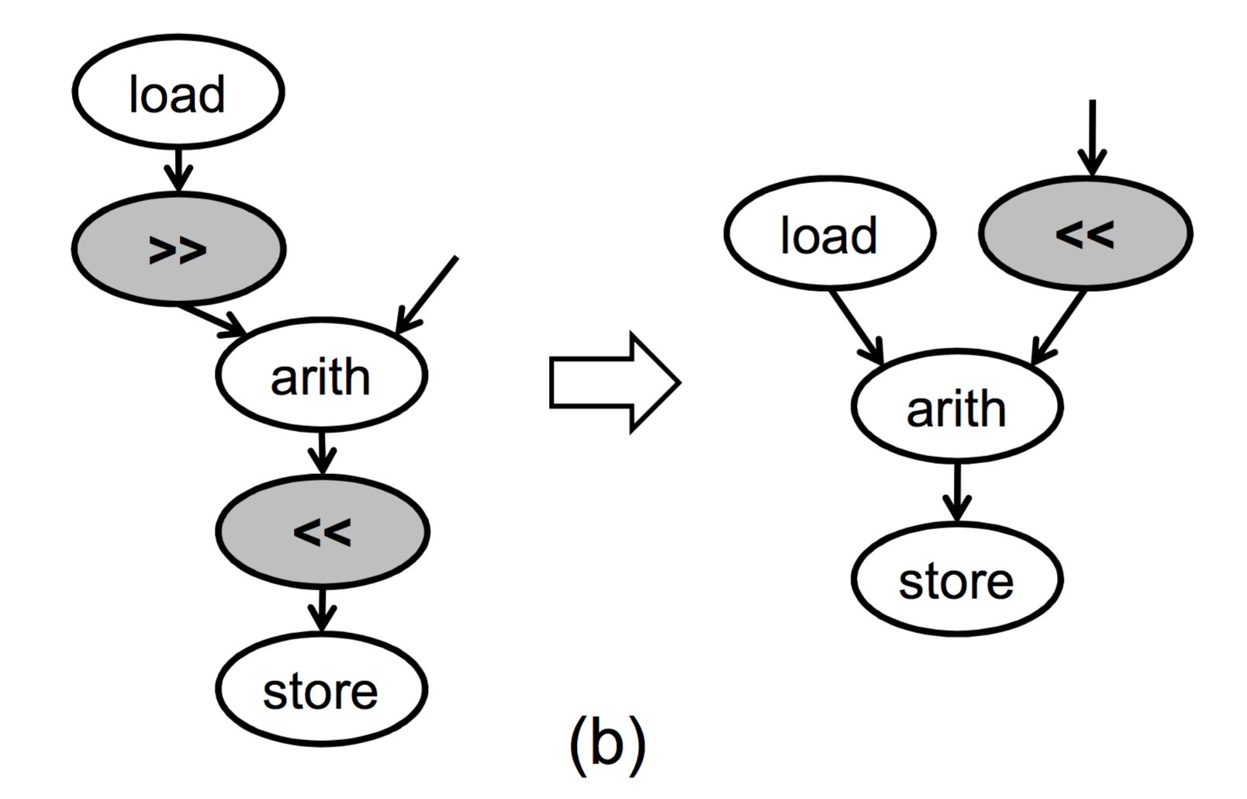
Extracting SLP from Remaining Scalar Operations
Load-compute-store patterns
Alignment offsets
Zero shift policy and dominant shift policy
Notes:
There are times when SIMD units don’t offer any special support for unaligned memory accesses, so the data reorganization must happen directly in the code. However, this reorganization code can be optimized to some extent. This is particularly relevant to load-compute-store patterns in the DFG. Array indirections still present a problem because the alignment offsets are unknown at compile time. For cases like this, compilers will normally generate reorganization code with a zero-shift-policy. This refers to the behavior where misaligned vector data is shifted to the zero offset in a SIMD register just after the load instruction. After that, it’s shifted back in to fit the alignment of the store address just before the store instruction. LEFT SIDE OF FIGURE.
However, if a vector with misaligned data is loaded, computed, and stored back into the same address then we know that the alignment offsets for load and store are the same, even though we don’t know what this number is yet.

Slide 22
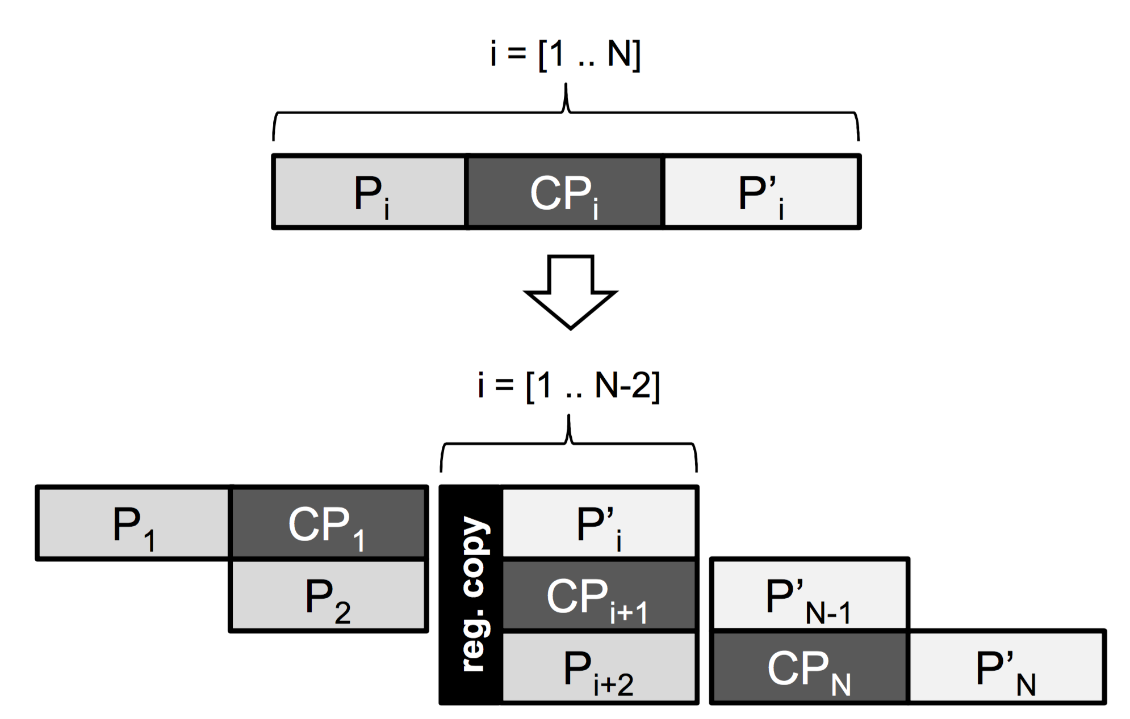
Code Generation
Each node in DFG corresponds to 3A-SSA instruction
Pipelining utilized
Minimize overlapping instruction latencies
Notes:
The final step of the proposed method for handling array indirection with SIMD compilers is the code generation stage. In this step, linear code is returned from the transformed DFG. The authors return C code with SIMD intrinsics (although since LLVM is used it could theoretically handle other languages). These operations are emitted using an ASAP schedule.
Since SIMD vectorization retains dependence cycles, operations in these cycles are replicated by multiple loop unrollings. These replicated operations have the potential to form long data flows among one another, so a method to attempt to hide the latencies of those instructions has been developed. A relatively simple software pipelining strategy is used. Basically the loop body is split into three stages based on dependence cycles. The largest dependence cycle in the loop is used to separate the operations before and after it into three stages. Three stage software pipelining is then applied and data from the prior iteration are explicitly copied to the current iteration at the beginning of each iteration.
By utilizing software pipelining, we increase the chance that multiple instructions latencies are overlapping one another which is beneficial for processors with in-order execution units and means the generated code will have a better chance at exploiting instruction level parallelism.

Slide 23
Preprocessing (parsing, if-conversions)
DFG construction
Identifying vectorizable operations
Optimized Insertion of data reorganization codes
SLP Extraction from scalar operations
Code generation
Notes:
So, once again, these are the 6 steps of the solution laid out by the authors. After pre-processing, the DFG is constructed, vectorizabale operations are identified, and then heuristics are applied to determine whether they should be in their vectorized forms or not based on their cost of packing/unpacking. In these steps we are extracting inter-iteration parallelism, that is from one iteration to another. After that, a number of scalar operations remain either because of dependence cycles or vectorizable operations don’t exist for them, or they might be functions. In this step the superword level parallelism algorithm is applied. This extracts any intra-level parallelism that might exist. Finally, the final code is generated after a simple software pipelining process is applied. This helps reduce overlapping instruction latencies to give the most optimized code.
So that’s the method that was developed, now lets see how it compares to existing techniques…

Slide 24
Experimental Results
4 irregular kernels from scientific applications
Synergistic Processing Unit (SPU) of Cell processor
SIMD processing unit
256 KB local store
128 bit vector data path
Constant memory latencies
VLIW-like two-way execution pipeline (Very Long Instruction Word)
Implemented on top of LLVM compiler
Emits C code, then compiled by GCC (4.1.1., optimization level 3)
Sony PlayStation3 with 3.2 GHz Cell processor and 256 MB RAM
Notes:
To test out the new SIMD approach, 4 irregular kernels were used. All four are mainly used for scientific applications. Their execution times were measured on a synergistic processor unit (SPU) of the Cell processor. To list some specs about the machine, an SPU uses SIMD processing unit and has a 256KB local store with a VLIW-like 2-way in-order execution pipeline. The vector data path is 128 bits long. The nice thing about testing on an SPU is that it’s memory latencies are constant since it can only execute load and store instructions upon its local store. As I mentioned during the pre-processing stage, this new method was built on top of the LLVM infrastucture, which doesn’t officially support SPU, so they modified it to output C code. This C code is then compiled with the GNU C compiler version 4.1.1. using optimization level 3. As far as hardware, tests were run on a Sony Playstation3 with a Cell processor and 256MB of RAM.

Slide 25
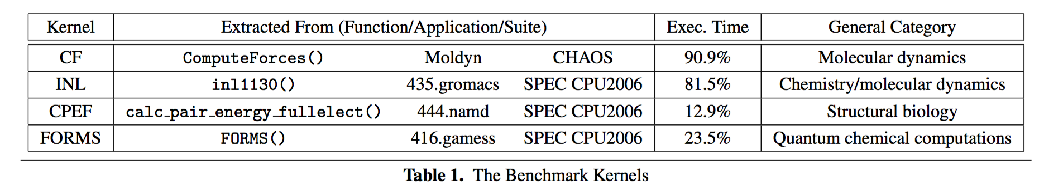
Benchmark Kernels
Notes:
This is a table of the 4 kernels used to test the new compiling method. Since the point of this study is to address challenges with array indirection, all of the inner-most loops of these kernels contain multiple indirect array accesses, for both read and write operations. The name (LEFT COLUMN) is just something the authors made based on their enclosing functions. The execution time column is the fraction of each function’s execution time compared to the rest of the program. The CF, INL and CPEF functions consist of only a single nested loop structure which contains the extracted kernel, so choosing was easy. FORMS is different in that the function contains 9 nested loops. For the sake of the experiment, the loop with the average number of instructions was used.
And as you can see, they are all used in biology/chemistry/physics fields where indirect array access is common.

Slide 26
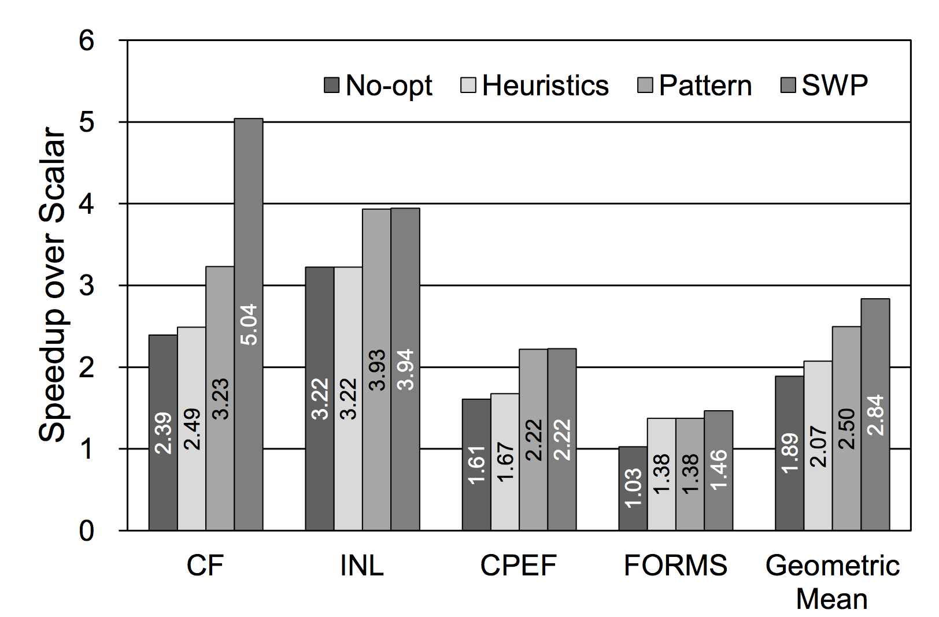
Performance Results
Notes:
This is a graph of the speedup factors achieved by the new SIMD approach. Instead of testing each component 1-by-1, the authors chose to take a cumulative approach. For example, for each of the 4 kernels, they were first run without any optimization. However, this No-opt can be a little misleading because they mean that no further logic was inserted after the DFG was made. That is, operations that were identified to be vectorizable were vectorized and scalar operations were not (so no opt is still better than just all scalar). Next, the heuristics like lazy packing, effective range of packing, and packing first were applied. This is when the new algorithm determines if the benefits outweigh the costs when packing/unpacking. Added on to that next, superword level parallelism is applied to the remaining scalar operations, if possible. Remember, this is done to extract intra-iteration parallelism while the heuristics are used to extract inter-iterations parallelism. Finally, SWP or software pipelining is applied right before the code is eventually generated.
As you can see, heuristics improves the performance by about 10% and pattern brings that up to an improved 20%. The FORMS kernel had no extracted superword level parallelism, so that’s why there’s no change between heuristics and pattern.
On average, there’s a pretty constant increase in performance in each accumulation.

Slide 27
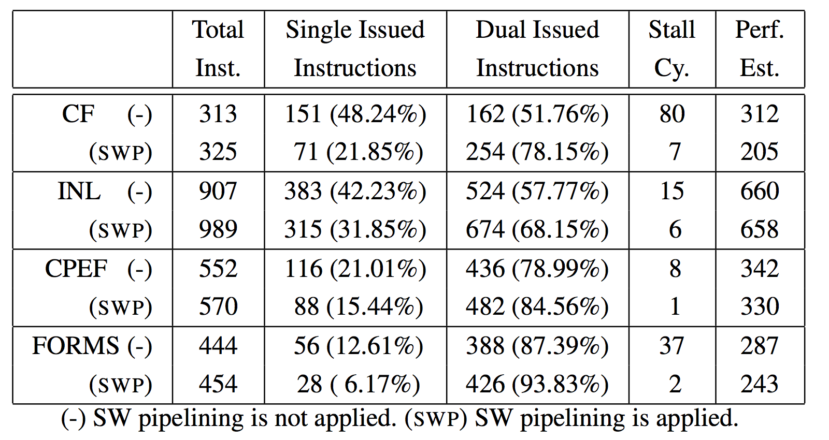
Static Timing Analysis
Notes:
This chart displays the static timing analysis of the kernels just before and after software pipelining was applied. Single and double issued instructions are counted separately along with the number of stall cycles for each kernel. As we can see, in each kernel, the software pipelinging decreased the number of single issued instructions ans increased the number of duel issued instructions. Additionally, stall cycles decreased across the board as well, sometimes more than others. However, you’ll notice that is also has the side effect of increasing the total number of instructions. This is because SWP has to add additional copy instructions in order to pass intermediate values from one stage to another.
So, to get the performance estimate (Perf Est), the formula is single + duel/2 + stall. EXPLAIN THIS
The biggest improvement from SWP is the CF kernel which trims off over 100 instructions, or 34%. However, in the other kernels there is hardly much difference.
GO BACK TO PREVIOUS SLIDE TO SHOW DIFFERENCE

Slide 28
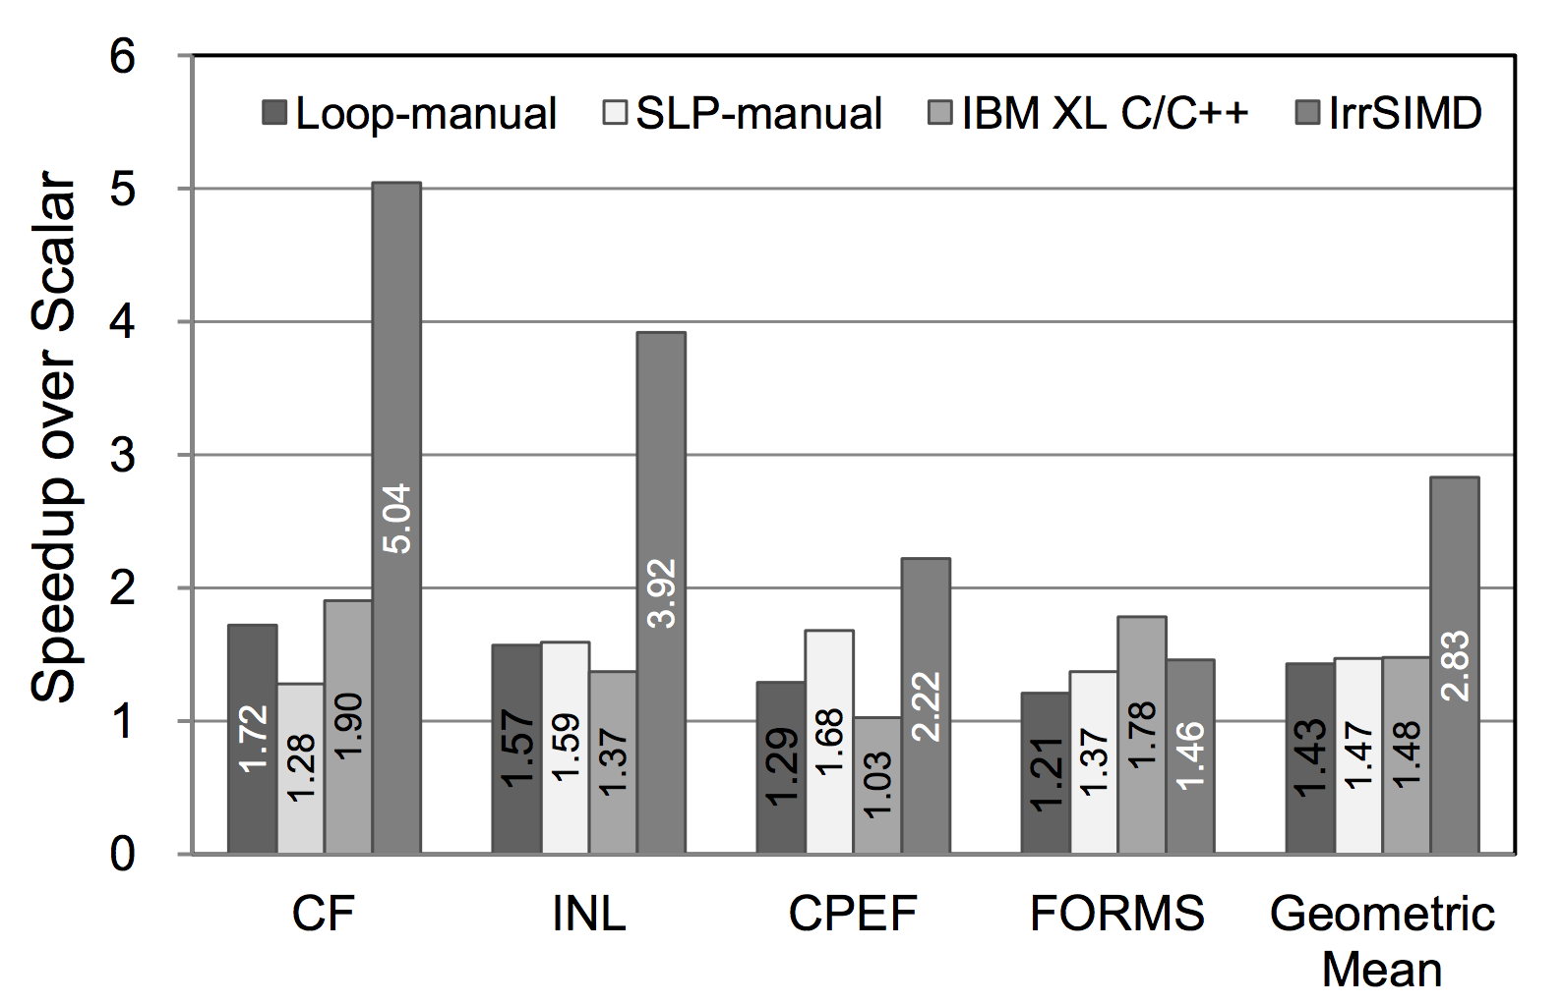
How does this method compare to traditional SIMD methods?
Notes:
So far weve seen how different components of this new SIMD method compare to one another, but now lets look at how this new method compared to existing SIMD compilers. Loop based vectorization and the manual superword level parallelism are two widely used SIMD compilation methods. Also, a commercial compiler for IBM was also tested. Various optimization levels were used (from 2 to 5) and the best results were recorded. The new method discussed in this paper is called IrrSIMD in the graph for irregular kernel SIMD. Clearly, IrrSIMD performs much better than the 3 other approaches, at least for these 4 kernel functions. On average, they all show a speedup factor less than 1.5, while IrrSIMD achieves an average speedup of 2.83 times a non-vectorized approach.
Both loop based and SLP can only extract either inter-or intra-iteration parallelism, but not both, they have a lower performance. On the other hand, our approach extracts parallelism both from within and across loop iterations, and clearly the results are positive.

Slide 29
Conclusion and Future Work
Optimize packing/unpacking
Extract superword-level parallelism
Inter and intra-iteration parallelism
Alignment optimization
Data permutation optimization
Notes:
In conclusion, the biggest challenges to SIMD compilation with array indirection are disjoint or noncontiguous memory references, unknown alignment units, dependence cycles, and so on. While a number of techniques have already addressed this problem, none of them were able to present a solution for dynamic stride arrays. Hardware approaches have also been taken but that’s a less convenient solution.
The proposed SIMD compilation method in this work uses data flow graph manipulation to find optimal data reorganization and extract both inter-and intra-iteration parallelism. Mixed scalar and SIMD instruction code is generated without loop distribution and this code is run using a software pipelining process. As we've seen, using this method gives us an average speedup of 2.83 times it’s non-optimized version and it almost doubles the speedup achieved by previous vectorization techniques.
This new method definitely has room for improvement. The authors mention optimization fields that could still be applied to further increase performance like alignment optimization and data permutation optimization.

