Slide 1

An Evaluation of Vectorizing Compilers
Maleki, Gao, Garzaran, Wong and Padua
University of Illinois at Urbana-Champaign
IBM Toronto Laboratory
(2011)
Notes:
In some ways more similar to a survey paper as they lay out a number of problems that pose the biggest challenges to vectorizing compilers and then investigate some ways to handle these problems.
Also, three different compilers were each evaluated with on three different benchmarks to give some insight into how often certain patterns cause failure any why this happens on some compilers but not others.

Slide 2


Introduction & Motivation
Why the need for Vectorization?
Broad range of applications
Video games & graphics
Multimedia applications
Scientific computations
Types of usages
Assembly code
Intrinsics in high-level languages
Vectorize the compiler itself
Pg. 1
Notes:
Vectorization can often improve performance in single threaded code where the same operation is applied across many iterations of a loop. Generally, vectorization targets high end vector processors or microprocessor extensions. In the 80s and 90s vector processors were the main components of supercomputers at the time. Later on in the 90s more general purpose microprocessors were introduced by intel’s MMX and IBM’s AltiVec, which generally supported multimedia processing. Today, vector devices can be found in video game consoles and graphics cards as well as for scientific computations.
Of course the maximum speedup of a vector process is defined by the width of the vector registers and units. Therefore, speedups change depending on the data type used.
The paper lists three ways that vector units can be used.
Program in assembly code and manually place values in vector registers.
Using intrinsics in higher level languages (SSE).
Use a vectorizing compiler to automatically translate code into vectorized form.
1 and 2 give the programmer complete control over low level details, but this creates code that is less portable and less readable. A nicer option is to leave it to the compiler to do the work for us. The purpose of this paper is to examine a number of different practiced that can be employed so that compilers can vectorize operations automatically.

Slide 3

Outline
Introduction & Motivation
Limiting factors and possible solutions
Non-unit stride accesses
Data alignment
Data dependencies
Generation of efficient vector code
Environment and Evaluation
Compilers and Benchmarks
Conclusion and Further Work

Slide 4
Problems with Vectorization
Accurate Compiler Analysis
Transformations to enable vectorizations
Profitability
Pg. 2
Notes:
The main shortcoming of compiler vectorization is the lack of accurate analysis, failure to perform transformations so that the compiler will automatically perform vectorization, and a lack of profitability analysis.
In order for compilers to generate efficient vector code, a certain amount of interprocedural analysis needs to be performed.
When given a piece of code, compilers may or may not be able to vectorize it even if it is inherently vectorizable. Sometimes, certain data transformations need to be applied so that the compiler will recognize it as vectorizable. Again, the point of this paper is focusing on ways to avoid having the programmer directly invoke vector intrinsics in the code.
We will look at a number if these transformations and when they are needed and when they can be applied. It is important to note that different compilers behave differently and a certain transformation might result in one compiler being able to automatically vectorize it but not another.
Finally, a number of these transformations require some amount of overhead, like packing/unpacking or scatter/gather/shuffle operations, or even additional loops. This means its possible for vectorized code to take a longer time to run than its scalar counterpart. Therefore, it’s important to have some profitability metric to determine if vectorization is even worth the trouble.
To do this, the compiler might need to take into account information like input data, number of iterations of a loop, and whether the overhead can be amortized by the benefit of the vector process.

Slide 5
Transformations
Non-Unit stride accesses
Data alignment
Data dependence based transformations
Generation of efficient vector code
Other
Pg. 2 - 6
Notes:
Most of this presentation and paper deals with the manual transformations that can be performed in the code so that the compiler will recognize it as a candidate for vectorization. The authors divided these transformations into 5 categories.

Slide 6

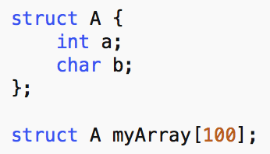
Non-Unit Stride Memory Accesses
Vectorization usually requires consecutive storage
If not, vectorization may not be worth it
Pg. 2
Notes:
Most current processors require vector loads and stores to access elements in consecutive memory locations.
Although it’s possible to load non-consecutive values into a vector register, and perform the vector op and store them back in their respective locations, this generally results in minimal speedups, and its possible that it would actually be slower than the plain scalar version.
For background, depending on language and architecture the struct shown here might have a stride length of 8 instead of 5, if the code is compiled for a 32 bit architecture. Generally, the compiler will optimize for minimum processing time rather than minimum memory storage.
Since, as a rule, you want your data to be unit-stride, we have several transformations that can help achieve this.

Slide 7
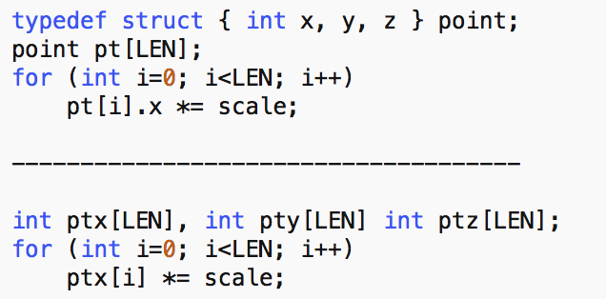
Memory Layout Change
Pg. 3
Notes:
One of the most basic transformations to deal with non-unit stride memory accesses is a memory layout change.
In the example at the top, accesses to pt[i].x are non-unit stride since pt is an array of the point struct.
By ditching the struct for three int arrays, this enables efficient vectorization by the compiler.
It’s important to note that both of these codes can be vectorized. However, the code on the bottom is much more efficient.
Many compilers don’t apply this transformation, and the ones that do are usually quite conservative, and as a result, don’t.

Slide 8
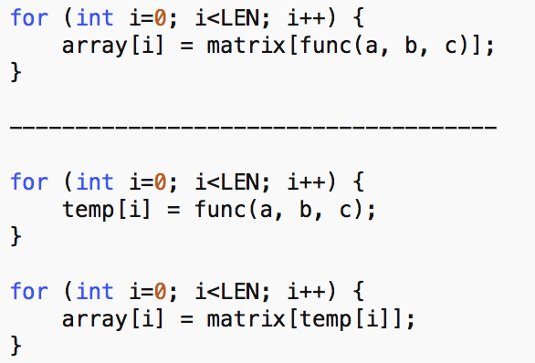
Data Copying
Copy data to local buffers where memory is consecutive
Can require significant overhead
Pg. 3
Notes:
Another transformation to help with non-unit stride accesses is called data copying.
This is copying data into local buffers where the data is consecutive in memory. After the operation the results are copied back.
Again, this is a transformations where the overhead of copying may or not not be amortized by the benefit from any vectorization.
In the example above, the func() call is not linear and therefore creates an indirect array access problem.
By storing results from it into a temp array that is contiguous in memory and then indexing from there, this can help improve data locality and therefore performance.
Again, important to determine profitability of transaction.

Slide 9
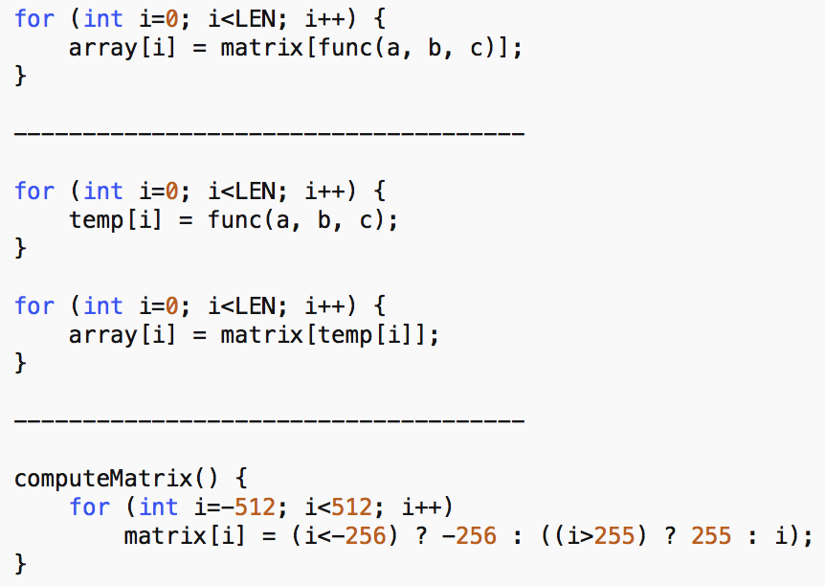
Transformations
Recomputation
Use of lookup table versus computing values from scratch
Loop interchange
Improves data locality and cache performance
Safety?
Pg. 4
Notes:
Often times loops with vectorization computations will use a look-up table to store values from computationally expensive functions like sin() or sqrt(). When the value of the index to access a table is statically unknown, it’s sometimes the case that its faster to recompute the functions instead of using the table.
From a mathematical or algorithmic standpoint it seems like a lookup table would be beneficial, from from the architecture perspective depending on size and how frequently different indices are accessed, this might not be the case.
The example on the screen is the same from the data copying example, but this time shows the function to initialize the matrix[] array. Since the matrix array is read only after it’s initialization, is possible that it would simply be faster to perform the computation when matrix is read from.
Next slide is same text but different picture

Slide 10
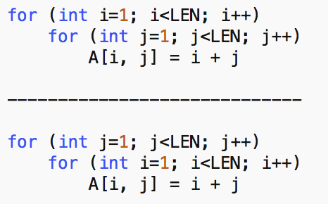
Transformations
Recomputation
Use of lookup table versus computing values from scratch
Loop interchange
Improves data locality and cache performance
Safety?
Pg. 4
Notes:
Finally, loop interchange can be applied when traversing a matrix with non-unit strides as a way to improve data locality and cache performance. However, we need to be careful about loop carried dependencies. More on this later.

Slide 11
Data Alignment
0
1
2
3
4
5
6
7
8
9
A
B
C
D
E
F
Performance increase when vectors are aligned in memory
Much higher latencies involved when vectorizing non-aligned memory
How we see memory
0
1
2
3
4
5
6
7
8
9
A
B
C
D
E
F
How the processor sees memory
0
1
2
3
4
5
6
7
8
9
10
11
Pg. 4
Notes:
Data alignment is another common problem with vectorizing compilers. A little background. As programmers, we generally think of memory locations as a number of blocks without much partitioning, but of course depending on the architecture groups of data will be blocked in different sizes.
Generally, higher latencies will be incurred on to accesses unaligned memory locations. This is due to an increased number of load instructions. This is not always the case, however, a new intel processor (Nehalem) supports unaligned load/store inctructions that execute nearly as fast as aligned ones.
BEFORE ANIMATION
If each block is a byte of data and we want to access the middle four bytes, with a 32 bit architecture we would only need one load operation to access the value.
SHOW ANIMATION
However, if we want bytes 2 through 5 we need to perform 2 load operations and then some shuffle operations will be performed to combine them.

Slide 12
Transformations
Data Alignment
Padding
Allocate larger chunk of memory than needed
Loop peeling
Removing beginning/ending iterations from loops
0
1
2
3
4
5
6
7
Pg. 4
Notes:
There are two common solutions to alignment problems.
The first is padding. We use padding to allocate a larger chunk of memory than needed and this extra space is used to guarantee data alignment. Compilers don’t automatically apply this transformations so this is something that a programmer needs to manually apply. The downside to this strategy is that it doesn't not optimize memory allocation at all, so in cased where many arrays with many elements are being allocated this might cause problems.
SHOW EXAMPLE
In the picture, the green blocks represent actual data and the red ones represent padded bits to ensure alignment.
The second strategy is loop peeling. This is the practice of removing the first and/or last iterations from a loop to force alignment.
MAYBE show image on previous slide

Slide 13

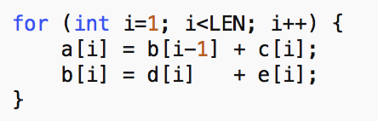
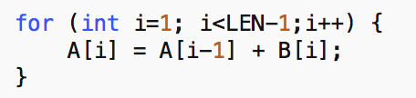
Data Dependence Based Transformations
Statement Reordering
Substitutions
General algorithm substitution
Reduction substitution
Pg. 4
Notes:
We’re used to loop carried dependencies at this point, which can often be a problem for vectorization to take place. In the example on the screen, there is an acyclic backwards dependence because there’s a load from b[i-1] and a store to b[i]. Some compilers are able to vectorize it by switching the order of the two statements, but some don’t recognize this. Since it is a backwards dependency, it’s clear the order has no effect on the scalar counterpart. However, in order to vectorize it the store to b[i] needs to be performed first because so that on the next iteration the correct value will be stores in b[i-1].
This is something the programmer should be aware of when writing code.
Substitutions can also be useful when dealing with dependencies in loops. Two main types discussed in this paper are algorithm and reduction substitution although technically reduction sub is a type of algorithm sub.
The second code example on the screen is know as the prefix sum algorithm. It’s a quite common algorithm in kernel code but none of the compilers evaluated in the paper vectorize it automatically. Instead the authors suggest implementing a manually vectorized version of such algorithms.
Common examples of reductions are functions like SUM or MAX/MIN.

Slide 14
Data Dependence Based Transformations
Loop peeling
Symbolic resolution
for (i = …)
A[i] = A[i + k] + …;
Recognition of Induction Pointers
Wrap Around Variable Detection
if (i > 0 && i + 1 > 0) VS if (i > 0)
Pg. 5
Notes:
Some other strategies for handling data dependencies include loop peeling, which we already discussed. Occasionally loops will only contain dependencies on the first or last iterations so by peeling off these iterations we can vectorize the code.
Symbolic resolution is another transformation that helps with dependencies. Compilers don’t automatically generate multiple versions of a loop for cases where a data dependence exists. For example, in the code above, the compiler can easily vectorize this if the value of k is positive, but when k is negative this either requires a more complicated transformation or vectorization is not possible. A runtime check should be added to run vectorized code for the positive values of k and scalar code for negative values.
An induction pointer refers to a pointer that is incremented by 1 or at least a constant value on each iteration. This amount is known at compile time. Compilers don’t always recognize induction pointers as array accesses so programmers should change them manually to their array counterpart.
Finally, wrap around variable detection. An example of a wrap around variable is a signed twos complement int that switches from positive to negative as you reach its capacity. Compilers should express these vars in terms of the loop induction var to enable vectorization. Sometimes this may require peeling of boundary iterations.

Slide 15
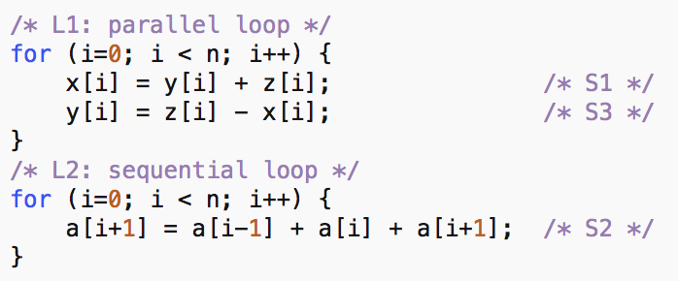
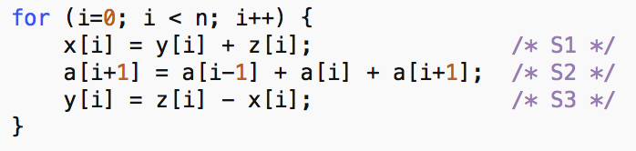
Loop Distribution (fission)
Fusion
Distribution
Loop Distribution
Loop Fusion
Depending on architecture,
can have effect on locality
Goal is to vectorize the parallel loop
More difficult to parallelize
More concisely written code
Pg. 5
Notes:
Loop distribution (of loop fission) is the act of distributing a loop over the statements inside the body. Distribution is commonly used when one or more of the statements in the loop can be vectorized but another cannot be. It’s possible for this to have negative effects on performance if it decreases cache or register locality.
SHOW example

Slide 16
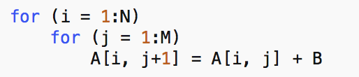
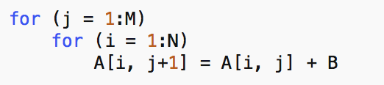
Loop Interchange
S_{1,4}
S_{2,4}
S_{3,4}
S_{4,4}
j=4
S_{1,3}
S_{2,3}
S_{3,3}
S_{4,3}
j=3
Vectorization Possible when
dependencies carried across
outer loop, not inner
Be cautious of non-unit stride
access
S_{1,2}
S_{2,2}
S_{3,2}
S_{4,2}
j=2
S_{1,1}
S_{2,1}
S_{3,1}
S_{4,1}
j=1
i=1
i=2
i=3
i=4
Pg. 5
Notes:
Loop interchange, as mentions before, if the act of switching the order of nested loops. This type of transformation can enable vectorization when data dependencies are carried out across iterations of the inner loop, but not the outer. However, care needs to be taken to ensure that the interchange is valid. Generally this means no backwards dependencies. Also, the programmer should be careful not to introduce any non-unit stride accesses.
Loop interchange is usually performed when working with multidimensional array so that elements are accesses in the order in which they are present in memory, thereby improving locality of reference. Basically the effectiveness of the loop interchange depend on the type of cache model employed by the underlying hardware.
SHOW EXAMPLE

Slide 17
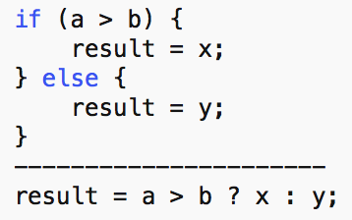
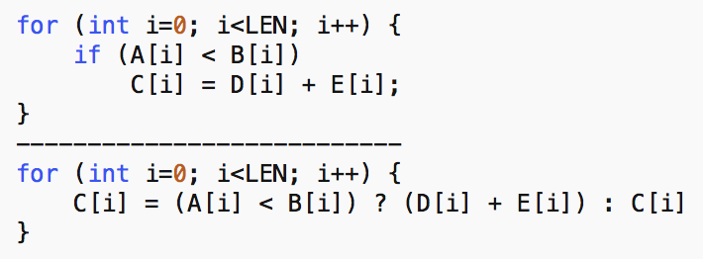
If-Conversion
Replace control dependencies with data dependencies
Helps to vectorize but may compute unnecessary instructions
Different languages have different rules
Profitable?
Pg. 6
Notes:
If conversion lets us write branch instructions in one line, for easy vectorization. This technique lets us replace control dependencies with data dependencies. This is incredibly useful, but there are some things to be aware of. Some languages will actually run the code in both branch bodies, regardless of the outcome of the branch. This is definitely something to be aware of when programming code for vectorization.
Because of this behavior, any function calls will be executed and expensive calculations may be performed unnecessarily.
This means that profitability analysis should be performed to determine whether it’s more efficient to just leave it in scalar form.

Slide 18
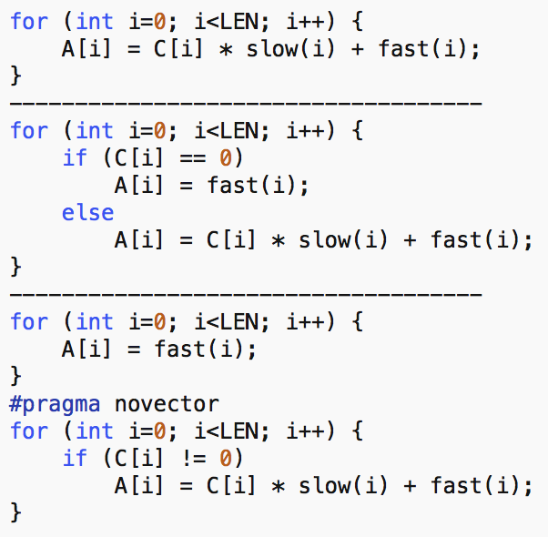
If-Conversion
3 options:
Execute both parts of branch and store appropriate value (?: syntax)
Remove branch condition entirely and vectorize normally
Vectorize if condition for all elements, and run second loop in scalar mode
Pg. 6
Notes:
SHOW EXAMPLE
fast() is a fast function and slow() is a slow function.
First code block is scalar and no branch. However, most of the values of C[i] end up being 0, so the branch condition is added. The second example cannot be vectorized due to this branch, but by employing if conversion both statements will be executed, which will slow down the code. This is the first of three options. The second option would be to vectorize the only the second statement, and not take any branches into account. Thirdly, we could run the fast() function over the entire array in a vectorized fashion no matter the condition. Then we go back through and update the values where C[i] is not zero is a sequential, scalar manner.
In the end, analysis should be performed to determine which of these provides the greatest performance speedup.

Slide 19
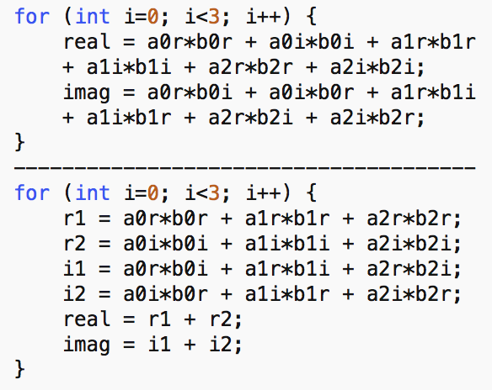
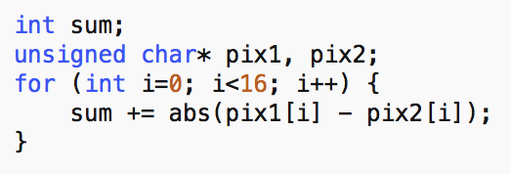
Generation of Efficient Vector Code
Data Permutations
Unaligned vector operations
Expensive, so try to minimize
Data Type Promotion
Casting variables to larger type not always necessary
Can result in less vector parallelism due to shuffling operations
Always check your types
CHAR_MAX = 127, SHORT_MAX = 32767
16 x 2 x CHAR_MAX < SHORT_MAX
Pg. 6
Notes:
The last category of transformations are to ensure the generation of efficient vector code. These either increase the amount of parallelism or decrease the amount of overhead.
The first is known as data permutation. This is used when the vector operation on two registers is such that corresponding elements are unaligned. Permutations can help fix this, however, they can be expensive so it is important to minimize the number of them.
SHOW EXAMPLES – compiler can easily vectorize each of these, but the first requires more permutations. The second is optimized to have the least amount possible.
Data Type promotion is casting a value to a larger data type, using larger than needed. SHOW EXAMPLE
Since chars in C are defined numerically, the max value for a char is 127. Therefore a 16 bit short can be used instead of an 32 bit int.
Generally the smaller data type you use, the more of them you can fit into a vector register thus increasing parallelism.
On the other hand, not all vector processors are able to vectorize all data types.

Slide 20
More Transformation
Loop Invariant Recognition
Does the statement need to be inside the loop
Reroll
Opposite of loop unrolling
Vectorization of while loops
Stopping condition not known at compile time
break; and continue;
while (a[i] < b[i]) { … }
Pg. 7
Notes:
Finally, a few more miscellaneous transformations.
Loop invariant recognition deals with the compiler recognizing which statements need to be in a loop not not. If a statement doesn’t need to be in a loop it should be moved above it.
Loop rerolling is the opposite of loop unrolling. In some cases rerolling loops can enable vectorization. Unless a compiler is able to vectorize basic blocks, unrolled loops can lead to inefficient vectorization.
Finally, it’s worth pointing out that while loops are a bit trickier to vectorize than for loops. This is because the looping condition is not necessarily known at compile time. Breaks and continues can also be problematic for vectorization. The authors suggest manually checking the conditional expression for consecutive interations in a vector manner. If true, vectorization can continue, if false, the scalar code should run.

Slide 21
Profitability
Cost models implemented to determine if
vectorization is profitable
Need information about:
Input data
Number of loop iterations
How much overhead exists with added code
Profiling data to predict branch instructions
Pg. 7
Notes:
We mentioned this before but it’s important for compilers to use cost models to determine whether a transformation is profitable. To arrive at this decision, certain information is needed like the size and type of the input data, the number of loop iterations that will be performed any how much overhead exists, if any, with any modified code.
It’s also possible for the compiler to use profiling to make predictions about branch instruction.
A number of the transformations we evaluated should incorporate some degree of profitability analysis to determine whether vector or scalar code should be run, or some sort of transformation.

Slide 22
Outline
Introduction & Motivation
Limiting factors and possible solutions
Non-unit stride accesses
Data alignment
Data dependencies
Generation of efficient vector code
Environment and Evaluation
Conclusion and Further Work

Slide 23
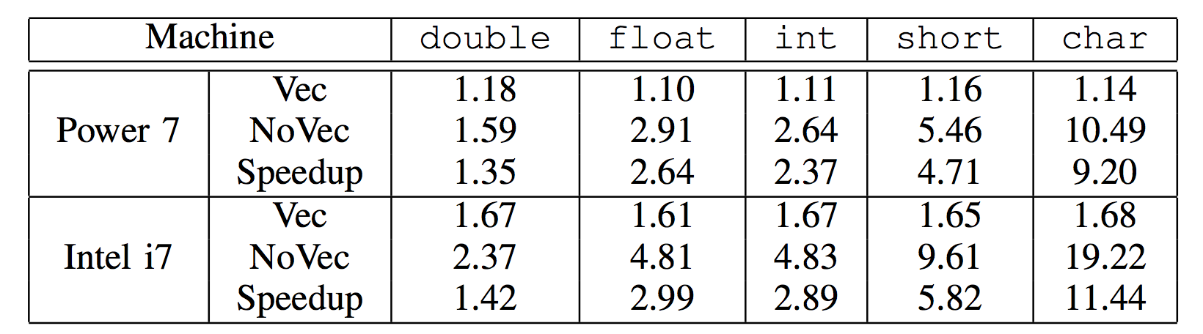
Benchmarks & Environment
Test Suite for Vectorizing Compilers (TSVC)
Code from Petascale Application Collaboration Teams (PACT)
Media Bench II
Platforms
IBM Power7
Intel i7
Compilers
GCC, ICC, XLC
A[i] = B[i] + 1 for 12.5 KB Array
Pg. 1 - 2
Notes:
The TSCV benchmark contains 135 loops, developed 20 years ago to assess vectorization capabilities of compilers. Originally written in fortran but was converted to C for this paper. 23 new loops were also added to asses newer developments
PACT develops code to meet performance milestones of several blue waters applications. Blue Waters is a very powerful supercomputer housed by the university of Illinois.
Media bench is a benchmark representing multimedia applications. This benchmark encodes/decodes video and image files, specifically MPEGs and JPEGs.
Two target platforms were used, IMB and intel. To get a baseline of the platforms tests were run on a simple code segment on a large array. You can see the speedup increases as the size of the data type decreases.
There compilers were evaluated.
GNU C Compiler or GNU Compiler Collection
ICC – intel’s compiler
XLC – IBM’s compiler

Slide 24
Methodology
Compiled code with and without vectorization for testing purposes
Speedup = time_{baseline} / time_{vectorized}
Auto Vectorized – Compiler auto vectorizes and speedup >= 1.15
Perfectly Auto Vectorized – Compiler auto vectorizes and no further speedups achieved manually
Not Vectorizable – Neither compiler nor manual vectorization can achieve a speedup >= 1.15
Pg. 7
Notes:
In this section, different compiler vectorization capabilities were evaluated.
EXPLAIN THE TERMINOLOGY
Classification of a loop as not vectorizable is done based on target platform, not so much the compiler.
It should also be noted that none of the evaluated compilers used profiling to improve the vectorization efficiency, excecpt once when XLC used symbolic resolution transformation.

Slide 25
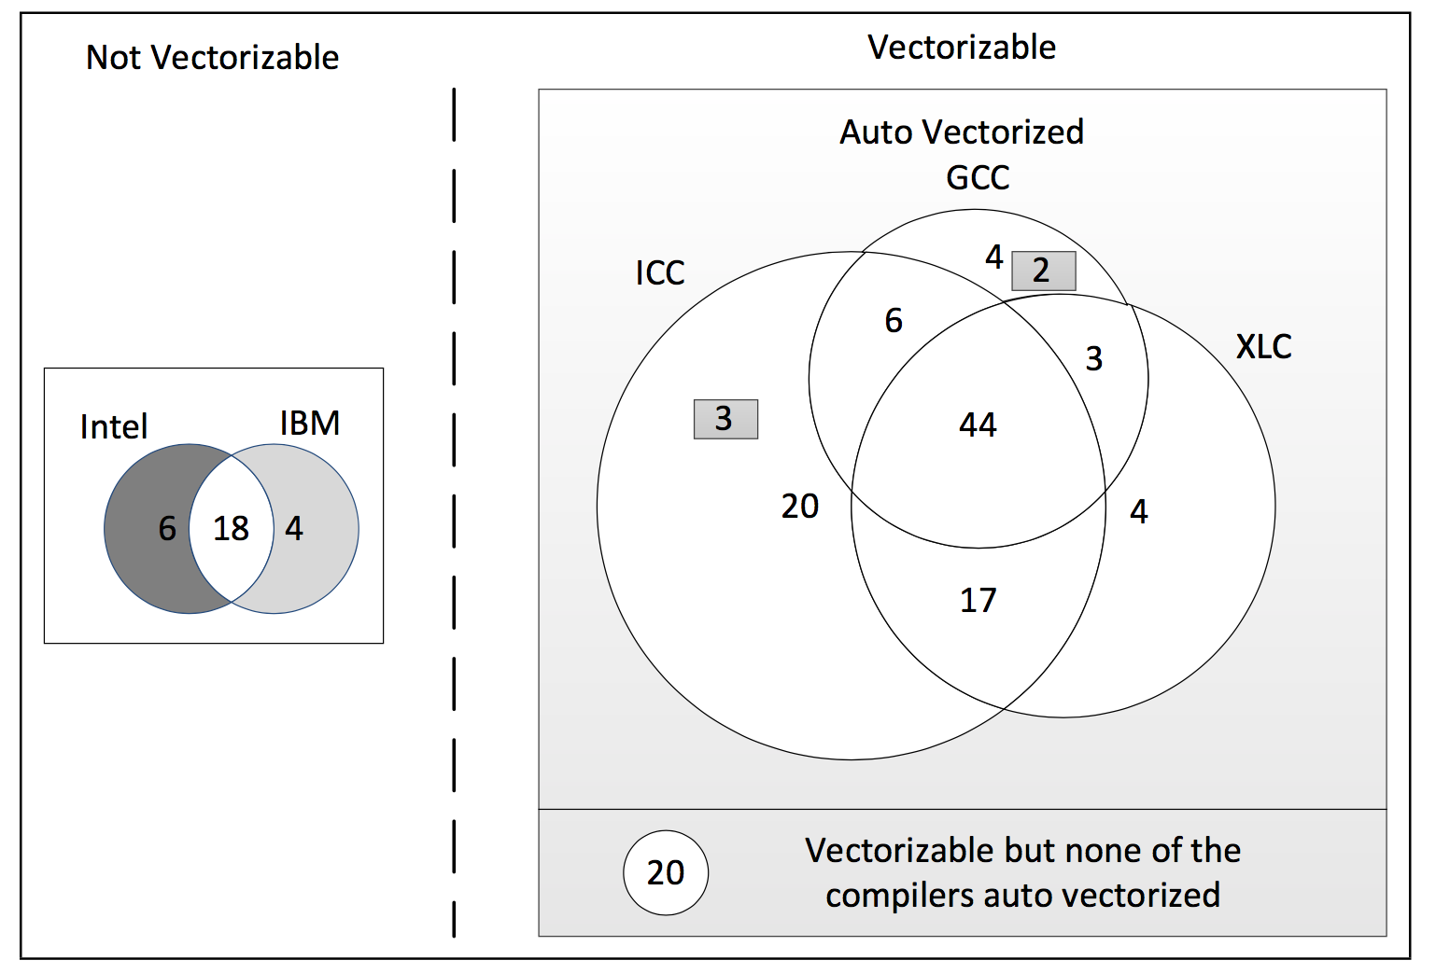
Compiler Evaluation for TSVC
Pg. 8
Notes:
This displays the results for the test suite for vectorizing compilers (TSVC). This shows loops that at auto-vectorized by different compilers (not perfectly autovectorized). The results show that ICC was able to auto vectorize 90 loops, while XLC got 68 and GCC had 59.
The shaded 2 and 3 denote the loops that were classified as non-vectorizable by the IBM platform but are auto vectorized on the intel platform.
18 couldn’t be vectorized by either platform due to complex gather/scatter hardware support to efficiently vectorize them.
A total of 20 were determined to be vectorizable by hand but none of the compiler did it automatically.
For example, ICC vectorizes 70.87% of loops in benchmark,
XLC has 54.84% and
GCC has 46.46%

Slide 26
Transformations Required for Perfect Auto Vectorization
Transformation Type | XLC | ICC | GCC
Total | 58 | 45 | 70
If-conversion | 10 | 0 | 14
Vectorization of while loop | 3 | 0 | 0
Algorithm substitution | 9 | 8 | 6
Statement reordering | 0 | 3 | 3
Data Copying | 9 | 8 | 12
Wrap around var detect | 5 | 2 | 2
Reduction | 4 | 5 | 10
Rerolling | 0 | 4 | 1
Symbolic resolution | 3 | 3 | 3
Loop interchange | 3 | 2 | 5
Loop distribution | 1 | 1 | 2
Other | 11 | 9 | 9
Pg. 9
Notes:
This table shows the different types of tranformations that were used to perfectly auto vectorize loops in the benchmarks.
Some takeaways:
XLC better at recognizing where statement reordering is needed than ICC
ICC better than XLC at determining when to use if-conversions
ICC better at handling transformations to deal with non-unit stride memory accesses
Both ICC and XLC vastly outperform GCC when it comes to both reductions and if-conversions

Slide 27
PACT and Media Bench II
Few loops vectorized automatically
Need manual transformation
Main reasons for failure:
Hardware limitations
Some programming patterns simply not recognized by today’s compilers
Data dependencies
Pg. 9
Notes:
The main takeaway from the results from the PACT and media bench, as well as the TSVC benchmarks is that compilers have a lot of room for improvement and few loops were vectorized by the compiler (especially in PACT and media bench).
There are a number of reasons for their shortcomings, notably limitations from the hardware for certain vector extensions. An example of this is that non-unit stride accesses are actually more challenging for todays compilers than they were for compilers 20 years ago. This is because those machines had hardware support that no longer exists in todays microprocessors.
Also, some programming patterns are no longer recognized by today’s compilers. The example the authors give are loops with wrap around variables.
Thirdly, data dependencies still pose a significant challenge to compilers and require statement reordering or algorithm substitution.

Slide 28
Conclusion
What should we take away from this?
The Imaginary compiler
Different compilers moving in different directions
Lack of resources
Know your architecture and compiler
Questions?
Pg. 10
Notes:
The big takeaway is that compilers still have a lot of work to do when optimizing vectorizing processes.
For example, ICC vectorizes 70.87% of loops in benchmark,
XLC has 54.84% and
GCC has 46.46%
There were few techniques that well known compiler techniques could not handle, but they constantly failed to recognize when to implement these techniques.
However, if there was an imaginary compiler that could vectorize all loops that the three compilers auto vectorized individually, 83.05% of the loops would be vectorized. This would seem to prove that compiler technology to vectorize most loop patterns already exists, but different compilers handle events in different ways.

