Slide 1
Vector Applications to Large Graph Processing
Alex Powell
Notes:
Research for improving efficiency of large graphs is not a novel research area, but little work has been done to incorporate data level parallelism of SIMD instructions into these approaches. My progress on this project this semester includes manual vectorization of certain graph benchmarks to find the difficulties and challenges of incorporating parallelism into these which will hopefully be useful when creating some library or API that a programmer can directly incorporate into their code.
Also, we look into different approaches to representing graphs in data and new approaches to processing them.

Slide 2



Background
Large graphs subset of big data problem
Billions of vertices and edges
Hundreds of gigabytes
Notes:
Clearly graphs are becoming more and more widely used to represent large sets of data and find trends. Social networking sites are common examples of how graphs can be used but of course there are many others. When we talk about the emergence of big data, graph play a big role in this.
Of course, just as there’s no concretely defined number that determines whether you're dealing with big data. The same thing applies to large graphs but generally we’re talking about graphs that have possibly billions of vertices and edges and might take up hundreds of GB in storage.

Slide 3
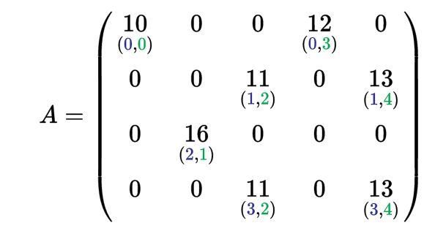
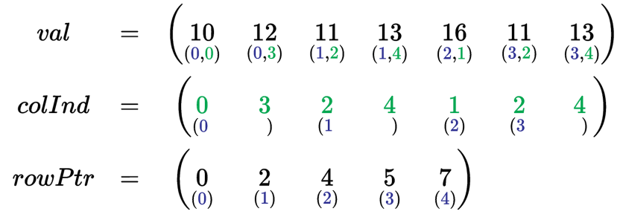
Storage Options
Adjacency matrix
Adjacency list
Compressed sparse row (CSR)
Notes:
Explain different graph storage formats.
Think about a graph representing all facebook users. There would be over 1 billion nodes but the average number of friends someone has is probably below 100. Generally, as graphs become larger their respective matrices become sparser which isn’t very efficient to store.
Compressed formats become important.
Also, these representations are generally vertex-centric, as opposed to edge centric.

Slide 4

Existing Solutions
MapReduce
Pregel (Google)
Gunrock
Normally use clustered solutions for HPC
Complexity
Power consumption
Portability
Notes:
As I mentioned, there are a number of existing projects to improve large graph processing efficiency. Some of the ones I looked at were mapreduce, pregel, and gunrock.
MapReduce usually splits the input data set into independent chunks which are processed in a serial manner. (This is the Map part). Then these individual outputs are “reduced” to generate a single final output.
The pregel model also uses a cluster of machines and is a vertex centric large scale graph computation model. User defined functions are executed on each vertex in parallel. It’s widely used for distributed computing.
Gunrock is the last project I looked into. Another large scale graph processing model but it is different from the others in that it is designed for use on a GPU.
These models all rely on clusters to spread graph across. Obvious downside to clustered approach. Explain
They are also all vertex centric.

Slide 5
Change in Philosophy
V
V
Vertex Centric
Edge Centric
Gather
Scatter
for each vertex V
if V has update
for each edge E from V
scatter/gather(E)
for each edge E
if E.src has update
scatter/gather(E)
Notes:
This brings me to another high performance graph processing library called X-stream. X-stream is used to perform analytics on big graphs but using a single machine, and it’s based on the philosophy that sequential access is generally best for all storage media. As opposed to the others, it presents an edge-centric approach to graph processing.
It uses the scatter/gather programming model
Show differences in for loops.
Also describe difference between scatter and gather.

Slide 6
SOURCE | DEST
1 | 3
1 | 5
2 | 7
2 | 4
3 | 2
3 | 8
4 | 3
4 | 7
4 | 8
5 | 6
6 | 1
8 | 5
8 | 6
1
6
3
7
2
5
8
4
BFS
https://github.com/epfl-labos/x-stream

Slide 7
SOURCE | DEST
1 | 3
1 | 5
2 | 7
2 | 4
3 | 2
3 | 8
4 | 3
4 | 7
4 | 8
5 | 6
6 | 1
8 | 5
8 | 6
1
6
3
7
2
5
8
4
BFS
https://github.com/epfl-labos/x-stream
Notes:
This change improves spatial locality which can improve overall performance.
By using a more sequential access pattern for edges, the access bandwidth increases greatly.

Slide 8
Applications
GraphBIG benchmark
PageRank
Betweenness Centrality
Gibbs Inference
Triangle Count
Manual Vectorization
Notes:
Pagerank – famous algorithm used by google search to rank websites by their assumed importance.
Betweenness centrality- indicator of a nodes centrality in a network. Equal to the number of shortest paths from all vertices to all others that pass through that node.
Gibbs inference – algorithm that employs markhov chains to obtain a sequence of iterations that are approximated from a specified distribution when direct sampling is difficult.
Triangle count – common benchmark used to obtain a count of the number of triangles in a graph.
These were manually vectorized and chosen as they had the most dense kernels with mathematic computations where sse could be incorporated.

Slide 9
Results

Slide 10
Results

Slide 11
Challenges
Lack of dense kernel to provide vectorization instructions
Loop carried dependencies
Loops with small number of iterations
Edge Divergence
Notes:
Challenges:
Sometimes no dense kernel or arithmetic instructions to vectorize – simply appending and popping to/from queues. Need to change the whole structure of the code to use vectors.
Dependencies – sometimes a larger vector size makes this more difficult.
Not enough iterations in inner loop to use vectorization. Overhead of added intrinsics is worse than sequential. Superword level parallelism used here.
Divergence of number of edges for each vertex. A large disparity is bad for parallelism. Better if all nodes have many edges.
2 ways to handle this: either change your problem to only focus on ”dense” graphs, or change input to be denser.

Slide 12
Challenges
Lack of dense kernel to provide vectorization instructions
Loop carried dependencies
Loops with small number of iterations
Edge Divergence
Questions?
Notes:
Challenges:
Sometimes no dense kernel or arithmetic instructions to vectorize – simply appending and popping to/from queues. Need to change the whole structure of the code to use vectors.
Dependencies – sometimes a larger vector size makes this more difficult.
Not enough iterations in inner loop to use vectorization. Overhead of added intrinsics is worse than sequential. Superword level parallelism used here.
Divergence of number of edges for each vertex. A large disparity is bad for parallelism. Better if all nodes have many edges.
2 ways to handle this: either change your problem to only focus on ”dense” graphs, or change input to be denser.

