Slide 1
Vector Applications to Large Graph Processing
Alex Powell

Slide 2



Background
Large graphs subset of big data problem
Billions of vertices and edges
Hundreds of gigabytes

Slide 3
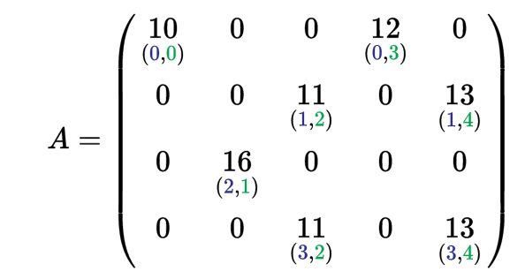
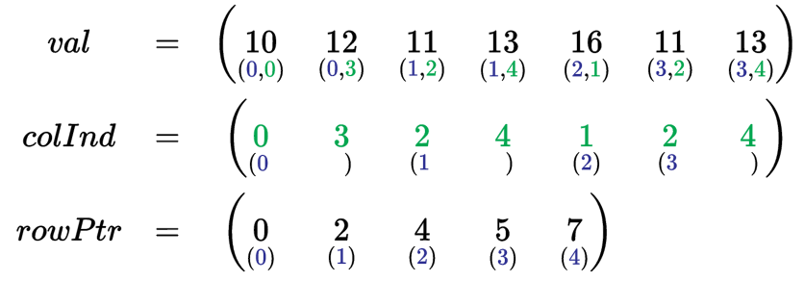
Storage Options
Adjacency matrix
Adjacency list
Compressed sparse row (CSR)
Notes:
As graphs become larger their respective matrices become sparser which isn’t very efficient to store.
Compressed formats become important.

Slide 4

Existing Solutions
MapReduce
Pregel (Google)
Gunrock
Normally use clustered solutions for HPC
Complexity
Power consumption
Portability
Notes:
Explain mapreduce, pregel, and gunrock
These models all rely on clusters to spread graph across. Obvious downside to clustered approach. explain

Slide 5
Change in Philosophy
V
V
Vertex Centric
Edge Centric
Gather
Scatter
for each vertex V
if V has update
for each edge E from V
scatter/gather(E)
for each edge E
if E.src has update
scatter/gather(E)
Notes:
A new way to view graph algorithms is an edge centric way as opposed to the vertex centric approach that the previous models have used.
This was based on the work in X-stream (TALK ABOUT DETAILS)

Slide 6
SOURCE | DEST
1 | 3
1 | 5
2 | 7
2 | 4
3 | 2
3 | 8
4 | 3
4 | 7
4 | 8
5 | 6
6 | 1
8 | 5
8 | 6
1
6
3
7
2
5
8
4
BFS

Slide 7
SOURCE | DEST
1 | 3
1 | 5
2 | 7
2 | 4
3 | 2
3 | 8
4 | 3
4 | 7
4 | 8
5 | 6
6 | 1
8 | 5
8 | 6
1
6
3
7
2
5
8
4
BFS

Slide 8
Application
GraphBIG benchmark
PageRank
Betweenness Centrality
Gibbs Inference
Triangle Count
Manual Vectorization

Slide 9
Results

Slide 10
Results

Slide 11
Challenges
Lack of dense kernel to provide vectorization instructions
Loop carried dependencies
Loops with small number of iterations
Notes:
Challenges:
Sometimes no dense kernel or arithmetic instructions to vectorize – simply appending and popping to/from queues. Need to change the whole structure of the code to use vectors.
Dependencies
Not enough iterations in inner loop to use vectorization. Overhead of added intrinsics is worse than sequential. Superword level parallelism used here.
Divergence of number of edges for each vertex. A large disparity is bad for parallelism. Better if all nodes have many edges.
2 ways to handle this: either change your problem to only focus on ”dense” graphs, or change input to be denser.

