Slide 1

About the Data
UCI School of Information & Computer Sciences
www.data.gov
University of Minho, Portugal, Dept. of Information Systems
Park Information

Slide 2

About the Data
517 Observations
12 Features (plus the output variable)
30% testing set (talk about pros and cons of larger testing set)

Slide 3
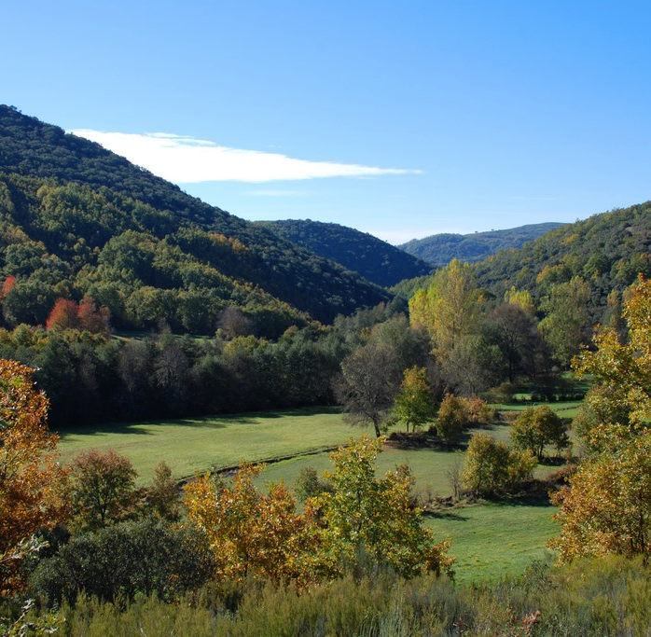
Features
X-axis spatial coordinate (1-9)
Y-axis spatial coordinate(2-9)
Month of the year
Day of the week

Slide 4
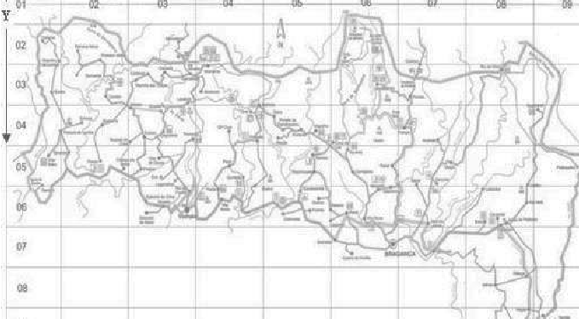
Montesinho National Park

Slide 5
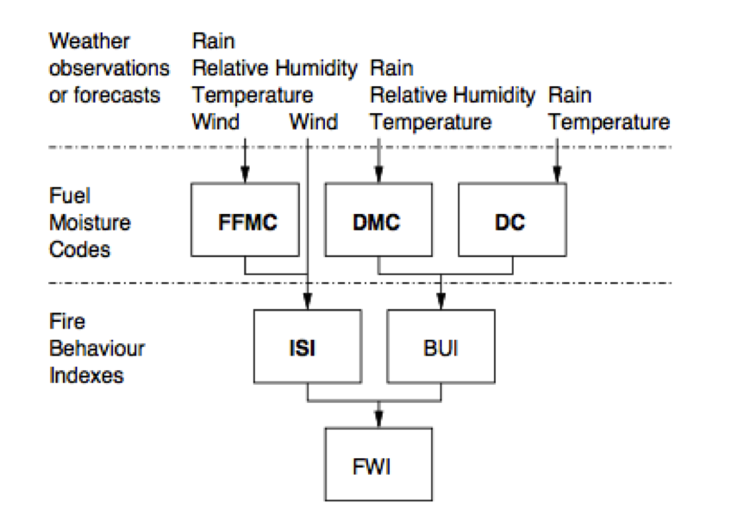
Forest Fire Weather Index
Fine Fuel Moisture Code
Duff Moisture Code
Drought Code
Initial Spread Index

Slide 6

Features
Relative Humidity (percentage)
Wind Speed (km/h)
Rain (mm/m²)
Burned Area (ha) – Output variable
No missing attributes

