Slide 1
MUSE
BEEP Network
27 January 2021
A novel agent-based energy systems model
Alex Kell
Sustainable Gas Institute, Imperial College London
a.kell@imperial.ac.uk

Slide 2

MUSE
27 January 2021
ModUlar energy system Simulation Environment
MUSE
Generalised Sector
Agent-Based Method
Case Study

Slide 3
What is an Integrated Assessment Model (IAM)?
IAMs
27 January 2021
Scientific model used for environmental policy analysis
Integrate knowledge from several domains:
Techno-economic
Climate
Analyse how supply can be used to meet future energy demand
Technologies
Environment
Policy
Society
Energy Systems Model

Slide 4
Why use an Integrated Assessment Model (IAM)?
IAMs
27 January 2021
Technologies
Environment
Policy
Society
Long-term climate change mitigation pathways
Strategy and business model development against scenarios
R&D prioritization
Role and value of technologies
Energy Systems Model

Slide 5
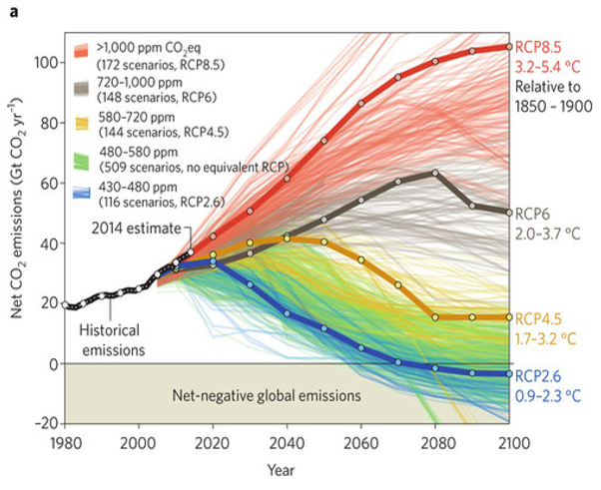
Common analysis techniques
Modelling techniques
27 January 2021
Top-down
Bottom-up
Econometric
Sector-specific micro-analyses
IPCC (Intergovernmental Panel of Climate Change)
5th Assessment Report
Methodology
Optimisation
Simulation
Hybrid

Slide 6
Limitations of typical energy system models
Modelling techniques
27 January 2021
Typical model
Real world
Optimization and rationality
Minimize system cost
Intertemporal optimization
Perfect foresight
Single investor per sector
Imperfect information
Imperfect foresight
Bounded rationality
Uncertainty
Financing challenges

Slide 7



MUSE
Modelling techniques
27 January 2021
Investor view of energy system transitions
Imperfect foresight
Transparency
Methodology
Simulation
Agent-based modelling
Flexibility and generalizability
Open access documentation
Open source software

Slide 8
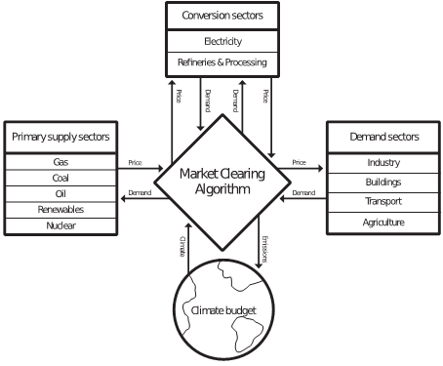
Overview
MUSE
27 January 2021
Ability to model all sectors in the energy system
Technology rich
Partial equilibrium
Supply and demand
Policy can be modelled
Carbon price
Subsidy

Slide 9
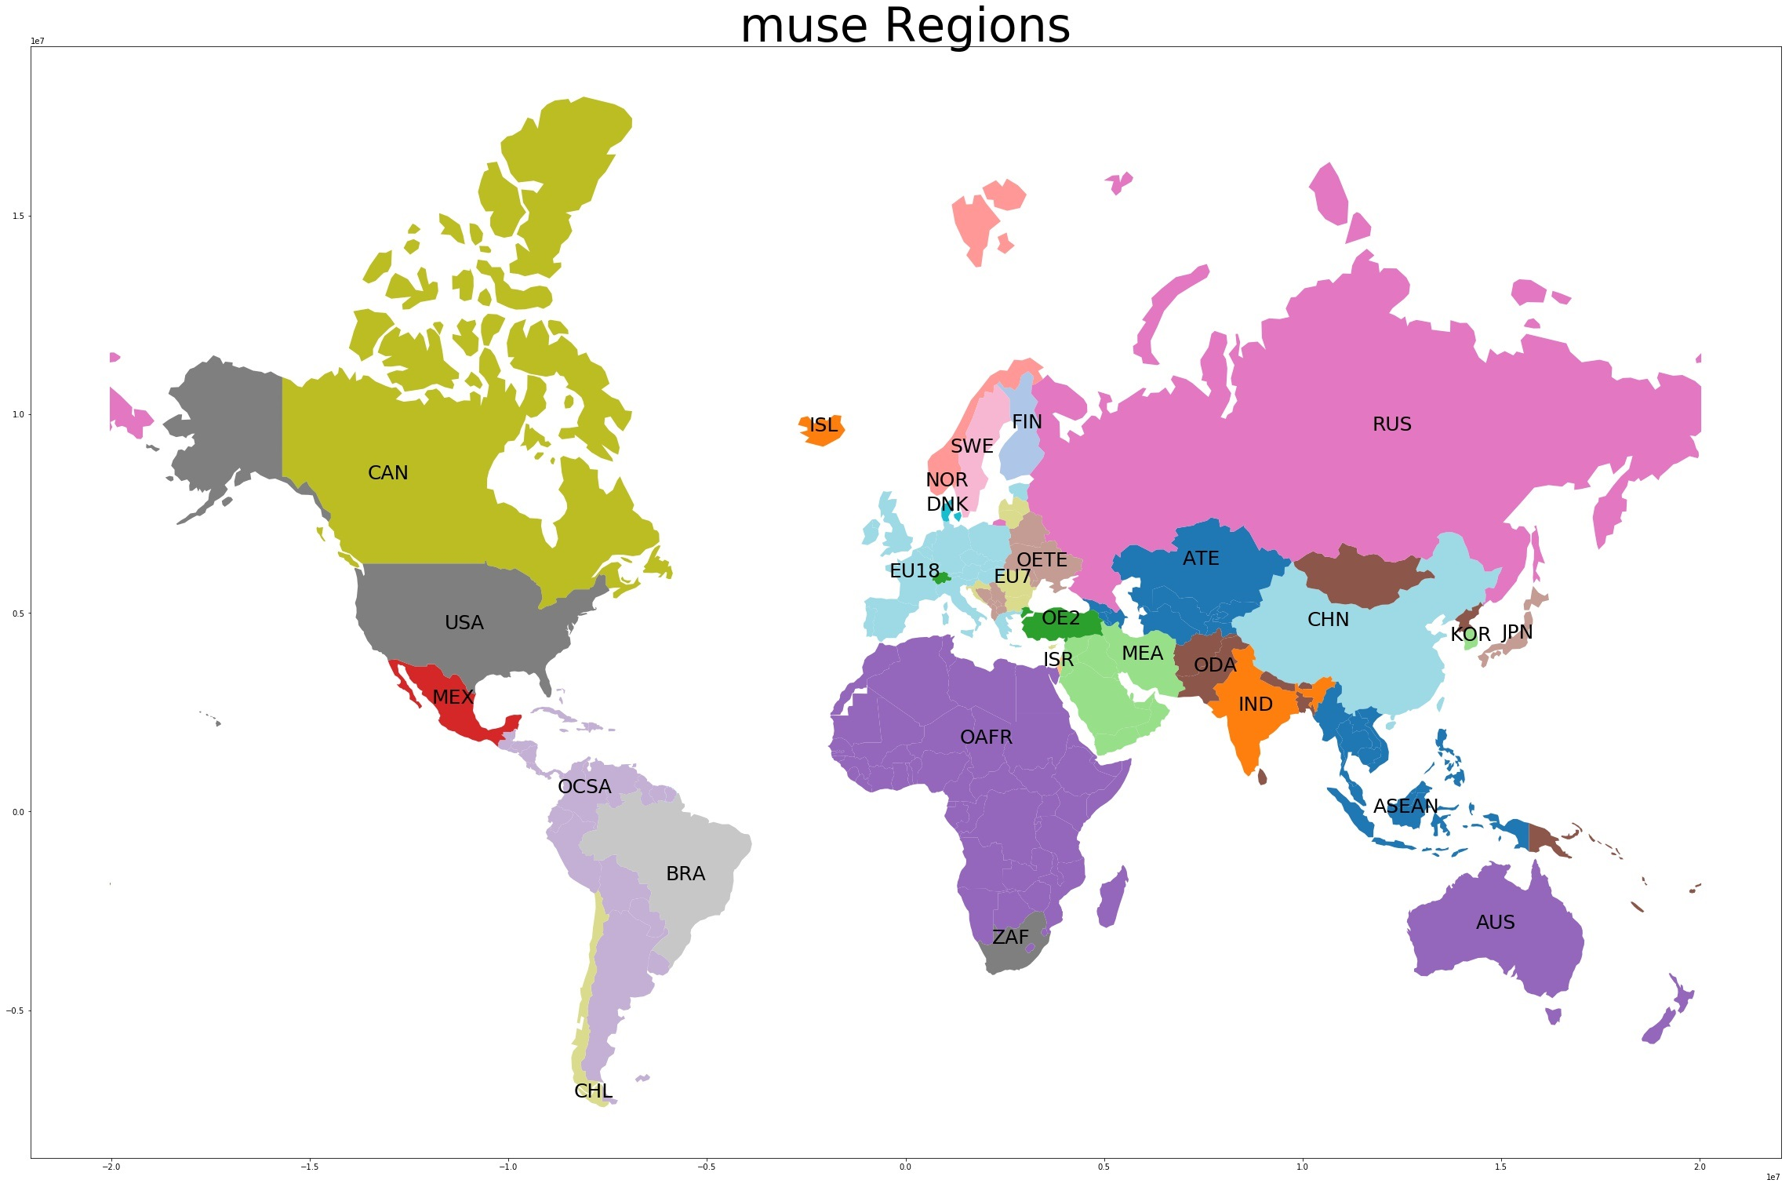
Structure
MUSE
27 January 2021
MUSE Regions
Flexible time horizon
2010 to 2100
Each period disaggregated into flexible timeslices
Summer, winter, spring, autumn
Weekday, weekend
Morning, afternoon, evening etc.
Global scale
Flexible region definition

Slide 10
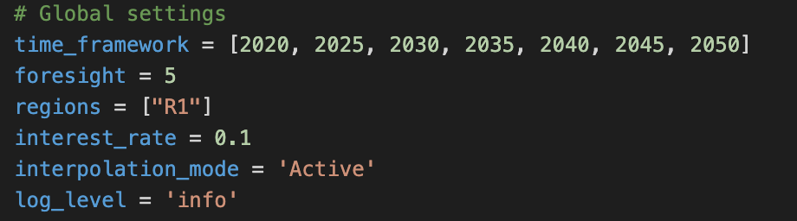
How to use MUSE?
MUSE
27 January 2021
User interface – no programming
Extendable
Multiple specification files
Technology characterization
Definition of environment
Timeslices and horizon
Hooks – integrate code with MUSE.
New consumers’ or firms’ objectives
Record new data outputs etc
Python code open source
Example input

Slide 11
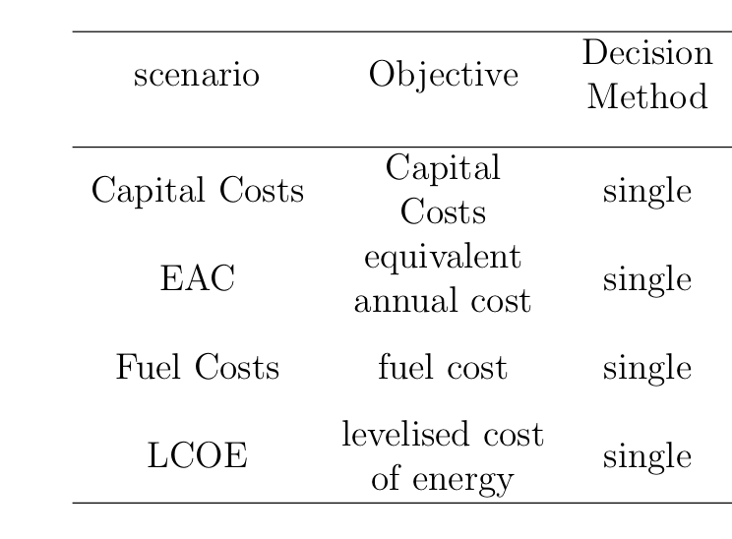
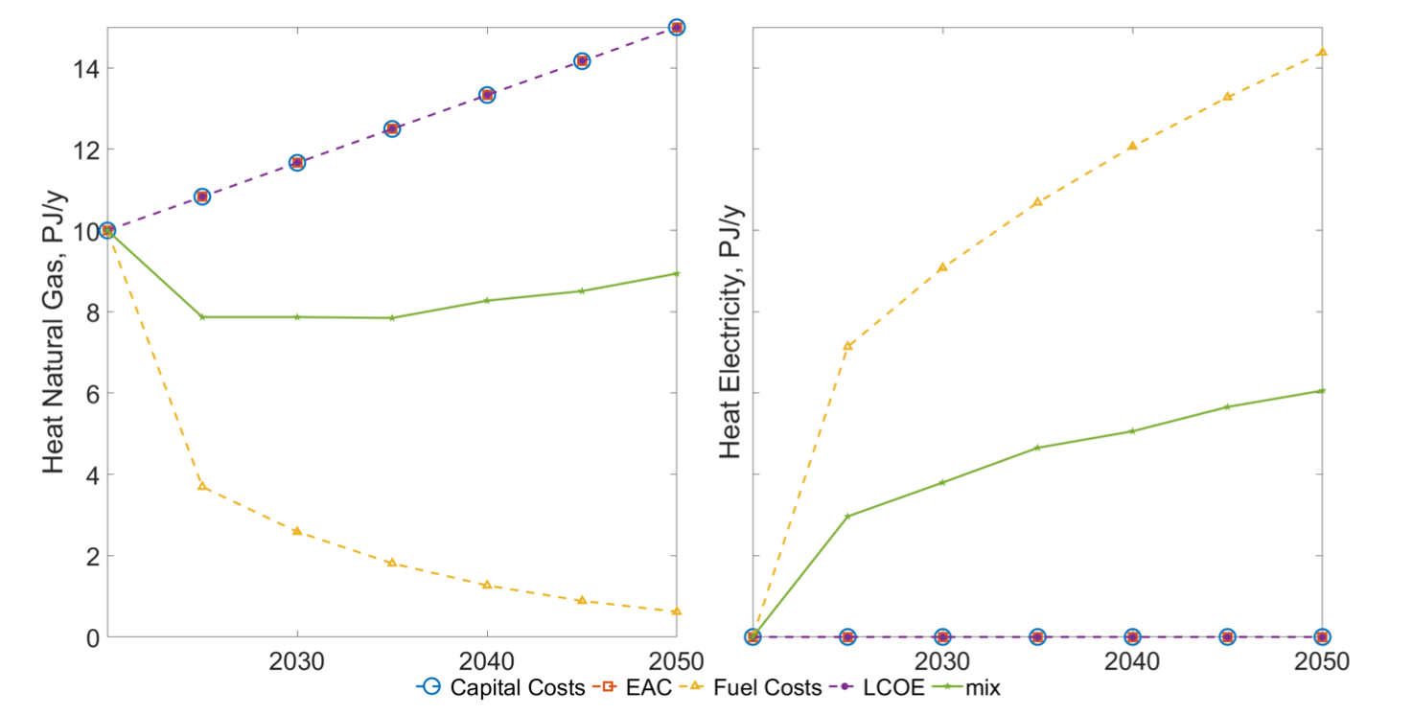
Example scenarios
27 January 2021
Running scenarios with MUSE.
Single-agent scenario
Heat generation (PJ/y): gas boilers (left) and heat pumps (right)
Minimisation of capital costs, LCOE and EAC favour gas boilers.
Minmisation of fuel costs favour heat pumps.

Slide 12
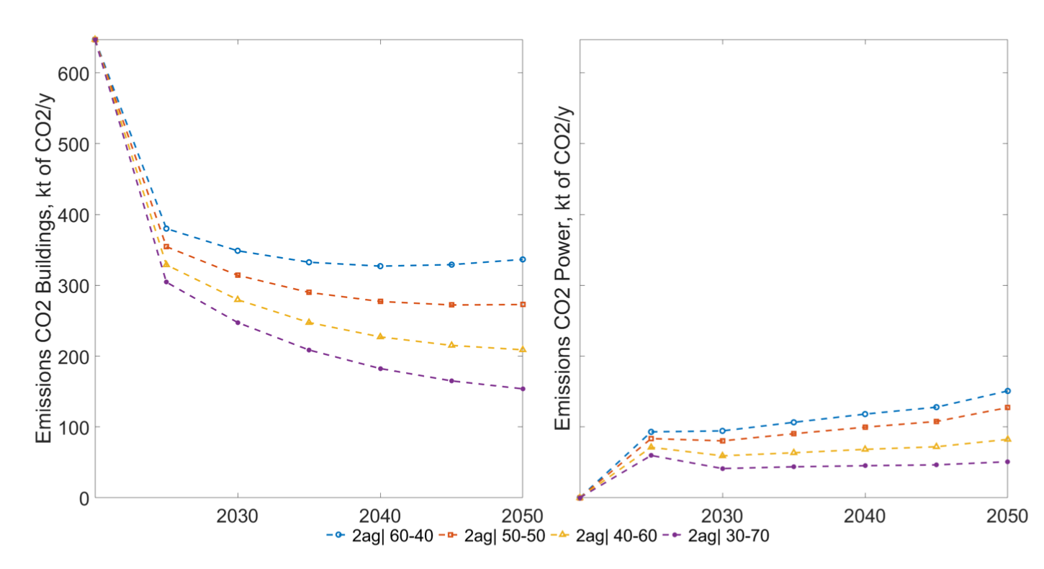
Example scenarios
27 January 2021
Heterogenous investor scenarios
Different power sector investor characteristics exhibit differing scenario trajectories
(2ag|60-40) scenario favours natural gas due to higher capital costs weighting of objectives
(2ag|30-70) scenario favours wind due to higher emissions costs weighting.
Scenarios with 2 agents at 40-60, 50-50, 60-40 and 70-30 % of the population. Primary energy of the system (PJ/y): natural gas (left) and wind (right)

Slide 13

Heterogenous population modelling
Population modelling
27 January 2021
Cost optimal solution assumes:
Economic rationality
Homogenous decision metrics
Sudden switching
Differing population characteristics:
Budget
Values
Perception of technologies
Comfort levels
Can lead to different macro system

Slide 14

Heterogenous population modelling
Population modelling
27 January 2021
Divide population into subcategories
Use of population data, GDP, urbanization data
Use of survey data (no single source for different regions)
Characterise population subcategories
Budget
Search strategy
Decision method
Location
Investments made based upon these characteristics

Slide 15
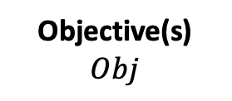


Heterogenous population modelling
Population modelling
27 January 2021
Search Space
$$SP$$
Objective(s)
$$Obj$$
Decision Strategy $DS$
Find all available alternatives
Find same type or fuel
Find popular alternatives (society, past decisions, peer group, etc.)
Find mature alternatives
Economic (capital, payback, NPV, etc.)
Environmental impact (energy consumption, CO2, etc.)
Comfort
One objective
Multiple objectives
Weighted sum
Epsilon-constraint
Lexicographic strategy

Slide 16
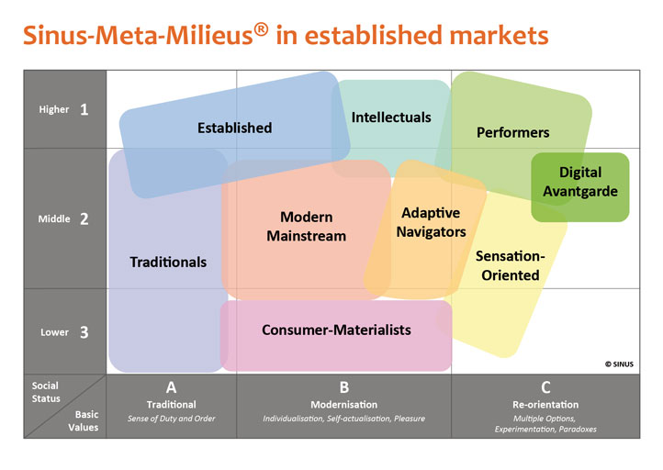
Population modelling
27 January 2021
Heterogenous population modelling
Agent Group | Quantity, % | Budget, MUS$
modern performers1 | 0.008 | 3600
modern performers2 | 0.081 | 3600
Post-materialists1 | 0.026 | 2600
Post-materialists2 | 0.084 | 2600
ground breaker1 | 0.011 | 2300
ground breaker2 | 0.057 | 2300
pleasure seeker1 | 0.016 | 4200
pleasure seeker2 | 0.125 | 4200
quite peaceful Britain1 | 0.018 | 4200
quite peaceful Britain2 | 0.168 | 4200
Precarious | 0.113 | 1600
Established | 0.102 | 2100
Traditional | 0.191 | 2400
Groups population according to their social status and basic values [1]
Based on market research
Plus Survey data (income, age, building types, household expenditure)
[1] Sachs, Julia, et al. "An agent-based model for energy investment decisions in the residential sector." Energy 172 (2019): 752-768.

Slide 17
Study aims
Population modelling
27 January 2021
Benefits of agent-based modelling (ABM)
Comparison of ABM to single-objective function
Determine diffusion of technologies between 2010– 2100 in the USA
Assumptions
Macrodrivers Shared Socioeconomic Pathways (SSPs) by IIASA
Agents have limited foresight of 5 years
Capacity addition limits for single objective case:
10% growth
20% maximum addition of installed capacity

Slide 18
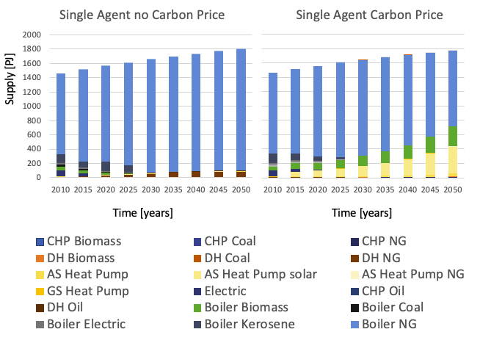
Example scenarios
27 January 2021
UK residential space heating scenario results
Natural gas boilers remain the dominant heating technology
Reliable
Cheap
Trusted
Carbon price scenario:
Heat pumps
Biomass boiler
Space heating technology scenarios

Slide 19
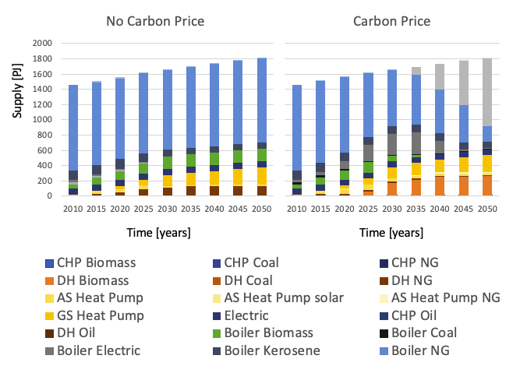
Example scenarios
27 January 2021
UK residential space heating scenario results
Energy efficient technologies uptake (e.g. heat pumps) regardless of carbon price.
Switch to biomass after 2030 in both scenarios
Wide spectrum of technologies during transition
Investment in hydrogen by lower class or middle-low class
Transition technologies show alternating market share but vanish over long-term
Multi-agent space heating technology scenarios

Slide 20
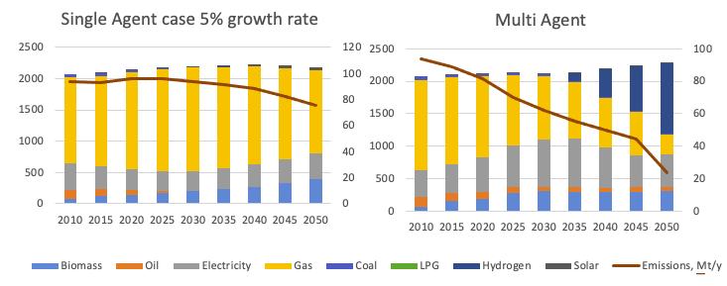
Example scenarios
27 January 2021
UK residential space heating scenario results
Multi-agent scenario achieves greater progress in sector carbon emissions
Wider spectrum of uptake in technologies.
Multi-agent space heating technology scenarios

Slide 21
Conclusions
27 January 2021
Conclusions
The MUSE Agent-based model allows for heterogenous decision making
Open source with code and tutorials available
Generalizable to model any industry
Broad representation of the population
Not based purely on cost minimization
Multi-agent space heating technology scenarios

Slide 22
