Slide 1
Data Science Capstone Project
Alexander Kim
9/21/21

Slide 2

Outline
Executive Summary
Introduction
Methodology
Results
Conclusion
Appendix

Slide 3

Executive Summary
Summary of methodologies
Summary of all results

Slide 4

Introduction
SpaceY is an rapidly growing commercial rocket company looking to compete with industry staples such as SpaceX. SpaceX has been so successful because of their ability to recover the first stage of their rockets after being used, saving a significant amount of cost. The goal of this project was to determine the price of a rocket launch using publicly available SpaceX data. The project also attempted to predict if a rocket’s first stage would land successfully using a machine learning model and the same dataset.

Slide 5
Methodology

Slide 6
Data collection
The data was collected using several calls to the SpaceX REST API.
Steps:
GET request was sent to acquire the data in the form of a JSON from the SpaceX API
JSON was normalized into Pandas dataframe
Data was converted from ID numbers to human-readable data using additional GET requests to the SpaceX API
Github: Data Collection with API

Slide 7
Data collection – SpaceX API
GET
Acquire data JSON and normalize into dataframe
GET
GET
GET
GET
Acquire launch site names from launchpads API
Acquire launch site names from rockets API
Acquire launch site names from payloads API
Acquire launch site names from cores API
getLaunchSite()
getBoosterVersion()
getPayloadData()
getCoreData()

Slide 8
Data collection – Web scraping
GET
Acquire Falcon9 HTML page
Present your web scraping process use key phrases and flowcharts
Github:
Data Collection with Webscraping
DataFrame
Pass extracted columns into Pandas dataframe
Soup
Create BeautifulSoup object from HTML response
Headers
Data
Parse BeautifulSoup object and process and extract data for each column
Parse BeautifulSoup object and extract column headers
8

Slide 9
Data wrangling
First, any missing values in the Payload Mass column were replaced with the mean of the column. Next, the Orbit column was examined to find out the number of occurrences of each orbit type. Finally, one-hot encoding was applied to create an Outcome column, with 1 representing a successful launch, and 0 representing unsuccessful.
Github: Data Wrangling
Orbit Type
Find out occurrences of each orbit type (GEO, SSO, etc.) using value_counts()
Replace
9
9
Replace missing values in Payload Mass column with mean
One-Hot
Use One-Hot encoding to create a column that assigns a 1 to all successful mission, and a 0 to unsuccessful missions
9
9

Slide 10
EDA with data visualization
Summarize what charts were plotted and why used those charts
Flight Number vs. Launch Site was plotted as a scatter plot to figure out how the chosen launch site changed over time
Payload Mass vs. Launch Site was plotted as a scatter plot to discover if each launch site only handled rockets carrying a certain payload mass
Orbit vs. Success Rate was plotted as a bar chart to visualize the rate of success for each orbit type
Flight Number vs. Orbit was plotted as a scatter plot to discover if the intended orbit type of a rocket launch changed over time
Payload Mass vs. Orbit was plotted to discover if certain orbit types could only handle certain payload masses
The launch success yearly trend was plotted to analyze how the number of successful rocket launches changed from year to year.
Github: EDA with Data Visualization

Slide 11
EDA with SQL
Summarize performed SQL queries using bullet points
Distinct launch sites were extracted
5 arbitrary records from the CCAFS LC-40 launch site were extracted
The total payload mass carried by boosters launched by NASA (CRS) was calculated
The average payload mass carried by booster version F9 v1.1 was calculated
The date of the first successful landing outcome on the ground pad was extracted
The unique booster names that had successful landing on a drone ship and had a payload mass between 4000 and 6000 kg were extracted
The total number of successful and unsuccessful mission outcomes were extracted
The unique booster versions that were successfully able to carry maximum payload mass were extracted using a subquery
The month, landing outcome, booster version, and launch site were displayed for launches that failed to land on the drone ship in 2015
The count of successful landing outcomes were ranked in descending order between the date 2010-06-04 and 2017-03-20
Github: EDA with SQL

Slide 12
Build an interactive map with Folium
First, each unique launch site was plotted on the map.
Next, a marker cluster was created in order to map successful and failed launches for each launch site, in order to see which sites had the highest success rates.
Next, a mouse pointer was added to view exact coordinates on the map. Using the coordinate function, lines were drawn from each launch site to the nearest cities, railways, and coastlines in order to discover how close each launch site was to transportation and resource centers.
Github: Folium

Slide 13
Build a Dashboard with Plotly Dash
Four items were added to the dashboard:
First, a dropdown menu was added so the user could choose to visualize either the entire dataset or just one particular launch site.
Second, a pie chart was added so the user can visualize the launch success rate. The chart would display each launch site’s percentage of total success upon selecting the whole data set, and would display the success and failure percentages upon selecting an individual launch site.
Third, a range slider for payload weight was added so the user could filter visualizations to only include launches in a certain weight range.
Finally, a scatterplot was added to plot payload weight vs. launch outcome, with each data point being color coded based on booster type. This was added to help identify if certain payload weights led to higher launch success rates.
Github: Plotly Dash Lab

Slide 14
Predictive analysis (Classification)
Summarize how you built, evaluated, improved, and found the best performing classification model
You need present your model development process using key phrases and flowchart
Github: Predictive Analysis

Slide 15
Predictive analysis (Classification)
Split
Preprocess
Split data into training and test sets using 80/20 (train/test) ratio
Remove “Class” (Y) column, standardize remaining (X) data using StandardScalar
Github: Predictive Analysis
Logistic Regression
Support Vector Machine
Decision Tree
K-nearest neighbors
Use GridSearchCV with 10 fold cross-validation on logistic regression model to find optimal parameters, then train model. Calculate accuracy on test set.
Use GridSearchCV with 10 fold cross-validation on SVM model to find optimal parameters, then train model. Calculate accuracy on test set.
Use GridSearchCV with 10 fold cross-validation on decision tree classifier model to find optimal parameters, then train model. Calculate accuracy on test set.
Use GridSearchCV with 10 fold cross-validation on k-nearest neigbors model to find optimal parameters, then train model. Calculate accuracy on test set.

Slide 16
EDA with Visualization

Slide 17
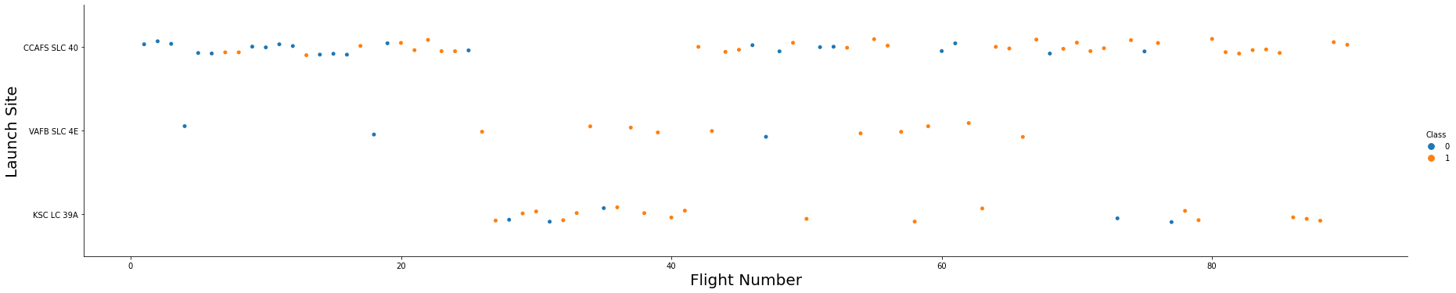
Flight Number vs. Launch Site
This chart shows that many of the early flights were at the launch site CCAFS SLC-40, but then briefly moved to site KSC LC-39A, before returning to the first site. It also shows that site VAFB SLC-4E has had very few and sporadic launches

Slide 18
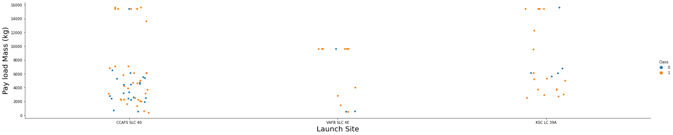
Payload vs. Launch Site
This chart shows that launches at CCAFS SLC-40 were mainly low payload mass (<8000kg) or near maximum payload mass (~16000kg), with a significant gap in between those two values. Site KSC LC-39A showed a similar distribution, albeit with less data points

Slide 19
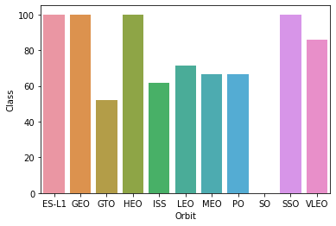
Success rate vs. Orbit type
ES-L1, GEO, HEO, and SSO all have a 100% success rate. In contrast, SO has a 0% success rate

Slide 20
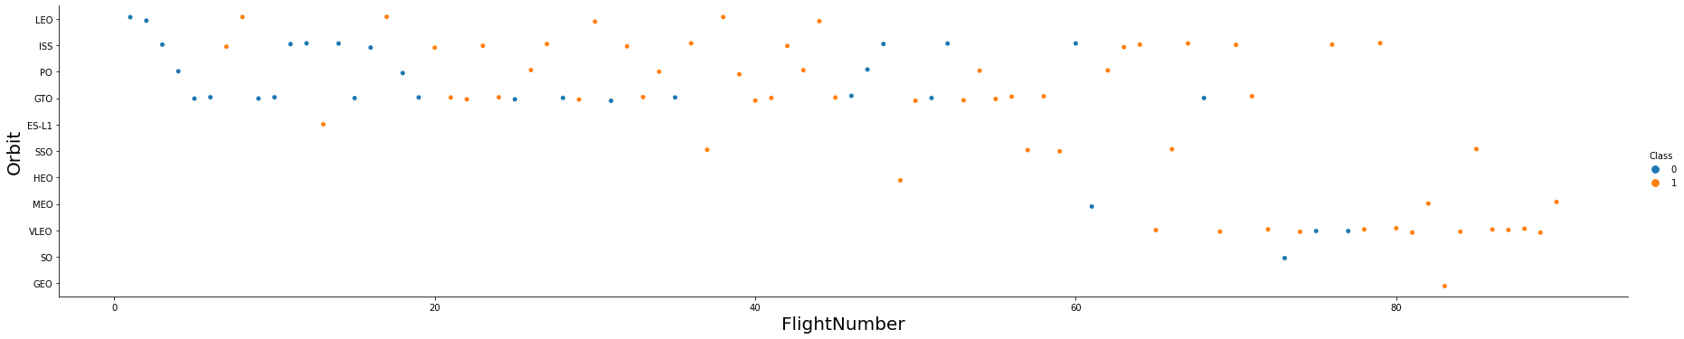
Flight Number vs. Orbit type
This chart shows that most of the early launches had orbital patterns that were around low-earth orbit (LEO, ISS, GTO), while the later launches began to shift to almost exclusively VLEO orbital patterns

Slide 21
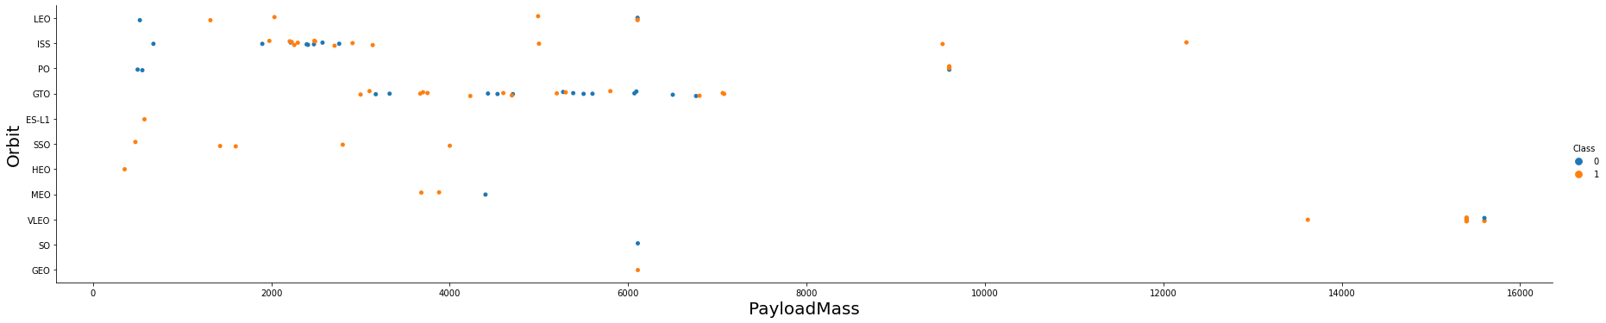
Payload vs. Orbit type
This chart shows that heavier payloads have a negative impact on the success rate of GTO orbits, and a positive impact on the success rate of Polar LEO (ISS) orbits.

Slide 22
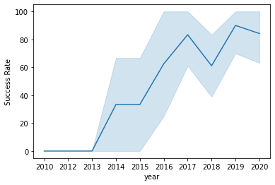
Launch success yearly trend
This chart shows that the launch success rate has steadily increased from 2013 through 2020.

Slide 23
EDA with SQL

Slide 24
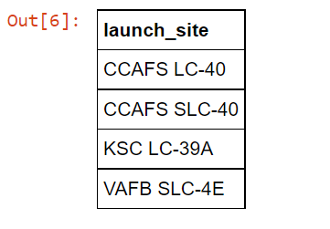
All launch site names
There are 4 unique launch sites: CCAFS LC-40, CCAFS SLC-40, KSC LC-39A, and VAFB SLC-4E

Slide 25
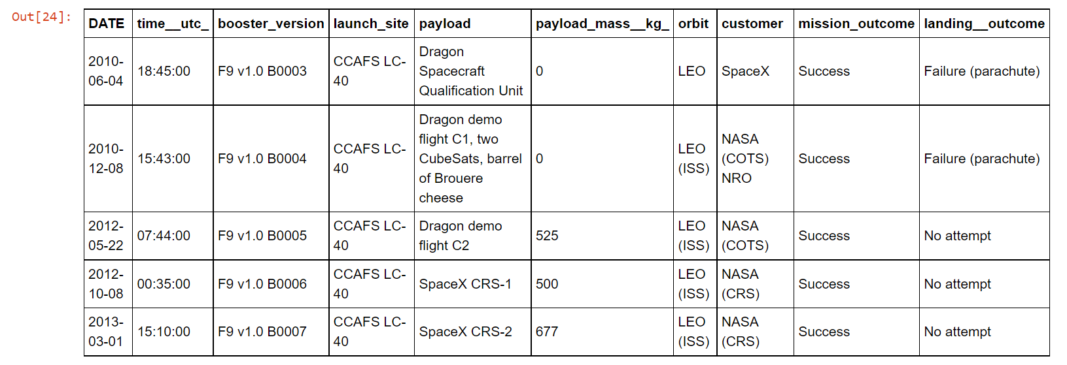
Launch site names begin with `CCA`
This shows 5 records with the launch site name beginning with CCA

Slide 26
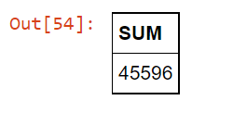
Total payload mass
The total payload mass carried by boosters launched by NASA is 45,596 kg

Slide 27
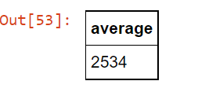
Average payload mass by F9 v1.1
The average payload mass carried by booster version F9 v1.1 is 2,534 kg.

Slide 28
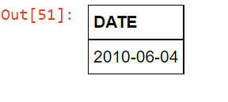
First successful ground landing date
The first successful ground landing date was June 4th, 2010

Slide 29
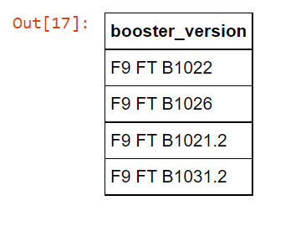
Successful drone ship landing with payload between 4000 and 6000
Four F9 FT booster versions carrying a payload between 4000 kg and 6000 kg have successfully landed on a drone ship: B1022, B1026, B1021.2, and B1031.2.

Slide 30
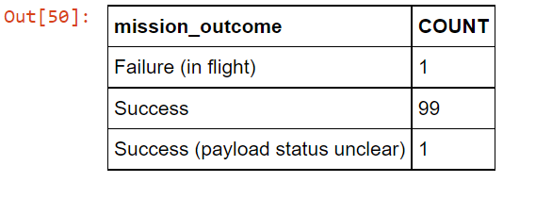
Total number of successful and failure mission outcomes
Out of the 101 missions, 100 have been labeled successful, with only 1 failure

Slide 31
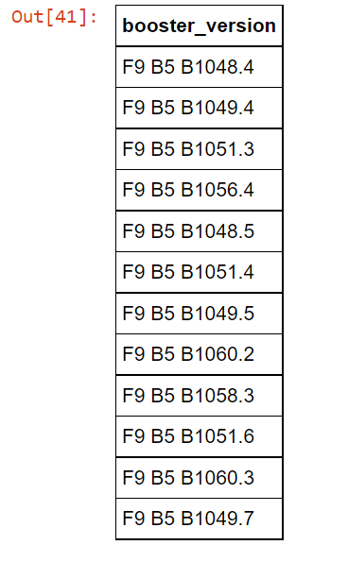
Boosters carried maximum payload
This chart shows all of the different booster versions that have carried the maximum payload

Slide 32
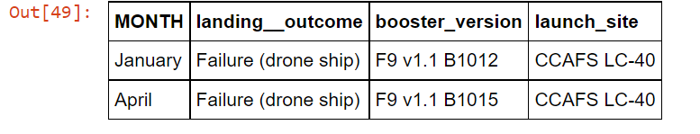
2015 launch records
This chart shows that there were only 2 launches in the year 2015, both of which had failed landing outcomes and both of which launched from CCAFS LC-40. One launched in January and one launched in April.

Slide 33
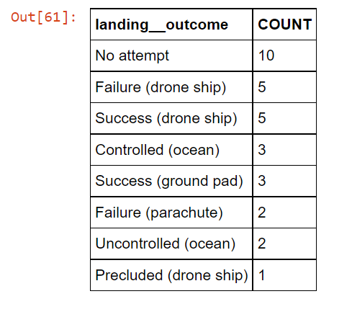
Rank success count between 2010-06-04 and 2017-03-20
This chart shows a count of all the different landing outcomes between the dates June 4th, 2010 and March 20th, 2017.

Slide 34
Interactive map with Folium

Slide 35
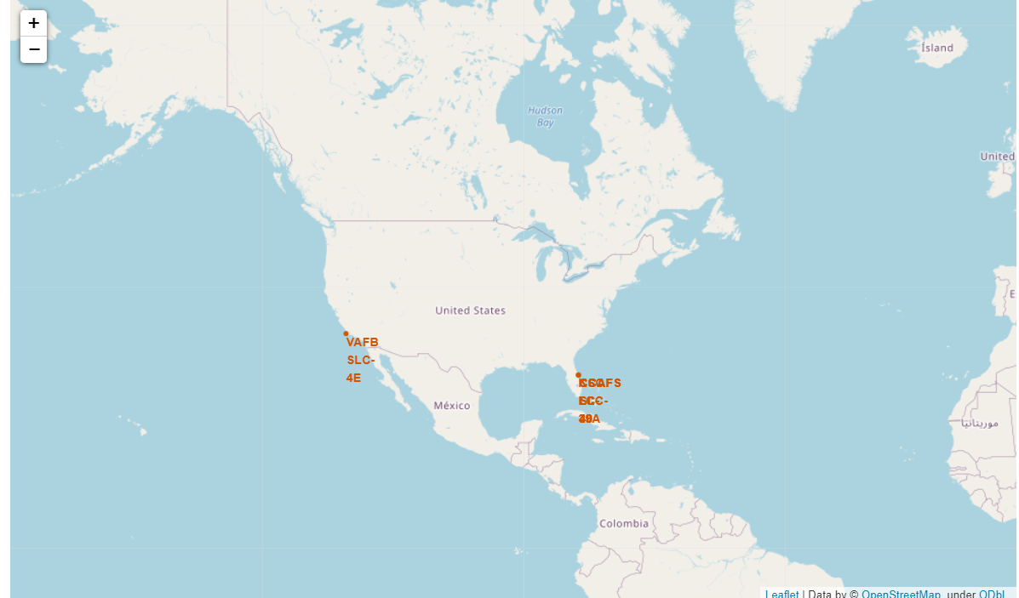
Global Launch Site Locations
There are three global launch sites: VAFB SLC-4E is located in southern California, and the remaining sites are located in Florida

Slide 36
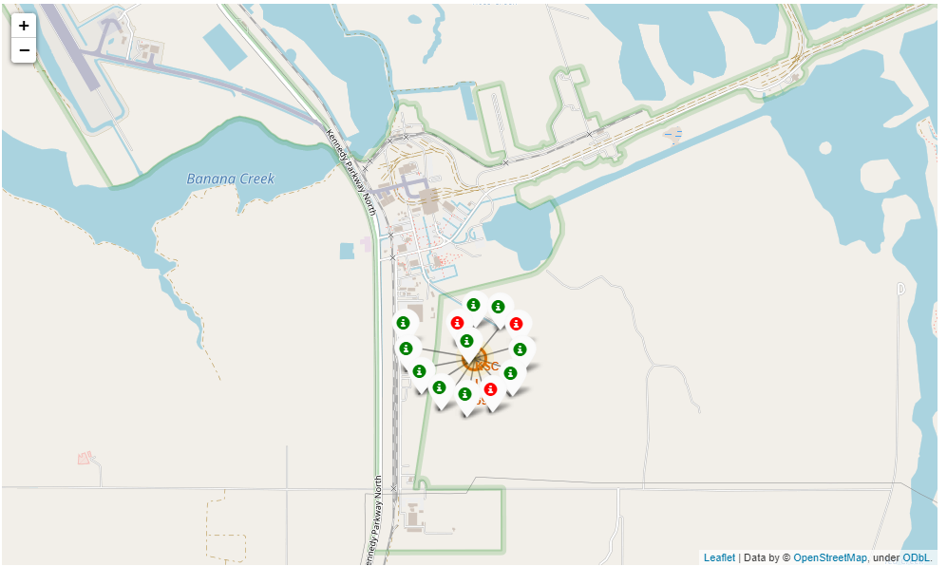
Color-coded Launch Records for Site KSC LC-39A
The red launch labels represent failures, whereas the green launch labels represent successes. There are 13 total launches, with 3 failures and 10 successes

Slide 37
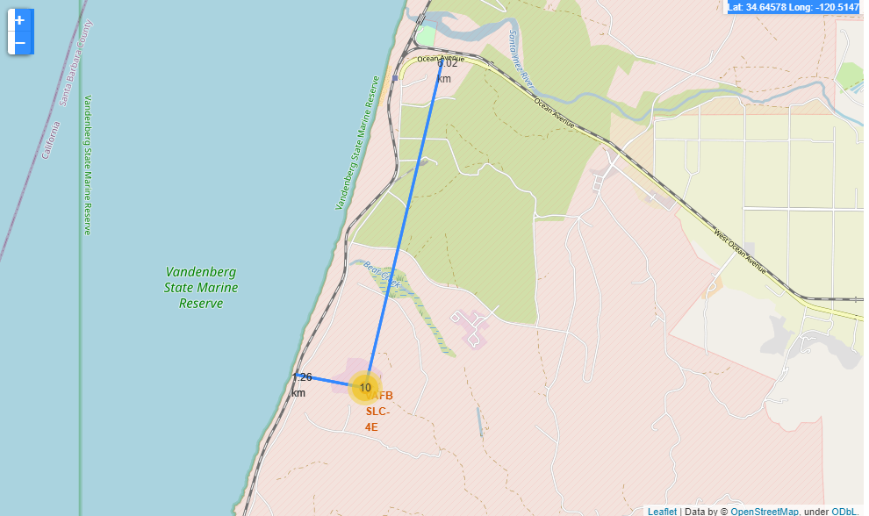
Notable Proximities for Site VAFB SLC-4E
This site is located 1.26 kilometers from the Santa Barbara Subdivision M1 railway, and 6.02 kilometers away from the nearest road Ocean Avenue

Slide 38
Build a Dashboard with Plotly Dash

Slide 39
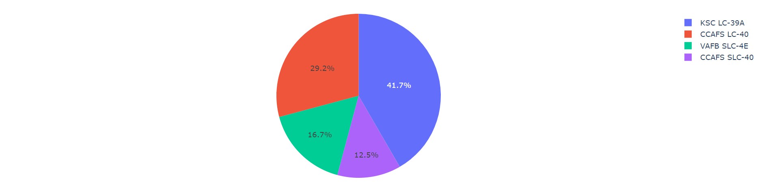
Launch Successes for All Sites
The chart shows that the KSC LC-39A launch site had the highest percentage of successes, while the CCAFS SLC-40 launch site had the lowest percentage of successes.

Slide 40
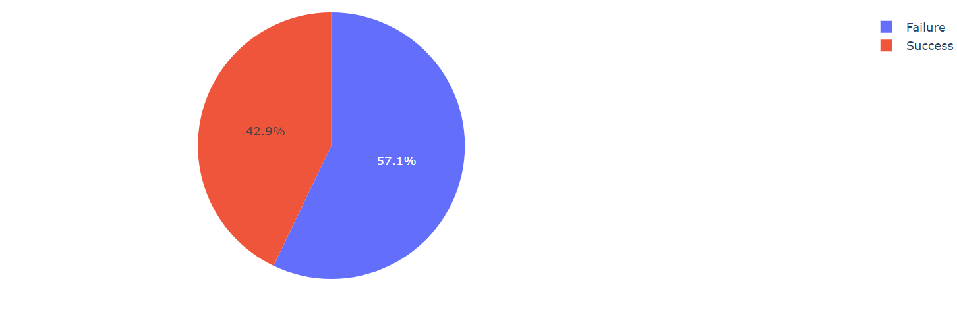
Launch Success Rate for Site CCAFS SLC-40
This chart shows that the launch success rate at site CCAFS SLC-40 was around 57%, while the failure rate was around 43%.

Slide 41
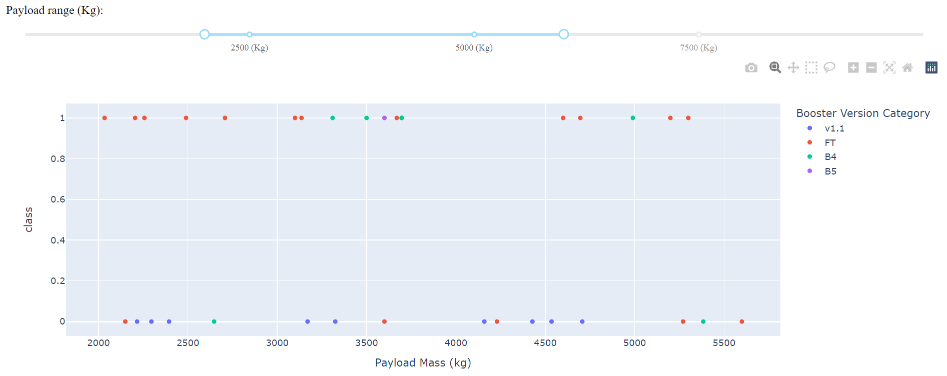
Payload Weight vs. Launch Outcome (2000kg – 6500kg) (All Sites)
There doesn’t appear to be a correlation between payload mass and launch outcome for this weight range. However, it does appear that booster v1.1 has a higher failure rate than other boosters, and than booster FT has a higher success rate than other boosters.

Slide 42
Predictive analysis (Classification)

Slide 43
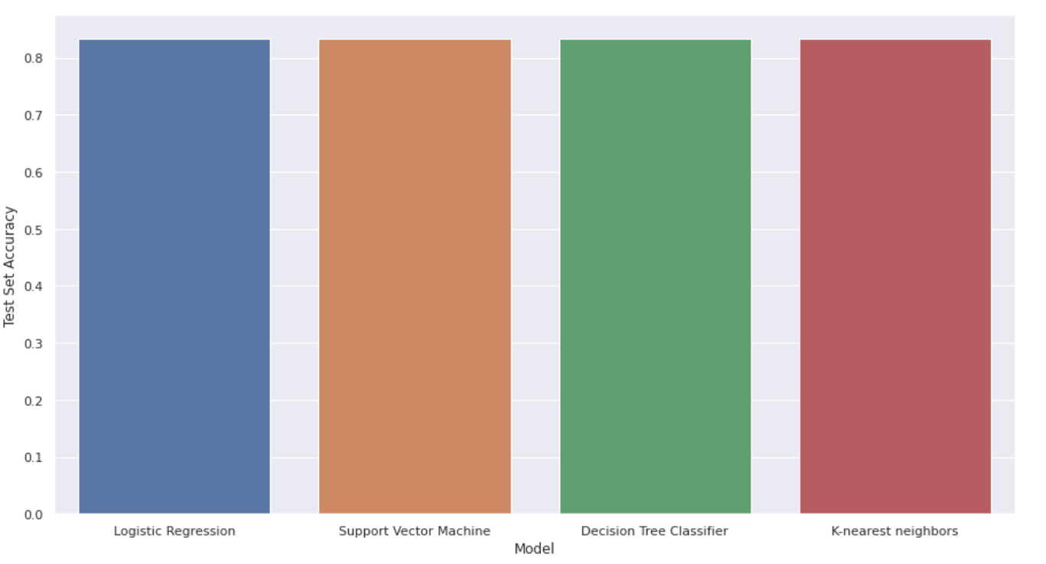
Classification Accuracy
All of the models had the same classification accuracy of ~83%

Slide 44
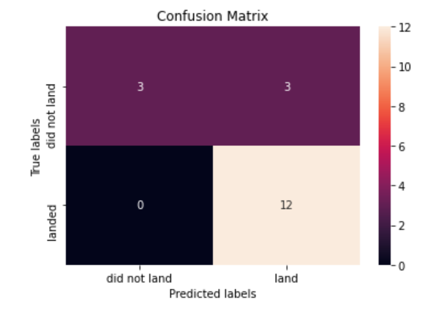
Confusion Matrix
Of the 18 test set data points, 15 were correctly predicted. There were 12 true positives and 3 true negatives. Of the 3 incorrectly predicted data points, all were false positives.

Slide 45

CONCLUSION
Point 1
Point 2
Point 3
Point 4
…

Slide 46

APPENDIX
All relevant assets can be found in the following Github repo: Repo

