Slide 1
Rewards Customer Health Segmentation
January 2017

Slide 2
Executive Summary
Rewards partnered with The George Institute (TGI) in 2016 to provide WR:
Access to TGI’s database which includes product ingredients and nutritional information as well as health star ratings (HSRs);
Access to additional content related to health, and ability to use that content and TGI’s branding in communications to members;
In each case, WR is permitted to use the data / content in relation to delivering personalised health offers and content to WR members only
The TGI dataset maps well to our data-set, with ~95% coverage of applicable grocery products
Using the TGI data (at a product level) we have developed a segmentation to categorise members by their healthiness at a unique customer level
Health Nut: Big focus on healthy products
Trying to be healthy: Buy healthy products, but not as committed as “Health Nuts”
Healthy when I can afford: Buy healthy products when they are discounted
Health a lower priority: More likely to buy non-health
Health agnostic: Rarely buy healthy products
We created the segmentation via K-means clustering performed at member level based on individual shopping behaviours mapped to HSR
Although we understand that the HSR has some limitations, it generally proved demonstrative through the clustering process (indicative of reliability at an aggregate level)
This segmentation is facilitating below-the-line campaign planning at a segment level, as we leverage personalised healthy product offers by leveraging the personalisation engine
In addition, we have used modelling to determine dietary flags at a unique customer level – currently:
253k member households can comfortably be regarded as gluten free, and 304k member households as lactose intolerant
These attributes will continue to be developed, though in some cases we will require guidance from nutritional experts
These attributes are key to our evolving unique member DNA, continuing to allow us to enhance our personalised engagement

Slide 3

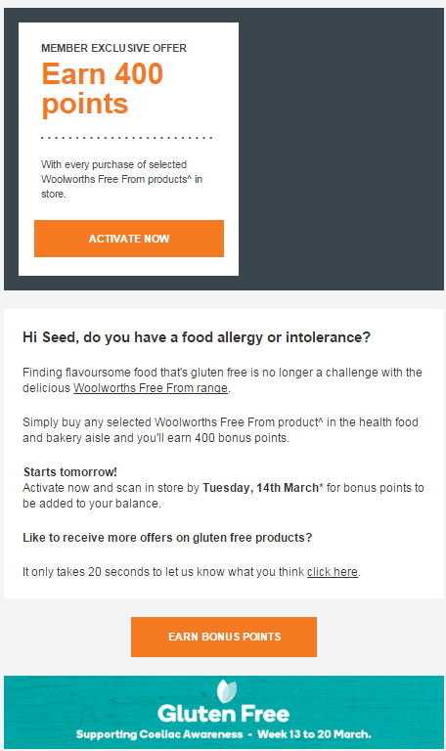
We can engage with members around health as well as unique preferences or dietary requirements
The personalisation engine is integrated with our health segmentation
This allows us to engage with members around unique preferences or dietary requirements – i.e., gluten free, lactose free, etc.
Personalised engagement reflected in high open and activation rates of ~45%
Effectiveness of targeting demonstrated by 40% increase in targeted customers shopping the product range during campaign period

Slide 4
AGENDA
1. What is the TGI Data and how did we segment (slide 4-6)
2. What is our segmentation (slide 7-8)
3. Validating our segmentation (slide 9-11)
4. What do our segments look like (slides 12-16)
5. Sizing success from driving health through WR (slide 17)
6. Our dietary attributes and opportunities (slides 18-19)
Appendix

Slide 5
Good Match Rate Between TGI Data and Woolworths Products
1. What is the TGI Data and how did we segment
TGI Data includes nutritional attributes, ingredients, health star ratings and other dietary flags (gluten free etc)
Of the total 37.1k SKUs in our database*, 23.8k have been mapped to TGI Data and HSR ratings.
Excluding the ‘inactive/not found’ and ‘not applicable category’ SKUs, the match rate is 95%.
The HSR range from 0 to 5 with items rated 5 being the most healthy item.
The matched SKUs distributed fairly evenly across the HSR range with most concentration in 4 and 3.5.
In terms of sales($), the HSR 5 level contribute most at 22%; the range 4 to 5 makes up 33%.
Not ranged / sold
95% Coverage
* As at end of Sept 2016.

Slide 6
HSR 5 Mainly Made of Fruit and Vegetables While Meat/Fish Make Up Mostly for HSR 4.5 and 4: The strongest clustering was produced by aggregating the HSRs into 5 buckets
1. What is the TGI Data and how did we segment
PRODUCE - VEG / FRESHCUTS /
HARD PRODUCE
PRODUCE
LIFESTYLE/WATER NON CARBONATED
DAIRY - MILK
FREEZER - VEGETABLES
1
2
3
4
5
CONFECTIONERY BISCUITS SERVICED DELICATESSEN DAIRY - BUTTER & MARGARINE COOKING NEEDS
CARBONATED SOFT DRINKS
CONFECTIONERY
BISCUITS
DAIRY - CREAM
LIFESTYLE/WATER NON CARBONATED
DAIRY - CHEESE
CONFECTIONERY
MEAT
SERVICED DELICATESSEN
PROPRIETARY BAKERY
DAIRY - CHEESE
CONFECTIONERY
MEAT
SERVICED DELICATESSEN
PROPRIETARY BAKERY
BISCUITS
ICE CREAM
PROPRIETARY BAKERY
SNACKS
DAIRY - MILK
SERVICED DELICATESSEN
MEAT
COOKING NEEDS
FROZEN MEALS
SNACKS
PROPRIETARY BAKERY
MEAT
SERVICED DELICATESSEN
DAIRY - MILK
FROZEN MEALS
MEAT
SERVICED DELICATESSEN
DAIRY - EGGS
PROPRIETARY BAKERY
SEAFOOD
MEAT
SERVICED DELICATESSEN
BREAKFAST FOODS
SEAFOOD
PRODUCE - VEG / FRESHCUTS / HARD PRODUCE
%Sales:
86%
%Sales:
72%
%Sales:
58%
%Sales:
51%
%Sales:
48%
%Sales:
43%
%Sales:
45%
%Sales:
40%
%Sales:
45%
%Sales:
72%
0.5
1.0
1.5
2.0
2.5
3.0
3.5
4.0
4.5
5.0
Mainly Meat/ Seafood
Mainly Produce

Slide 7
Our Health Segmentation Approach
1. What is the TGI Data and how did we segment
Objective
To identify our members’ attitude to or focus on health based on their shopping behaviour to evolve our personalisation strategy.
Methodology
K-means clustering performed at member level based on individual shopping behaviours mapped to HSR.
The clustering variables include;
Each member’s spend distribution(%) across HSR range, and
Total spend (standardised)
Other data treatment performed include;
Produce category spend excluded
HSR level further collapsed to few levels: 0 – 1.5, 2 – 2.5, 3 – 3.5, 4, 4.5 – 5
Outcome
5 distinct clusters of members identified based on their shopping choices across the HSR range.
We undertook 5 different approaches to triangulate to the most robust output

Slide 8
Rewards customer health segmentation helps to understand each customer’s focus on health
2. What is our segmentation
TO BE UPDATED
Healthiness
Health Nuts
‘Buys mostly from healthy products’
17% of total members
16% member sales
56% of sales is healthy
A ‘Health Nut’ spends ~5 times* more on healthy products and ~2 times more in total than an ‘Unhealthy Individual’.
Trying To Be Healthy
‘Buys relatively more of healthy products’
18% of total members
15% member sales
56% of sales is healthy
Healthy When I Can Afford
‘Buys mixed amount of healthy products’
17% of total members
18% member sales
29% of sales is healthy
Health Low Priority
‘Buys mostly from unhealthy products’
34% of total members
45% member sales
28% of sales is healthy
Health Agnostic
‘Buys mostly from unhealthy products’
13 % of total members
7% member sales
17% of sales is healthy
* Based on average spend on items from HSR 4 to 5 range.

Slide 9
Examining distribution of spend by HSR demonstrates the robustness of the segmentation – with one segment being similar but for price / affordability
2. What is our segmentation
* Based on average spend on items from HSR 4 to 5 range.

Slide 10
Applying the segmentation demonstrates distinct difference in spend distribution across sub-categories based on health
3. Validating our segmentation
Healthy
Unhealthy
Mix of top and bottom sub-categories by spend index of Health Nuts segment selected.

Slide 11
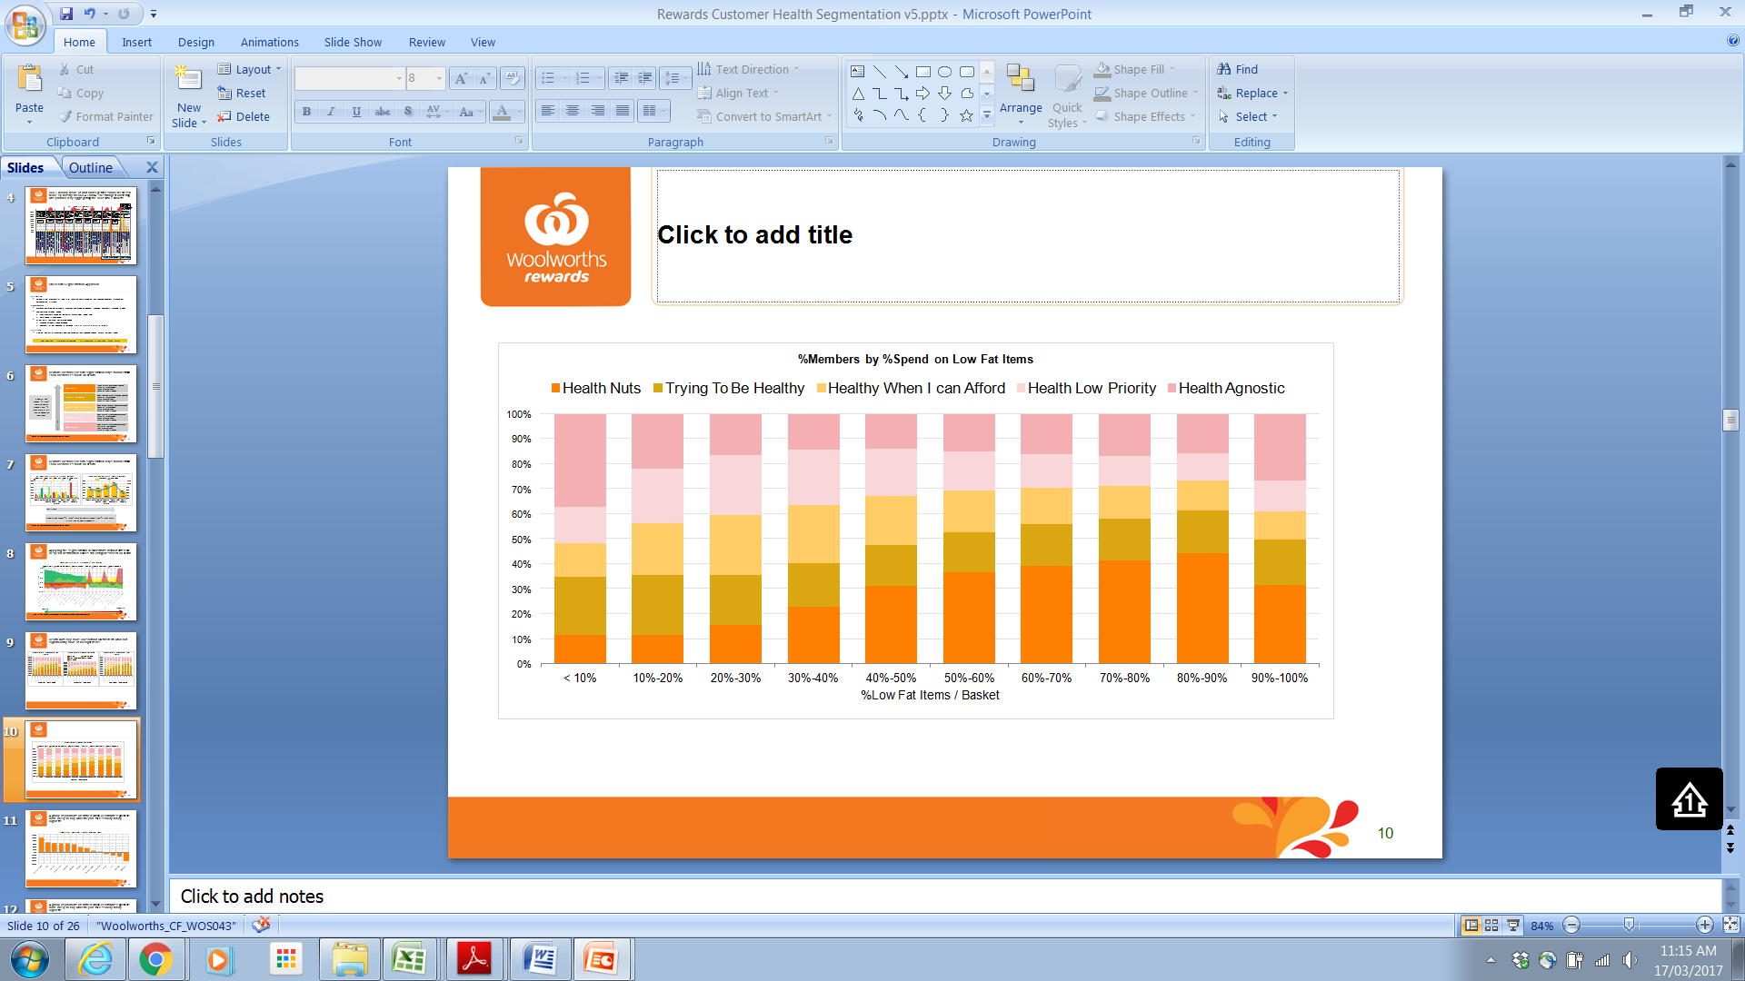
Health Nuts buy more low salt and low fat items while not significantly more of no sugar items *
3. Validating our segmentation
‘Health Nuts’ do not generally buy from categories which have ‘No Sugar’ option (likely to be processed food) so show little sign of sensitivity in the above chart.
‘Trying To Be Healthy’ on the other hand do show more sensitivity to ‘No Sugar’ items.
* The above analysis based on selected categories that contains wide range of salt/fat/sugar levels.

Slide 12
Health Nuts are more likely to buy health trending products, and far less likely to buy cigarettes
3. Validating our segmentation
‘Health Nuts’ over-index mostly in spend on ‘Macro Organic’ products.
While ‘Health Nuts’ also over index on Stevia and Chai, they under-index on their by-products.
‘Health Nuts’ also under-index significantly on cigarette.

Slide 13





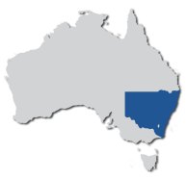




Health Nuts
4. What do our segments look like
17% Members
16% Sales
SHOPPING
Demographics
Avg Wkly Spend: $64 (-7%)
Avg Wkly Baskets #: 1.3 (-12%)
#Items / Basket: 13.0 (+3%)
Avg Basket Size ($): $50 (+5%)
BPM: Premium, 49% (+17ppt)
Gender: Female, 65% (+0ppt)
Avg Age: 47 (-1%)
Life-stage:
Older Singles/Couples, 24% (+2ppt)
State: NSW (+1ppt), Vic (-0ppt)
Membership
Engagement
Tenure: 5.2 years (+0%)
CVM:
LV (+1ppt); MVMEDA (-0ppt)
SOW: 50% (0ppt)
QFF: Unk (-3ppt), Join (-2ppt)
Avg Scan Rate**: 42% (+1ppt)
Engagement Score: 78 (+0%)
%Marketable: 81% (+0ppt)
* Percentage values in bracket represent the change over the full base average.
** Avg Scan rate based on adjusted total baskets by segment.

Slide 14
Trying To Be Healthy
4. What do our segments look like
18% Members
15% Sales
SHOPPING
Demographics
Avg Wkly Spend: $55 (-20%)
Avg Wkly Baskets #: 1.2 (-16%)
#Items / Basket: 11.7 (-8%)
Avg Basket Size ($): $45 (-5%)
BPM: Premium, 38% (+6ppt)
Gender: Female, 62% (-3ppt)
Avg Age: 49 (+3%)
Life-stage:
Older Singles/Couples, 26% (+4ppt)
State: NSW (+1ppt), Qld (+0ppt)
Membership
Engagement
Tenure: 5.2 years (+1%)
CVM:
LV (+5ppt); MVMEDA (-1ppt)
SOW: 48% (-2ppt)
QFF: Unk (-1ppt), Join (-1ppt)
Avg Scan Rate**: 42% (+2ppt)
Engagement Score: 78 (+0%)
%Marketable: 81% (-0ppt)
* Percentage values in bracket represent the change over the full base average.
** Avg Scan rate based on adjusted total baskets by segment.

Slide 15
Healthy When I Can Afford
4. What do our segments look like
17% Members
18% Sales
SHOPPING
Demographics
Avg Wkly Spend: $71 (+3%)
Avg Wkly Baskets #: 1.6 (+9%)
#Items / Basket: 12.9 (+2%)
Avg Basket Size ($): $45 (-6%)
BPM: Mainstream, 37% (+0ppt)
Gender: Female, 69% (+4ppt)
Avg Age: 47 (-1%)
Life-stage:
Older Families, 24% (+4ppt)
State: NSW (-2ppt), Vic (+3ppt)
Membership
Engagement
Tenure: 5.3 years (+1%)
CVM:
LV (-3ppt); MVMEDA (+3ppt)
SOW: 51% (+1ppt)
QFF: Unk (-1ppt), Join (+3ppt)
Avg Scan Rate**: 43% (+2ppt)
Engagement Score: 78 (+0%)
%Marketable: 83% (+2ppt)
* Percentage values in bracket represent the change over the full base average.
** Avg Scan rate based on adjusted total baskets by segment.

Slide 16
Health A Lower Priority
4. What do our segments look like
34% Members
45% Sales
SHOPPING
Demographics
Avg Wkly Spend: $97 (+40%)
Avg Wkly Baskets #: 1.8 (+26%)
#Items / Basket: 13.9 (+10%)
Avg Basket Size ($): $51 (+8%)
BPM: Mainstream, 40% (+2ppt)
Gender: Female, 68% (+3ppt)
Avg Age: 48 (+1%)
Life-stage:
Older Families, 22% (+2ppt)
State: NSW (-0ppt), Vic (-1ppt)
Membership
Engagement
Tenure: 5.2 years (+1%)
CVM:
MV (+2ppt); MVMEDA (+1ppt)
SOW: 54% (+4ppt)
QFF: Unk (+1ppt), Join (-1ppt)
Avg Scan Rate**: 37% (-4ppt)
Engagement Score: 77 (-0%)
%Marketable: 80% (-2ppt)
* Percentage values in bracket represent the change over the full base average.
** Avg Scan rate based on adjusted total baskets by segment.

Slide 17
Health Agnostic
4. What do our segments look like
13% Members
7% Sales
SHOPPING
Demographics
Avg Wkly Spend: $37 (-47%)
Avg Wkly Baskets #: 1.0 (-30%)
#Items / Basket: 10.4 (-18%)
Avg Basket Size ($): $36 (-24%)
BPM: Budget, 41% (+10ppt)
Gender: Female, 63% (-2ppt)
Avg Age: 45 (-5%)
Life-stage:
Young Singles/Couples, 21% (+5ppt)
State: NSW (+0ppt), Vic (+1ppt)
Membership
Engagement
Tenure: 4.9 years (-5%)
CVM:
LV (+14ppt); LVLFB (+9ppt)
SOW: 42% (-8ppt)
QFF: Unk (+6ppt), Join (-0ppt)
Avg Scan Rate**: 40% (-1ppt)
Engagement Score: 77 (-1%)
%Marketable: 81% (+0ppt)
* Percentage values in bracket represent the change over the full base average.
** Avg Scan rate based on adjusted total baskets by segment.

Slide 18
A conservative estimate would suggest that encouraging members to be healthier could deliver ~$25m of sales per annum
5. Sizing success from driving health through WR
 | Health Nuts | Trying to be healthy
Avg Basket Size | $50 | $45
Avg Weekly Spend | $66 | $57
Number of members | 1.0m | 1.1m
If we get x% of members to be healthier, based on basket size (no increase in shops/week) = A$m per annum
Driving members to be healthier, defined as converting “Trying to be healthy” to “Health nuts”
If we get x% of members to be healthier, based on avg weekly spend = A$m per annum
This estimate does not include additional upside from increasing the basket size / average weekly spend of members in lower segments by introducing more health into their basket

Slide 19
Target Gluten Free Conscious households;Total of 253k Identified as Potential Gluten Free Conscious Customers
6. Our dietary attributes and opportunities
As well as providing HSR, TGI further provides Gluten Status for each food item.
Mapping the status to the members’ transactions we can select customers most likely to be gluten conscious.
253k members identified who have not purchased any items with ‘Contains Gluten’ status.
As at end of Sept 2016 and out of 37,129 overall products (exclude non-food)
Based on transactions during 8 week period to end of Sept 2016.

Slide 20
Target Lactose Intolerant Customers households;Total of 304k Identified as Potential Lactose Intolerant Customers
6. Our dietary attributes and opportunities
The article names analysed to flag items that contains the word ‘lactose’.
Using the flag, potential lactose intolerant shoppers identified if they purchased any of the flagged items in the 8 week period analysed.
5% (approx. 304k customers) of members purchased these items.
78% shopped at categories that included lactose flagged items but they didn’t shop any.
17% didn’t shop in any categories that includes lactose flagged items.
* Based on transactions during 8 week period to end of Sept 2016. Spending exclude categories without the lactose flagged items.

Slide 21
APPENDIX

Slide 22
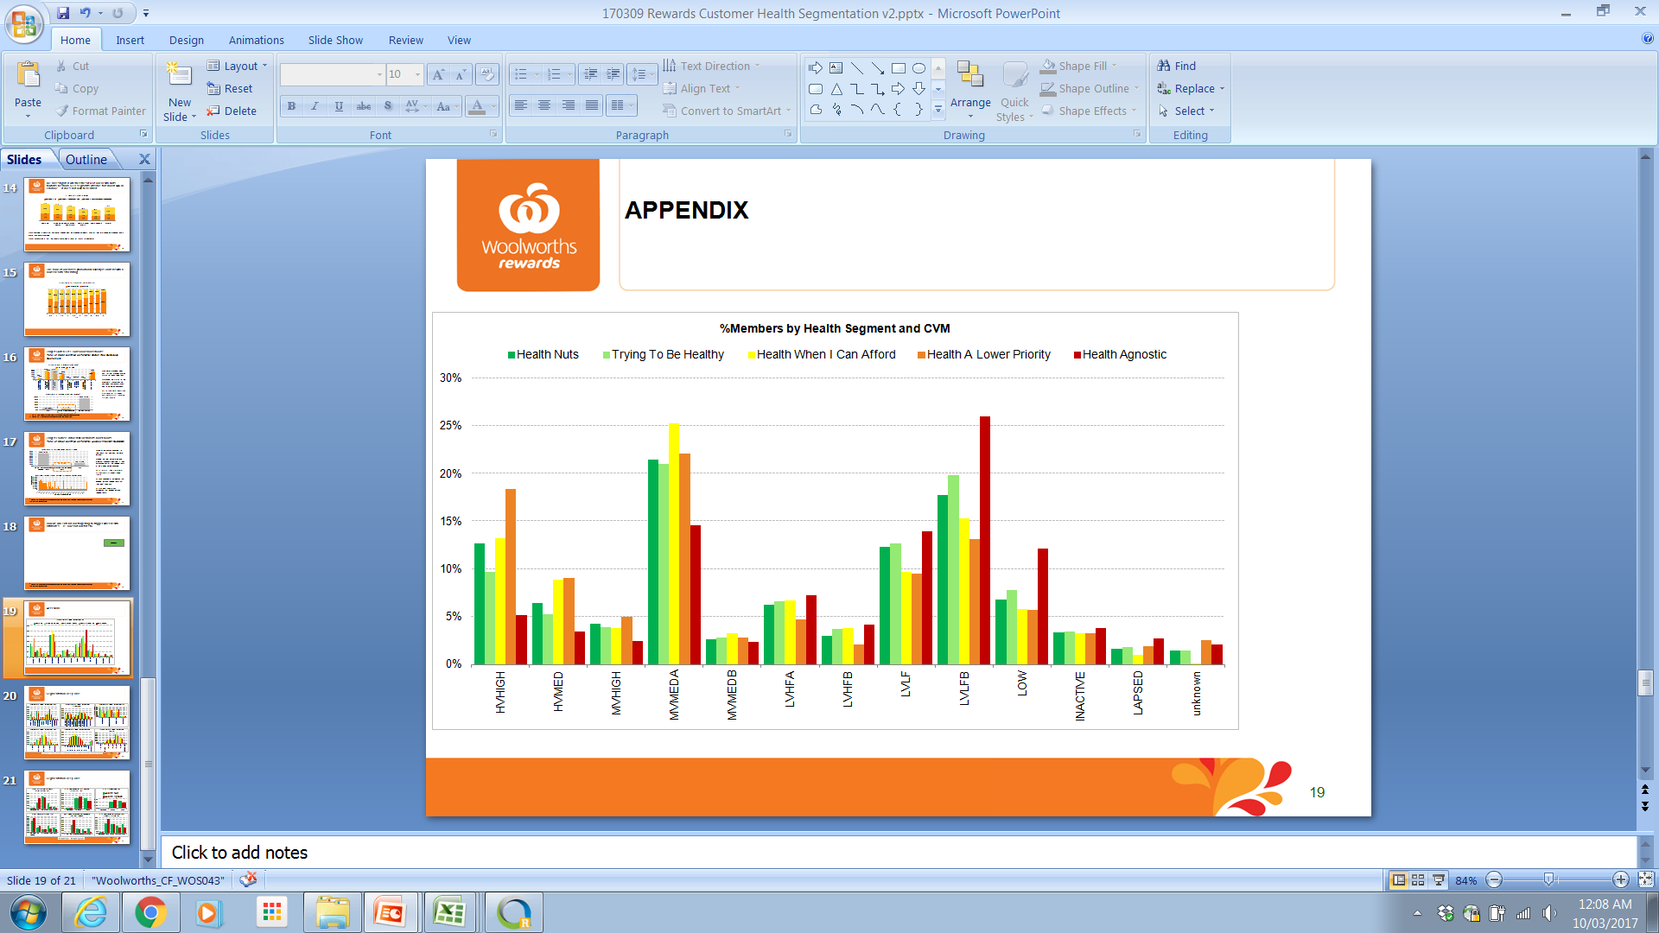
Segmentation Deep Dive

Slide 23
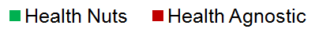
Segmentation Deep Dive (‘Health Nuts’ vs ‘Health Agnostic’ Propensity Model Selected Variables)

Slide 24
The bulk of our mass promotional activity is on items with a lower health star rating
Opportunity for WOW to promote more healthy items to encourage healthy diet

Slide 25
We investigated whether the skew of our Health Nuts towards Medium & LV segments was due to reduced SOW in Produce – it does not look to be driver
On average, a health nut customer spends most on produce category: 23% of their total spend on produce, 4ppts more than overall average
Our assumption is that the skew is more likely a result of healthier customers skewing away from family lifestage segments (which have a more diverse basket, see slide 19) as well as healthier customers spending very little on cigarettes which are purchased more frequently by valuable customers

Slide 26
Health trend product spend by health segment

