Slide 1
Intro to Quarto
Alexander Lawless

Slide 2
Topics to cover
What are quarto and markdown?
Set up demo
Quarto gallery

Slide 3
Quarto according to Hadley Wickham
Quarto files are designed to be used in three ways:
For communicating to decision-makers, who want to focus on the conclusions, not the code behind the analysis.
For collaborating with other data scientists (including future you!), who are interested in both your conclusions, and how you reached them (i.e. the code).
As an environment in which to do data science, as a modern-day lab notebook where you can capture not only what you did, but also what you were thinking.
R for Data Science - https://r4ds.hadley.nz/quarto.html

Slide 4
Quarto vs Markdown
“Quarto is a multi-language, next-generation version of R Markdown from Posit and includes dozens of new features and capabilities while at the same being able to render most existing Rmd files without modification.”
https://quarto.org/docs/get-started/hello/rstudio.html
For our purposes, we can use think of the two as interchangeable.
Quarto is not currently available in both tiers:
Tier 0: Markdown
Tier 3: Markdown or Quarto

Slide 5
Quarto vs Markdown
Feature | R Markdown | Quarto
Basic Formats | html_document | html
 | pdf_document | pdf
 | word_document | docx
Beamer | beamer_presentation | beamer
PowerPoint | powerpoint_presentation | pptx
HTML Slides | xaringan | revealjs
 | ioslides
 | revealjs
Advanced Layout | tufte | Quarto Article Layout
 | distill
Cross References | html_document2 | Quarto Crossrefs
 | pdf_document2
 | word_document2
Websites & Blogs | blogdown | Quarto Websites
 | distill | Quarto Blogs
Books | bookdown | Quarto Books
Interactivity | Shiny Documents | Quarto Interactive Documents
Journal Articles | rticles | Quarto Journal Articles
Paged HTML | pagedown | Planned
Dashboards | flexdashboard | Planned
Interactive Tutorials | learnr | No equivalent planned
https://quarto.org/docs/faq/rmarkdown.html

Slide 6
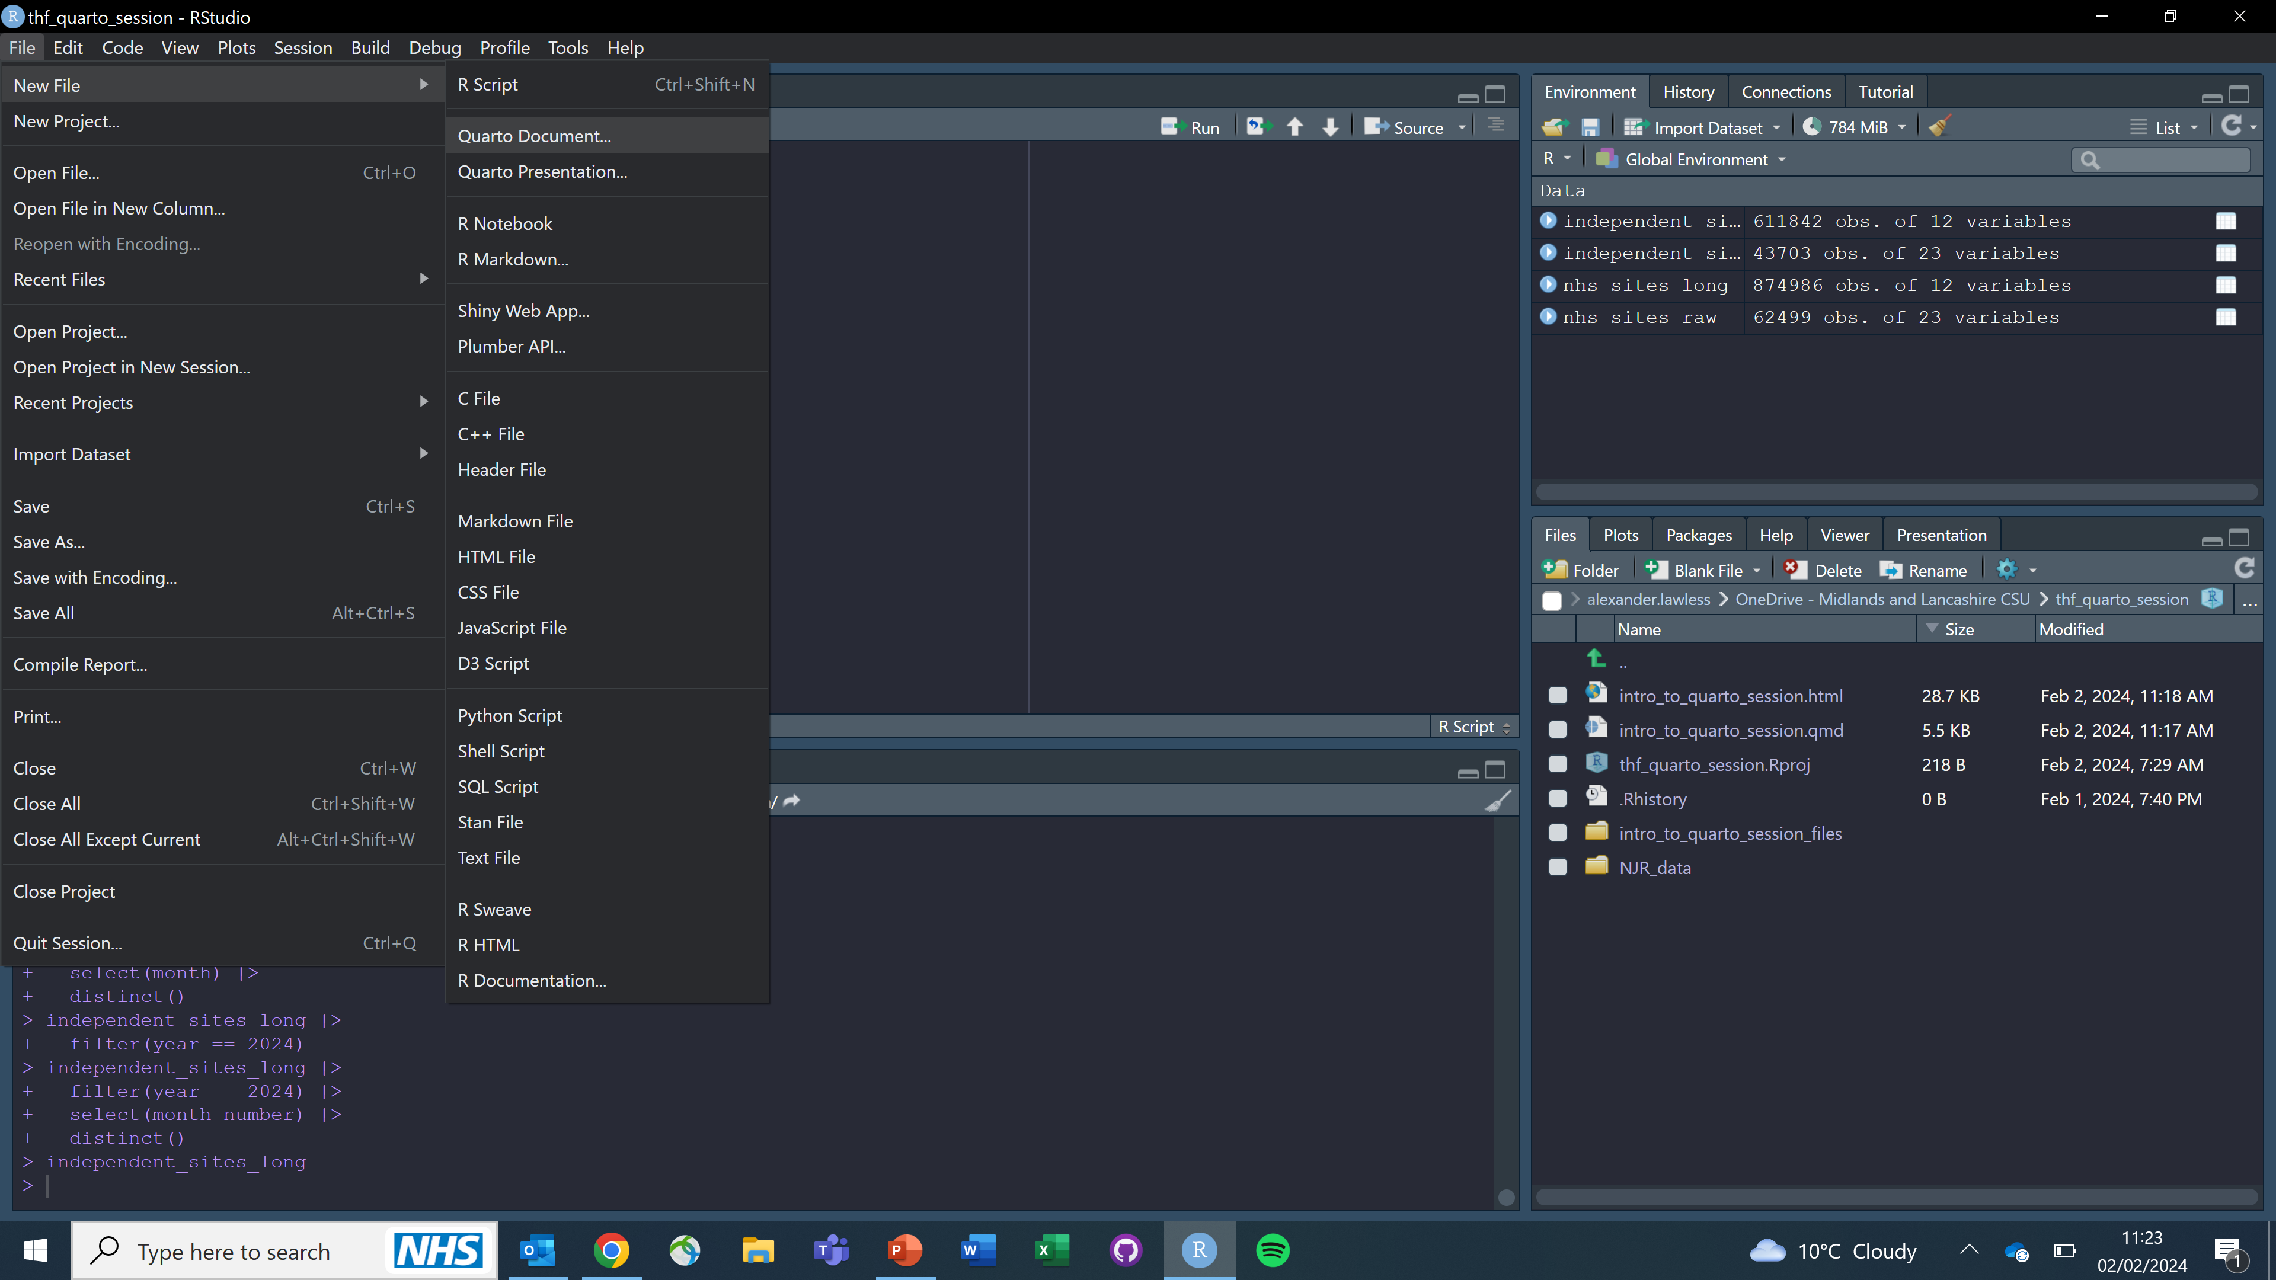
Set up:

Slide 7
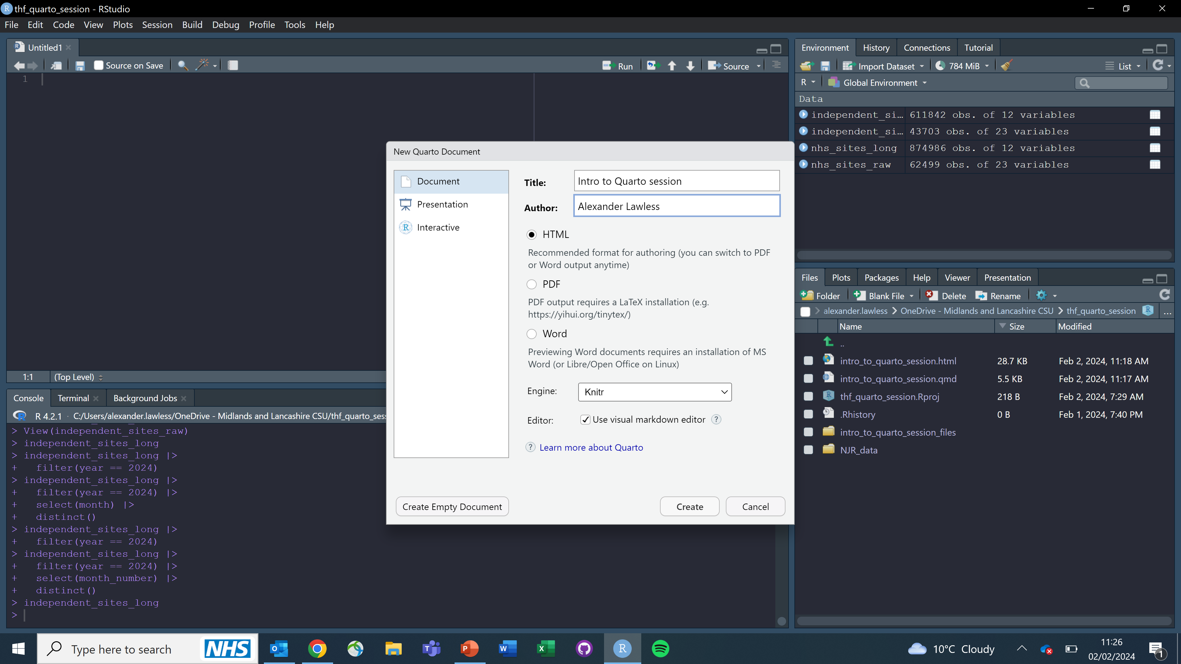
Set up:

Slide 8
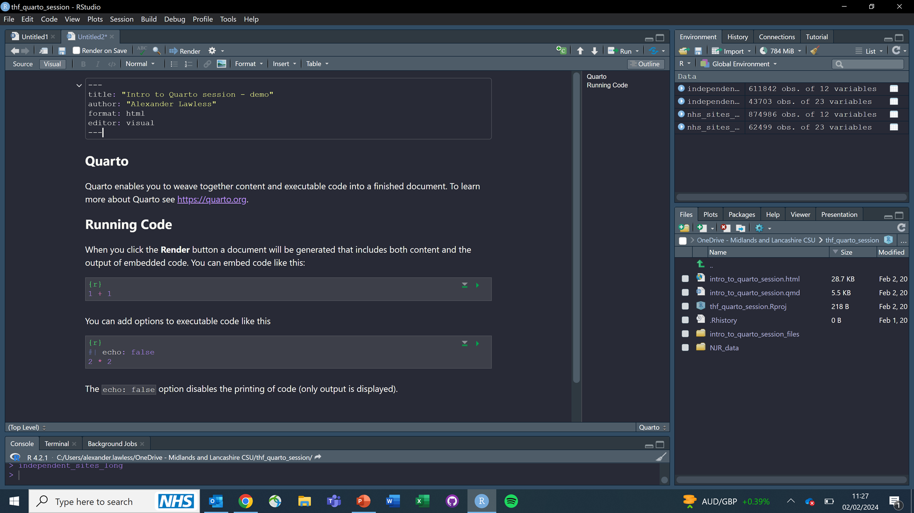
Set up:

Slide 9
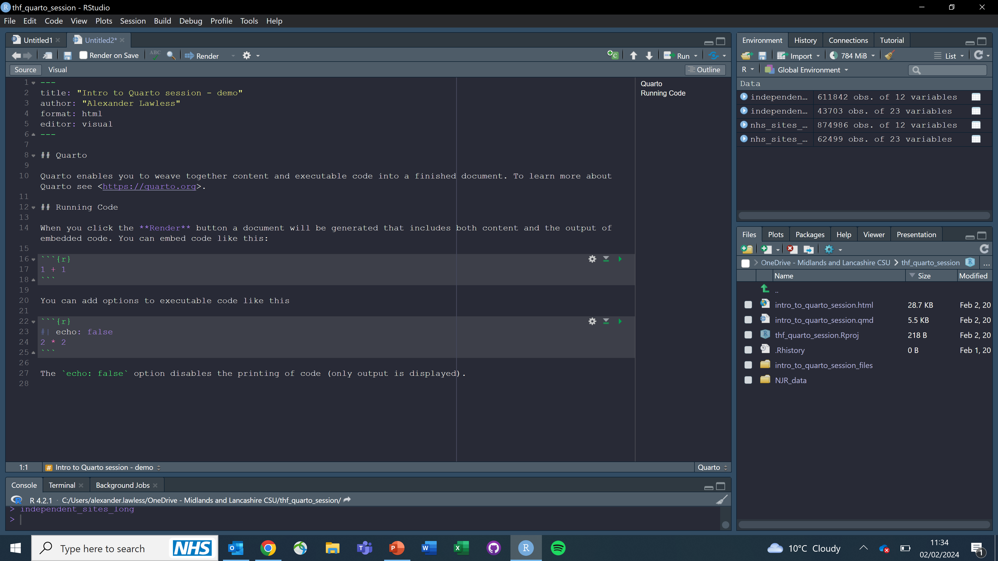
Set up:

Slide 10
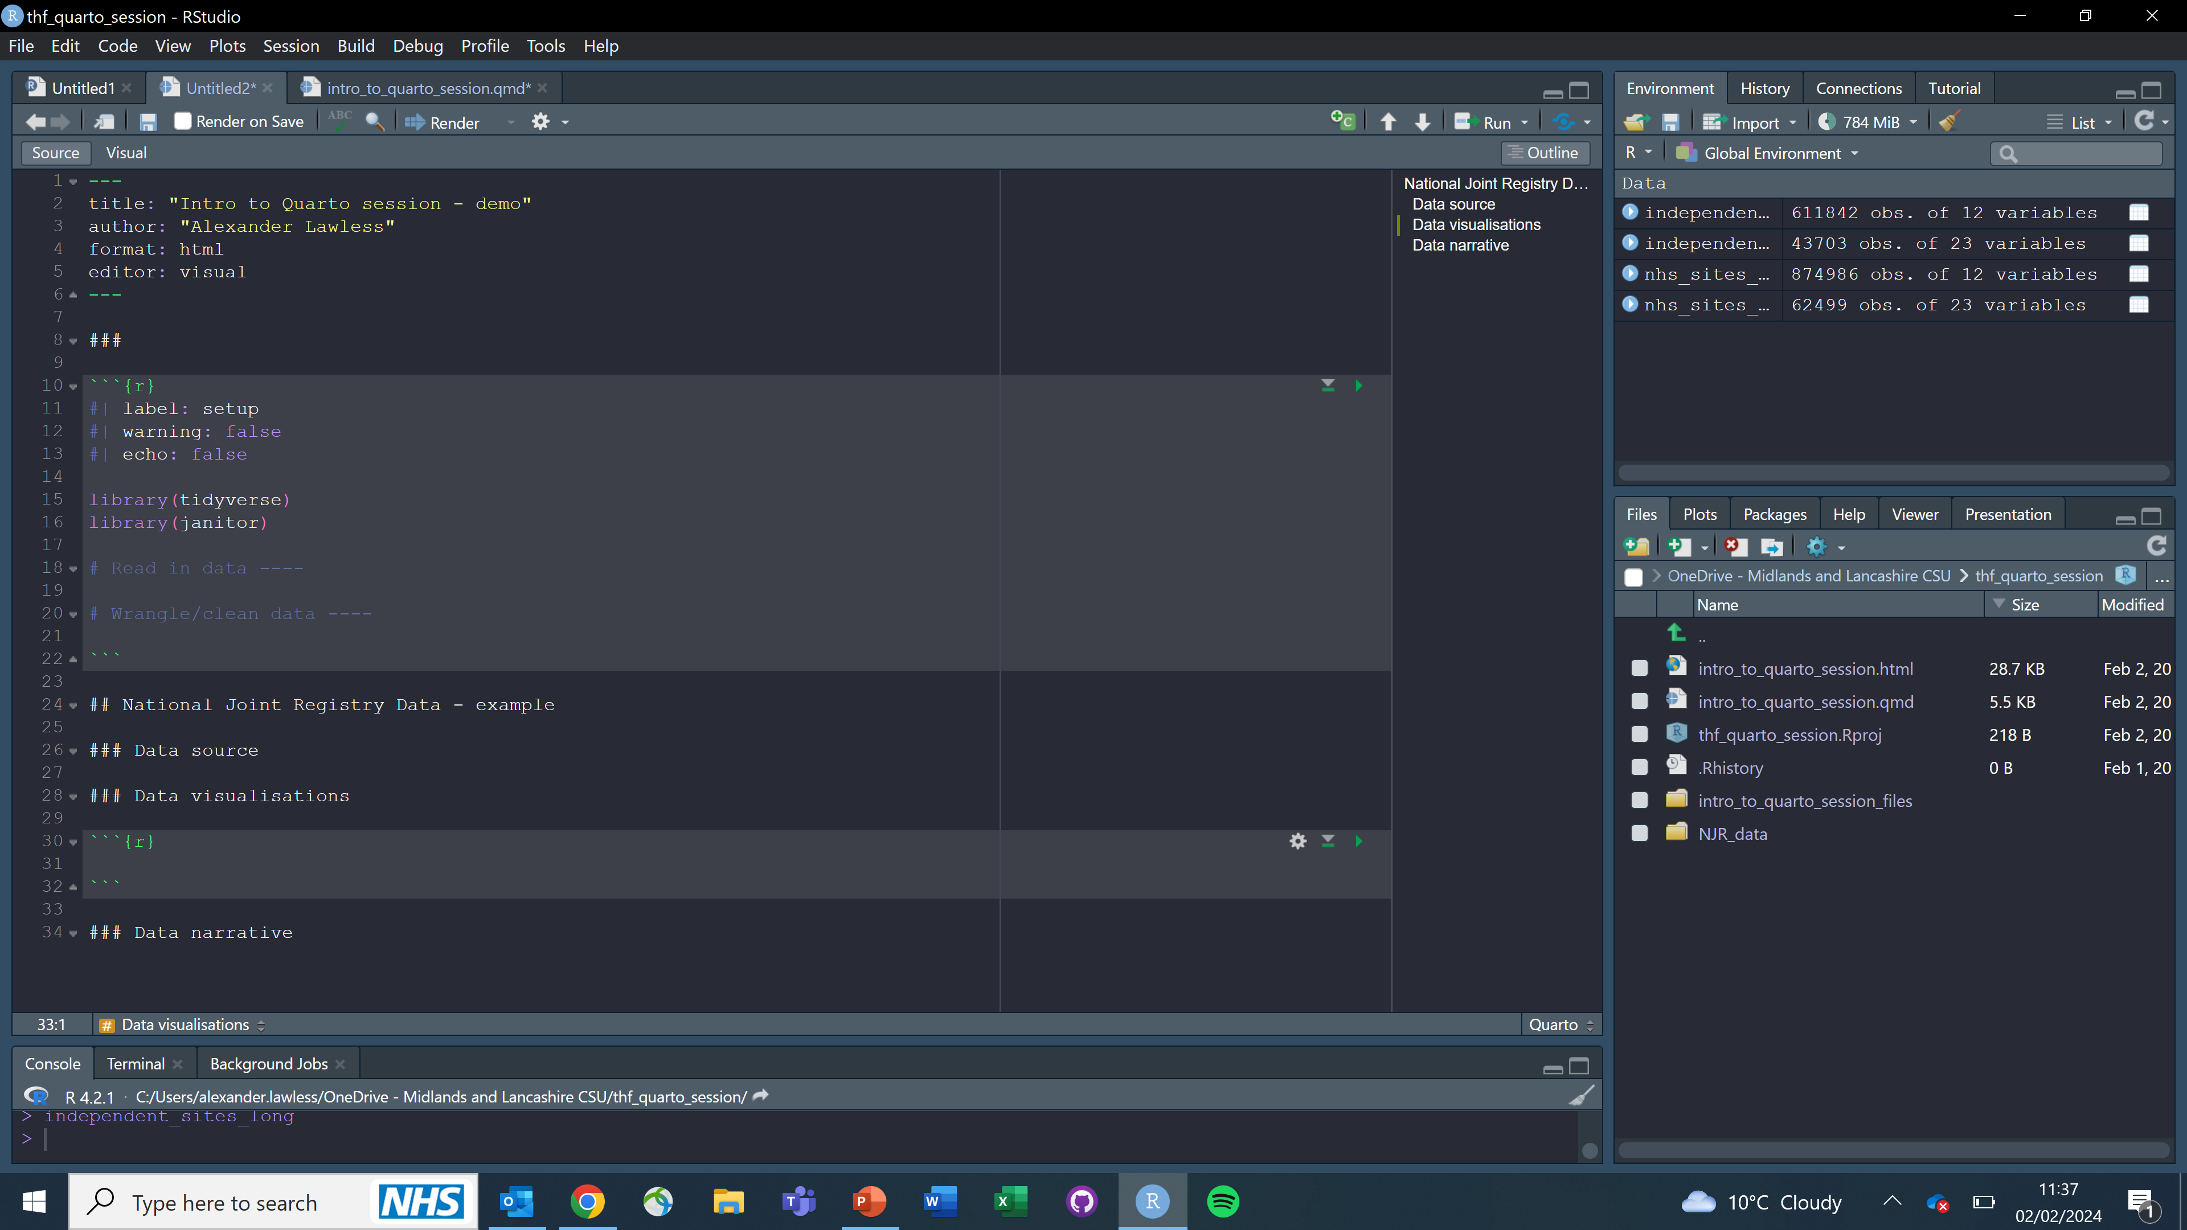
Set up:

Slide 11
Quarto Gallery:
Basic
Private healthcare explainer piece
Flexdashboard
https://connect.strategyunitwm.nhs.uk/content/eb650d8d-dfa6-4104-82ae-3d911ec243f3/#section-commissioner-flows
Presentations
https://quarto.org/docs/gallery/#presentations
Website
https://mine-cetinkaya-rundel.github.io/quarto-tip-a-day/
Lots and lots of other stuff
https://quarto.org/docs/gallery/

Slide 12

Any questions?

