Slide 1
Case Study 2 Employee Attrition Analysis
Alex Lopez
Doing Data Science

Slide 2
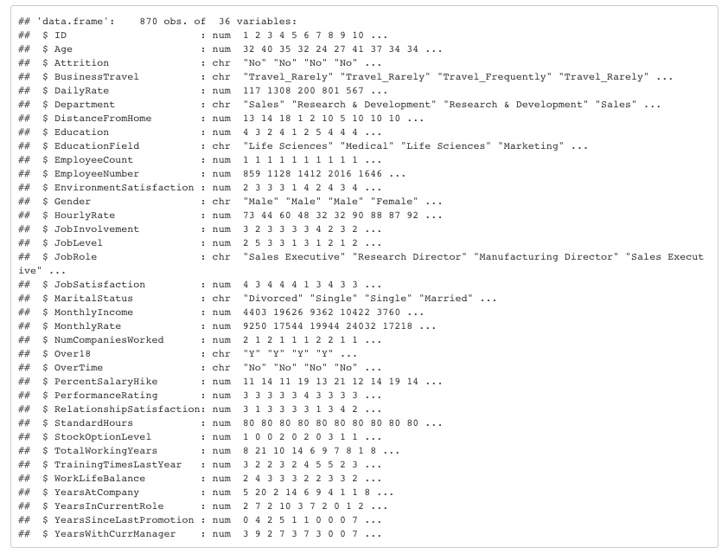
Data Set

Slide 3
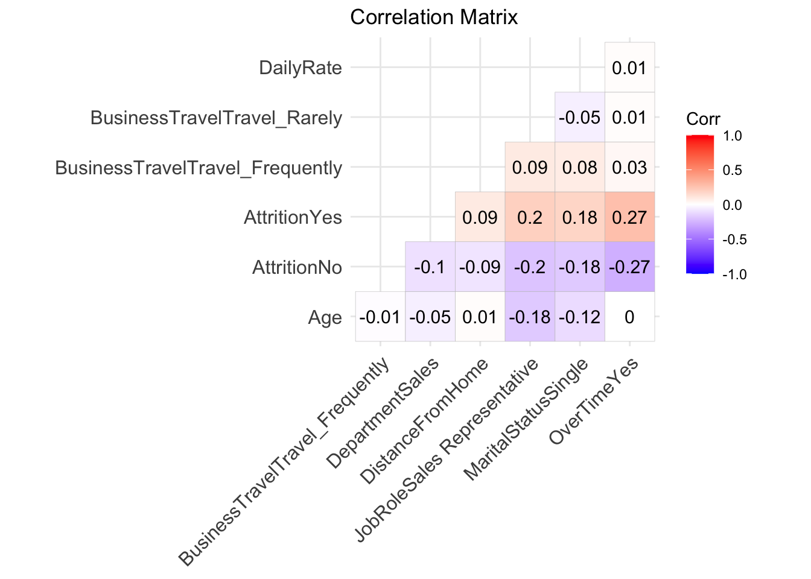
EDA – Top 3 Contributing Factors

Slide 4
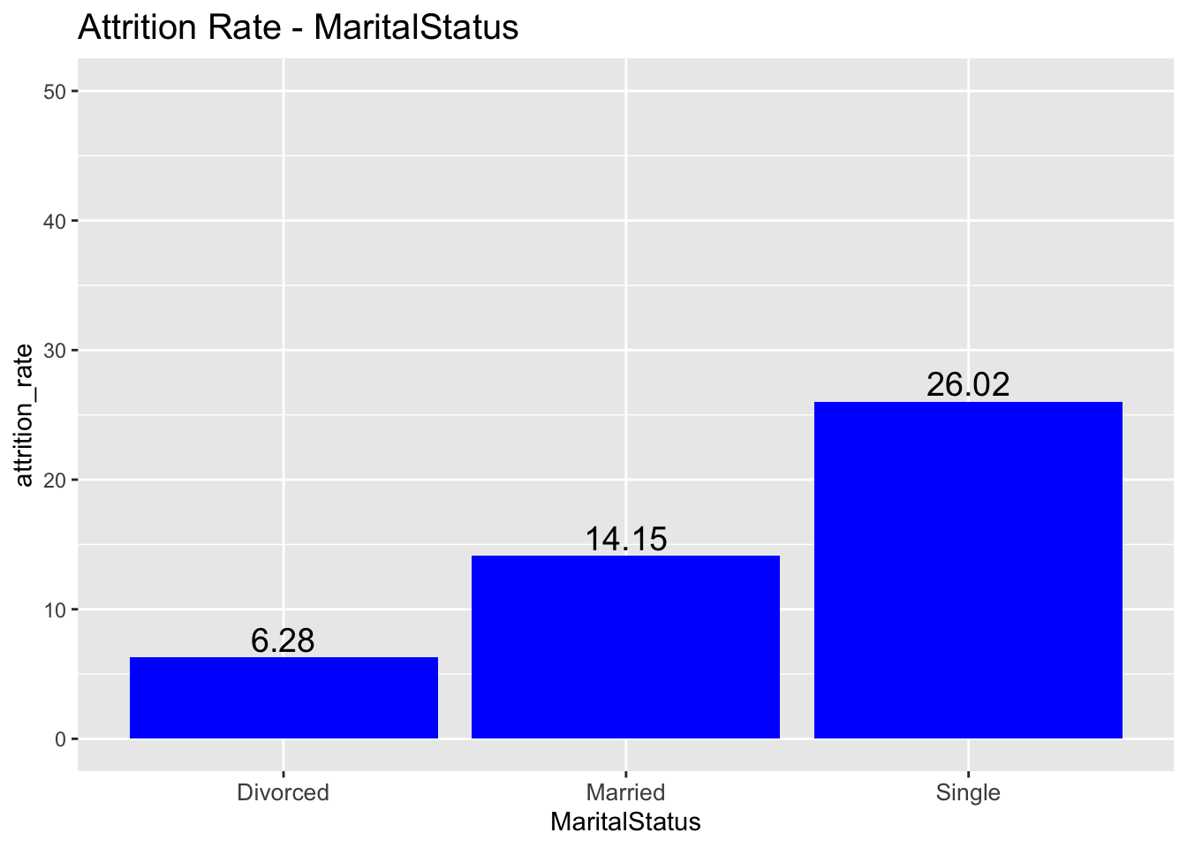
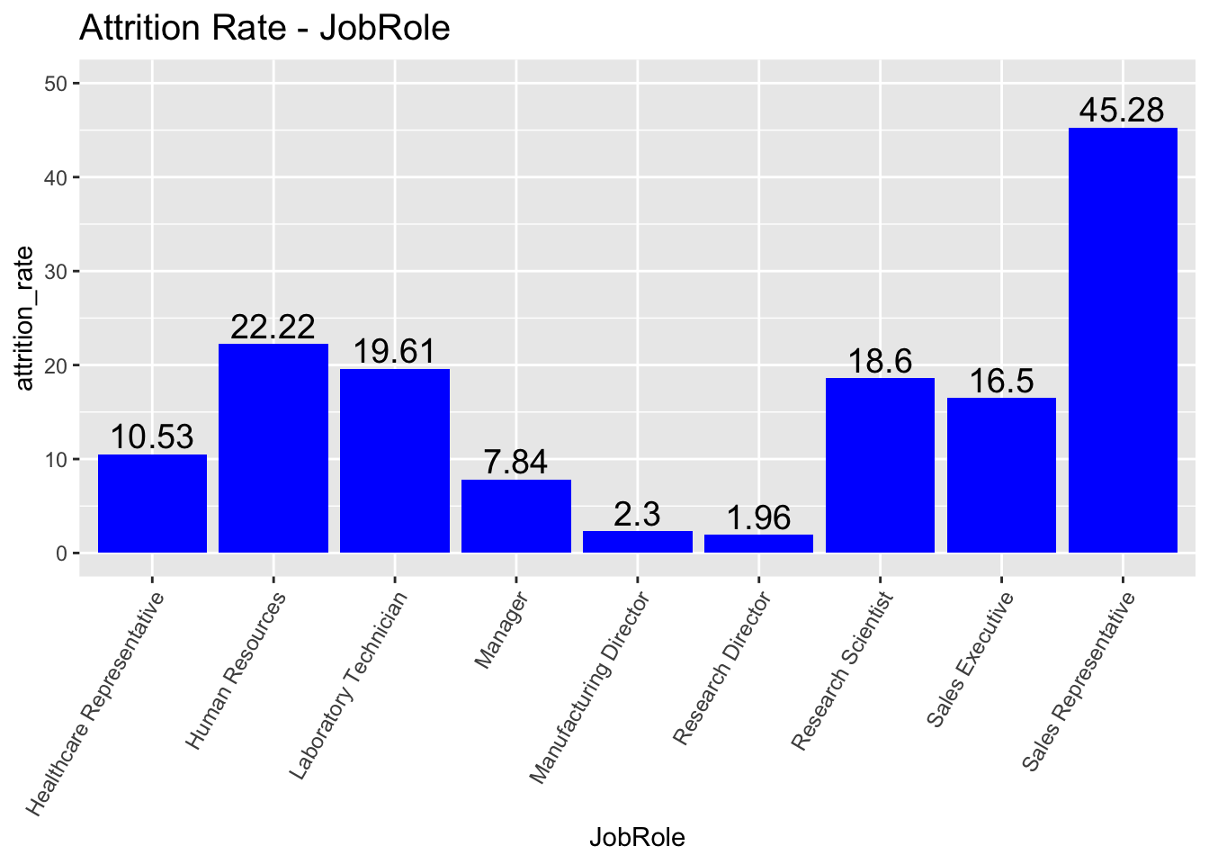
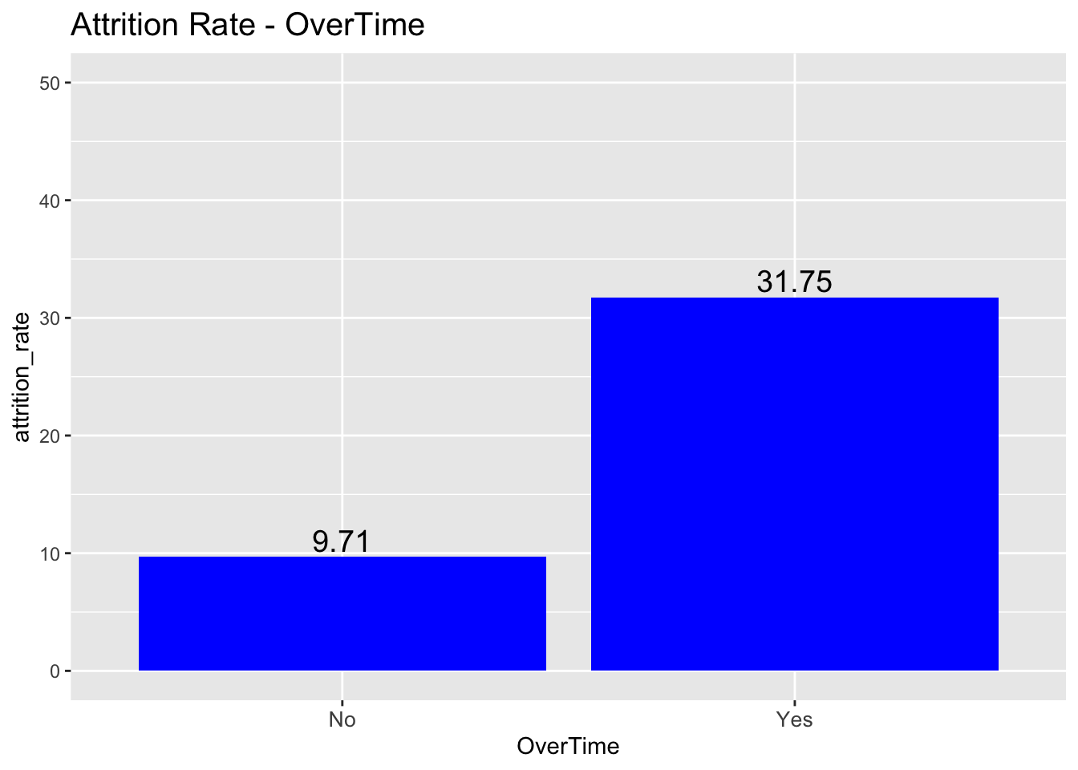
EDA – Top 3 Contributing Factors

Slide 5
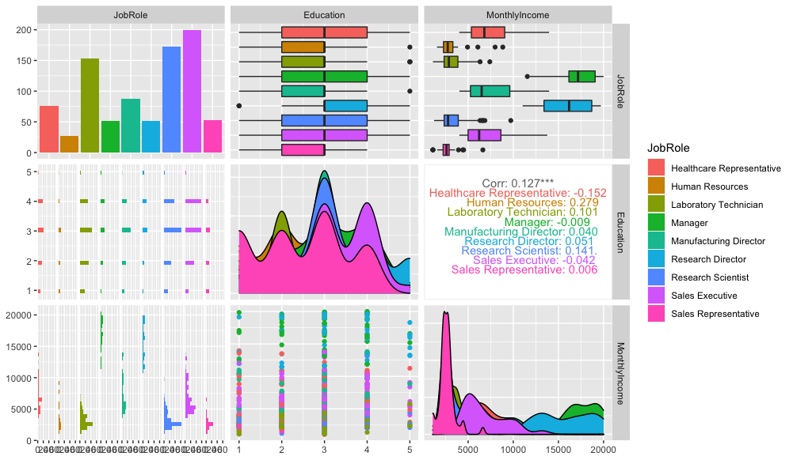
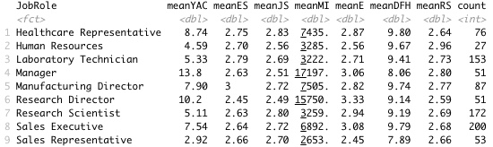
Job Role Trends
Sales Representatives have the lowest mean monthly income (2653), lowest mean education level (2.45) and are the least experienced employees with a mean of 2.9 years with the company.
Mangers and Research Directors have the highest mean monthly incomes (17197 and 15750 respectively) and are the most experienced employees with 13.8 and 10.2 years with the company.
Healthcare Representatives have the highest mean job satisfaction score (2.83), even with the highest mean distance from home (9.8).

Slide 6
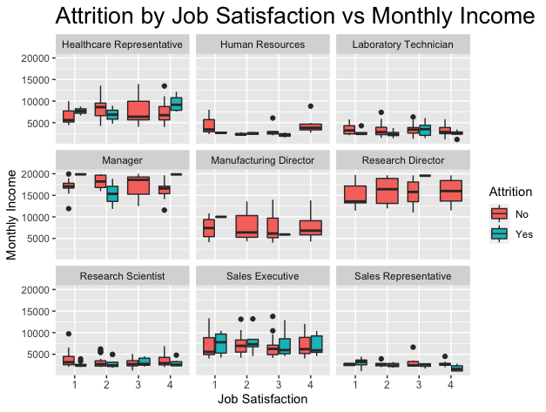
Additional Insight
Job satisfaction did not appear have significant impact on attrition.
Managers and Directors saw very little attrition regardless of satisfaction score.
Increase wages to decrease attrition.

Slide 7
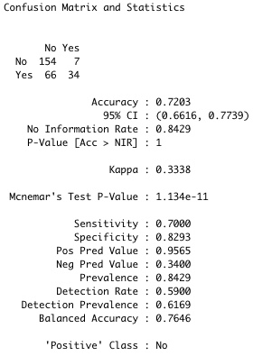
Attrition Classification Model
KNN Model Results:
Accuracy = 78%
Sensitivity = 91%
Specificity = 7%
Naive Bayes model provided required metric scores and so can be used as the Attrition classification model.

Slide 8
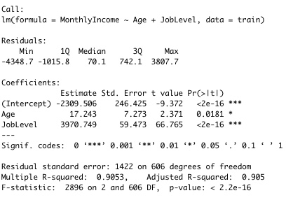
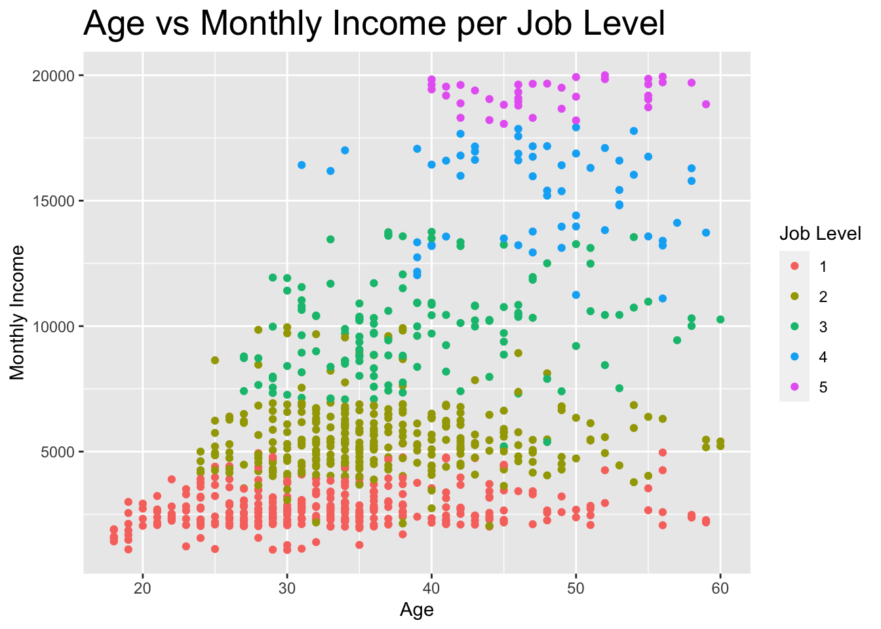
Monthly Income Regression Model
RMSE = 1327.05
Variables to considered were selected after reviewing data during EDA.
Job Level seems to hold the most significance when predicting monthly income (p-value = <2e-16).

Slide 9

Questions/Comments?

