Slide 1


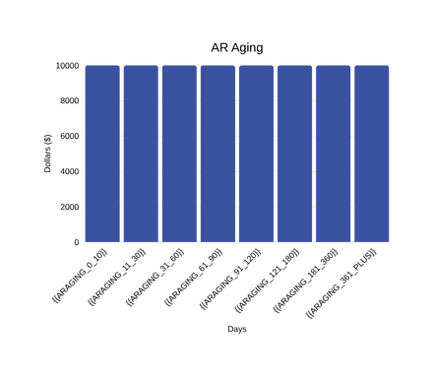
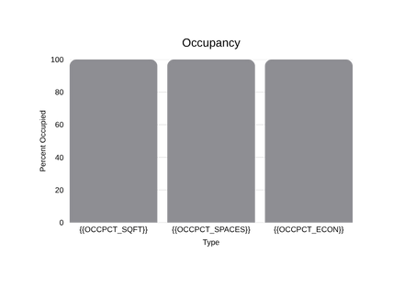
Daily Flash Report
{{PROPERTYDISPLAYNAME}} · As of {{ASOFDATE}}
Flash Report · {{FACILITYCODE}} · {{FACILITYSHORTNAME}}
MTD Rentals | Daily Rentals | Leads (MTD) | Lead Conversion | MTD Vacates | Daily Vacates | MTD Net
{{MTDRENTALS}} | {{DAILYRENTALS}} | {{LEADSMTD}} | {{CONV}} | {{MTDVACATES}} | {{DAILYVACATES}} | {{MTDNETRENTALS}}
Total RSF | Occ RSF | RSF Occ % | Occ Units | TPP Coverage % | AR > 30d % | AR > 60d %
{{TOTALRSF}} | {{OCCRSF}} | {{RSFOCCPCT}} | {{OCCUNITS}} | {{COVERAGE}} | {{AROVER30DAYSPCT}} | {{AROVER60DAYSPCT}}
Proj. Rent | Proj. Rent / SF | Proj. Rent MoM | Gross Pot. Rent | GPR / SF | GPR MoM% | Econ Occ.
{{PROJRENT}} | {{PROJRENTPERSF}} | {{PROJRENTMOMPCT}} | {{GROSSPOTRENT}} | {{GPRPERSF}} | {{GPRMOMPCT}} | {{ECONOCCPCT}}
*Facility opened on {{FACILITYOPENDATE}}.

