Slide 1
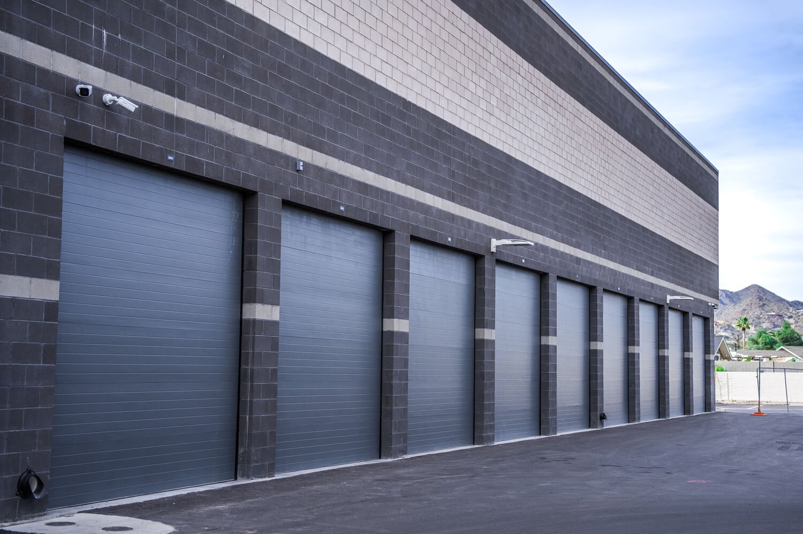
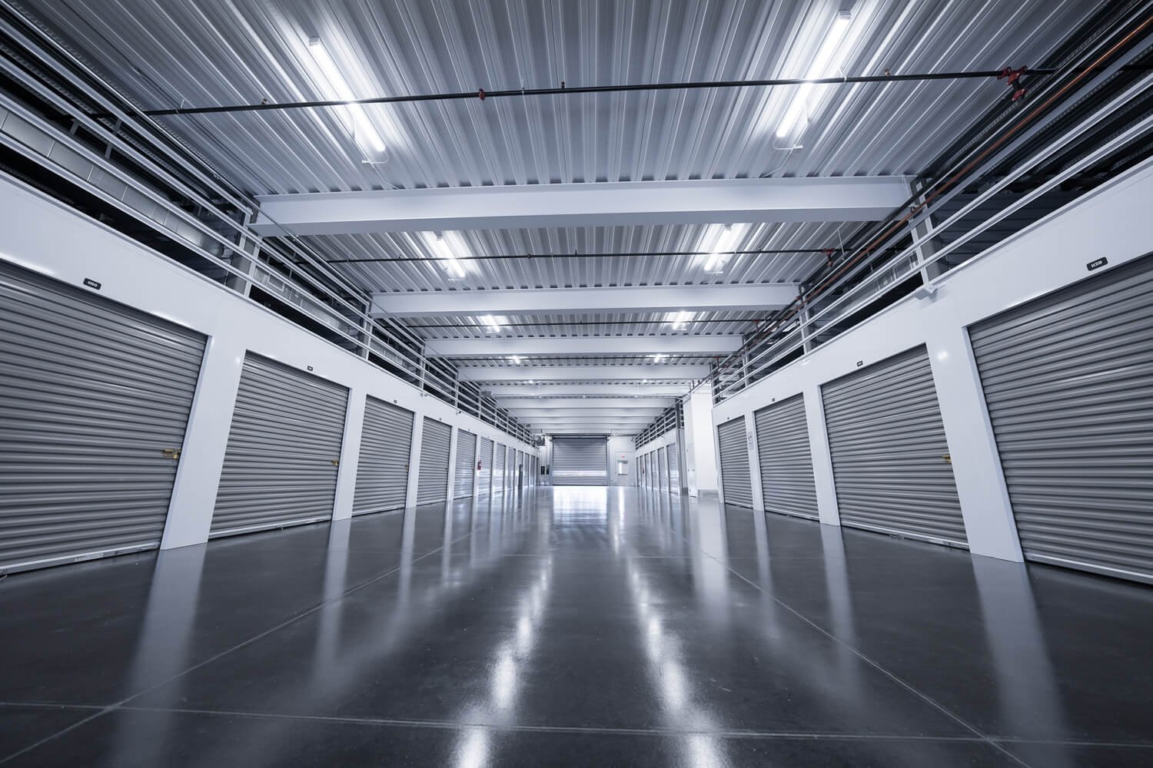


OWNER SUMMARY REPORT
{{CURRENTMONTH}} 2026
ADDRESS
{{ADDRESS}}
OWNERS
{{OWNERGROUP}}
MANAGEMENT ACQUIRED DATE
{{ACQUIREDDATE}}
TOTAL UNITS
{{TOTALUNITS}}
RENTABLE SQUARE FEET
{{RENTABLESQFT}}

Slide 2
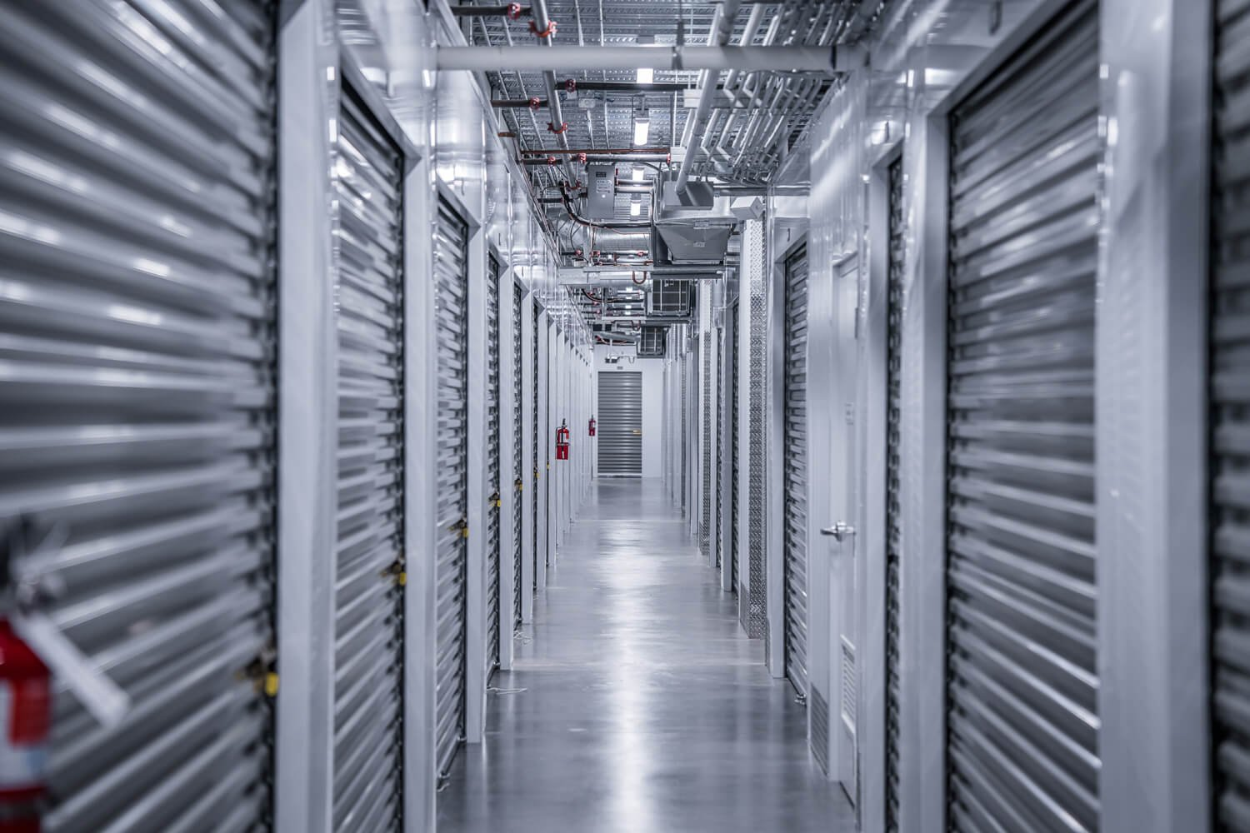
{{CURRENTMONTH}} Performance
FINANCIAL
{{TOTALRENTALINCOME}}
{{TOTALINCOME}}
{{TOTALEXPENSES}}
{{NETINCOME}}
Total Rental Income
Total Income
Operating Expenses
Net Operating Income
OCCUPANCY
{{OCCUPIEDAREASQFT}} ft²
{{OCCUPANCYBYUNITS}}%
{{OCCUPIEDAREAPERCENT}}
Occupied Area
Occupancy by units
Occupancy by area
2
Owner Summary Report | {{CURRENTDATE}}
2

Slide 3
{{CURRENTMONTH}} Data
 | {{CURRENTMONTH}} | PTD Budget | Variance | % Var |  | YTD Actual | YTD Budget | Variance | % Var
Rental Income | {{RENTINCCM}} | {{RENTINCPTD}} | {{RENTINCVAR}} | {{RENTINCVARPER}} |  | {{RENTINCYTD}} | {{RENTINCYTDBUD}} | {{RENTINCYTDVAR}} | {{RENTINCYTDVARPER}}
Discounts | {{DISCCM}} | {{DISCPTD}} | {{DISCVAR}} | {{DISCVARPER}} |  | {{DISCYTD}} | {{DISCYTDBUD}} | {{DISCYTDVAR}} | {{DISCYTDVARPER}}
Total Rental Income | {{TOTRENINCCM}} | {{TOTRENINCPTD}} | {{TOTRENINCVAR}} | {{TOTRENINCVARPER}} |  | {{TOTRENINCYTD}} | {{TOTRENINCYTDBUD}} | {{TOTRENINCYTDVAR}} | {{TOTRENINCYTDVARPER}}
Admin Fees | {{ADMFEECM}} | {{ADMFEEPTD}} | {{ADMFEEVAR}} | {{ADMFEEVARPER}} |  | {{ADMFEEYTD}} | {{ADMFEEYTDBUD}} | {{ADMFEEYTDVAR}} | {{ADMFEEYTDVARPER}}
Late Fees | {{LATFEECM}} | {{LATFEEPTD}} | {{LATFEEVAR}} | {{LATFEEVARPER}} |  | {{LATFEEYTD}} | {{LATFEEYTDBUD}} | {{LATFEEYTDVAR}} | {{LATFEEYTDVARPER}}
Tenant Protection Fee | {{INSURCM}} | {{INSURPTD}} | {{INSURVAR}} | {{INSURVARPER}} |  | {{INSURYTD}} | {{INSURYTDBUD}} | {{INSURYTDVAR}} | {{INSURYTDVARPER}}
Retail Sales | {{RETSALCM}} | {{RETSALPTD}} | {{RETSALVAR}} | {{RETSALVARPER}} |  | {{RETSALYTD}} | {{RETSALYTDBUD}} | {{RETSALYTDVAR}} | {{RETSALYTDVARPER}}
Secure Payment Fee | {{SECPPCM}} | {{SECPPPTD}} | {{SECPPVAR}} | {{SECPPVARPER}} |  | {{SECPPYTD}} | {{SECPPYTDBUD}} | {{SECPPYTDVAR}} | {{SECPPYTDVARPER}}
Total Income | {{TOTALINCCM}} | {{TOTALINCPTD}} | {{TOTALINCVAR}} | {{TOTALINCVARPER}} |  | {{TOTALINCYTD}} | {{TOTALINCYTDBUD}} | {{TOTALINCYTDVAR}} | {{TOTALINCYTDVARPER}}
Expenses
Advertising & Marketing | {{ADVERCM}} | {{ADVERPTD}} | {{ADVERVAR}} | {{ADVERVARPER}} |  | {{ADVERYTD}} | {{ADVERYTDBUD}} | {{ADVERYTDVAR}} | {{ADVERYTDVARPER}}
Auction Expenses | {{AUCTCM}} | {{AUCTPTD}} | {{AUCTVAR}} | {{AUCTVARPER}} |  | {{AUCTYTD}} | {{AUCTYTDBUD}} | {{AUCTYTDVAR}} | {{AUCTYTDVARPER}}
Bank Charges | {{BANKCHGCM}} | {{BANKCHGPTD}} | {{BANKCHGVAR}} | {{BANKCHGVARPER}} |  | {{BANKCHGYTD}} | {{BANKCHGYTDBUD}} | {{BANKCHGYTDVAR}} | {{BANKCHGYTDVARPER}}
Credit Card Merchant Fees | {{CCMCM}} | {{CCMPTD}} | {{CCMVAR}} | {{CCMVARPER}} |  | {{CCMYTD}} | {{CCMYTDBUD}} | {{CCMYTDVAR}} | {{CCMYTDVARPER}}
Dues & Subscriptions | {{DUESCM}} | {{DUESPTD}} | {{DUESVAR}} | {{DUESVARPER}} |  | {{DUESYTD}} | {{DUESYTDBUD}} | {{DUESYTDVAR}} | {{DUESYTDVARPER}}
Fire Prevention | {{FIRECM}} | {{FIREPTD}} | {{FIREVAR}} | {{FIREVARPER}} |  | {{FIREYTD}} | {{FIREYTDBUD}} | {{FIREYTDVAR}} | {{FIREYTDVARPER}}
Insurance | {{INSURXPCM}} | {{INSURXPPTD}} | {{INSURXPVAR}} | {{INSURXPVARPER}} |  | {{INSURXPYTD}} | {{INSURXPYTDBUD}} | {{INSURXPYTDVAR}} | {{INSURXPYTDVARPER}}
Licenses & Permits | {{PERMCM}} | {{PERMPTD}} | {{PERMVAR}} | {{PERMVARPER}} |  | {{PERMYTD}} | {{PERMYTDBUD}} | {{PERMYTDVAR}} | {{PERMYTDVARPER}}
Management Fees | {{MGMTCM}} | {{MGMTPTD}} | {{MGMTVAR}} | {{MGMTVARPER}} |  | {{MGMTYTD}} | {{MGMTYTDBUD}} | {{MGMTYTDVAR}} | {{MGMTYTDVARPER}}
Payroll Costs | {{MGMTSTFCM}} | {{MGMTSTFPTD}} | {{MGMTSTFVAR}} | {{MGMTSTFVARPER}} |  | {{MGMTSTFYTD}} | {{MGMTSTFYTDBUD}} | {{MGMTSTFYTDVAR}} | {{MGMTSTFYTDVARPER}}
Office & Building Supplies | {{OFFSUPCM}} | {{OFFSUPPTD}} | {{OFFSUPVAR}} | {{OFFSUPVARPER}} |  | {{OFFSUPYTD}} | {{OFFSUPYTDBUD}} | {{OFFSUPYTDVAR}} | {{OFFSUPYTDVARPER}}
Professional Fees | {{PROFCM}} | {{PROFPTD}} | {{PROFVAR}} | {{PROFVARPER}} |  | {{PROFYTD}} | {{PROFYTDBUD}} | {{PROFYTDVAR}} | {{PROFYTDVARPER}}
Repairs & Maintenance | {{REPCM}} | {{REPPTD}} | {{REPVAR}} | {{REPVARPER}} |  | {{REPYTD}} | {{REPYTDBUD}} | {{REPYTDVAR}} | {{REPYTDVARPER}}
Retail Products | {{RETACM}} | {{RETAPTD}} | {{RETAVAR}} | {{RETAVARPER}} |  | {{RETPRODYTD}} | {{RETAYTDBUD}} | {{RETAYTDVAR}} | {{RETAYTDVARPER}}
Security | {{SECCM}} | {{SECPTD}} | {{SECVAR}} | {{SECVARPER}} |  | {{SECYTD}} | {{SECYTDBUD}} | {{SECYTDVAR}} | {{SECYTDVARPER}}
Software | {{SOFTCM}} | {{SOFTPTD}} | {{SOFTVAR}} | {{SOFTVARPER}} |  | {{SOFTYTD}} | {{SOFTYTDBUD}} | {{SOFTYTDVAR}} | {{SOFTYTDVARPER}}
Telephone & Internet | {{INTERCM}} | {{INTERPTD}} | {{INTERVAR}} | {{INTERVARPER}} |  | {{INTERYTD}} | {{INTERYTDBUD}} | {{INTERYTDVAR}} | {{INTERYTDVARPER}}
Travel | {{TRAVELCM}} | {{TRAVELPTD}} | {{TRAVELVAR}} | {{TRAVELVARPER}} |  | {{TRAVELYTD}} | {{TRAVELYTDBUD}} | {{TRAVELYTDVAR}} | {{TRAVELYTDVARPER}}
Utilities | {{UTILCM}} | {{UTILPTD}} | {{UTILVAR}} | {{UTILVARPER}} |  | {{UTILYTD}} | {{UTILYTDBUD}} | {{UTILYTDVAR}} | {{UTILYTDVARPER}}
Total Operating Expenses | {{TOTALPROPCM}} | {{TOTALPROPPTD}} | {{TOTALPROPVAR}} | {{TOTALPROPVARPER}} |  | {{TOTALPROPYTD}} | {{TOTALPROPYTDBUD}} | {{TOTALPROPYTDVAR}} | {{TOTALPROPYTDVARPER}}
Total Other Expenses | {{TOTOTHEXPCM}} | {{TOTOTHEXPPTD}} | {{TOTOTHEXPVAR}} | {{TOTOTHEXPVARPER}} |  | {{TOTOTHEXPYTD}} | {{TOTOTHEXPYTDBUD}} | {{TOTOTHEXPYTDVAR}} | {{TOTOTHEXPYTDVARPER}}
Total Expenses | {{TOTEXPCM}} | {{TOTEXPPTD}} | {{TOTEXPVAR}} | {{TOTEXPVARPER}} |  | {{TOTEXPYTD}} | {{TOTEXPYTDBUD}} | {{TOTEXPYTDVAR}} | {{TOTEXPYTDVARPER}}
Net Income | {{NETINCCM}} | {{NETINCPTD}} | {{NETINCVAR}} | {{NETINCVARPER}} |  | {{NETINCYTD}} | {{NETINCYTDBUD}} | {{NETINCYTDVAR}} | {{NETINCYTDVARPER}}

Slide 4
{{CURRENTMONTH}} Performance
{{CURRENTMONTH}}
{{NETMOVE}}
{{MOVEINS}}
{{MOVEOUTS}}
Move-ins
Move-outs
Net
TRAILING 3-MONTH
{{MOVEOUTSTRL3}}
{{NETTRL3}}
{{MOVEINSTRL3}}
Move-ins
Move-outs
Net
TRAILING 6-MONTH
{{MOVEINSTRL6}}
{{MOVEOUTSTRL6}}
{{NETTRL6}}
Move-ins
Move-outs
Net
TRAILING 12-MONTH
{{MOVEINSTRL12}}
{{MOVEOUTSTRL12}}
{{NETTRL12}}
Move-ins
Move-outs
Net
Trailing number includes current month.
4
Owner Summary Report | {{CURRENTDATE}}
4

Slide 5
{{CURRENTMONTH}} Performance
SUMMARY
RATE MANAGEMENT
KPI | Current | Last Month Value
SqFt Occupancy | {{SFTOC}} | {{SFTOCLM}}
MTD MoveIns | {{MTDMI}} | {{MTDMILM}}
$/SqFt MoveIns | {{DSFTMI}} | {{DSFTMILM}}
MTD Moveouts | {{MTDMO}} | {{MTDMOLM}}
$/SqFt MoveOuts | {{DSFTMO}} | {{DSFTMOLM}}
% Occ Units LOR > 6 Months | {{PERLOR}} | {{PERLORLM}}
Avg LOR of MoveOuts | {{AVGLOR}} | {{AVGLORLM}}
% MoveIns with Promo | {{PROMO}} | {{PROMOLM}}
{{NEXTMONTH}} ECRI | {{ECRIMONTH}} In-place Rent Escalations (4-6 months since last increase)
Number of rent increase letters sent | {{NUMREN}}
Total square footage | {{TOTSFT}}
Base rental rate; prior to ECRI ($/sq ft) | {{BASERENPR}}
Total $ increase with ECRI | {{TOTINCESC}}
New rental rate, after ECRI ($/sq ft) | {{NEWRENRT}}
Average percent increase per unit | {{AVGPERINC}}
Move outs in 90 days | {{MOVEOUT90}}
{{NEXTMONTH2}} ECRI | {{ECRIMONTH2}} In-place Rent Escalations (4-6 months since last increase)
Number of rent increase letters sent | {{NUMREN2}}
Total square footage | {{TOTSFT2}}
Base rental rate; prior to ECRI ($/sq ft) | {{BASERENPR2}}
Total $ increase with ECRI | {{TOTINCESC2}}
New rental rate, after ECRI ($/sq ft) | {{NEWRENRT2}}
Average percent increase per unit | {{AVGPERINC2}}
Move outs in 90 days | {{MOVEOUT902}}
Definitions in rate management report.
Blank fields are due to missing historical data from seller.
Owner Summary Report | {{CURRENTDATE}}
5

Slide 6
Rate Management | Current Sell Rate
Unit | Current Sell Rate | Sell Rate ($/sq ft)
5 x 5 | {{5X5WEBPR}} | {{5X5WEBRT}}
10 x 5 | {{10X5WEBPR}} | {{10X5WEBRT}}
10 x 10 | {{10X10WEBPR}} | {{10X10WEBRT}}
10 x 15 | {{10X15WEBPR}} | {{10X15WEBRT}}
10 x 20 | {{10X20WEBPR}} | {{10X20WEBRT}}
20 x 15 | {{20X15WEBPR}} | {{20X15WEBRT}}
ALL UNITS
Sell Rates are only available for vacant spaces.
6
Owner Summary Report | {{CURRENTDATE}}
6

Slide 7
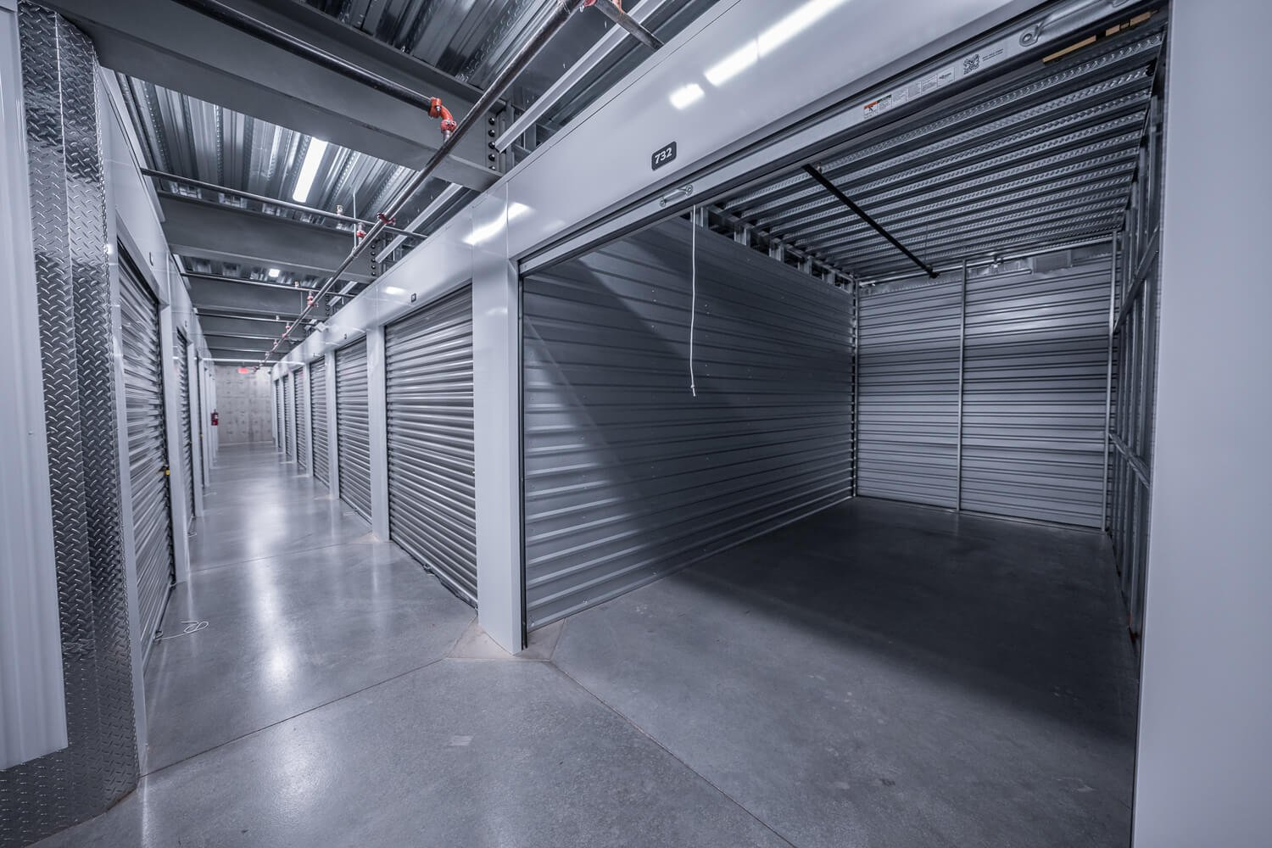
{{CURRENTMONTH}} Operational Snapshot
{{MTDRENTALS}}
{{MTDVACATES}}
{{MTDNETRENTALS}}
MTD Rentals
MTD Vacates
MTD Net
{{PROJRENT}}
{{PROJRENTPERSF}}
Projected Rent
Projected Rent/SF
{{EFFPOTRENT}}
{{AVGSFVACA}}
Sell Rate + Pot. Rent
Sell Rate/SF
{{GROSSPOTRENT}}
{{GROSSPOTRENTRATE}}
Gross Pot. Rent
GPR Rate/SF
Additional information can be found in the daily flash report.
7
Owner Summary Report | {{CURRENTDATE}}
7

Slide 8
Tenant Protection Capture Rate
{{CURRENTMONTH}}
{{INSURPER}}
Total Protected
OVERALL
{{OVERALLPER}}
Protected Percentage
TPP excludes parking spaces and wine storage.
8
Owner Summary Report | {{CURRENTDATE}}
8

Slide 9
Repair and Maintenance Budget Variance
 | Month-to-date | Year-to-date
Budget | {{REPPTD}} | {{REPYTDBUD}}
Actual | {{REPCM}} | {{REPYTD}}
Variance | {{REPVAR}} | {{REPYTDVAR}}
MANAGEMENT NOTES
{{MNGNOTES}}
REPAIR LOG
DATE: {{REPAIRDATE}} DESCRIPTION OF EXPENSES: {{REPAIRDESCRIP}} COST: {{REPAIRCOST}} STATUS: {{REPAIRSTATUS}}
9
Owner Summary Report | {{CURRENTDATE}}
9

Slide 10
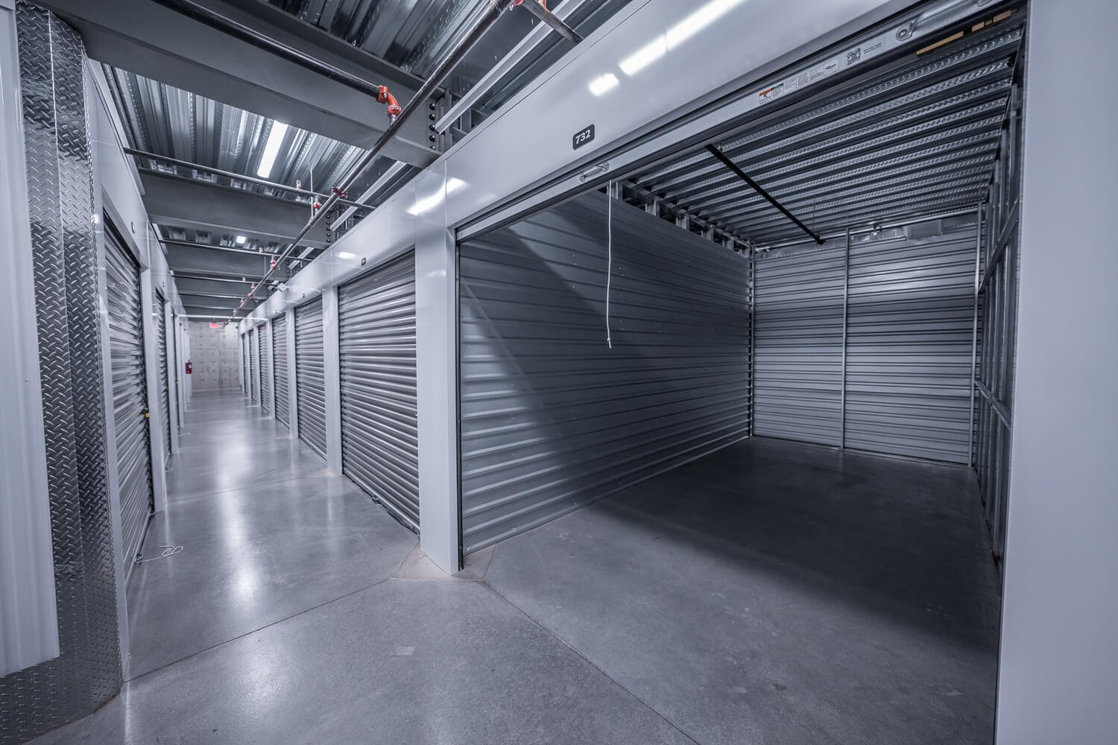
Delinquent Rent
DELINQUENT RENT | DELINQUENT RENT | DELINQUENT RENT | DELINQUENT RENT
Days | Percent | Units | Dollars
1-30 | {{DELINPER30}} | {{DELINUNIT30}} | {{DELINDOL30}}
31-60 | {{DELINPER60}} | {{DELINUNIT60}} | {{DELINDOL60}}
61+ | {{DELINPER61}} | {{DELINUNIT61}} | {{DELINDOL61}}
Percent reflects delinquent units as a percentage of occupied units.
Owner Summary Report | May 2025
Owner Summary Report | {{CURRENTDATE}}
10
10

Slide 11
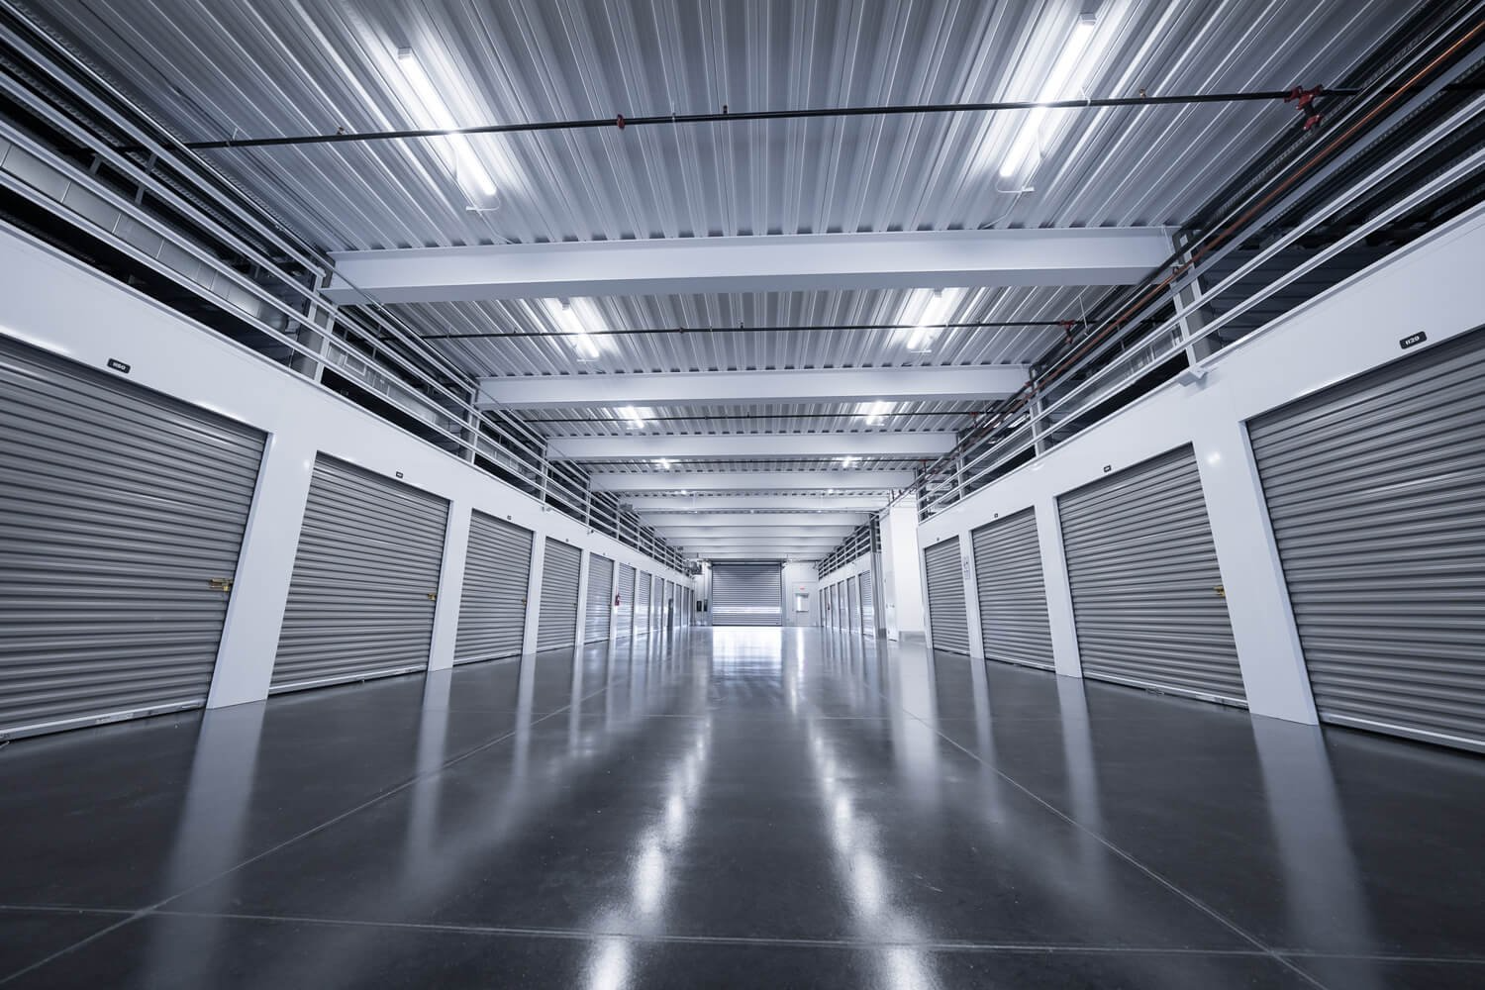

Marketing & Digital Performance |
{{GOOIMPRES}}
{{GOOCLICKS}}
{{GOOCTR}}
{{GOOCPC}}
Impressions
Total Clicks
CTR
Cost/Click
XXX
Keyword Search Grid (MoM)
Google Rank Tracker (MoM)
{{GOOPOS}}
{{POSCHG}}
{{KEYMAP}}
{{KEYPOS}}
Avg Google Position
Position Change
Avg Map Rank
Position Change
*Results for “{{GOOKEYWORD}}”

Slide 12
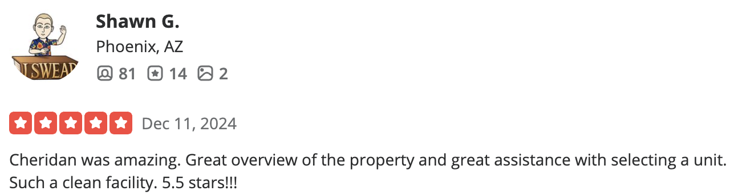
Customer Experience |
{{GBPREVIEWS}}
{{MOMCHANGEALL}}
{{MOMCHANGE}}
Total Reviews
MoM Change (All Platforms)
MoM Change (Google)
{{GGLRAT}}
Google Rating
TOP REVIEWS
{{REVIEW3}}
“{{REVIEW3BIO}}”
{{REVIEW1}}
“{{REVIEW1BIO}}”
{{REVIEW2}}
“{{REVIEW2BIO}}”

Slide 13
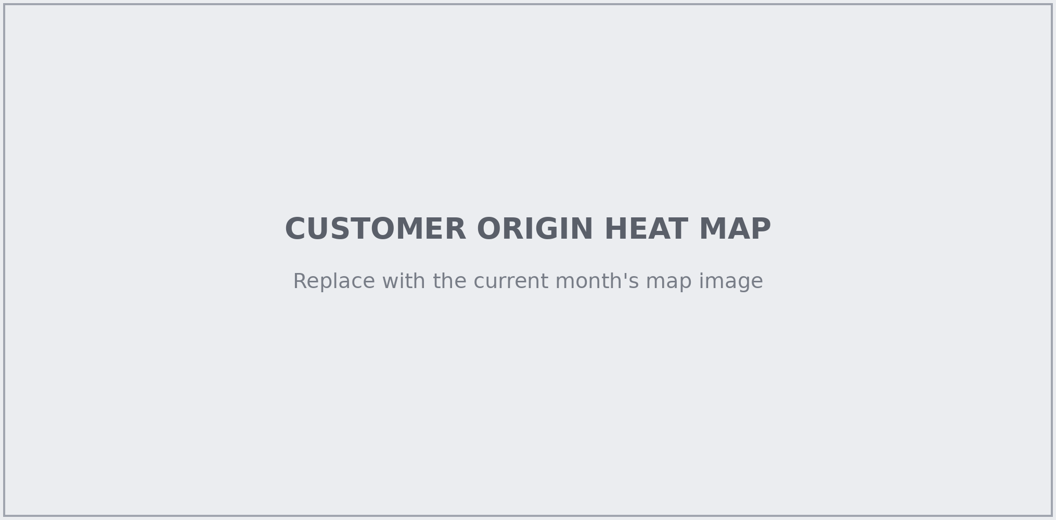
Customer Origin Heat Map
Home addresses of every active customer, plotted as a density map. Darker red shading is more customers from that area.
Low
High

Slide 14
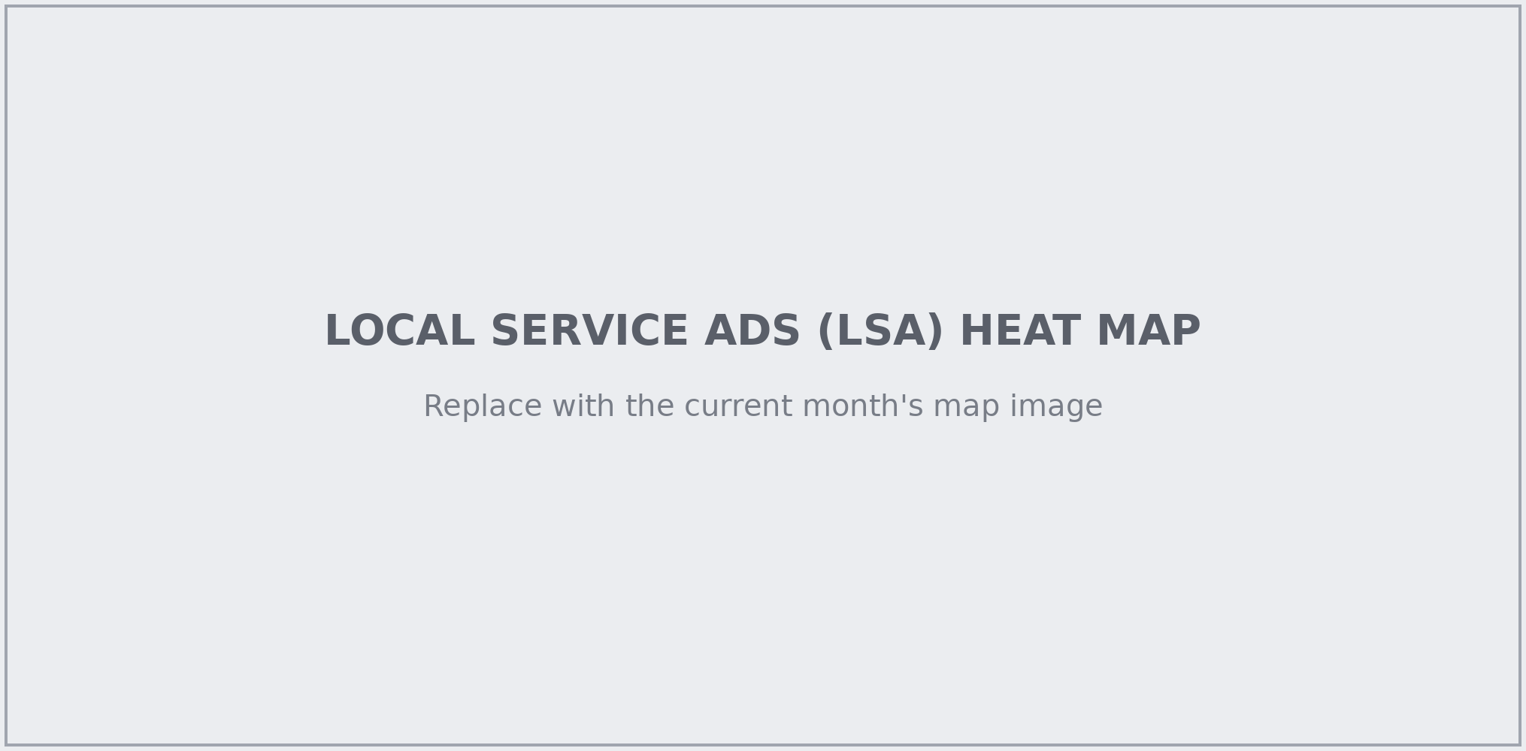
Local Service Ads (LSA) Heat Map |
Where Google Local Service Ads for {{PROPERTYNAME}} are shown to nearby searchers. Darker red shading means heavier ad activity.
Low
High

Slide 15
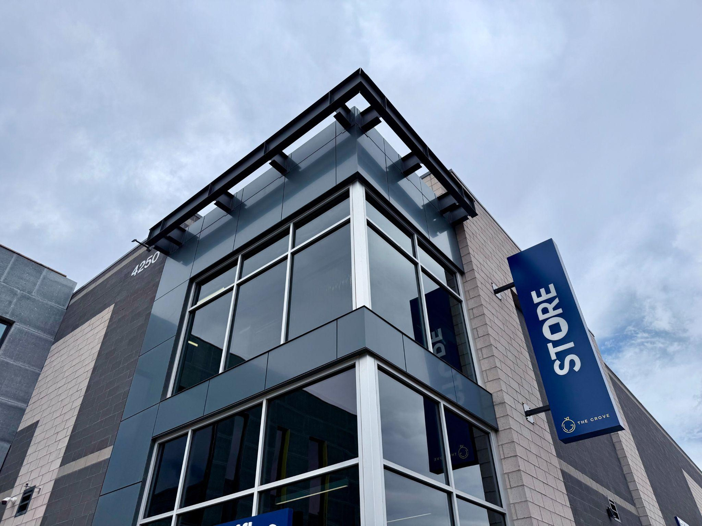
OWNER SUMMARY REPORT
{{CURRENTDATE}}
2111 E. Highland Avenue
Suite 360
Phoenix, AZ 85016
www.STOREstorage.com

