Slide 1
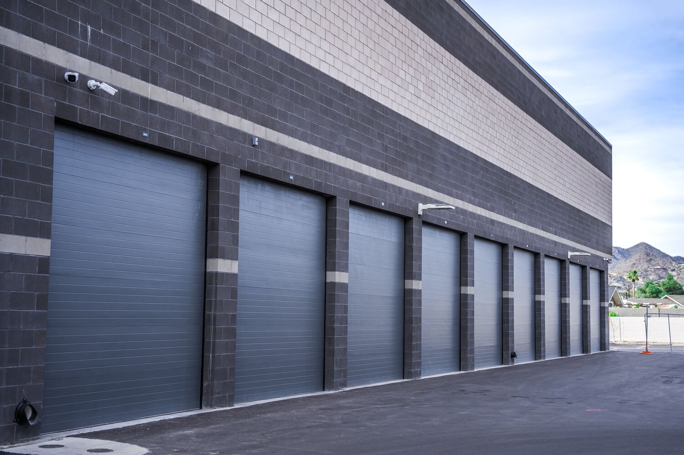
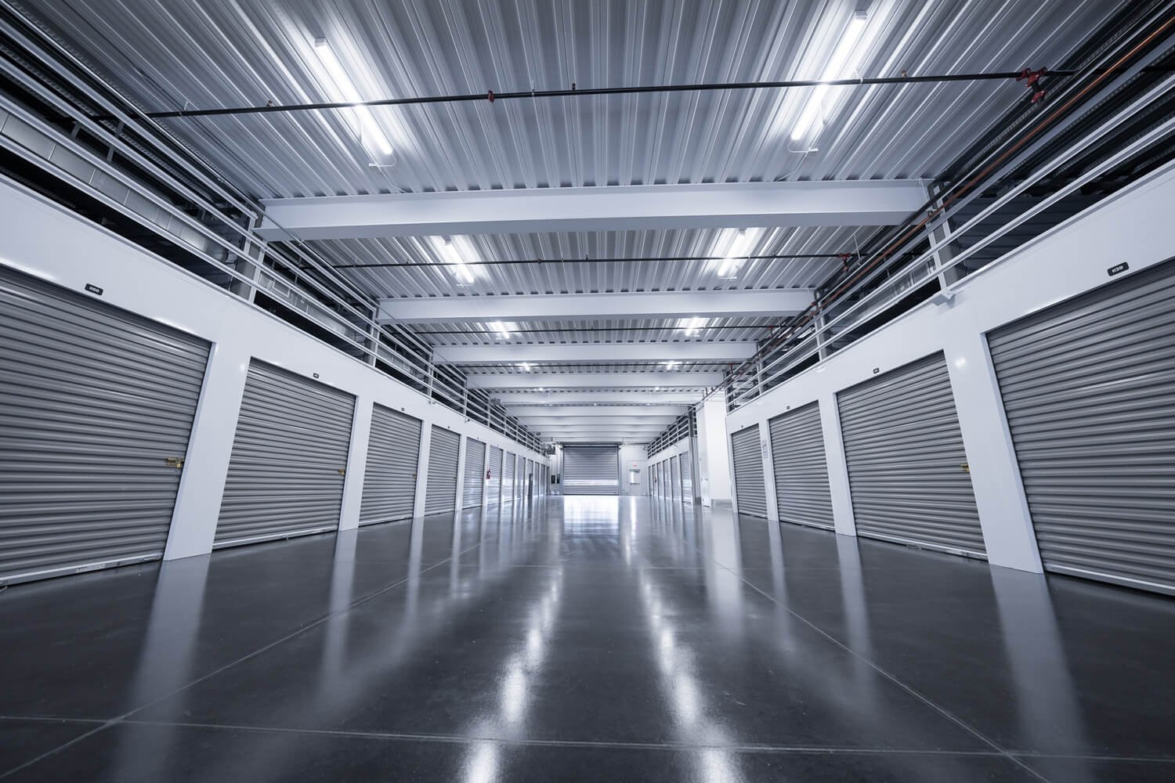


OWNER SUMMARY REPORT
{{CURRENTDATE}}
ADDRESS
{{ADDRESS}}
OWNERS
{{OWNERGROUP}}
MANAGEMENT ACQUIRED DATE
{{ACQUIREDDATE}}
TOTAL UNITS
{{TOTALUNITS}}
RENTABLE SQUARE FEET
{{RENTABLESQFT}}

Slide 2
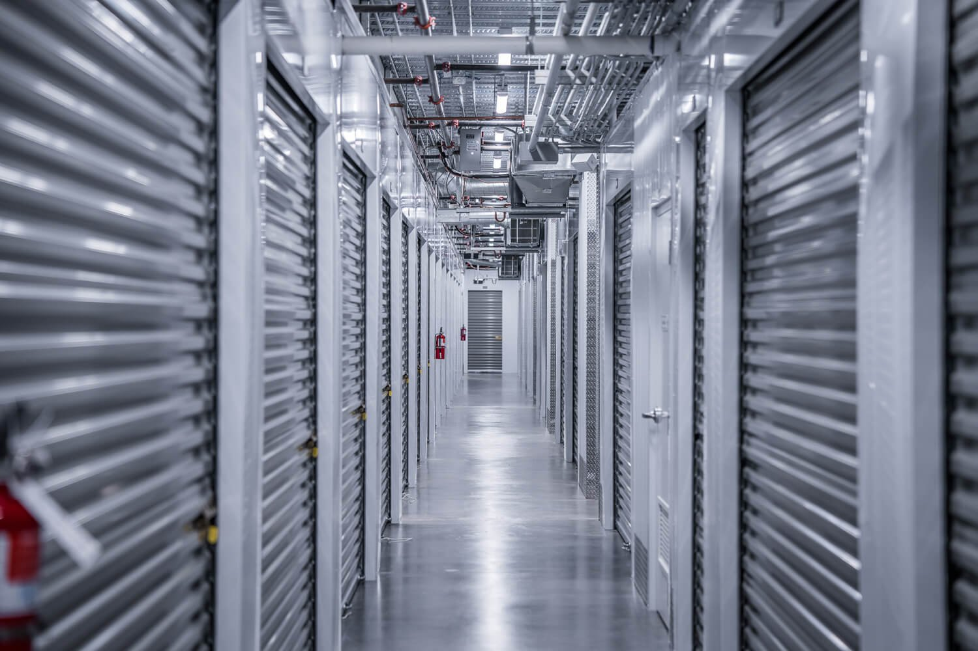
{{CURRENTMONTH}} Performance
FINANCIAL
{{TOTALRENTALINCOME}}
{{TOTALINCOME}}
{{TOTALEXPENSES}}
{{NETINCOME}}
Total Rental Income
Total Income
Total Expenses
Net Income
OCCUPANCY
{{OCCUPIEDAREASQFT}}
{{OCCUPANCYBYUNITS}}
{{OCCUPIEDAREAPERCENT}}
Occupied Area
Occupancy by units
Occupancy by area
2
Owner Summary Report | {{CURRENTDATE}}
2

Slide 3
{{CURRENTMONTH}} Data
 | {{CURRENTMONTH}} | PTD Budget | Variance | % Var |  | YTD Actual | YTD Budget | Variance | % Var
Rental Income | {{RENTINCCM}} | {{RENTINCPTD}} | {{RENTINCVAR}} | {{RENTINCVARPER}} |  | {{RENTINCYTD}} | {{RENTINCYTDBUD}} | {{RENTINCYTDVAR}} | {{RENTINCYTDVARPER}}
Discounts | {{DISCCM}} | {{DISCPTD}} | {{DISCVAR}} | {{DISCVARPER}} |  | {{DISCYTD}} | {{DISCYTDBUD}} | {{DISCYTDVAR}} | {{DISCYTDVARPER}}
TOTAL RENTAL INCOME | {{TOTRENINCCM}} | {{TOTRENINCPTD}} | {{TOTRENINCVAR}} | {{TOTRENINCVARPER}} |  | {{TOTRENINCYTD}} | {{TOTRENINCYTDBUD}} | {{TOTRENINCYTDVAR}} | {{TOTRENINCYTDVARPER}}
Tenant Income - Admin Fees | {{ADMFECM}} | {{ADMFEEPTD}} | {{ADMFEEVAR}} | {{ADMFEVARPER}} |  | {{ADMFEEYTD}} | {{ADMFEEYTDBUD}} | {{ADMFEEYTDVAR}} | {{ADMFEEYTDVARPER}}
Tenant Income - Late Fees | {{LATFEECM}} | {{LATFEEPTD}} | {{LATFEEVAR}} | {{LATFEEVARPER}} |  | {{LATFEEYTD}} | {{LATFEEYTDBUD}} | {{LATFEEYTDVAR}} | {{LATFEEYTDVARPER}}
Tenant Income – Insurance | {{INSURCM}} | {{INSURPTD}} | {{INSURVAR}} | {{INSURVARPER}} |  | {{INSURYTD}} | {{INSURYTDBUD}} | {{INSURYTDVAR}} | {{INSURYTDVARPER}}
Tenant Income – Other | {{OTHERCM}} | {{OTHERPTD}} | {{OTHERVAR}} | {{OTHERVARPER}} |  | {{OTHERYTD}} | {{OTHERYTDBUD}} | {{OTHERYTDVAR}} | {{OTHERYTDVARPER}}
Retail Sales | {{RETSALCM}} | {{RETSALPTD}} | {{RETSALVAR}} | {{RETSALVARPER}} |  | {{RETSALYTD}} | {{RETSALYTDBUD}} | {{RETSALYTDVAR}} | {{RETSALYTDVARPER}}
Secure Payment Processing | {{SECPPCM}} | {{SECPPPTD}} | {{SECPPVAR}} | {{SECPPVARPER}} |  | {{SECPPYTD}} | {{SECPPYTDBUD}} | {{SECPPYTDVAR}} | {{SECPPYTDVARPER}}
TOTAL INCOME | {{TOTALINCCM}} | {{TOTALINCPTD}} | {{TOTALINCVAR}} | {{TOTALINCVARPER}} |  | {{TOTALINCYTD}} | {{TOTALINCYTDBUD}} | {{TOTALINCYTDVAR}} | {{TOTALINCYTDVARPER}}
PROPERTY EXPENSES
Advertising & Marketing | {{ADVERCM}} | {{ADVERPTD}} | {{ADVERVAR}} | {{ADVERVARPER}} |  | {{ADVERYTD}} | {{ADVERYTDBUD}} | {{ADVERYTDVAR}} | {{ADVERYTDVARPER}}
Auction Expenses | {{AUCTCM}} | {{AUCTPTD}} | {{AUCTVAR}} | {{AUCTVARPER}} |  | {{AUCTYTD}} | {{AUCTYTDBUD}} | {{AUCTYTDVAR}} | {{AUCTYTDVARPER}}
CAM Charges | {{CAMCM}} | {{CAMPTD}} | {{CAMVAR}} | {{CAMVARPER}} |  | {{CAMYTD}} | {{CAMYTDBUD}} | {{CAMYTDVAR}} | {{CAMYTDVARPER}}
Credit Card Merchant Fees | {{CCMCM}} | {{CCMPTD}} | {{CCMVAR}} | {{CCMVARPER}} |  | {{CCMYTD}} | {{CCMYTDBUD}} | {{CCMYTDVAR}} | {{CCMYTDVARPER}}
Dues & Subscriptions | {{DUESCM}} | {{DUESPTD}} | {{DUESVAR}} | {{DUESVARPER}} |  | {{DUESYTD}} | {{DUESYTDBUD}} | {{DUESYTDVAR}} | {{DUESYTDVARPER}}
Fire Prevention | {{FIRECM}} | {{FIREPTD}} | {{FIREVAR}} | {{FIREVARPER}} |  | {{FIREYTD}} | {{FIREYTDBUD}} | {{FIREYTDVAR}} | {{FIREYTDVARPER}}
Insurance | {{INSURCM}} | {{INSURPTD}} | {{INSURVAR}} | {{INSURVARPER}} |  | {{INSURYTD}} | {{INSURYTDBUD}} | {{INSURYTDVAR}} | {{INSURYTDVARPER}}
Licenses & Permits | {{PERMCM}} | {{PERMPTD}} | {{PERMVAR}} | {{PERMVARPER}} |  | {{PERMYTD}} | {{PERMYTDBUD}} | {{PERMYTDVAR}} | {{PERMYTDVARPER}}
Management Fees | {{MGMTCM}} | {{MGMTPTD}} | {{MGMTVAR}} | {{MGMTVARPER}} |  | {{MGMTYTD}} | {{MGMTYTDBUD}} | {{MGMTYTDVAR}} | {{MGMTYTDVARPER}}
Management Fees - Staff Costs | {{MGMTSTFCM}} | {{MGMTSTFPTD}} | {{MGMTSTFVAR}} | {{MGMTSTFVARPER}} |  | {{MGMTSTFYTD}} | {{MGMTSTFYTDBUD}} | {{MGMTSTFYTDVAR}} | {{MGMTSTFYTDVARPER}}
Office Supplies | {{OFFSUPCM}} | {{OFFSUPPTD}} | {{OFFSUPVAR}} | {{OFFSUPVARPER}} |  | {{OFFSUPYTD}} | {{OFFSUPYTDBUD}} | {{OFFSUPYTDVAR}} | {{OFFSUPYTDVARPER}}
Professional Fees | {{PROFCM}} | {{PROFPTD}} | {{PROFVAR}} | {{PROFVARPER}} |  | {{PROFYTD}} | {{PROFYTDBUD}} | {{PROFYTDVAR}} | {{PROFYTDVARPER}}
Repairs & Maintenance | {{REPCM}} | {{REPPTD}} | {{REPVAR}} | {{REPVARPER}} |  | {{REPYTD}} | {{REPYTDBUD}} | {{REPYTDVAR}} | {{REPYTDVARPER}}
Retail Products | {{RETACM}} | {{RETAPTD}} | {{RETAVAR}} | {{RETAVARPER}} |  | {{RETPRODYTD}} | {{RETAYTDBUD}} | {{RETAYTDVAR}} | {{RETAYTDVARPER}}
Security | {{SECCM}} | {{SECPTD}} | {{SECVAR}} | {{SECVARPER}} |  | {{SECYTD}} | {{SECYTDBUD}} | {{SECYTDVAR}} | {{SECYTDVARPER}}
Software | {{SOFTCM}} | {{SOFTPTD}} | {{SOFTVAR}} | {{SOFTVARPER}} |  | {{SOFTYTD}} | {{SOFTYTDBUD}} | {{SOFTYTDVAR}} | {{SOFTYTDVARPER}}
Supplies - Building | {{SUPCM}} | {{SUPPTD}} | {{SUPVAR}} | {{SUPVARPER}} |  | {{SUPYTD}} | {{SUPYTDBUD}} | {{SUPYTDVAR}} | {{SUPYTDVARPER}}
Telephone & Internet | {{INTERCM}} | {{INTERPTD}} | {{INTERVAR}} | {{INTERVARPER}} |  | {{INTERYTD}} | {{INTERYTDBUD}} | {{INTERYTDVAR}} | {{INTERYTDVARPER}}
Utilities | {{UTILCM}} | {{UTILPTD}} | {{UTILVAR}} | {{UTILVARPER}} |  | {{UTILYTD}} | {{UTILYTDBUD}} | {{UTILYTDVAR}} | {{UTILYTDVARPER}}
TOTAL PROPERTY EXPENSES | {{TOTALPROPCM}} | {{TOTALPROPPTD}} | {{TOTALPROPVAR}} | {{TOTALPROPVARPER}} |  | {{TOTALPROPYTD}} | {{TOTALPROPYTDBUD}} | {{TOTALPROPYTDVAR}} | {{TOTALPROPYTDVARPER}}
TOTAL OTHER EXPENSES | {{TOTOTHEXPCM}} | {{TOTOTHEXPPTD}} | {{TOTOTHEXPVAR}} | {{TOTOTHEXPVARPER}} |  | {{TOTOTHEXPYTD}} | {{TOTOTHEXPYTDBUD}} | {{TOTOTHEXPYTDVAR}} | {{TOTOTHEXPYTDVARPER}}
TOTAL EXPENSES | {{TOTEXPCM}} | {{TOTEXPPTD}} | {{TOTEXPVAR}} | {{TOTEXPVARPER}} |  | {{TOTEXPYTD}} | {{TOTEXPYTDBUD}} | {{TOTEXPYTDVAR}} | {{TOTEXPYTDVARPER}}
Interest Income | {{INTINCCM}} | {{INTINCPTD}} | {{INTINCVAR}} | {{INTINCVARPER}} |  | {{INTINCYTD}} | {{INTINCYTDBUD}} | {{INTINCYTDVAR}} | {{INTINCYTDVARPER}}
NET INCOME | {{NETINCCM}} | {{NETINCPTD}} | {{NETINCVAR}} | {{NETINCVARPER}} |  | {{NETINCYTD}} | {{NETINCYTDBUD}} | {{NETINCYTDVAR}} | {{NETINCYTDVARPER}}

Slide 4
{{CURRENTMONTH}} Performance
{{CURRENTMONTH}}
{{NETMOVE}}
{{MOVEINS}}
{{MOVEOUTS}}
Move-ins
Move-outs
Net
{{MOVIPER}} {{INCORDEC1}} vs. {{PREVMON}}
{{MOVOPER}} {{INCORDEC2}} vs. {{PREVMON}}
{{MOVN}} {{INCORDEC3}} vs. {{PREVMON}}
TRAILING 3-MONTH
{{MOVEOUTSTRL3}}
{{NETTRL3}}
{{MOVEINSTRL3}}
Move-ins
Move-outs
Net
TRAILING 6-MONTH
{{MOVEINSTRL6}}
{{MOVEOUTSTRL6}}
{{NETTRL6}}
Move-ins
Move-outs
Net
TRAILING 12-MONTH
{{MOVEINSTRL12}}
{{MOVEOUTSTRL12}}
{{NETTRL12}}
Move-ins
Move-outs
Net
Trailing number includes current month.
4
Owner Summary Report | {{CURRENTDATE}}
4

Slide 5
{{CURRENTMONTH}} Performance
SUMMARY
RATE MANAGEMENT
KPI | Current | Last Month Value
SqFt Occupancy | {{SFTOC}} | {{SFTOCLM}}
MTD MoveIns | {{MTDMI}} | {{MTDMILM}}
$/SqFt MoveIns | {{DSFTMI}} | {{DSFTMILM}}
MTD Moveouts | {{MTDMO}} | {{MTDMOLM}}
$/SqFt MoveOuts | {{DSFTMO}} | {{DSFTMOLM}}
% Occ Units LOR > 6 Months | {{PERLOR}} | {{PERLORLM}}
Avg LOR of MoveOuts | {{AVGLOR}} | {{AVGLORLM}}
% MoveIns with Promo | {{PROMO}} | {{PROMOLM}}
{{NEXTMONTH}} ECRI | {{CURRENTMONTH}} In-place Rent Escalations (4-6 months since last increase)
Number of rent increase letters sent | {{NUMREN}}
Total square footage | {{TOTSFT}}
Base rental rate; prior to ECRI ($/sq ft) | {{BASERENPR}}
Total $ increase with ECRI | {{TOTINCESC}}
New rental rate, after ECRI ($/sq ft) | {{NEWRENRT}}
Average percent increase per unit | {{AVGPERINC}}
Definitions in rate management report.
Blank fields are due to missing historical data from seller
Owner Summary Report | {{CURRENTDATE}}
5

Slide 6
Rate Management | Current Sell Rate
Unit | Current Sell Rate | Sell Rate ($/sq ft) | Set Rate
5 x 5 | {{5X5WEBPR}} | {{5X5WEBRT}} | {{5X5WEBPR}}
10 x 5 | {{10X5WEBPR}} | {{10X5WEBRT}} | {{10X5WEBPR}}
10 x 10 | {{10X10WEBPR}} | {{10X10WEBRT}} | {{10X10WEBPR}}
10 x 15 | {{10X15WEBPR}} | {{10X15WEBRT}} | {{10X15WEBPR}}
10 x 20 | {{10X20WEBPR}} | {{10X20WEBRT}} | {{10X20WEBPR}}
15 x 5 | {{15X5WEBPR}} | {{15X5WEBRT}} | {{15X5WEBPR}}
20 x 15 | {{20X15WEBPR}} | {{20X15WEBRT}} | {{20X15WEBPR}}
FLOOR 1 UNITS
Unit | Current Sell Rate | Sell Rate ($/sq ft) | Set Rate
5 x 5 | {{5X5WEBPREV}} | {{5X5WEBPREVRT}} | {{5X5WEBPREV}}
10 x 5 | {{10X5WEBPREV}} | {{10X5WEBPREVRT}} | {{10X5WEBPREV}}
10 x 10 | {{10X10WEBPREV}} | {{10X10WEBPREVRT}} | {{10X10WEBPREV}}
10 x 15 | {{10X15WEBPREV}} | {{10X15WEBPREVRT}} | {{10X15WEBPREV}}
10 x 20 | {{10X20WEBPREV}} | {{10X20WEBPREVRT}} | {{10X20WEBPREV}}
20 x 15 | {{20X15WEBPREV}} | {{20X15WEBPREVRT}} | {{20X15WEBPREV}}
ELEVATOR UNITS
Sell Rates are only available for vacant spaces
6
Owner Summary Report | {{CURRENTDATE}}
6

Slide 7
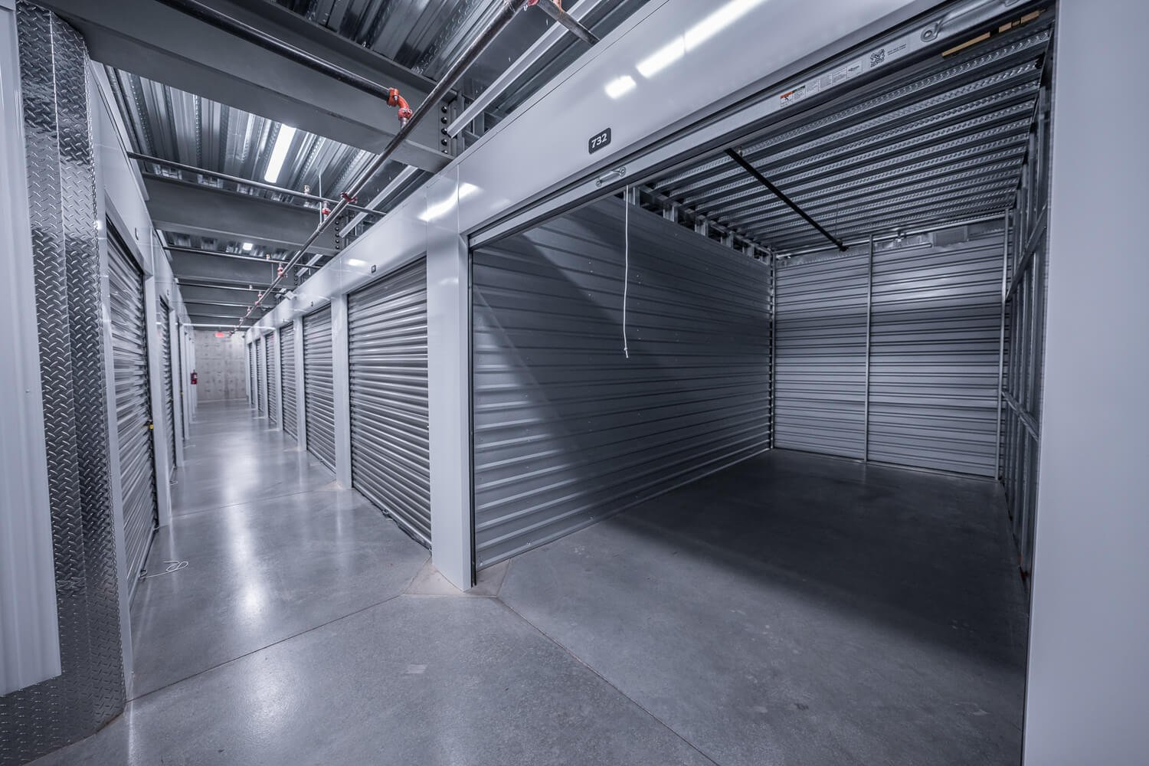
{{CURRENTMONTH}} Operational Snapshot
{{MTDRENTALS}}
{{MTDVACATES}}
{{MTDNETRENTALS}}
MTD Rentals
MTD Vacates
MTD Net
{{PROJRENT}}
{{PROJRENTPERSF}}
Projected Rent
Projected Rent/SF
{{EFFPOTRENT}}
{{AVGSFVACA}}
Sell Rate Pot. Rent
Sell Rate/SF
{{GROSSPOTRENT}}
{{GROSSPOTRENTRATE}}
Gross Pot. Rent
GPR Rate/SF
Additional information can be found in the daily flash report.
7
Owner Summary Report | {{CURRENTDATE}}
7

Slide 8
Tenant Protection Capture Rate
{{CURRENTMONTH}}
{{INSURPER}}
Total Protected
OVERALL
{{OVERALLPER}}
Protected Percentage
TPP excludes parking spaces and wine storage
8
Owner Summary Report | {{CURRENTDATE}}
8

Slide 9
Repair and Maintenance Budget Variance
 | Month-to-date | Year-to-date
Budget | {{REPCM}} | {{REPYTDBUD}}
Actual | {{REPPTD}} | {{REPYTD}}
Variance | {{REPVAR}} | {{REPYTDVAR}}
MANAGEMENT NOTES
N/A
REPAIR LOG
DATE: {{REPAIRDATE}} DESCRIPTION OF EXPENSES: {{REPAIRDESCRIP}} COST: {{REPAIRCOST}} STATUS: {{REPAIRSTATUS}}
9
Owner Summary Report | {{CURRENTDATE}}
9

Slide 10
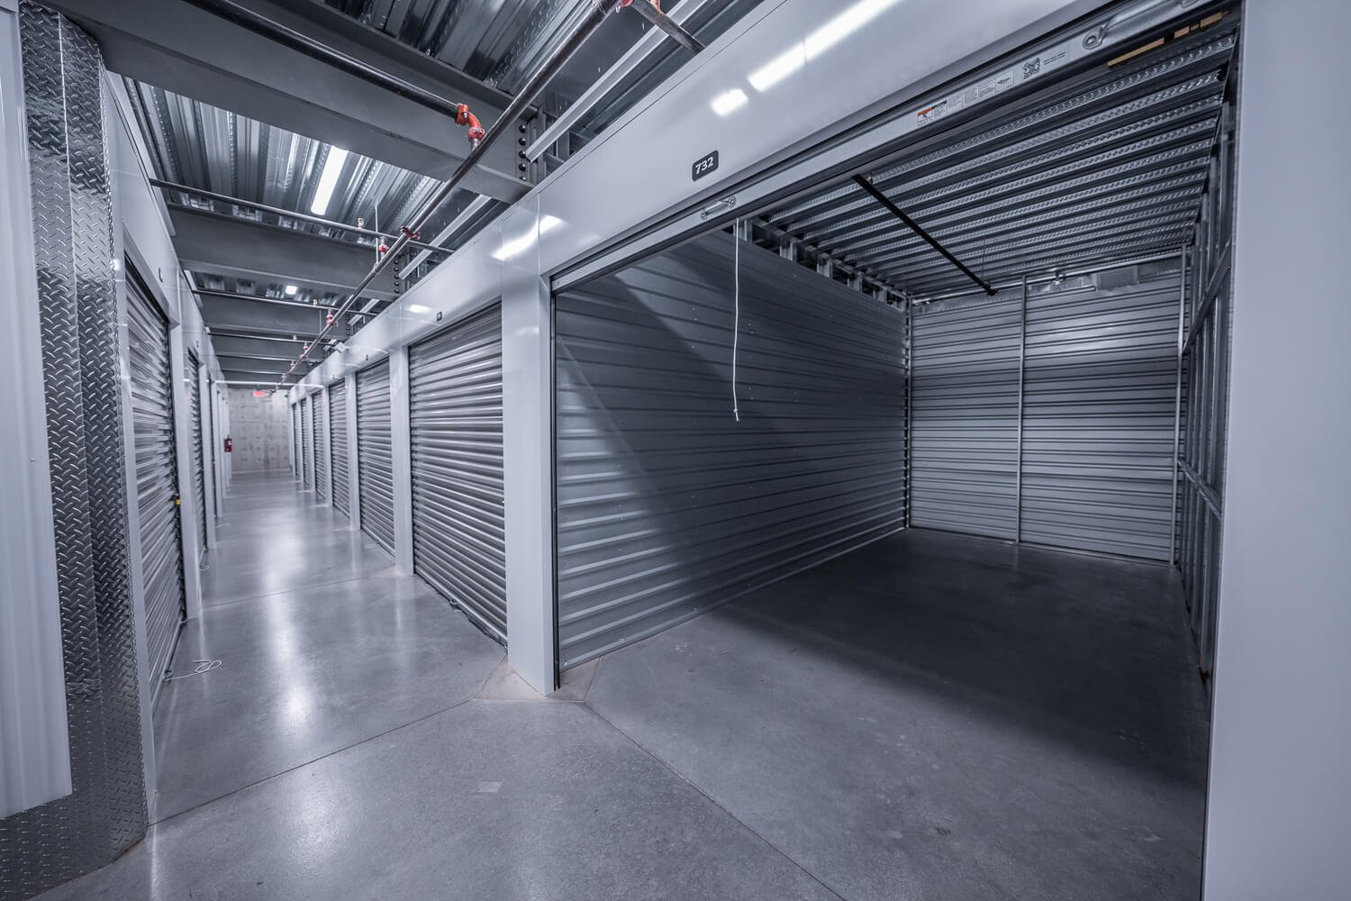
Delinquent Rent
DELINQUENT RENT | DELINQUENT RENT | DELINQUENT RENT | DELINQUENT RENT
Days | Percent | Units | Dollars
1-30 | {{DELINPER30}} | {{DELINUNIT30}} | {{DELINDOL30}}
31-60 | {{DELINPER60}} | {{DELINUNIT60}} | {{DELINDOL60}}
61+ | {{DELINPER61}} | {{DELINUNIT61}} | {{DELINDOL61}}
Percent is total delinquent rent against total rental income.
Owner Summary Report | May 2025
Owner Summary Report | {{CURRENTDATE}}
10
10

Slide 11
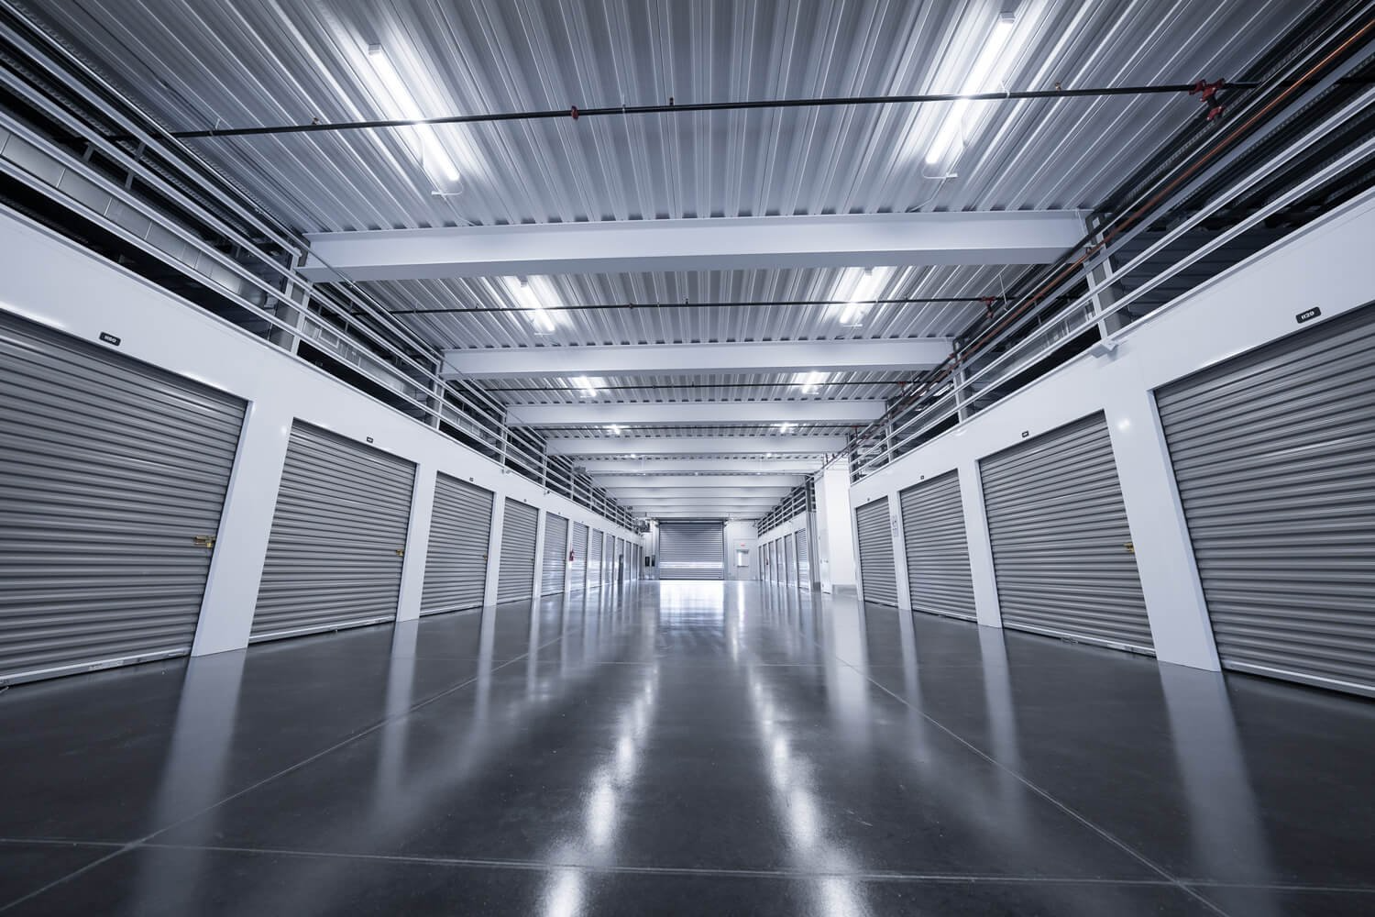

Marketing & Digital Performance |
{{GOOIMPRES}}
{{GOOCLICKS}}
{{GOOCONV}}
{{GOOCOSCON}}
Impressions
Total Clicks
Conversions
Cost/Conversion
XXX
Keyword Search Grid (MoM)
Google Rank Tracker (MoM)
{{GOOPOS}}
{{POSCHG}}
{{KEYMAP}}
{{KEYPOS}}
Avg Google Position
Position Change
Avg Map Rank
Position Change
*Results for “self storage near me”

Slide 12
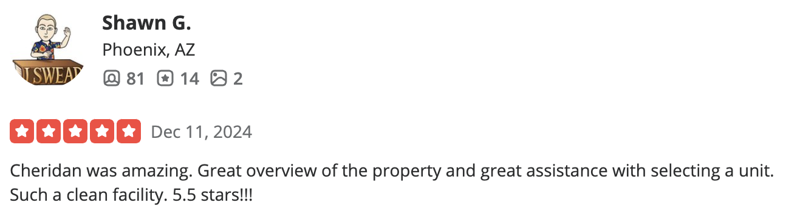

Customer Experience |
161
1
+1
Total GBP Reviews
MTD Reviews
MoM Change
4.9
Google Rating
NOVEMBER’S TOP REVIEWS
Koko Tzavaras
“Outstanding, helpful staff, beautiful facility, and excellent location! This is my second time being a client! Thank you!”
Hannah Pedersen
“Great service, easy, safe, great location”
Livier Delgadillo
“Great customer service from Andrew!”

Slide 13
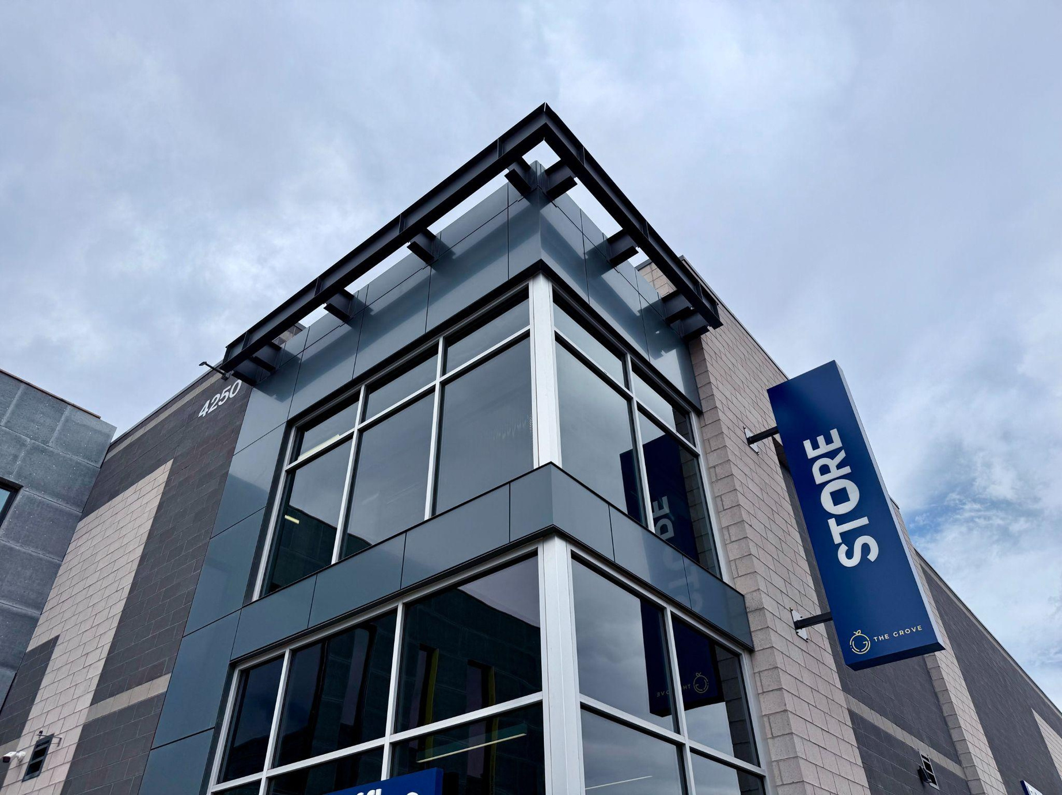
OWNER SUMMARY REPORT
{{CURRENTDATE}}
2111 E. Highland Avenue
Suite 360
Phoenix, AZ 85016
www.STOREstorage.com

