Slide 1


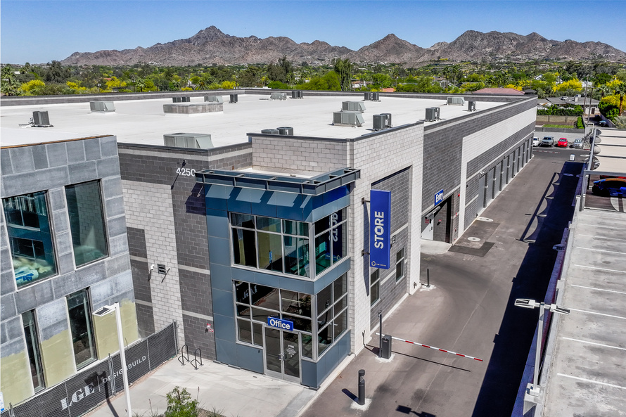
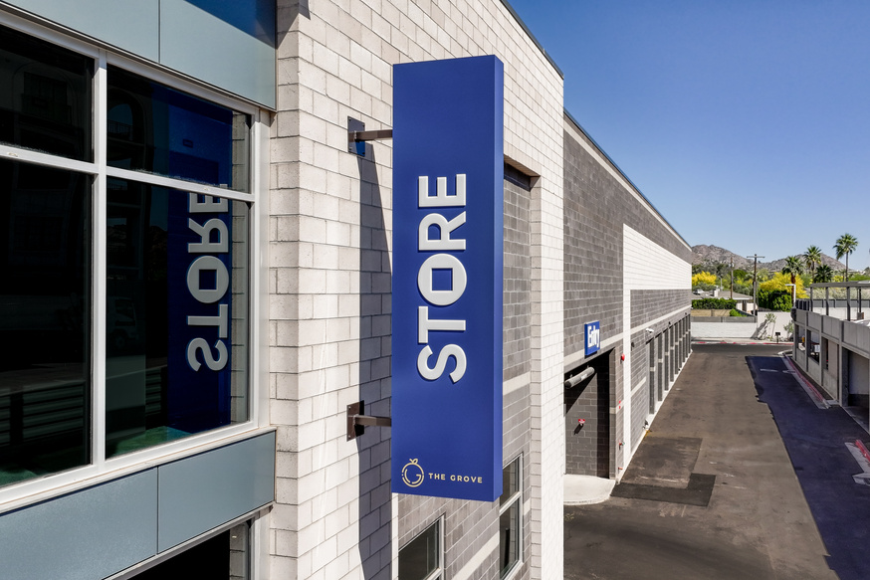
Daily Flash Report
{{FACILITYSHORTNAME}} · As of {{ASOFDATE}}
{{FACILITYCODE}} · {{FACILITYSHORTNAME}}
MTD Rentals | Daily Rentals | Leads (MTD) | Lead Conversion | MTD Vacates | Daily Vacates | MTD Net
{{MTDRENTALS}} | {{DAILYRENTALS}} | {{LEADSMTD}} | {{CONV}} | {{MTDVACATES}} | {{DAILYVACATES}} | {{MTDNETRENTALS}}
Total RSF | Occ RSF | RSF Occ % | Occ Units | Net SqFt Activity (MTD) | TPP Coverage % | AR > 30d %
{{TOTALRSF}} | {{OCCRSF}} | {{RSFOCCPCT}} | {{OCCUNITS}} | {{NETSQFTACTMTD}} | {{COVERAGE}} | {{AROVER30DAYSPCT}}
Total Revenue
Occupancy / RSF
Proj. Rent¹ | Proj. Rent / SF | Sell Rate + Pot. Rent² | Sell Rate / SqFt | Gross Pot. Rent³ | GPR / SqFt
{{PROJRENT}} | {{PROJRENTPERSF}} | {{EFFPOTRENT}} | {{AVGSFVACA}} | {{GROSSPOTRENT}} | {{GROSSPOTSFT}}
Total income from occupied space at in-place rents, including approved rate increases ¹
Total income if all vacant spaces were leased at the sell (current) rate plus proj. rent ²
Projected total income assuming 100% occupancy at the set (target) rental rates ³
STORE Managed since {{FACILITYOPENDATE}}

