Slide 1
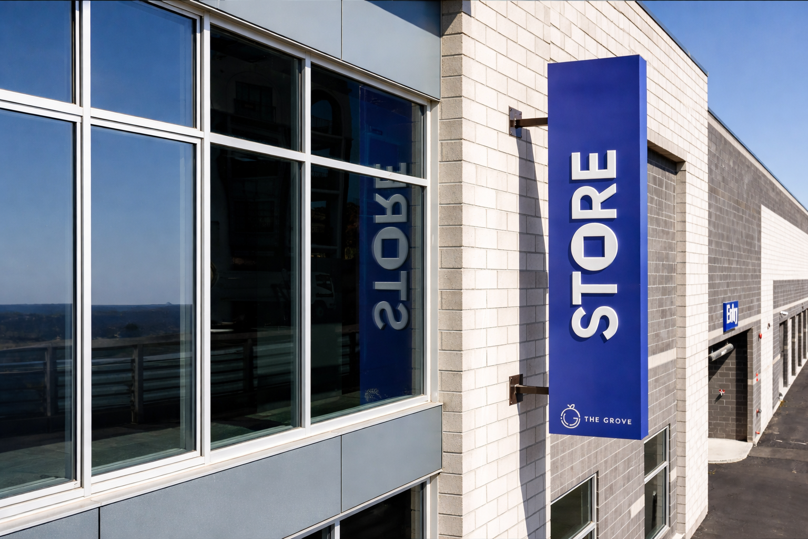

Property Analysis
Confidential | {{PUBLISHMONTHYEAR}}

Slide 2
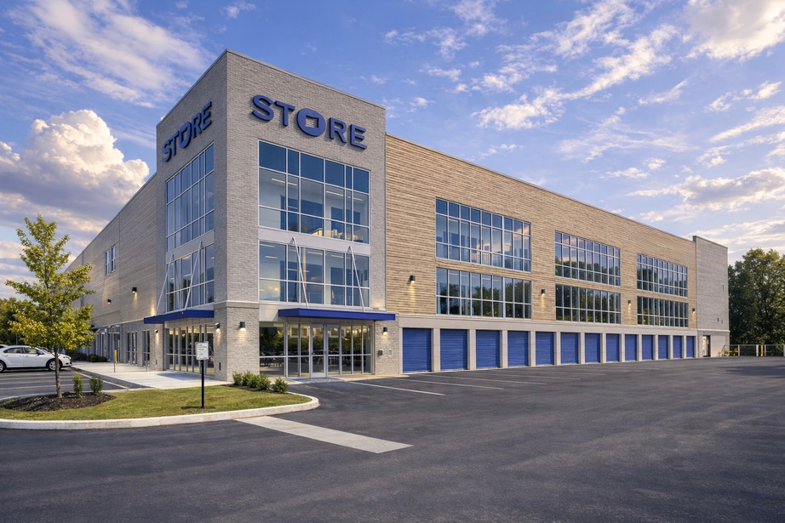

Property overview
{{NOIPERCENT}}% NOI Increase
Execution-led operational repositioning
${{REVENUELIFT}}k+ Revenue Lift
Dynamic pricing, tenant protection programs, and fee optimization
{{EXPREDPERC}} Expense Reduction
Fee optimization and disciplined cost controls
Investment Return Profile
Location: Primary Market in {{REGION}}
3-Year Hold | {{3YIRR}} IRR | {{3YMUL}}
5-Year Hold | {{5YIRR}} IRR | {{5YMUL}}
7-Year Hold | {{7YIRR}} IRR | {{7YMUL}}
${{ASSETVALUE}} Asset Value Added

Slide 3
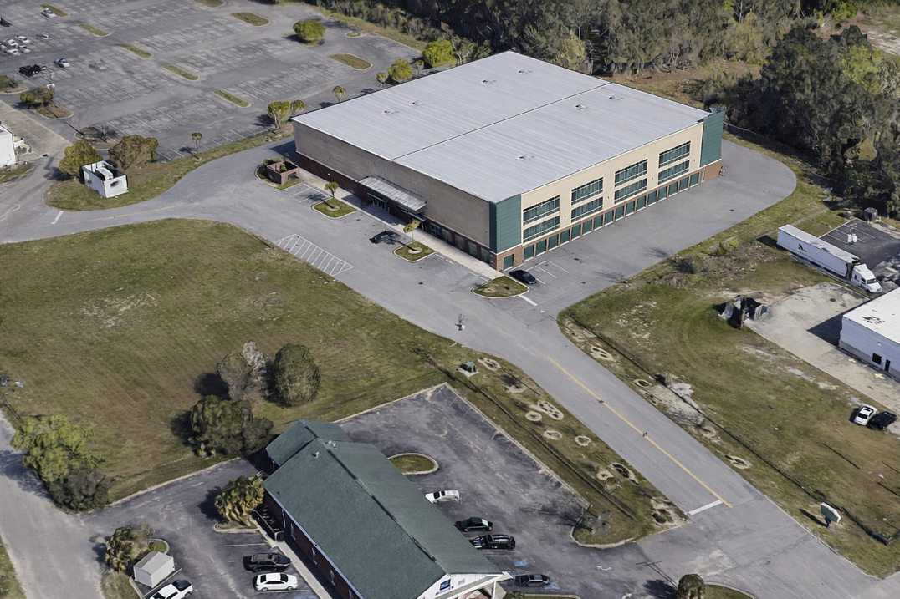

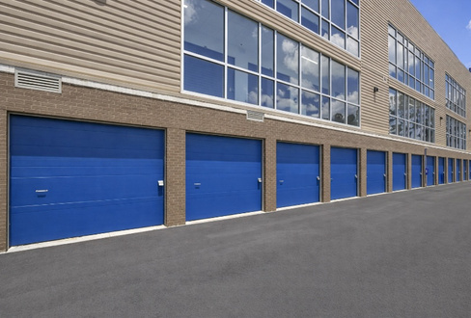

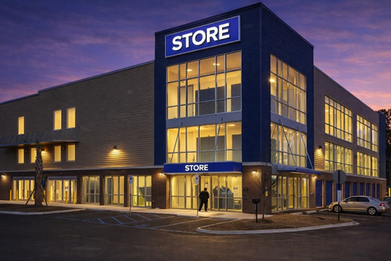


Market & Property Snapshot
{{OCCPER}}
Occupancy
{{RENTSQFT}}
Rentable SqFt
{{UNITS}}
Total Units
{{RATING}} Rating
{{REVIEWS}} Reviews
{{SNAPSHOTDESCRIPTION}}

