Slide 1


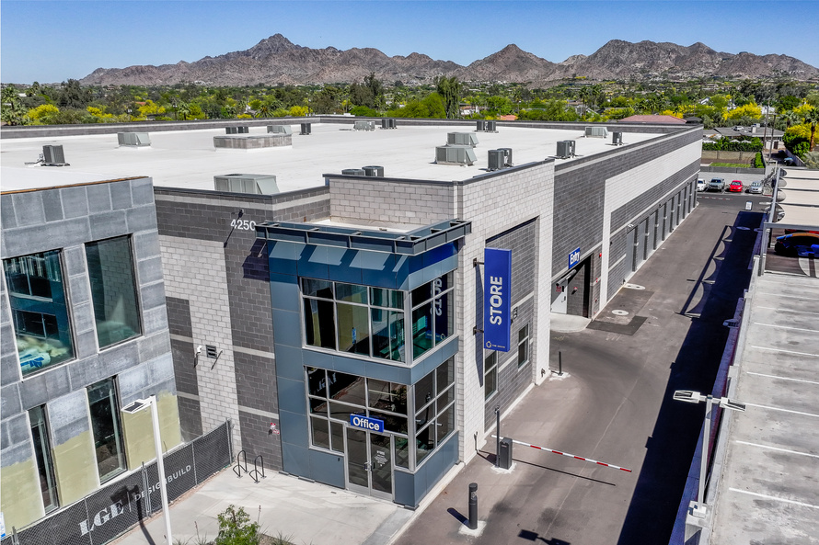
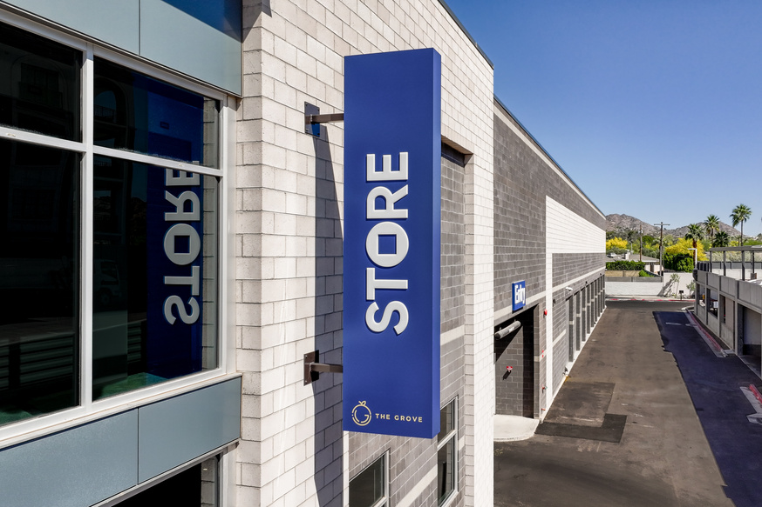
Daily Flash Report
{{FACILITYSHORTNAME}} · As of {{ASOFDATE}}
{{FACILITYCODE}} · {{FACILITYSHORTNAME}}
MTD Rentals | Daily Rentals | Leads (MTD) | Lead Conversion | MTD Vacates | Daily Vacates | MTD Net
{{MTDRENTALS}} | {{DAILYRENTALS}} | {{LEADSMTD}} | {{CONV}} | {{MTDVACATES}} | {{DAILYVACATES}} | {{MTDNETRENTALS}}
Total RSF | Occ RSF | RSF Occ % | Occ Units | Net SqFt Activity (MTD) | TPP Coverage % | AR > 30d %
{{TOTALRSF}} | {{OCCRSF}} | {{RSFOCCPCT}} | {{OCCUNITS}} | {{NETSQFTACTMTD}} | {{COVERAGE}} | {{AROVER30DAYSPCT}}
AR Aging
Occupancy
Proj. Rent | Proj. Rent / SF | Proj. Rent MoM | *Gross Pot. Rent | GPR / SF | Sell Rate | **Econ Occ.
{{PROJRENT}} | {{PROJRENTPERSF}} | {{PROJRENTMOMPCT}} | {{GROSSPOTRENT}} | {{GPRPERSF}} | {{GPRMOMPCT}} | {{ECONOCCPCT}}
*The total income of all spaces rented at posted rates including projected rate increases
STORE Managed since {{FACILITYOPENDATE}}
**The ratio of occupied revenue (the sum of the current rent for all occupied spaces) to potential revenue (the sum of the sell rates for all spaces), expressed as a percentage

