Slide 1
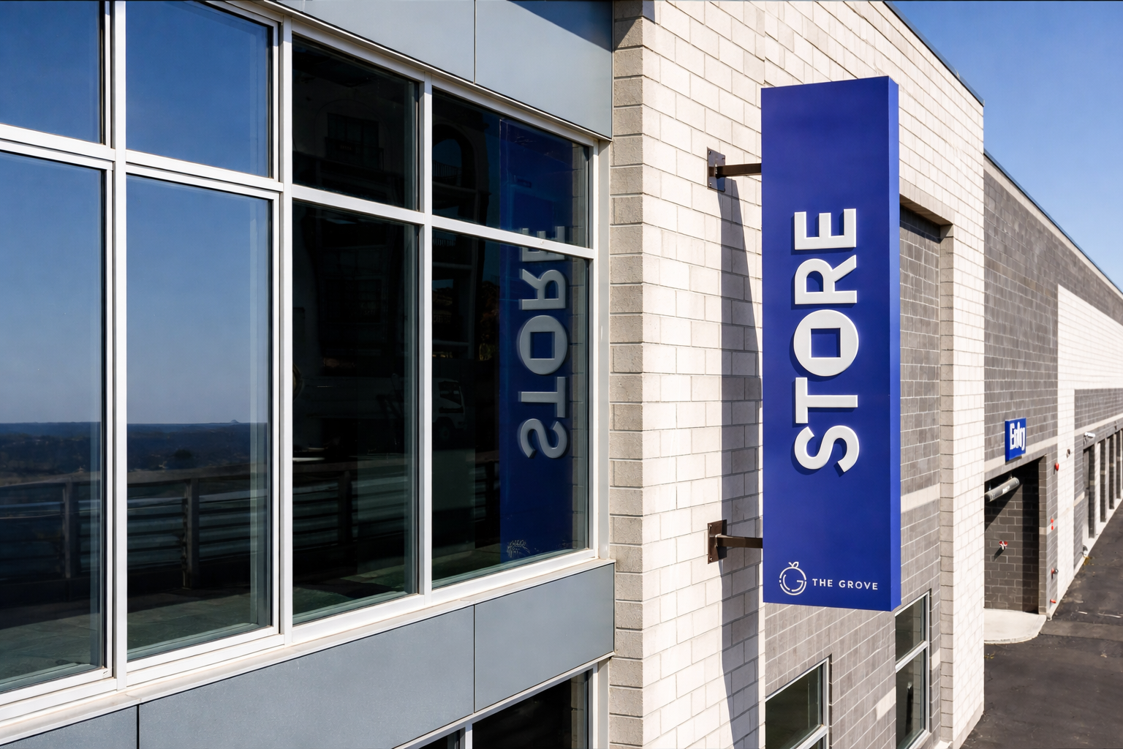

Acquisition &
Return Analysis
Confidential | {{PUBLISHMONTHYEAR}}

Slide 2

Value Creation Summary
{{NOIPERCENT}}% NOI Increase
Execution-led operational repositioning
${{REVENUELIFT}}K+ Revenue Lift
Dynamic pricing, tenant protection programs, and fee optimization
{{EXPREDPERC}} Expense Reduction
Fee optimization and disciplined cost controls
Investment Return Profile | Investment Return Profile | Investment Return Profile
3-Year Hold | {{3YIRR}} IRR | {{3YMUL}}
5-Year Hold | {{5YIRR}} IRR | {{5YMUL}}
7-Year Hold | {{7YIRR}} IRR | {{7YMUL}}
${{ASSETVALUE}} Asset Value Added

Slide 3
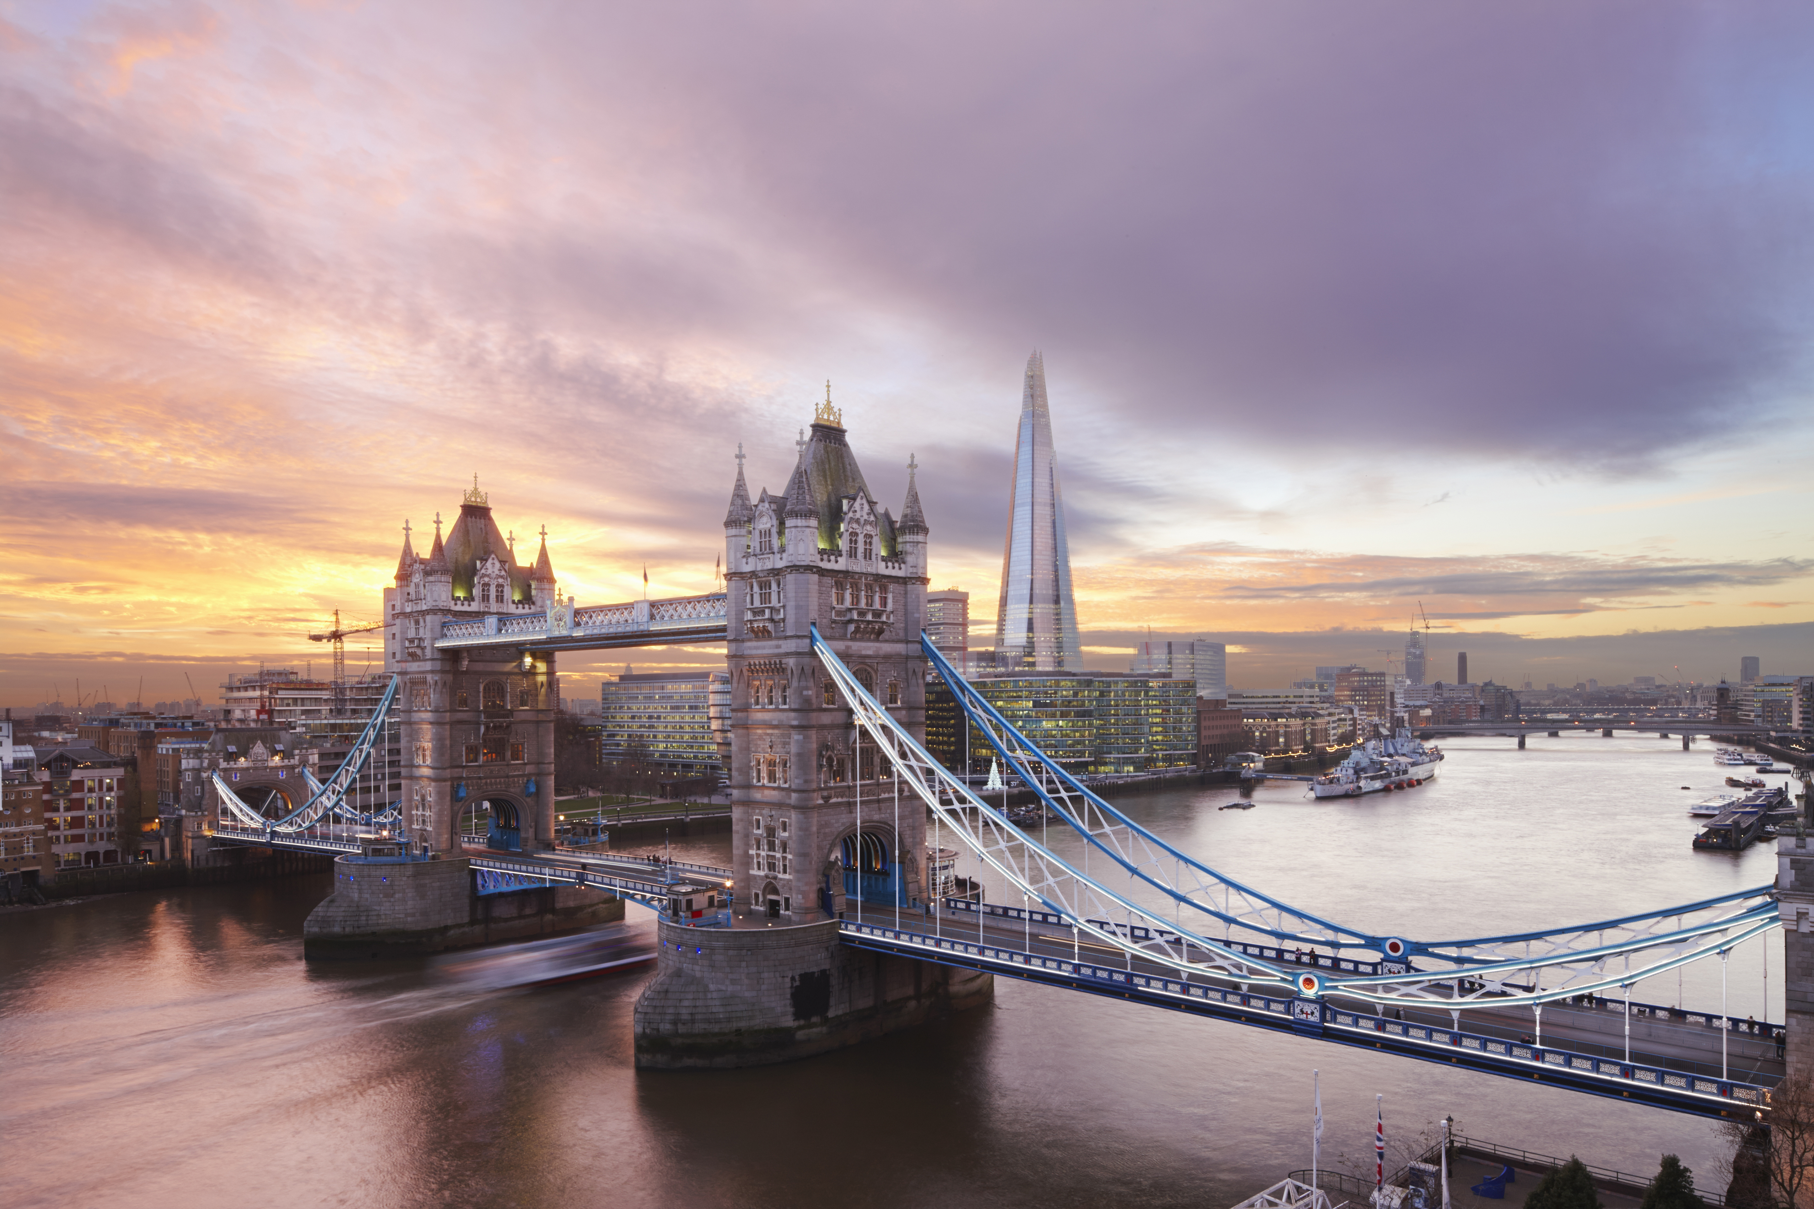
Market & Property Snapshot
{{OCCPER}}
Occupancy
{{RENTSQFT}}
Rentable SqFt
{{UNITS}}
Total Units
{{RATING}} Rating
{{REVIEWS}} Reviews
{{SNAPSHOTDESCRIPTION}}

Slide 4
1-Year Proforma
INCOME | T-12 AVG | T-12 | APR 2026 | MAY 2026 | JUN 2026 | JUL 2026 | AUG 2026 | SEP 2026 | OCT 2026 | NOV 2026 | DEC 2026 | JAN 2027 | FEB 2027 | MAR 2027 | STORE | CURRENT MANAGEMENT | IMPACT TO N.O.I.
Rental Income | {{CELL0003}} | {{CELL0004}} | {{CELL0005}} | {{CELL0006}} | {{CELL0007}} | {{CELL0008}} | {{CELL0009}} | {{CELL0010}} | {{CELL0011}} | {{CELL0012}} | {{CELL0013}} | {{CELL0014}} | {{CELL0015}} | {{CELL0016}} | {{CELL0017}} | {{CELL0018}} | {{CELL0019}}
STORE Rate Management Revenue | {{CELL1000}} | {{CELL1001}} | {{CELL1002}} | {{CELL1003}} | {{CELL1004}} | {{CELL0020}} | {{CELL0021}} | {{CELL0022}} | {{CELL0023}} | {{CELL0024}} | {{CELL0025}} | {{CELL0026}} | {{CELL0027}} | {{CELL0028}} | {{CELL0029}} | {{CELL1005}} | {{CELL0030}}
Discounts | {{CELL1006}} | {{CELL1007}} | {{CELL0031}} | {{CELL0032}} | {{CELL0033}} | {{CELL0034}} | {{CELL0035}} | {{CELL0036}} | {{CELL0037}} | {{CELL0038}} | {{CELL0039}} | {{CELL0040}} | {{CELL0041}} | {{CELL0042}} | {{CELL0043}} | {{CELL0044}} | {{CELL1008}}
Net Rental Income | {{CELL0045}} | {{CELL0046}} | {{CELL0047}} | {{CELL0048}} | {{CELL0049}} | {{CELL0050}} | {{CELL0051}} | {{CELL0052}} | {{CELL0053}} | {{CELL0054}} | {{CELL0055}} | {{CELL0056}} | {{CELL0057}} | {{CELL0058}} | {{CELL0059}} | {{CELL0060}} | {{CELL0061}}
Admin Fee Income | {{CELL0080}} | {{CELL0081}} | {{CELL0082}} | {{CELL0083}} | {{CELL0084}} | {{CELL0085}} | {{CELL0086}} | {{CELL0087}} | {{CELL0088}} | {{CELL0089}} | {{CELL0090}} | {{CELL0091}} | {{CELL0092}} | {{CELL0093}} | {{CELL0094}} | {{CELL0095}} | {{CELL1011}}
Late Fee Income | {{CELL0096}} | {{CELL0097}} | {{CELL0098}} | {{CELL0099}} | {{CELL0100}} | {{CELL0101}} | {{CELL0102}} | {{CELL0103}} | {{CELL0104}} | {{CELL0105}} | {{CELL0106}} | {{CELL0107}} | {{CELL0108}} | {{CELL0109}} | {{CELL0110}} | {{CELL0111}} | {{CELL1012}}
Current Tenant Protection Split | {{CELL0112}} | {{CELL0113}} | {{CELL0114}} | {{CELL0115}} | {{CELL0116}} | {{CELL0117}} | {{CELL0118}} | {{CELL0119}} | {{CELL0120}} | {{CELL0121}} | {{CELL0122}} | {{CELL0123}} | {{CELL0124}} | {{CELL0125}} | {{CELL1010}} | {{CELL0126}} | {{CELL1013}}
STORE Tenant Protection Split | {{CELL1008}} | {{CELL1009}} | {{CELL0127}} | {{CELL0128}} | {{CELL0129}} | {{CELL0130}} | {{CELL0131}} | {{CELL0132}} | {{CELL0133}} | {{CELL0134}} | {{CELL0135}} | {{CELL0136}} | {{CELL0137}} | {{CELL0138}} | {{CELL0139}} | {{CELL1014}} | {{CELL0140}}
Other Tenant Income | {{CELL1015}} | {{CELL1016}} | {{CELL1017}} | {{CELL1018}} | {{CELL1019}} | {{CELL1020}} | {{CELL1021}} | {{CELL1022}} | {{CELL1023}} | {{CELL1024}} | {{CELL1025}} | {{CELL1026}} | {{CELL1027}} | {{CELL1028}} | {{CELL1029}} | {{CELL1010}} | {{CELL1010}}
Retail Sales Income | {{CELL0141}} | {{CELL0142}} | {{CELL0143}} | {{CELL0144}} | {{CELL0145}} | {{CELL0146}} | {{CELL0147}} | {{CELL0148}} | {{CELL0149}} | {{CELL0150}} | {{CELL0151}} | {{CELL0152}} | {{CELL0153}} | {{CELL0154}} | {{CELL0155}} | {{CELL0156}} | {{CELL1010}}
Total Operating Income | {{CELL0157}} | {{CELL0158}} | {{CELL0159}} | {{CELL0160}} | {{CELL0161}} | {{CELL0162}} | {{CELL0163}} | {{CELL0164}} | {{CELL0165}} | {{CELL0166}} | {{CELL0167}} | {{CELL0168}} | {{CELL0169}} | {{CELL0170}} | {{CELL0171}} | {{CELL0172}} | {{CELL0173}}
 | APR 2026 | MAY 2026 | JUN 2026 | JUL 2026 | AUG 2026 | SEP 2026 | OCT 2026 | NOV 2026 | DEC 2026 | JAN 2027 | FEB 2027 | MAR 2027
Rent ($/SF) | {{CELL0175}} | {{CELL0176}} | {{CELL0177}} | {{CELL0178}} | {{CELL0179}} | {{CELL0180}} | {{CELL0181}} | {{CELL0182}} | {{CELL0183}} | {{CELL0184}} | {{CELL0185}} | {{CELL0186}}
Vacancy | {{CELL0187}} | {{CELL0188}} | {{CELL0189}} | {{CELL0190}} | {{CELL0191}} | {{CELL0192}} | {{CELL0193}} | {{CELL0194}} | {{CELL0195}} | {{CELL0196}} | {{CELL0197}} | {{CELL0198}}

Slide 5
EXPENSES | T-12 AVG | T-12 | APR 2026 | MAY 2026 | JUN 2026 | JUL 2026 | AUG 2026 | SEP 2026 | OCT 2026 | NOV 2026 | DEC 2026 | JAN 2027 | FEB 2027 | MAR 2027 | STORE | CURRENT MANAGEMENT | IMPACT TO N.O.I.
Advertising & Marketing | {{CELL0201}} | {{CELL0202}} | {{CELL0203}} | {{CELL0204}} | {{CELL0205}} | {{CELL0206}} | {{CELL0207}} | {{CELL0208}} | {{CELL0209}} | {{CELL0210}} | {{CELL0211}} | {{CELL0212}} | {{CELL0213}} | {{CELL0214}} | {{CELL0215}} | {{CELL0216}} | {{CELL1030}}
Current Payment Processing Fees | {{CELL0217}} | {{CELL0218}} | {{CELL0219}} | {{CELL0220}} | {{CELL0221}} | {{CELL0222}} | {{CELL0223}} | {{CELL0224}} | {{CELL0225}} | {{CELL0226}} | {{CELL0227}} | {{CELL0228}} | {{CELL0229}} | {{CELL0230}} | {{CELL1063}} | {{CELL0231}} | {{CELL1031}}
STORE Payment Processing Fees | {{CELL1049}} | {{CELL1050}} | {{CELL1051}} | {{CELL1052}} | {{CELL1053}} | {{CELL1054}} | {{CELL1055}} | {{CELL1056}} | {{CELL1057}} | {{CELL1058}} | {{CELL1059}} | {{CELL1060}} | {{CELL1061}} | {{CELL1062}} | {{CELL1064}} | {{CELL1068}} | {{CELL1032}}
Fire Prevention | {{CELL1082}} | {{CELL1083}} | {{CELL1071}} | {{CELL1072}} | {{CELL1073}} | {{CELL1074}} | {{CELL1075}} | {{CELL1076}} | {{CELL1077}} | {{CELL1078}} | {{CELL1079}} | {{CELL1080}} | {{CELL1080}} | {{CELL1081}} | {{CELL1065}} | {{CELL1069}} | {{CELL1033}}
Licenses & Permits | {{CELL1084}} | {{CELL1085}} | {{CELL1086}} | {{CELL1087}} | {{CELL1088}} | {{CELL1089}} | {{CELL1090}} | {{CELL1091}} | {{CELL1092}} | {{CELL1093}} | {{CELL1094}} | {{CELL1095}} | {{CELL1096}} | {{CELL1097}} | {{CELL1066}} | {{CELL1070}} | {{CELL1034}}
Current Management Fee | {{CELL0233}} | {{CELL0234}} | {{CELL0235}} | {{CELL0236}} | {{CELL0237}} | {{CELL0238}} | {{CELL0239}} | {{CELL0240}} | {{CELL0241}} | {{CELL0242}} | {{CELL0243}} | {{CELL0244}} | {{CELL0245}} | {{CELL0246}} | {{CELL1067}} | {{CELL0247}} | {{CELL1035}}
STORE Management Fee | {{CELL1098}} | {{CELL1099}} | {{CELL0248}} | {{CELL0249}} | {{CELL0250}} | {{CELL0251}} | {{CELL0252}} | {{CELL0253}} | {{CELL0254}} | {{CELL0255}} | {{CELL0256}} | {{CELL0257}} | {{CELL0258}} | {{CELL0259}} | {{CELL0260}} | {{CELL1119}} | {{CELL1036}}
Payroll | {{CELL0262}} | {{CELL0263}} | {{CELL0264}} | {{CELL0265}} | {{CELL0266}} | {{CELL0267}} | {{CELL0268}} | {{CELL0269}} | {{CELL0270}} | {{CELL0271}} | {{CELL0272}} | {{CELL0273}} | {{CELL0274}} | {{CELL0275}} | {{CELL0276}} | {{CELL0277}} | {{CELL1037}}
Office Supplies | {{CELL0279}} | {{CELL0280}} | {{CELL0281}} | {{CELL0282}} | {{CELL0283}} | {{CELL0284}} | {{CELL0285}} | {{CELL0286}} | {{CELL0287}} | {{CELL0288}} | {{CELL0289}} | {{CELL0290}} | {{CELL0291}} | {{CELL0292}} | {{CELL0293}} | {{CELL0294}} | {{CELL1038}}
Repairs & Maintenance | {{CELL0295}} | {{CELL0296}} | {{CELL0297}} | {{CELL0298}} | {{CELL0299}} | {{CELL0300}} | {{CELL0301}} | {{CELL0302}} | {{CELL0303}} | {{CELL0304}} | {{CELL0305}} | {{CELL0306}} | {{CELL0307}} | {{CELL0308}} | {{CELL0309}} | {{CELL0310}} | {{CELL1039}}
Security | {{CELL1100}} | {{CELL1101}} | {{CELL0311}} | {{CELL0312}} | {{CELL0313}} | {{CELL0314}} | {{CELL0315}} | {{CELL0316}} | {{CELL0317}} | {{CELL0318}} | {{CELL0319}} | {{CELL0320}} | {{CELL0321}} | {{CELL0322}} | {{CELL0323}} | {{CELL1118}} | {{CELL1040}}
Retail Products | {{CELL0325}} | {{CELL0326}} | {{CELL0327}} | {{CELL0328}} | {{CELL0329}} | {{CELL0330}} | {{CELL0331}} | {{CELL0332}} | {{CELL0333}} | {{CELL0334}} | {{CELL0335}} | {{CELL0336}} | {{CELL0337}} | {{CELL0338}} | {{CELL0339}} | {{CELL0340}} | {{CELL1041}}
Telephone & Internet | {{CELL0341}} | {{CELL0342}} | {{CELL0343}} | {{CELL0344}} | {{CELL0345}} | {{CELL0346}} | {{CELL0347}} | {{CELL0348}} | {{CELL0349}} | {{CELL0350}} | {{CELL0351}} | {{CELL0352}} | {{CELL0353}} | {{CELL0354}} | {{CELL0355}} | {{CELL0356}} | {{CELL1042}}
Software | {{CELL0357}} | {{CELL0358}} | {{CELL0359}} | {{CELL0360}} | {{CELL0361}} | {{CELL0362}} | {{CELL0363}} | {{CELL0364}} | {{CELL0365}} | {{CELL0366}} | {{CELL0367}} | {{CELL0368}} | {{CELL0369}} | {{CELL0370}} | {{CELL0371}} | {{CELL0372}} | {{CELL0373}}
Bank Charges | {{CELL1102}} | {{CELL1103}} | {{CELL1104}} | {{CELL1105}} | {{CELL1106}} | {{CELL1107}} | {{CELL1108}} | {{CELL1109}} | {{CELL1110}} | {{CELL1111}} | {{CELL1112}} | {{CELL1113}} | {{CELL1114}} | {{CELL1115}} | {{CELL1116}} | {{CELL1117}} | {{CELL1043}}
Prof Fees - Legal/Acctg | {{CELL0374}} | {{CELL0375}} | {{CELL0376}} | {{CELL0377}} | {{CELL0378}} | {{CELL0379}} | {{CELL0380}} | {{CELL0381}} | {{CELL0382}} | {{CELL0383}} | {{CELL0384}} | {{CELL0385}} | {{CELL0386}} | {{CELL0387}} | {{CELL0388}} | {{CELL0389}} | {{CELL1044}}
Utilities | {{CELL0390}} | {{CELL0391}} | {{CELL0392}} | {{CELL0393}} | {{CELL0394}} | {{CELL0395}} | {{CELL0396}} | {{CELL0397}} | {{CELL0398}} | {{CELL0399}} | {{CELL0400}} | {{CELL0401}} | {{CELL0402}} | {{CELL0403}} | {{CELL0404}} | {{CELL0405}} | {{CELL1045}}
Insurance | {{CELL0406}} | {{CELL0407}} | {{CELL0408}} | {{CELL0409}} | {{CELL0410}} | {{CELL0411}} | {{CELL0412}} | {{CELL0413}} | {{CELL0414}} | {{CELL0415}} | {{CELL0416}} | {{CELL0417}} | {{CELL0418}} | {{CELL0419}} | {{CELL0420}} | {{CELL0421}} | {{CELL1046}}
Property Taxes | {{CELL0422}} | {{CELL0423}} | {{CELL0424}} | {{CELL0425}} | {{CELL0426}} | {{CELL0427}} | {{CELL0428}} | {{CELL0429}} | {{CELL0430}} | {{CELL0431}} | {{CELL0432}} | {{CELL0433}} | {{CELL0434}} | {{CELL0435}} | {{CELL0436}} | {{CELL0437}} | {{CELL1047}}
Other Expense | {{CELL1135}} | {{CELL1134}} | {{CELL1120}} | {{CELL1121}} | {{CELL1122}} | {{CELL1123}} | {{CELL1124}} | {{CELL1125}} | {{CELL1126}} | {{CELL1127}} | {{CELL1128}} | {{CELL1129}} | {{CELL1130}} | {{CELL1131}} | {{CELL1132}} | {{CELL1133}} | {{CELL1048}}
Total Operating Expense | {{CELL0438}} | {{CELL0439}} | {{CELL0440}} | {{CELL0441}} | {{CELL0442}} | {{CELL0443}} | {{CELL0444}} | {{CELL0445}} | {{CELL0446}} | {{CELL0447}} | {{CELL0448}} | {{CELL0449}} | {{CELL0450}} | {{CELL0451}} | {{CELL0452}} | {{CELL0453}} | {{CELL0454}}
Net Operating Income | {{CELL0473}} | {{CELL0474}} | {{CELL0475}} | {{CELL0476}} | {{CELL0477}} | {{CELL0478}} | {{CELL0479}} | {{CELL0480}} | {{CELL0481}} | {{CELL0482}} | {{CELL0483}} | {{CELL0484}} | {{CELL0485}} | {{CELL0486}} | {{CELL0487}} | {{CELL0488}} | {{CELL0489}}

Slide 6
Acquisition & Returns Analysis
Sources of Capital | Sources of Capital
Senior Debt | {{CELL0568}}
Equity | {{CELL0569}}
Total Sources | {{CELL0570}}
Uses of Capital | Uses of Capital
Purchase Price | {{CELL0571}}
Closing Costs | {{CELL0572}}
Upfront CapEx | {{CELL0573}}
Total Uses | {{CELL0574}}
Key Metrics | Key Metrics
Purchase Price | {{CELL0490}}
Going-In Cap Rate | {{CELL0491}}
All-In Interest Rate (SOFR+{{CELL0492}}bps) | {{CELL0493}}
LTC | {{CELL0494}}
Loan Amount | {{CELL0495}}
Equity Required | {{CELL0496}}
Total CapEx | {{CELL0497}}
NRSF | {{CELL0498}}
Price / SqFt | {{CELL0499}}
Asset Mgmt Fee | {{CELL0500}}
Debt Service Schedule | Year 1 | Year 2 | Year 3 | Year 4 | Year 5
Beginning Balance | {{CELL0506}} | {{CELL0507}} | {{CELL0508}} | {{CELL0509}} | {{CELL0510}}
Annual Debt Service | {{CELL0511}} | {{CELL0512}} | {{CELL0513}} | {{CELL0514}} | {{CELL0515}}
Interest Portion | {{CELL0516}} | {{CELL0517}} | {{CELL0518}} | {{CELL0519}} | {{CELL0520}}
Principal Portion | {{CELL0521}} | {{CELL0522}} | {{CELL0523}} | {{CELL0524}} | {{CELL0525}}
DSCR | {{CELL0526}}x | {{CELL0527}}x | {{CELL0528}}x | {{CELL0529}}x | {{CELL0530}}x
Ending Balance | {{CELL0531}} | {{CELL0532}} | {{CELL0533}} | {{CELL0534}} | {{CELL0535}}
Cash Flow | Year 1 | Year 2 | Year 3 | Year 4 | Year 5
Net Operating Income | {{CELL0541}} | {{CELL0542}} | {{CELL0543}} | {{CELL0544}} | {{CELL0545}}
Less: CapEx | {{CELL0546}} | {{CELL0547}} | {{CELL0548}} | {{CELL0549}} | {{CELL0550}}
Less: Debt Service | ({{CELL0551}} | ({{CELL0552}} | ({{CELL0553}} | ({{CELL0554}} | ({{CELL0555}}
Less: Asset Mgmt Fee | ({{CELL0556}} | ({{CELL0557}} | ({{CELL0558}} | ({{CELL0559}} | ({{CELL0560}}
Levered Cash Flow | {{CELL0561}} | {{CELL0562}} | {{CELL0563}} | {{CELL0564}} | {{CELL0565}}
Returns | Returns
Cash-on-Cash Return | {{CELL0566}}
Yield on Cost | {{CELL0567}}
Projected returns driven by
disciplined rate management
and operational efficiency.

Slide 7
Exit Return Profile
Hold Period Comparison
Exit Assumptions | 3-Year Hold | 5-Year Hold | 7-Year Hold
Exit Year NOI | {{CELL0578}} | {{CELL0579}} | {{CELL0580}}
Forward NOI (exit + 1 yr) | {{CELL0582}} | {{CELL0583}} | {{CELL0584}}
Gross Sale Price / SF | {{CELL0585}} / {{CELL0586}} | {{CELL0587}} / {{CELL0588}} | {{CELL0589}} / {{CELL0590}}
Disposition Costs | ({{CELL0591}} | ({{CELL0592}} | ({{CELL0593}}
Net Sale Price | {{CELL0594}} | {{CELL0595}} | {{CELL0596}}
Loan Balance at Exit | {{CELL0597}} | {{CELL0598}} | {{CELL0599}}
Net Equity Proceeds | {{CELL0600}} | {{CELL0601}} | {{CELL0602}}
Returns by Hold Period | Returns by Hold Period
3-Year IRR | {{CELL0604}}
5-Year IRR | {{CELL0606}}
7-Year IRR | {{CELL0608}}
Equity Multiple | Equity Multiple
3-Year | {{CELL0610}}x
5-Year | {{CELL0612}}x
7-Year | {{CELL0614}}x
Cap Rate Sensitivity [Implied Value at Exit (Year {{CELL0650}} NOI)] | Cap Rate Sensitivity [Implied Value at Exit (Year {{CELL_0651}} NOI)] | Cap Rate Sensitivity [Implied Value at Exit (Year {{CELL_0652}} NOI)] | Cap Rate Sensitivity [Implied Value at Exit (Year {{CELL_0653}} NOI)] | Cap Rate Sensitivity [Implied Value at Exit (Year {{CELL_0654}} NOI)]
Exit Rate | Net Proceeds | Equity Proceeds | Equity Multiple | Levered IRR
5.50% | {{CELL0656}} | {{CELL0657}} | {{CELL0658}}x | {{CELL0659}}
5.75% | {{CELL0661}} | {{CELL0662}} | {{CELL0663}}x | {{CELL0664}}
6.00% | {{CELL0666}} | {{CELL0667}} | {{CELL0668}}x | {{CELL0669}}
6.50% | {{CELL0671}} | {{CELL0672}} | {{CELL0673}}x | {{CELL0674}}
7.00% | {{CELL0676}} | {{CELL0677}} | {{CELL0678}}x | {{CELL0679}}
7.50% | {{CELL0681}} | {{CELL0682}} | {{CELL0683}}x | {{CELL0684}}
8.00% | {{CELL0686}} | {{CELL0687}} | {{CELL0688}}x | {{CELL0689}}
8.50% | {{CELL0691}} | {{CELL0692}} | {{CELL0693}}x | {{CELL0694}}
Sensitivity Analysis
Interest Rate Sensitivity [Levered IRR (Exit Cap × All-In Rate)] | Interest Rate Sensitivity [Levered IRR (Exit Cap × All-In Rate)] | Interest Rate Sensitivity [Levered IRR (Exit Cap × All-In Rate)] | Interest Rate Sensitivity [Levered IRR (Exit Cap × All-In Rate)] | Interest Rate Sensitivity [Levered IRR (Exit Cap × All-In Rate)] | Interest Rate Sensitivity [Levered IRR (Exit Cap × All-In Rate)]
Exit Cap / All-In Rate | 5.30% | 5.80% | 6.30% | 6.80% | 7.30%
5.50% | {{CELL0621}} | {{CELL0622}} | {{CELL0623}} | {{CELL0624}} | {{CELL0625}}
6.00% | {{CELL0627}} | {{CELL0628}} | {{CELL0629}} | {{CELL0630}} | {{CELL0631}}
6.50% | {{CELL0633}} | {{CELL0634}} | {{CELL0635}} | {{CELL0636}} | {{CELL0637}}
7.00% | {{CELL0639}} | {{CELL0640}} | {{CELL0641}} | {{CELL0642}} | {{CELL0643}}
7.50% | {{CELL0645}} | {{CELL0646}} | {{CELL0647}} | {{CELL0648}} | {{CELL0649}}

