Slide 1
Q355/Q590
Linear Algebra

Slide 2
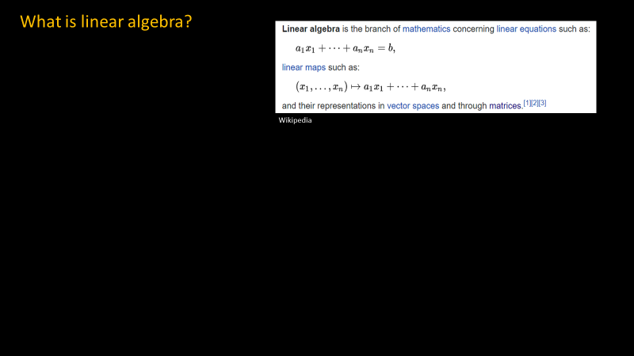


Slide 1
Which among the following are linear equations?
Notes:
When you plot a linear equation, it should give a straight line - > so if you have an equation in 2 variables, then you can plot one with wrt other in a 2-dimensional plane → should give a straight line. If it does not give a straight line, then the equation at hand is not linear.

Slide 3

Slide 2
O, H1, and H2
I1, I2, H1, and H2

Slide 4
Slide 3
This is matrix representation of the equations.
Matrix – Numbers arranged in rows and columns.
Such one-dimensional matrices are often called vectors.
(Dimensions of a matrix = number of rows x number of columns
Rules for matrix multiplication?

Slide 5
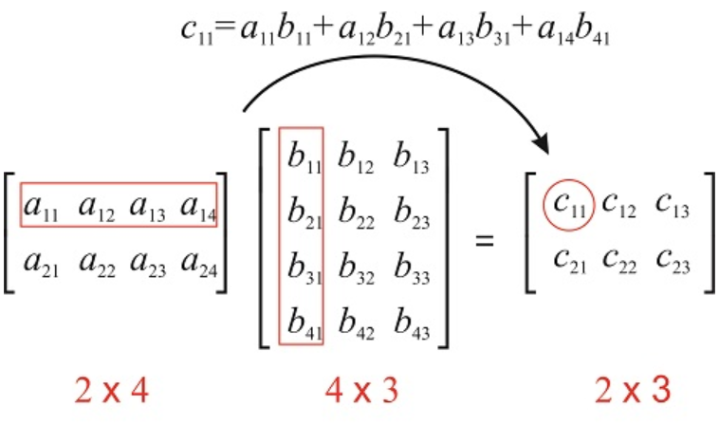
Slide 4
Matrix multiplication
Entry at (i,j) where ‘i’ is the row number and ‘j’ is the column number in the product corresponds to multiplication of ith row of first matrix and jth column of second matrix.
Matrix multiplication A x B can only take place if,
Number of columns in A = Number of rows in B

Slide 6
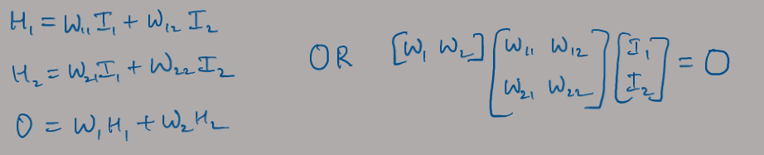
Slide 5
Why to use matrix representation?
You can say,
“I am someone who sells or grows flowers or studies or writes about flowers.”
OR “I am a florist”
Similarly, you can solve,
LHS will soon get intractable as your network size grows
Notes:
Efficient
Easy to communicate
Solves equations in parallel

Slide 7
















Different types of matrices
Slide 6

Slide 8
Properties of matrices
Slide 7
Transpose, of
A = [3 2
1 5] ?
Determinant of
A = [3 2
1 5] ?
Notes:
Determinant is only calculated for square matrices

Slide 9

Inverse of a matrix
Slide 8
-
-
-
-
Notes:
Observe the correspondence between solving these equations the old-fashioned way and through matrices → that helps in understanding what all these operations are doing like the cofactor matrix
Notice that,
Solutions don’t exist when determinant is zero.
Matrix is not invertible if the determinant is zero.

Slide 10






Slide 9
For entries whose position indices add to an odd number, also add a negative in-front of them.
So, add a negative infront of C12 and C21 in case of 2x2 matrix.
Cofactor matrix of
A = [3 2
1 5] ?
Notes:
Cofactor matrix for matrix A shown in the slides= [5 -1; -2 3]

Slide 11
Slide 10

Slide 12
Slide 11
Rank of a matrix
Indicates number of linearly independent rows OR columns in the matrix
Number of linearly independent rows and columns in any matrix are always equal
Rank of a non-singular n x n square matrix is ‘n’
Rank of a m x n rectangular matrix can at-most be equal to min(m,n)

Slide 13

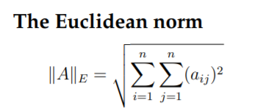
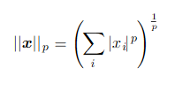
Norm
Slide 12
City Block Norm
How “long” is a vector?
It depends on what “length” means.
L1 norm = City block norm
L2 norm = Euclidean Norm
In general, L(p) norm is:
Euclidean Norm

Slide 14

Useful properties of matrix math
Slide 13

Slide 15
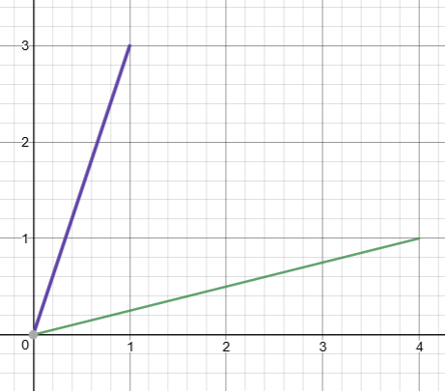

Dot product (aka inner product)
Slide 14
Suppose we want to project a vector onto another, asking e.g. “How far out is p along C from the origin?”
Vectors are one dimensional matrices, e.g. C=$\left[\begin{matrix}4 \\ 1\end{matrix}\right]$ and D = $\left[\begin{matrix}1 \\ 3\end{matrix}\right]$
We can plot vectors as a line from the origin to the coordinates of the ector
The dot product: C • D = $C^{T}D=\left[4 1\right]∗\left[\begin{matrix}1 \\ 3\end{matrix}\right]$=7
In general, C • D = |C|*|D|*cos(a)
=4.123*3.162*cos(71.57-14.04) = 7
(This matters for neural network weights later on)
Dot product of A^{T} = [1 1] and B^{T} = [1 – 1]?
D
C
a
p?
So p= |D|*cos(a)
Thus P= C•D / |C|
= 1.70
Notes:
Dot product of [1 1] and [1 -1] is zero → the 2 vectors are perpendicular to each other.

Slide 16
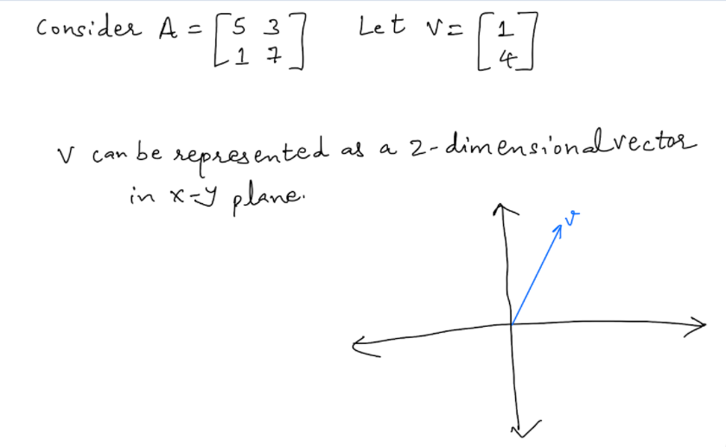
Think of a matrix as performing linear transformation
Slide 15
Notes:
Consider a vector v → now when we say that we are multiplying a matrix A by v, what do we really mean? We can think of this operation as the matrix performing linear transformation on v.

Slide 17
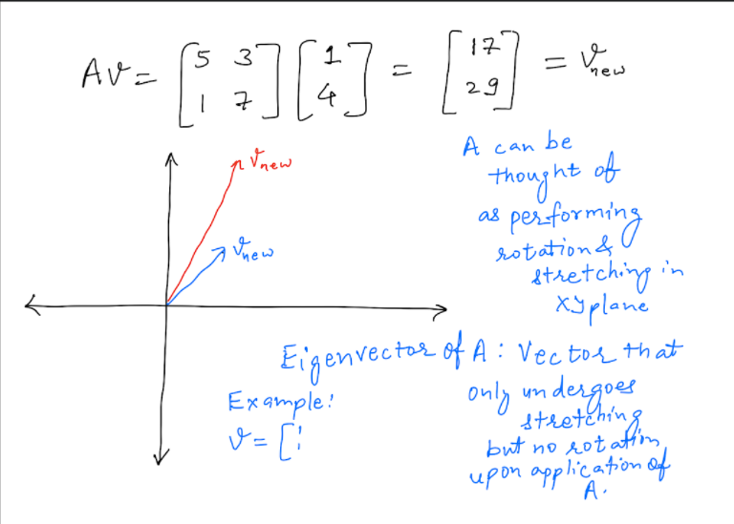
Slide 16

Slide 18
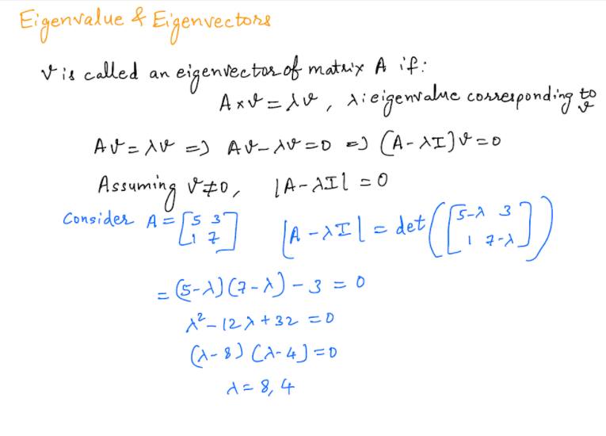
Slide 17

Slide 19
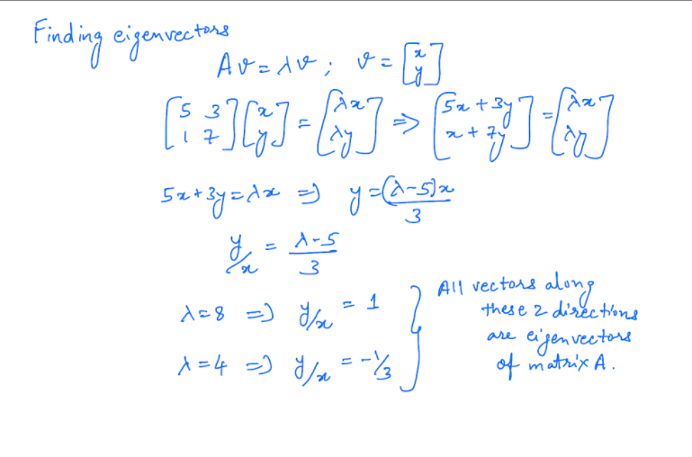
Slide 18

Slide 20
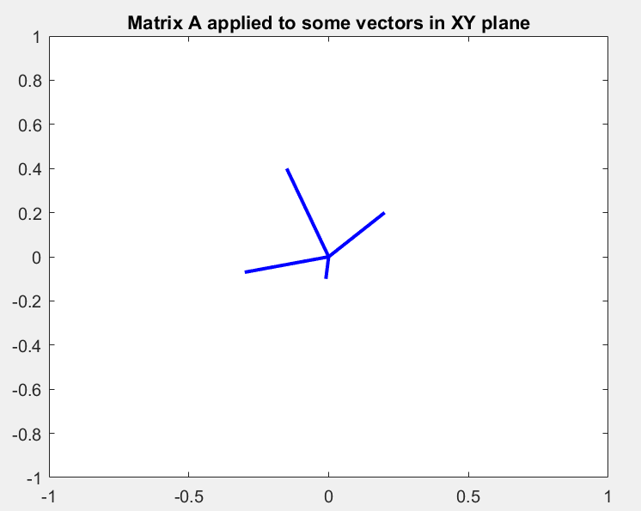
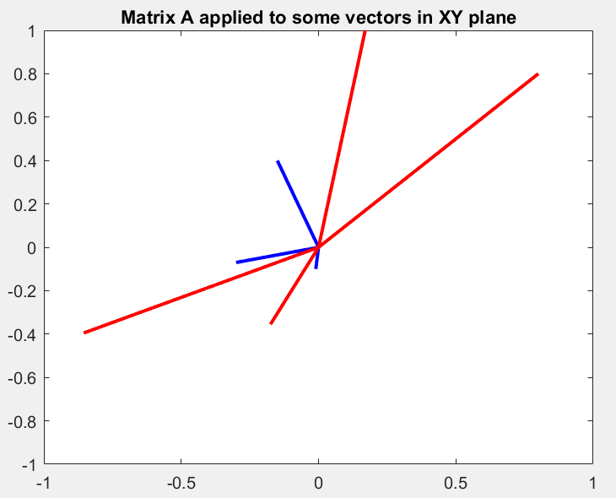
Slide 19
Original data points: They have been joined with the origin (0,0) so that each data points looks like a vector.
Data points after matrix A was applied to them; Observe that three of the vectors (data points) got rotated and stretched, but one of them only got stretched (but was not rotated) → such a vector is called ‘eigenvector of matrix A’
Notes:
Screenshots from Matlab demonstration.

Slide 21
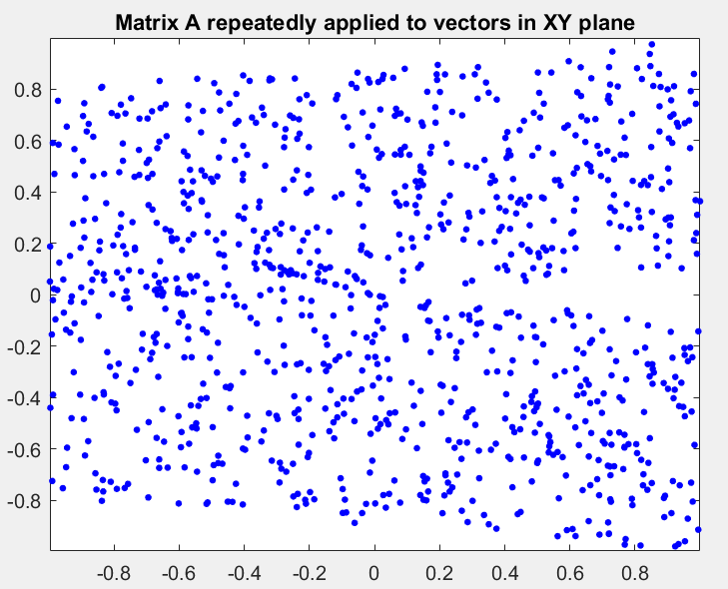
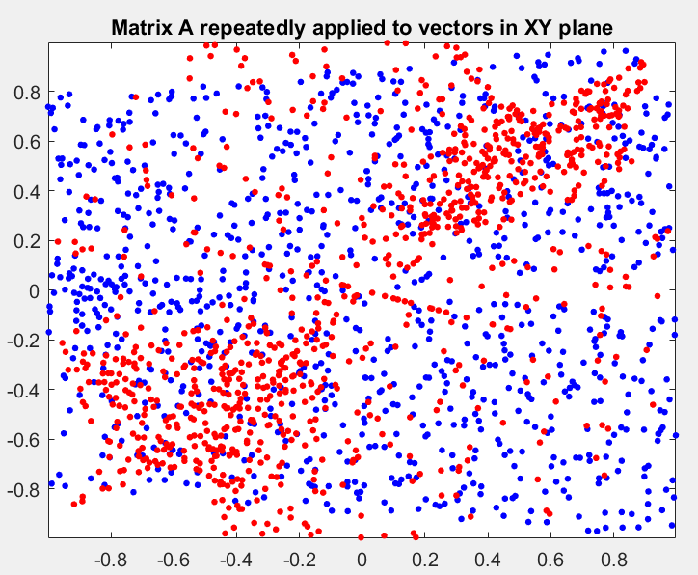
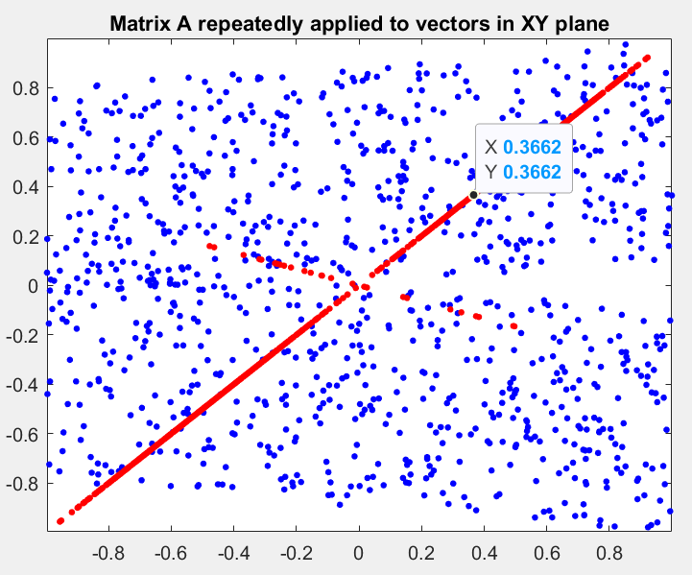
Slide 20
Blue: Original points (vectors); each dot represents the tip of the vector.
Red: Resultant vectors after application of matrix A
Observe that as A is applied repeatedly, the vectors get stretched and rotated and eventually settle along 2 directions → This are the directions of the eigenvectors of matrix A.

Slide 22
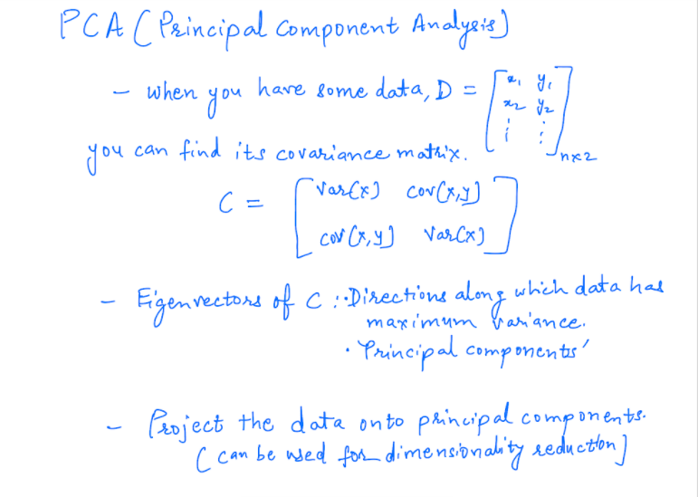
Slide 21
Notes:
Recall how vector D was ‘projected’ onto vector C in the ‘dot product’ slide. Similarly, you can project the vectors representing data points onto the eigenvectors. This can be used for dimensionality reduction – if your data is, say 10 dimensional, its covariance matrix will be 10x10 and have 10 eigenvectors. You can make your data 5 dimensional by projecting the data onto eigenvectors with top 5 eigenvalues. Projecting data on eigenvectors will help you preserve the maximum variance of the original data even if you made it 5 dimensional.

Slide 23
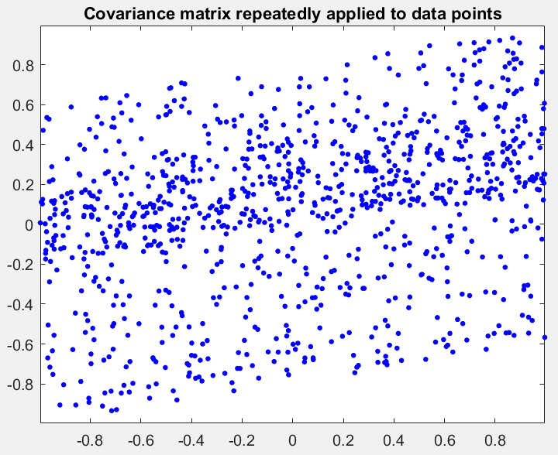
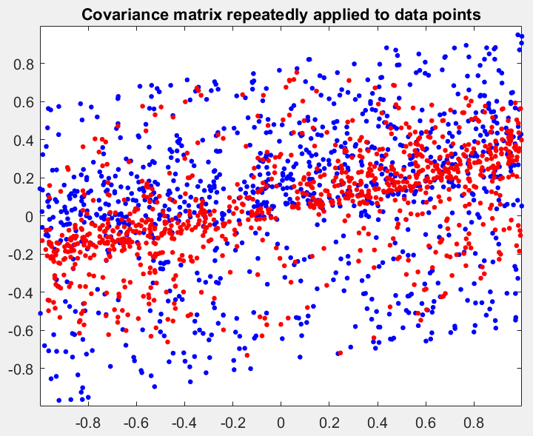
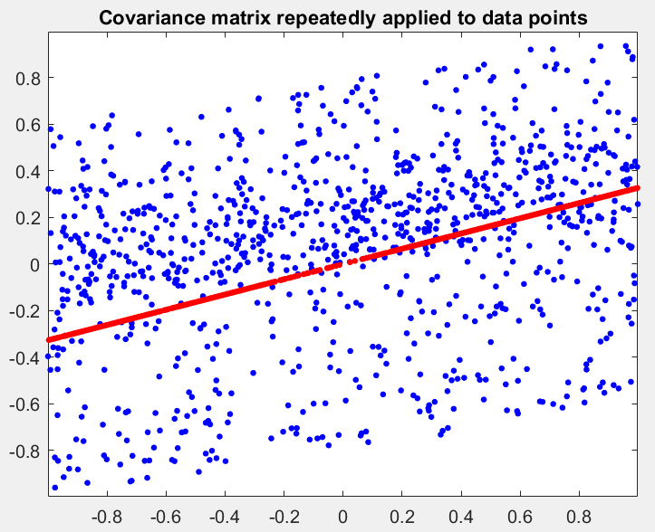
Slide 22
Blue: Data points (vectors); each dot represents the tip of the vector.
A covariance matrix is formed using these very data points and that is applied to these repeatedly.
Red: Resultant vectors after application of matrix A
Observe that as the covariance matrix is applied repeatedly, the vectors get stretched and rotated and eventually settle along the directions of the eigenvectors of the covariance → One clearly visible is the direction of the eigenvector with highest eigenvalue →Also the direction along which the data has maximum variance.

Slide 24
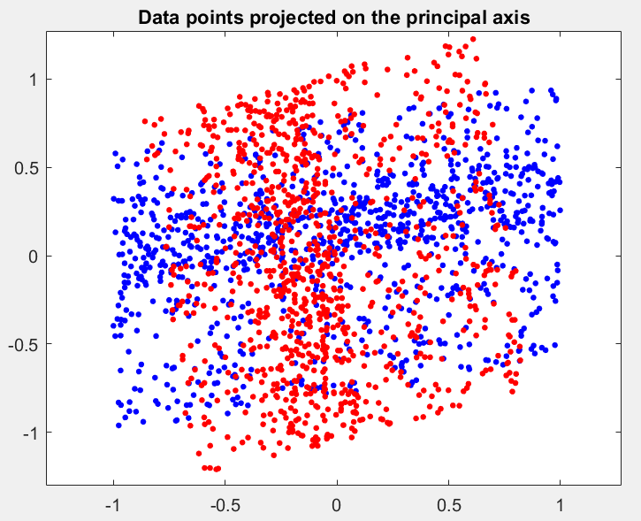
Slide 23
Blue: Original data as also shown in previous slide
Data projected onto both the eigenvectors of covariance matrix; You can also project the data only along the eigenvector with highest eigenvalue → data will become one dimensional → dimensionality reduction

Slide 25
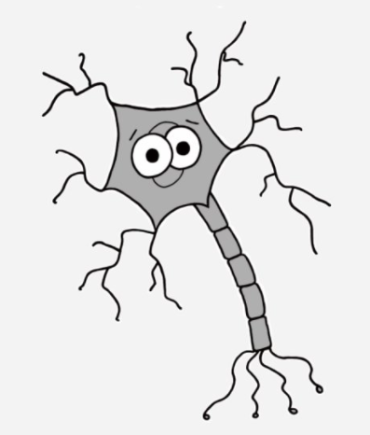
I have some questions!
Slide 24
Q1. What is the transpose of matrix, A = [5 3
3 2] ?
What can we say about symmetric matrices based on that?
A. A^{T} = -A B. A^{T} = A C. A^{T}A=I
Q2. Why does this system of equations not have finite number of solutions, in terms of matrix properties? A = [6 3
2 1]; C = [9 -7]^{T} , AX = C
Q4. What are the eigenvalues of matrix, A = [5 0
0 3]?
A. Don’t exist B. (5,3) C. (15,1)
Q3. Which of the following matrices is definitely non-invertible? (multiple correct answers)
A. Singular B. Non-singular C. det(A) is non-zero D. det(A) is zero
Q5. What are the eigenvectors of matrix A in Q4?
A. Does not have any B. [0 1], [1,0] C. All vectors in XY plane
Notes:
Answers:
B: A^{T} = A
Determinant is zero
A,D
5,3
B [0,1], [1,0]

