Slide 1
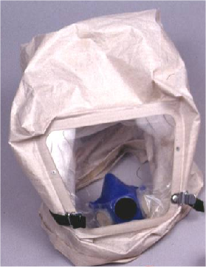
PBE
Puritan Protective Breathing Equipment
Notes:
PROTECTIVE BREATHING EQUIPMENT (PBE)
The Puritan Protective Breathing Equipment (PBE) is a closed circuit breathing apparatus designed to help protect the wearer's eyes and respiratory tract in an irrespirable atmosphere by isolating the eyes and breathing functions from the environment. Isolation is achieved by a hood system which envelopes the head of the wearer and a breathable atmosphere is maintained by a demand based chemical air regeneration system that supplies oxygen and removes carbon dioxide and water vapor. This equipment is certified in accordance with the requirements on TSO-C116.

