Slide 1
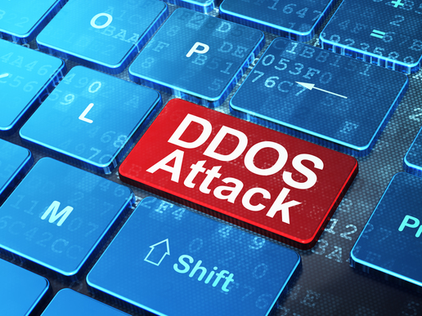
Denial of Service Attacks (DDOS)

Slide 2

Table of contents.
What is a Denial of Service Attack?
Types of Denial of Service Attacks (DDoS).
Volumetric attacks.
Application-layer attacks.
Targets of application layer-attacks.
State-exhaustion attacks.
A few reasons for DDoS attacks.
Defending against DDoS attacks.
References.

Slide 3
What is a Denial of Service Attack?
A Denial of Service Attack is a cyber-attack that is directed at a machine or network to make it unavailable for users to access it by flooding it with traffic so it overloads and cannot process all of the requests that it is being sent.
Hackers usually infect other machines with viruses or trojan horses to help them perform the DDoS attack or other malicious tasks. The compromised machines are called “Zombies”

Slide 4
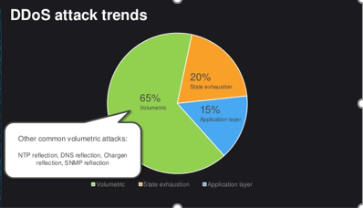
Types of Denial of Service Attacks (DDoS)
Volumetric attacks (most common DDoS attack).
Application-layer attacks.
State-exhaustion attacks.

Slide 5
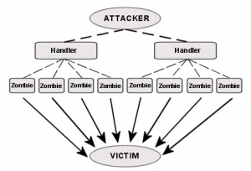
Volumetric Attacks.
These attacks use multiple infected systems to flood the network layers with seemingly legitimate traffic.
Slows down and/or makes network operations not function.
65% of DDoS attacks are Volumetric attacks.

Slide 6
Application-layer attacks.
Application-layer attacks disrupt transmission of data between hosts.
Mainly for specific targets such as transaction and access to databases disruption.
15% of DDoS attacks are Application-layer attacks.

Slide 7
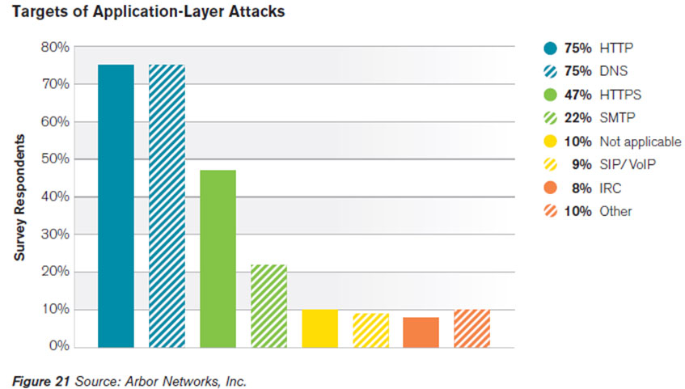
Targets of application layer attacks.

Slide 8
State-exhaustion attacks (a.k.a. protocol attacks).
Often used together with other types of DDoS attacks to compromise a single target.
One of the most common protocol attack is the ping of death which sends a defragmented large packet to a user and when it is reassembled a buffer overload occurs and causes the system to crash.
20% of DDoS attacks are State-exhaustion attacks.

Slide 9

A few reasons for DDoS attacks.
DDoS attacks are usually done for money extortion
Disruption of certain private or government operations.
Demonstration of DDoS attacks by criminals for potential customers.
Rivalry.
Distraction from other criminal actions.

Slide 10

Defending against DDoS attacks.
Firewalls.
DDS based defence.
IPS based prevention.
Blackholing and sinkholing.
Upstream filtering.

Slide 11

Some websites and game servers that were attacked with a DDoS attack.
BBC website.
Donald Trump campaign website.
Blizzard games.
Sony computer entertainment websites.
Vatican website.

Slide 12
References!
http://www.webopedia.com/TERM/D/DoS_attack.html
http://www.calyptix.com/top-threats/ddos-attacks-101-types-targets-motivations/
https://en.wikipedia.org/wiki/Zombie_(computer_science)
https://en.wikipedia.org/wiki/Application_layer_DDoS_attack#Application_layer
https://en.wikipedia.org/wiki/Denial-of-service_attack#Defense_techniques
https://en.wikipedia.org/wiki/Timeline_of_events_associated_with_Anonymous#Operation_Sony
http://venturebeat.com/2016/09/23/blizzard-games-suffer-yet-another-ddos-attack/

