Slide 1
The Dog That Did Not Bark: A Defense of Return Predictability
John Cochrane (RFS 2008)
Discussant: Alexander Ober

Slide 2
Background and Motivation
Are returns predictable?
A host of recently suggested predictors (see, e.g., Goyal and Welch 2008)
This paper focuses on the dividend yield (e.g., Fama French 1988, Campbell Shiller 1988)

Slide 3
Summary
Basic manipulations suggest the dividend yield must predict cash flow growth and/or returns.
Given the lack of predictability of cash flow growth, returns must be predictable.

Slide 4
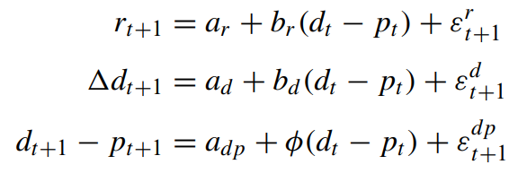



Some return algebra:
$$P =\sum_{k}{\frac{D g^{k}}{r^{k+1}}}= \frac{D}{r−g}$$
$\overset{⇒}{\begin{aligned} \\ \end{aligned}}\frac{D}{P}=r−g$
A VAR system:
This implies:
Campbell-Shiller Log-Linearization:

Slide 5
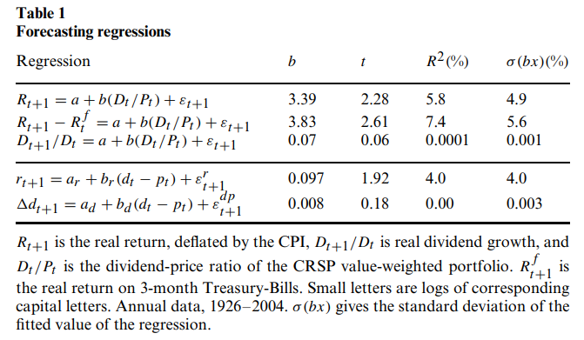
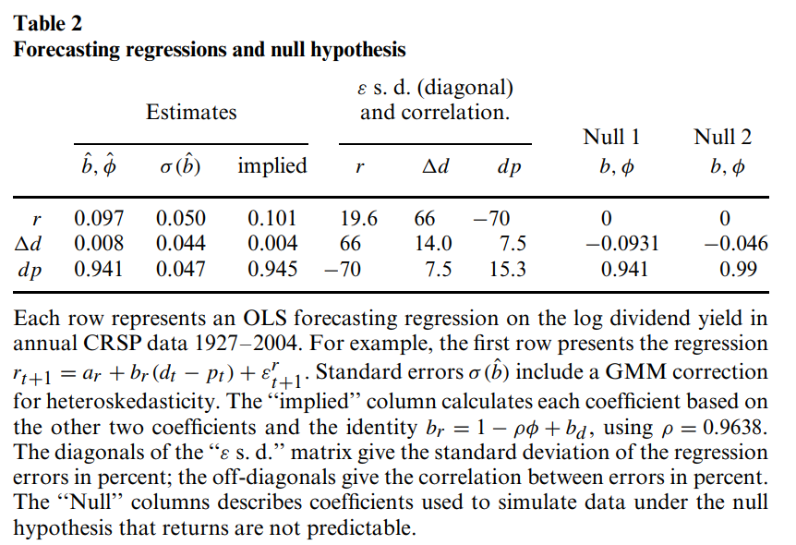
Tables 1 and 2

Slide 6
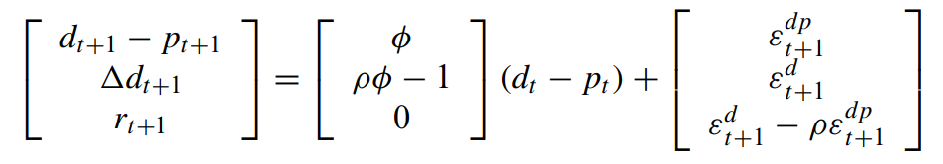
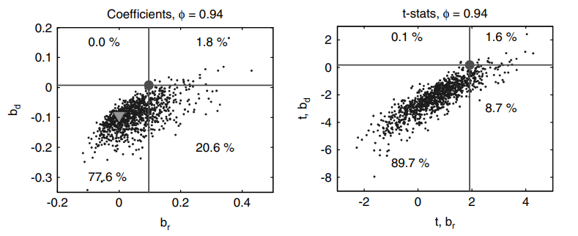
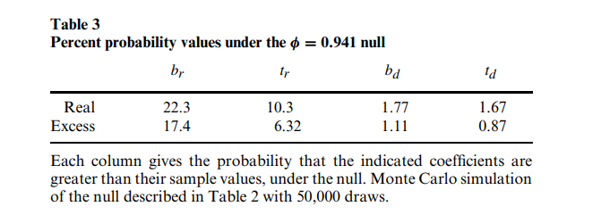
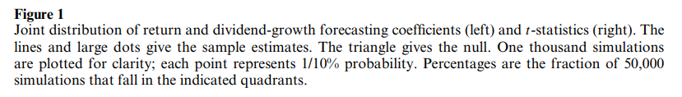
Single Period Simulation Results: Table 3 and Figure 1

Slide 7
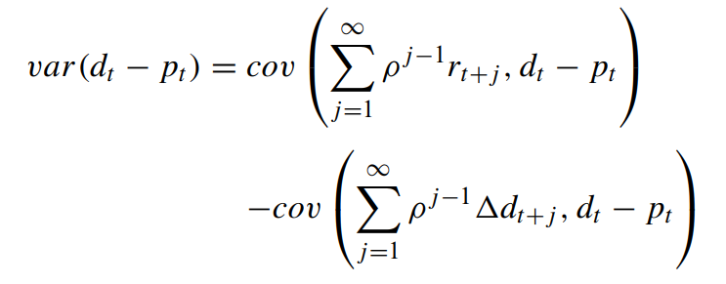
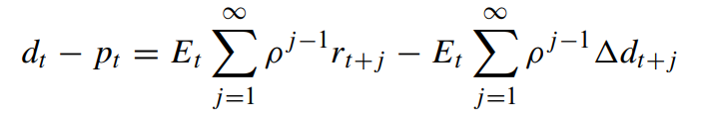
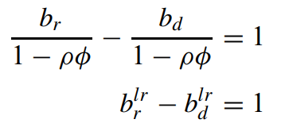
Moving On From Single Period Tests
Sources of variation in the dividend yield
Campbell-Shiller Relation
Long-Run Coefficients

Slide 8
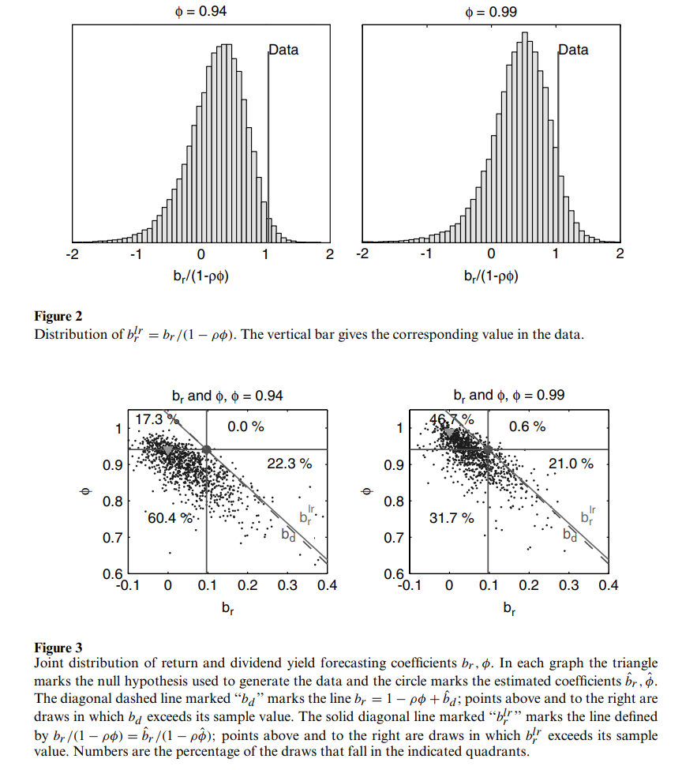
Long-Run Tests: Figures 2 and 3

Slide 9

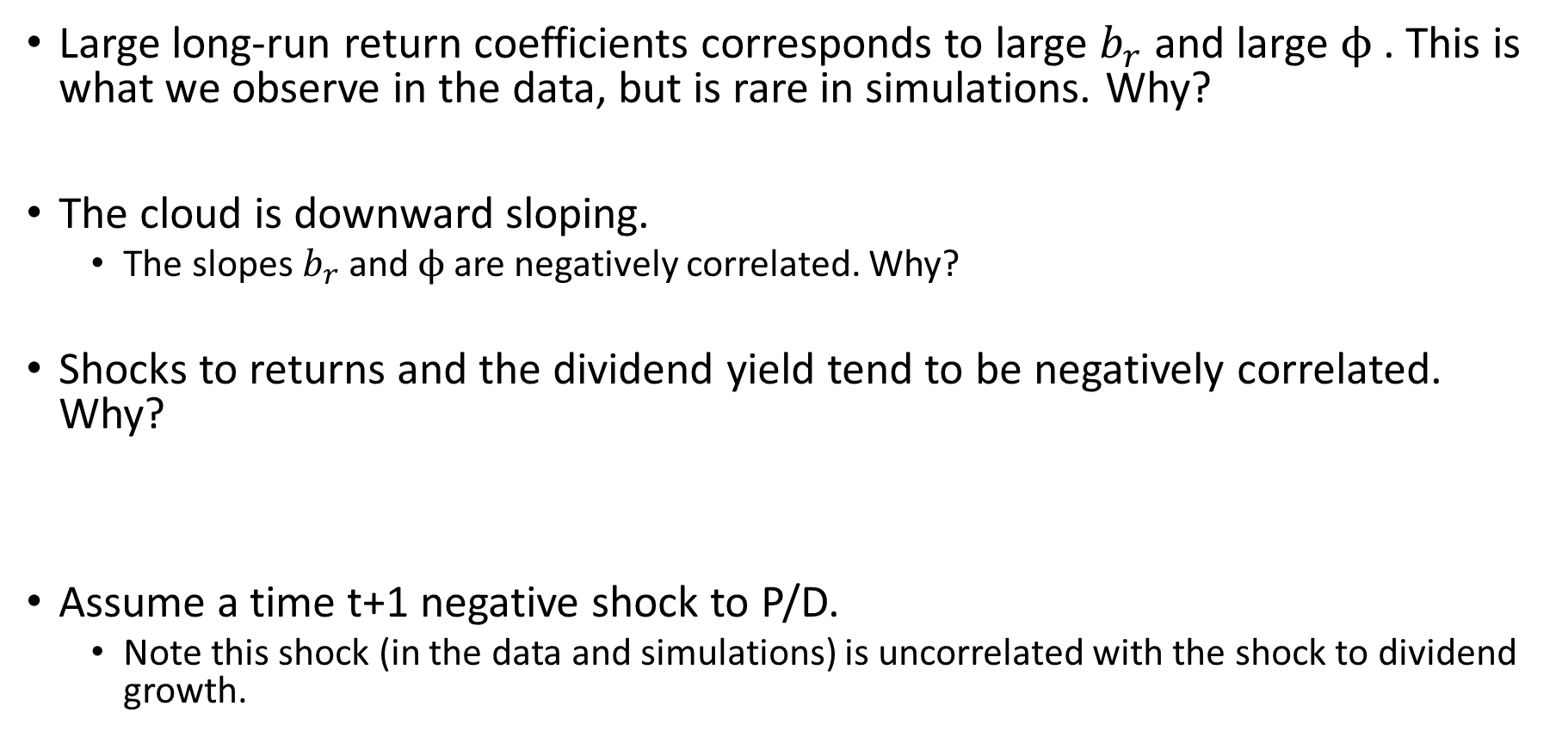
Where does the increased power come from?
Large long-run return coefficients corresponds to large $b_{r}$ and large $ϕ$. This is what we observe in the data, but is rare in simulations. Why?
The cloud is downward sloping.
The slopes$b_{r}$ and $ϕ$are negatively correlated. Why?
Shocks to returns and the dividend yield tend to be negatively correlated. Why?
Assume a time t+1 negative shock to P/D.
Note this shock (in the data and simulations) is uncorrelated with the shock to dividend growth.

Slide 10
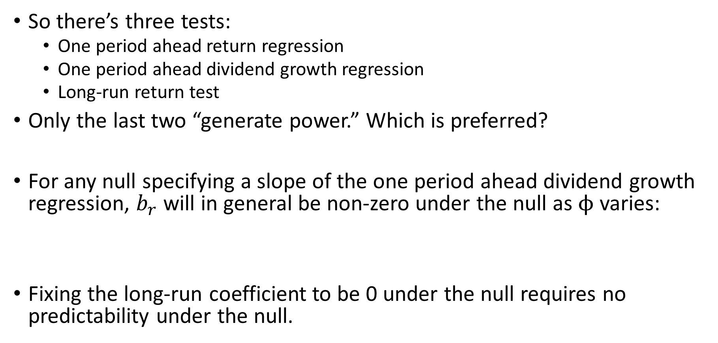
Which of the powerful tests are most sensible?
So there’s three tests:
One period ahead return regression
One period ahead dividend growth regression
Long-run return test
Only the last two “generate power.” Which is preferred?
For any null specifying a slope of the one period ahead dividend growth regression, $b_{r}$ will in general be non-zero under the null as $ϕ$ varies:
Fixing the long-run coefficient to be 0 under the null requires no predictability under the null.

Slide 11
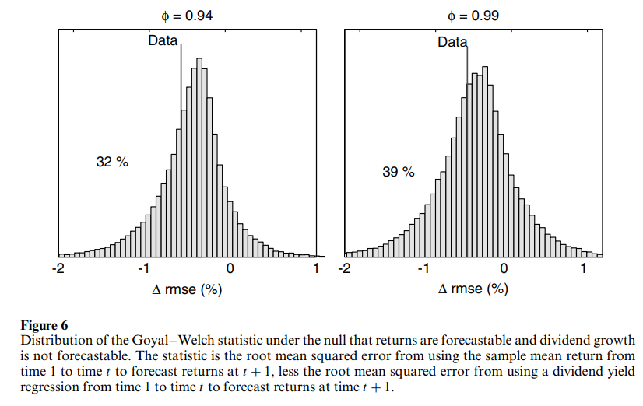
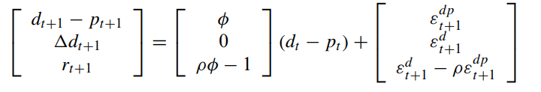
Response to Goyal and Welch (2008)
Assume predictability:

Slide 12
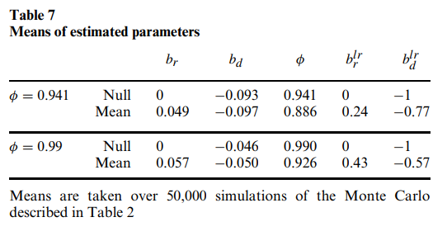
Small Sample Bias?

Slide 13
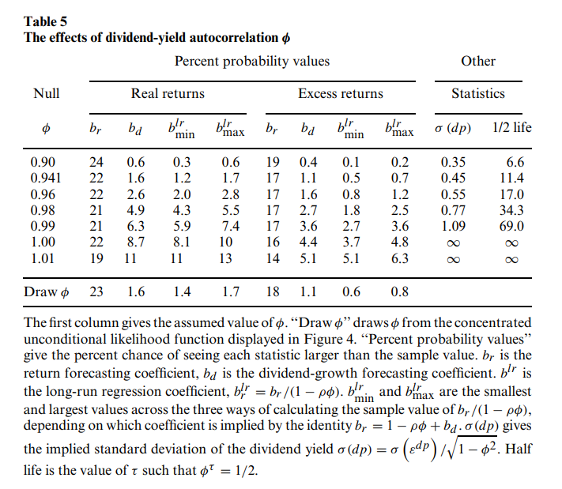
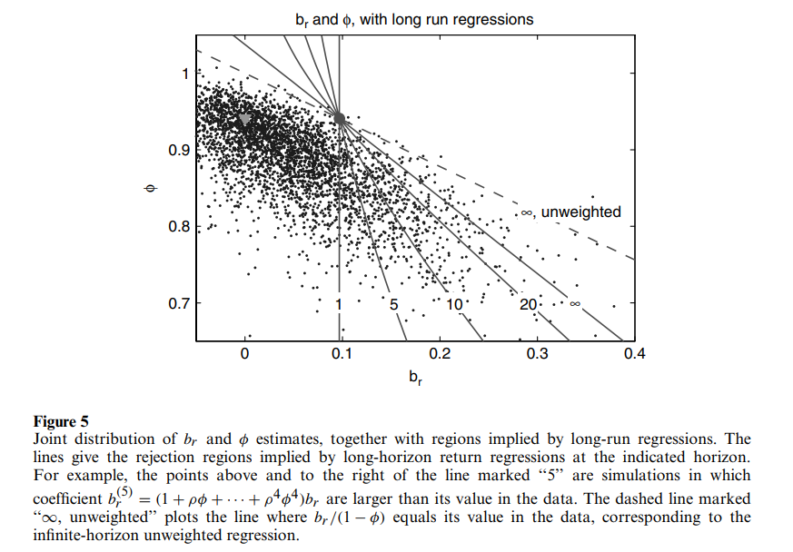
Some Robustness: Varying $ϕ$ and how long run?

Slide 14
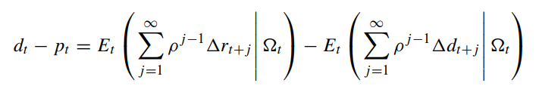
Some More Additional Points
Accounting:
Repurchases count as dividends if a firm repurchases all its shares
Looking at aggregate dividends should reduce concerns about firm-level dividend smoothing
If a predictor can forecast dividend growth, this does not worsen return predictability:
More variables will only improve predictability
Maybe a 1-year VAR isn’t the right specification – multi-year regressions yield similar results

Slide 15
Conclusion
“If returns really are not forecastable, then dividend growth must be forecastable in order to generate the observed variation in dividend-price ratios.”
The absence of dividend-growth forecastibility is stronger in single period regressions than the existence of return forecastibility.
Long-run regression capture this.
“Excess return forecastibility is not a comforting result.”
It would be nice if prices moved on purely observable cash flow news
Instead they move on discount rate news – it would be nice if these discount rates were determined by observables such as interest rates

Slide 16
Discussion & Replication

Slide 17
Thoughts
In general, many of the ideas of this paper are not new.
We know that D/P ratios proxy for expected returns, and shocks to expected returns move prices (Fama French 1988)
“the dividend yield is a noisy proxy for expected returns because it also reflects expected dividend growth”
Many (if not all) of the Campbell-Shiller log-linearization calculations are not new.
What is new is the idea that on average the dividend yield gives no news about dividend growth, thus must predict returns.
And of course this idea is formalized statistically.

Slide 18
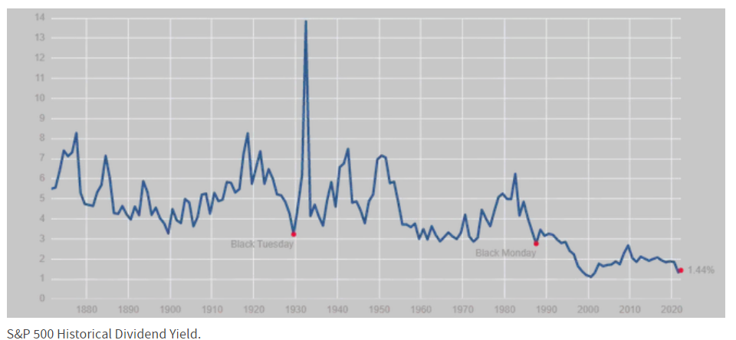
Some more thoughts
Does the fact we’re log-linearizing matter – log-linearization is only exact for D/P near its steady state value?
According to Cochrane, no (see pp. 1558).
Campbell (1993) log-linearization of budget constraint be applied to CAY - aggregate consumption-to-wealth ratio - as a return predictor?
This log-linearization is essentially mathematically equivalent to the Campbell Shiller log-linearization.
Does CAY predict consumption growth?
Source: Investopedia

Slide 19
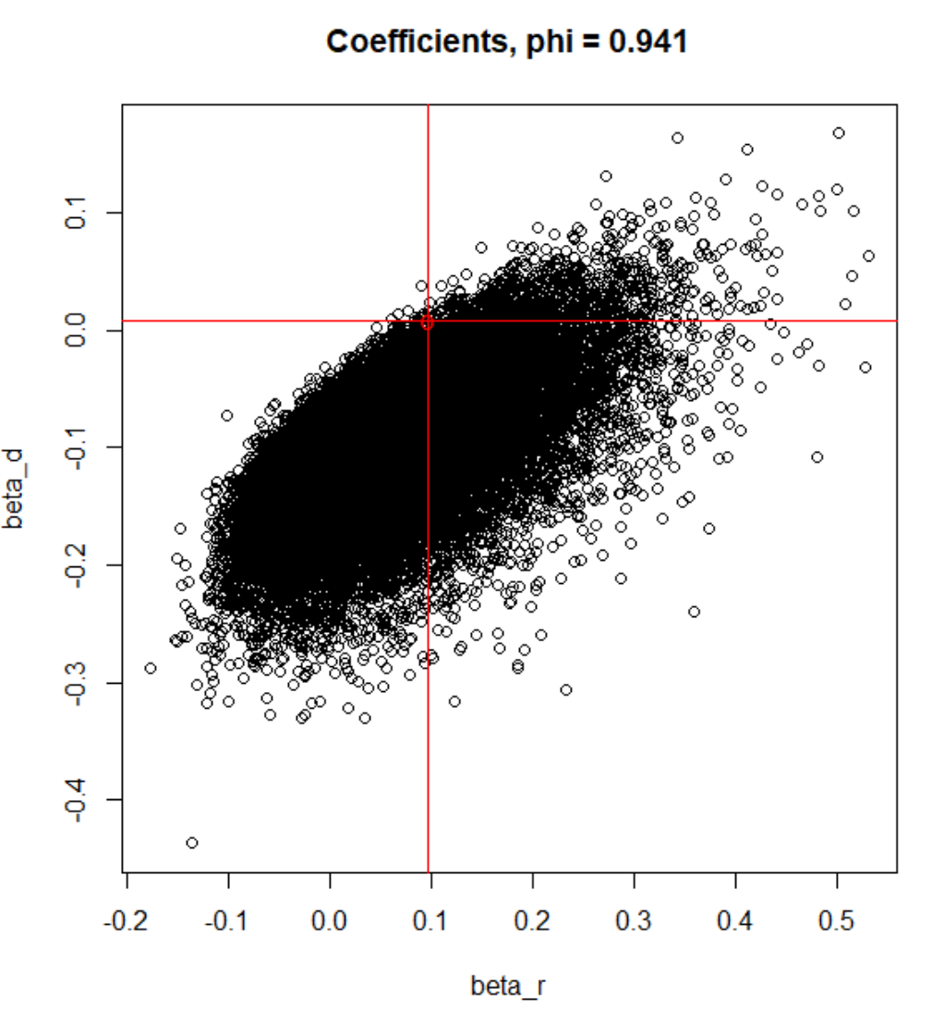
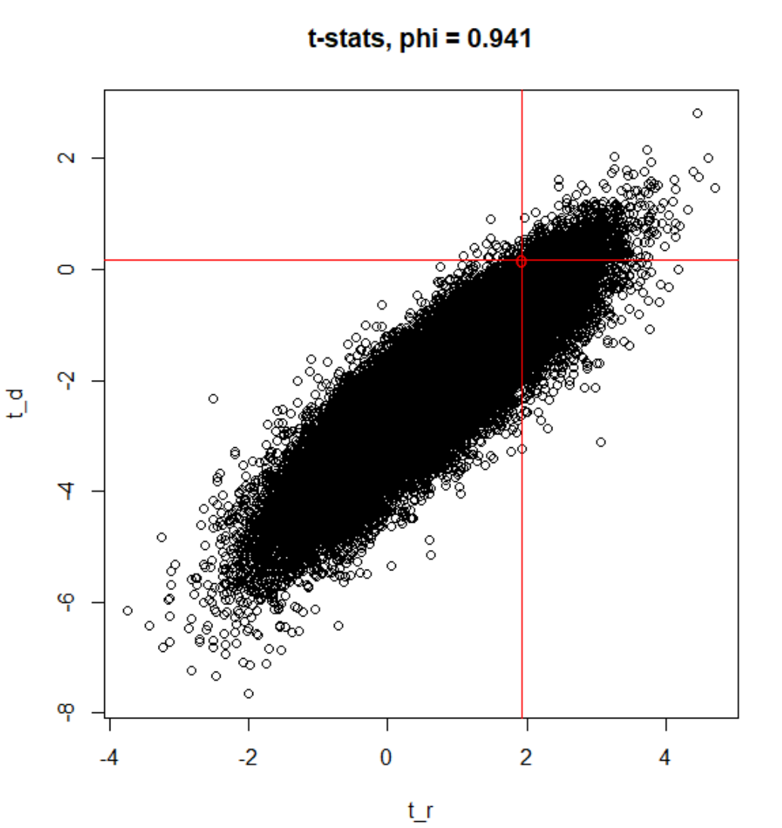
Replication of Table 3 and Figure 1
Statistic | Probability (%)
b_r | 22.1
t_r | 9.0
b_d | 1.78
t_d | 1.67

Slide 20
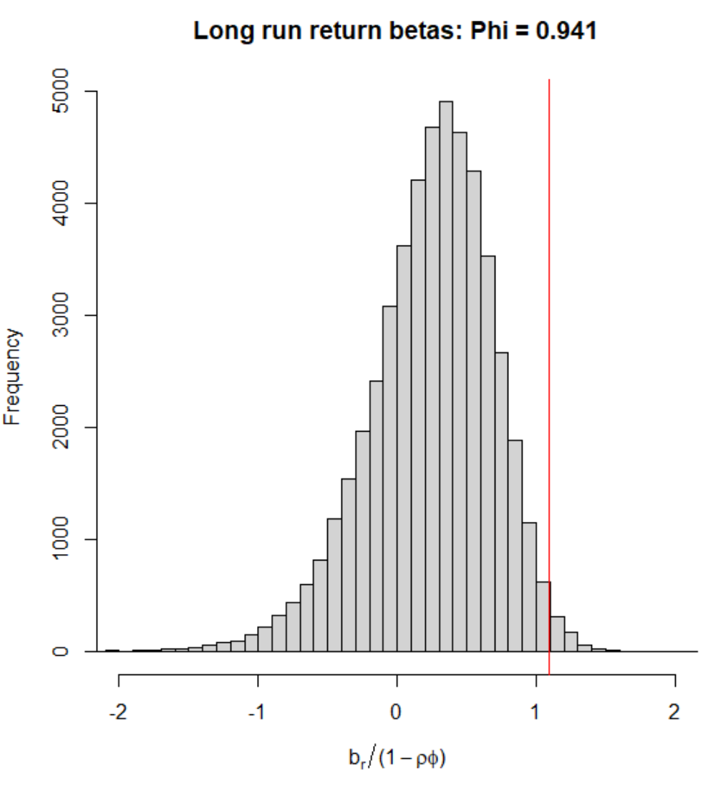
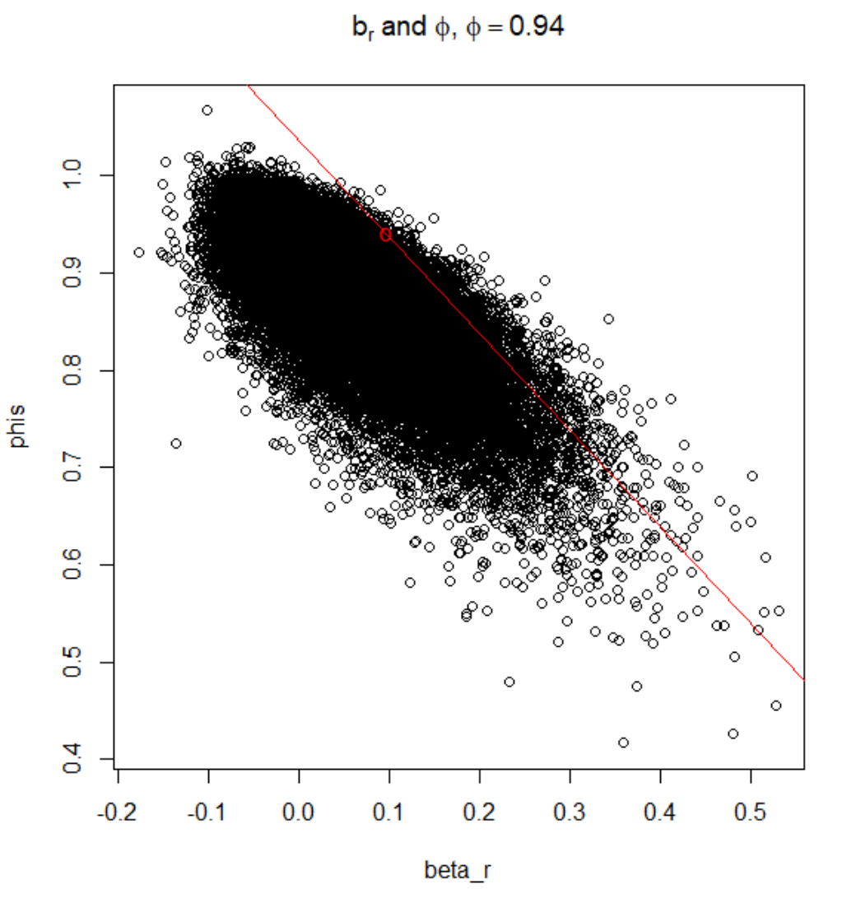
Replication of Figures 2 and 3
1.3%

Slide 21
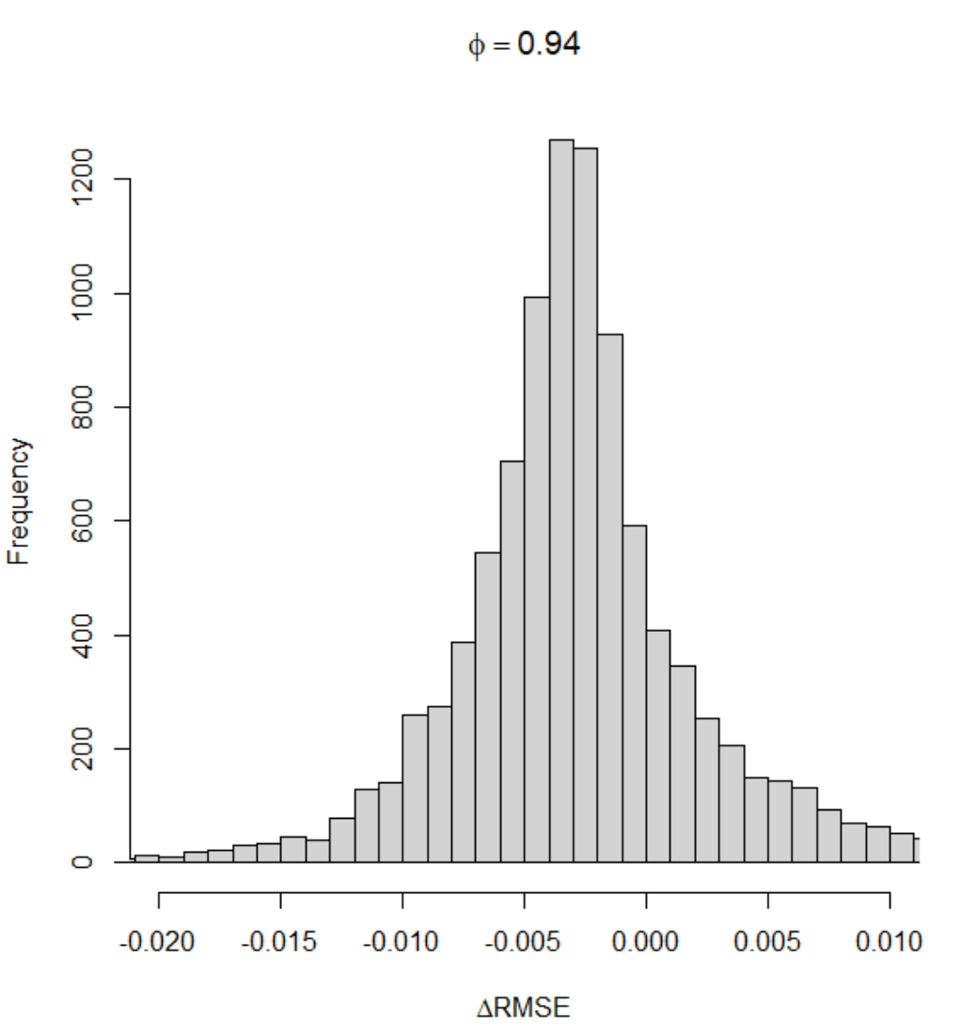
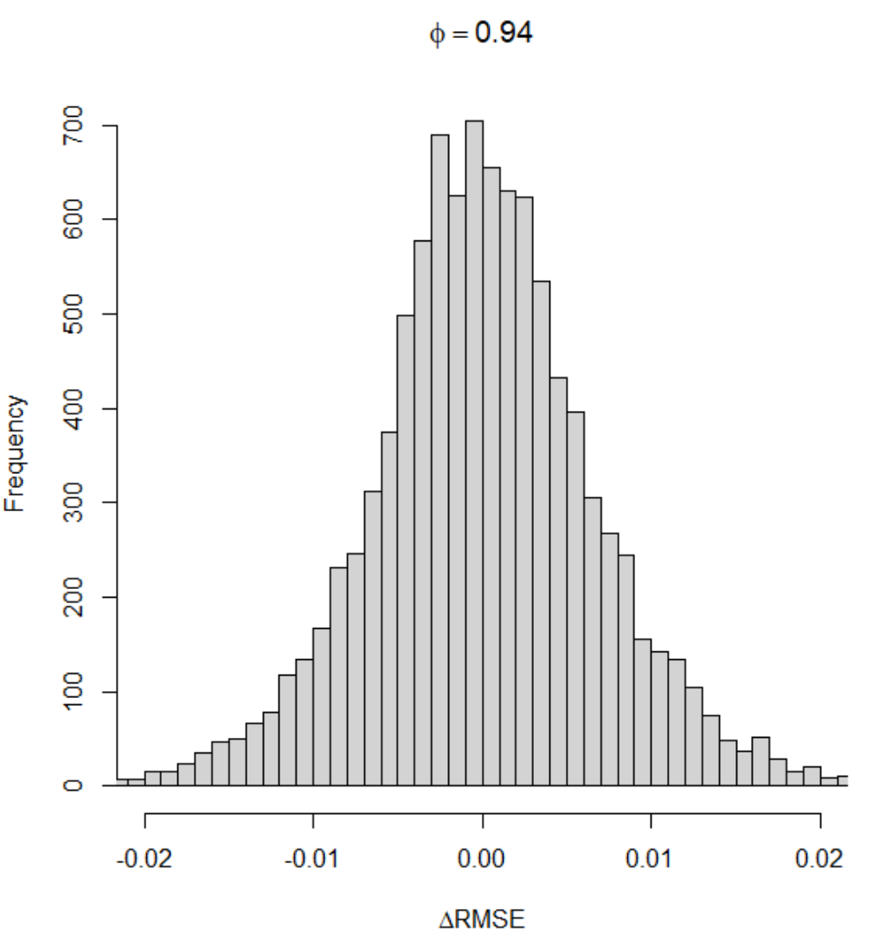
Replication of the Goyal-Welch results
There appears to be a typo here. The right corrects the typo. The typo makes return autocorrelation much higher.
Area to the right of
-0.004:
Left: 34.57%
Right: 24.63%

Slide 22
Thank You!

