Slide 1
Arctiq Mission
Alexander Ogorodnikov

Slide 2
Mission debrief
Deploy Google Kubernetes Engine using terraform as IaC
Use CI/CD to deploy sample app
Canary deployment mode must be used

Slide 3
What was done
GKE cluster deployed with terraform: platinum-banner-379721-gke
Classic k8s deployment process with Azure DevOps services:
clouddemo app built with Azure DevOps CI/CD pipeline and GCR image storage
clouddemo app deployed with Azure DevOps CI/CD pipeline
clouddemo app release mechanism added with Azure DevOps release pipeline

Slide 4
What was done - continue
Canary k8s deployment process with Azure DevOps services:
sampleapp built with Azure DevOps CI/CD pipeline and GCR image storage
sampleapp app deployed with Azure DevOps CI/CD pipeline using canary-deployment mechanism for release
prometheus/grafana services deployed with DevOps CI/CD pipeline and used to monitor apps and take release decision
fortio app deployed with DevOps CI/CD pipeline and used to simulate traffic to sampleapp

Slide 5
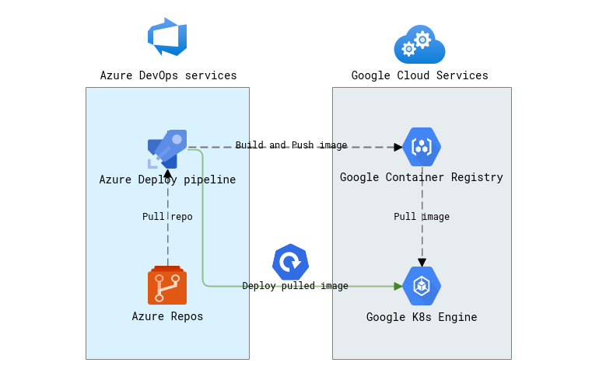

Slide 6
demo

Slide 7
questions

Slide 8
ref
https://github.com/alexanderogorodnikov/arctiq-gke - terraform IaC
Arctique-demo - Repos (azure.com) - project for classic K8S app deployment
Arctic-gke-canary - Repos (azure.com) - project for canary K8S app deployment

