Slide 1
Fish Tank
Alexander Owen
https://github.com/alexanderowen/FishTank
CIS 441 Computer Graphics
University of Oregon

Slide 2
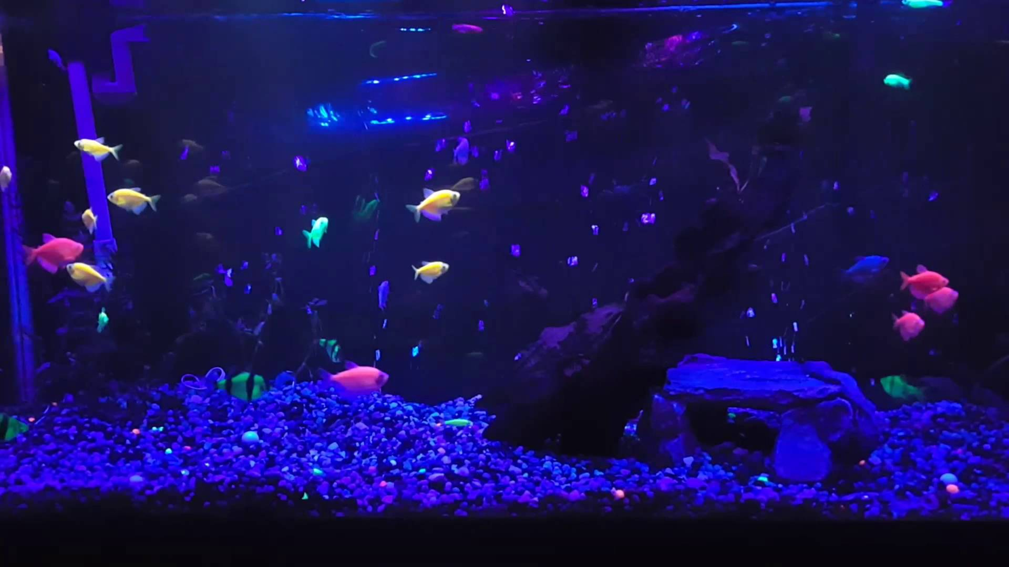
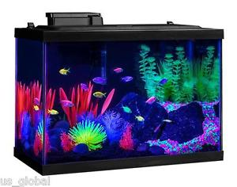
Conceptual Idea

Slide 3
Tools
Blender
3D modeling
VTK
Render models, add lighting effects and color

Slide 4
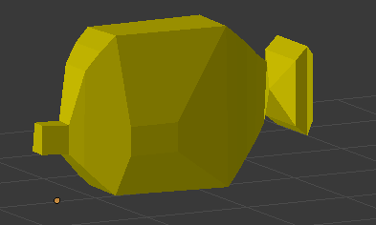
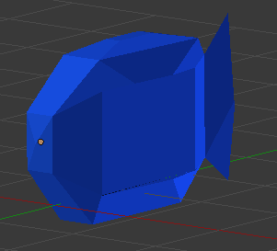
Models

Slide 5
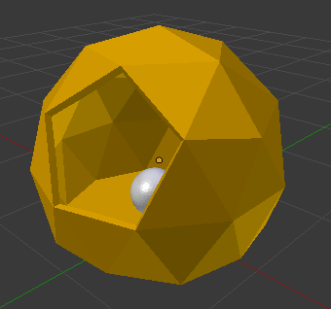
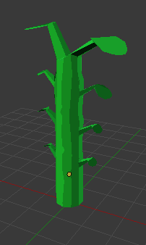
Models

Slide 6
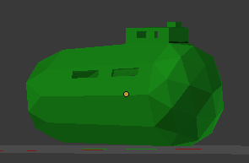
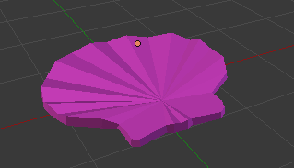
Models

Slide 7
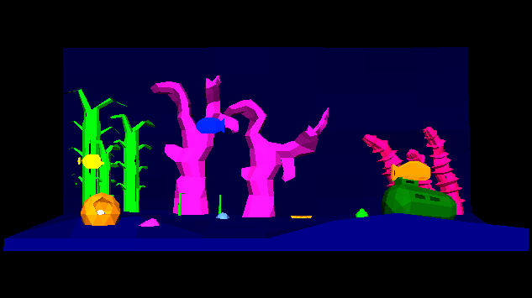
Result

Slide 8
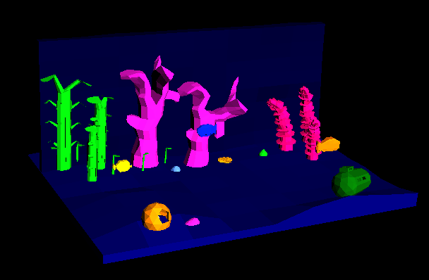
Result

Slide 9
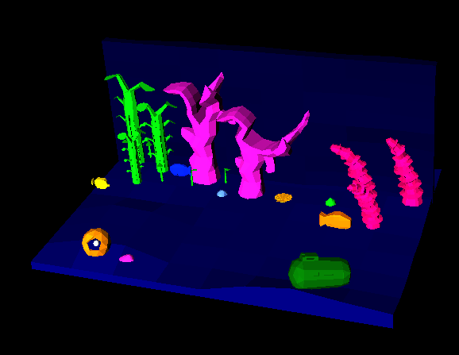
Result

Slide 10
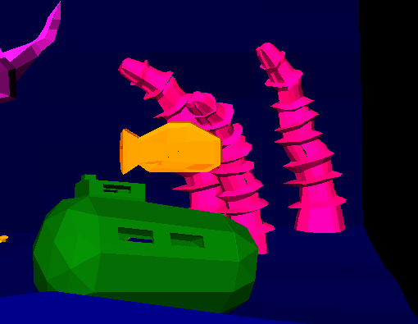
Result

Slide 11
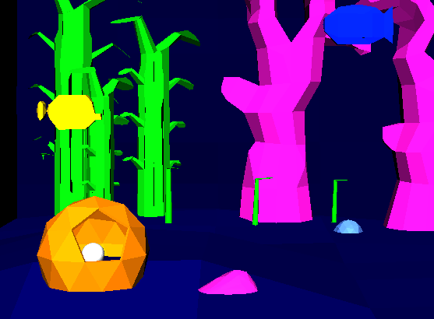
Result

Slide 12
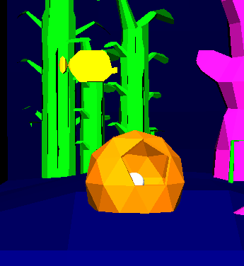
Result

Slide 13
Where Time Spent
19 custom 3D models made in Blender
Designed to look like models that have been flat-shaded
VTK
Lighting effects (Phong shading)
Give objects vibrancy

Slide 14
Things I Did Right
Clear design plan early on
Listed necessary functionality and functionality that could be pushed aside
Worked intermittently throughout the weeks, balancing other course work, culminating in a final sprint this week

Slide 15
Things I Did Wrong/Lessons Learned
Time Estimation!!!
Ambitious design led to some timing shortfalls
Have a better idea of what I can get done in what amount of time

Slide 16
Future Plans (over Winter Break)
Add animations
Fish swim around
Bubbles
Allow user to play as a fish and explore the tank
Minigame pick-up-items game

