Slide 1
The M Programming Language
Benjamin Quintero, Alexander Paolini, Vivek Kondapalli
A KnightHacks Project Launch Submission

Slide 2
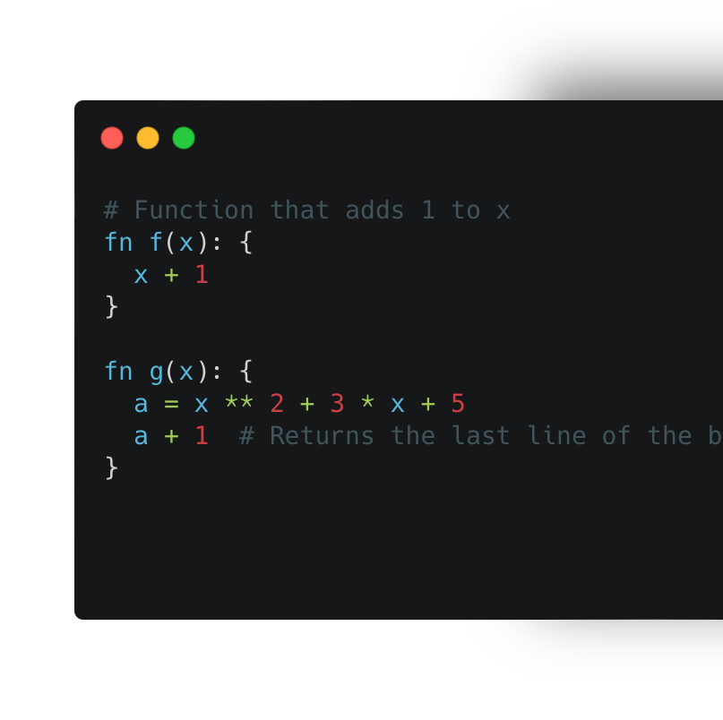
What is M?
A math-oriented programming language

Slide 3
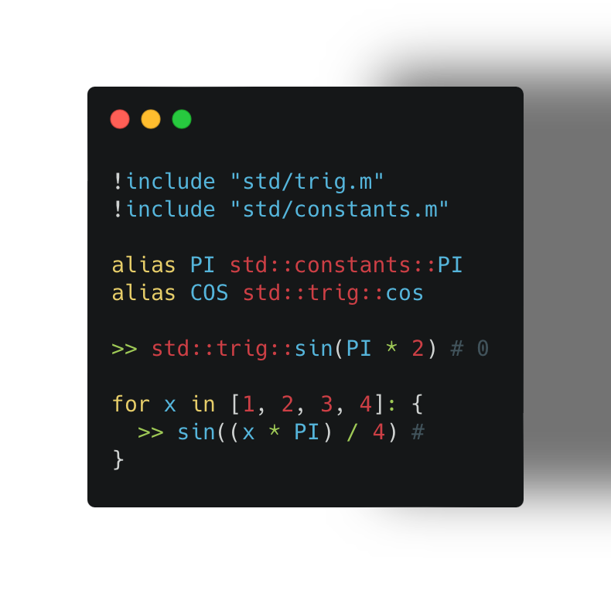
What does M support?
Data Types:
Numbers
Arrays
Conditionals
Functions
Math Operations
Aliases
Imports

Slide 4
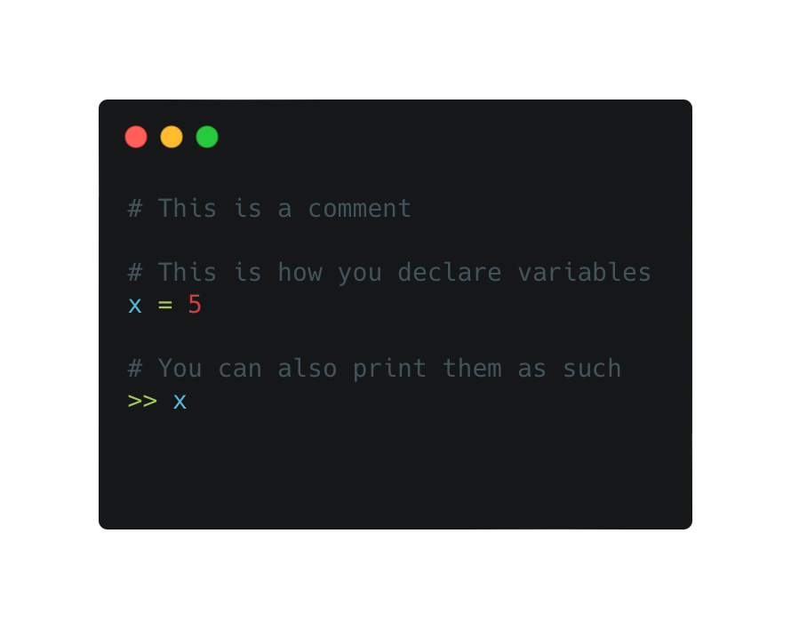
Example 1
Comments begin with a “#”
Variable declarations are simple. ”name = value”
Printing uses the double greater-than symbol “>>”

Slide 5
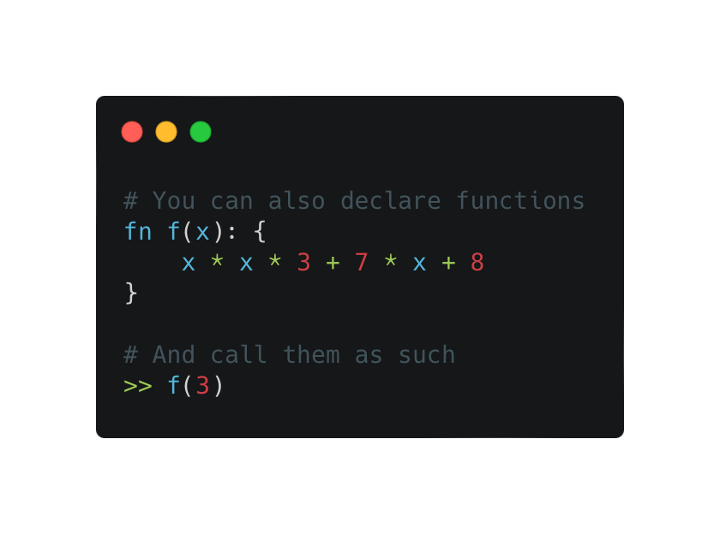
Example 2
Functions use the syntax “fn NAME: BODY”
They return the last line of their body
Function calls are as expected “NAME(…data)”

Slide 6
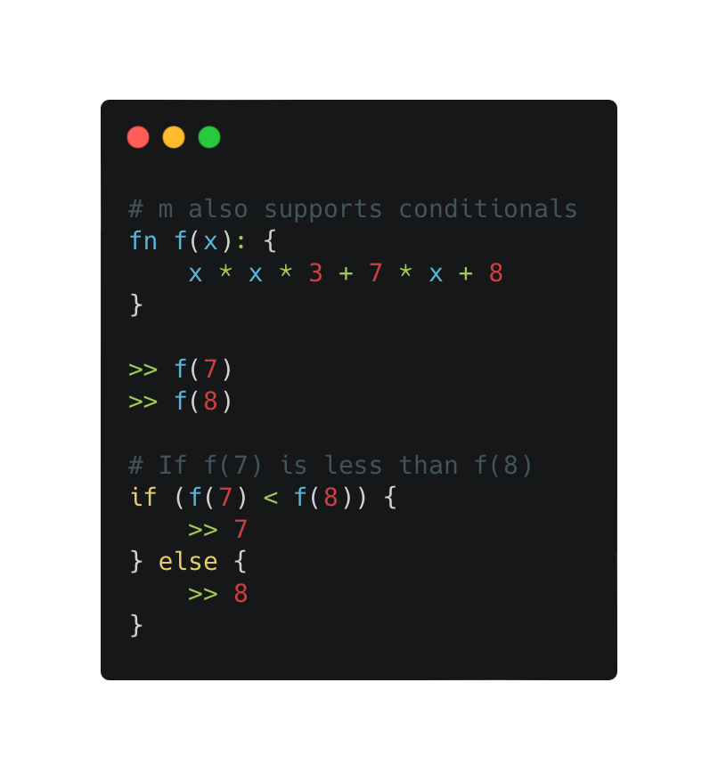
Example 3
Conditionals are as follows:
If (cond) ifBody else elseBody

