Slide 1
Overthinking: Faith Slocumb
By Alexander Parris

Slide 2
Green Flags
Value
High
1. Social and relationship values. She seems totally aligned with me on core values and politics. Even on loyalty, honesty, family structure, eugenics, conspiracy, disgust for the needy, and racial prejudices.
2. Temperamentally stable. Not intent on inserting herself in my activates just to soak up my attention or monopolizing my time just for the sake of it.
3. Not vaccinated. She has a growing distrust of pharmaceuticals.
4. I may get along well with my in-laws. From the sounds of it we are aligned.
5. We are physically attracted to each other.
6. No major debt.
7. Good relationship with father and mother.
8. No history of rampant sexual promiscuity, relationship trauma, or STDs.
High
Mid
Mid
High
Low
High
High

Slide 3
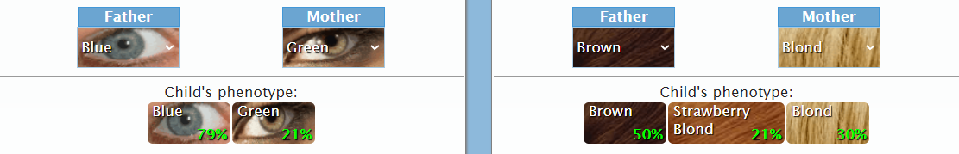
Red Flags
1. Possible non-white ancestry. The remarks, said in a joking manner and unable to be verified, that she may have a distant ancestor who is either native American or black have come up twice now. (Acceptable)
Based on the context of share-croppers in America and her traits of very blonde hair and green eyes, she can’t be more than 1/16 to 1/32 non-white. Meaning at the worst, my children could be 1/32 to 1/64 non-white. As seen above our children would have a 40% chance to look like India, 40% chance to look like me, 10% chance to look like Faith, and a 10% chance to look like my mom. Also, her family comes from Scottland which means red-heads are on the table. Overall, non-white DNA would only be detectable via a DNA test. I have to take this as a 99% win.
2. Drinking. She has ordered at least one drink on ¾ of the dates we have had together. (Tolerable. Pending her thoughts on temperance)
If limited to a glass of wine at dinner or a margarita at the bar, then it really isn’t a big deal. She claims that she doesn’t get plastered on the regular. This is something that can only be verified over time though.
3. Tattoos and vaping. These go together as things that are specific to our generation’s culture. (Acceptable)
It really doesn’t bother me while I’m with her, so this is just something that will fade into the background. I would like to have an understanding on teaching possible kids to be reserved with these two things though.
4. Non-virginity. (Seems acceptable. Pending her thoughts on commitment and past trauma)
According to her, she doesn’t go around hooking up so I’m led to believe that she just had sex with past exes. My worry here doesn’t have to do with feeling sexually inadequate (I’m hot blooded as they come). It includes only two things: possibility of STDs and the increased chance for divorce linked positively to someone's number of prior sexual partners. On STDs, she said that she doesn’t have any. On the ladder I need her to reinforce her desire to be committed.
5. Physical Frailty. She inherited EDS (Ehlers-Danlos Syndrome) which weakens her joints and left her with tooth decay and ultimately tooth implants. (Acceptable)
Surprisingly, I don’t feel very strongly about this. It means there is a low chance that one of our grandchildren may suffer this burden. The disease isn’t fatal but it means the child would perhaps be forced to rely on their mind rather than take up sports. Her sister doesn’t have the disease so there is no guarantee that future generations would suffer. For her, I would probably like to see her gain 5-10 lbs of muscle for her own health. Really a non-factor overall.
6. Prescription drugs. She does take a sleeping pill to fall asleep and she did use chemical birth control. (Acceptable)
Really a non-factor. She isn’t sure if she will continue to take chemical birth control or at least dump it and observe the effects for a month or so. Really the end of birth-control is a double-edged sword since we are hot for each other but I don’t want her to take it if it messes with her hormones and might cause her to not find me attractive when she is off the pill.

Slide 4

My Own Red Flags
1. Nervous about intimacy. She could intemperate this as rejection and then feel unloved.
2. Overly judgmental. She may see my high standards as unreasonable or arbitrary and destructive.
3. Technically short. She is overlooking my height completely. We are at least the same height, so there is a good chance my kids will be taller than me with her (See top of slide for % chance based on our heights).
4. Not rich. I’m not rich, what else can I say?

Slide 5
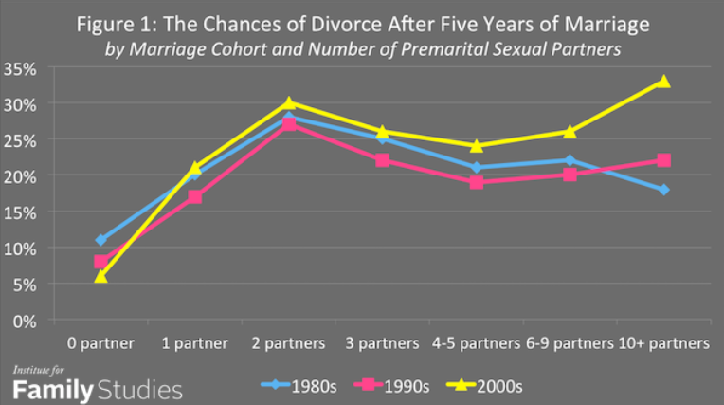
Issues that need to be discussed
Faith’s opinion on children, sex and divorce. I want to ask her opinion on children, sex and divorce in a very open-ended way. Then follow up with maybe a question on what she wants her children to look like and be like.
I want a relationship that abides by “till death due us part” and a parent partnership where we have the same vision for raising our kids, where neither of us undercut the other on important decisions.
What is sex contingent on for me?
Getting through all the hurtles and checks of personality and family.
There being a high possibility we will marry.

Slide 6
Prospective Timeline
Mid-October: my house is repaired
Beginning of Spring
Either decide to propose or break up.
2- months: boyfriend girlfriend
Faith Wedding trip
Take a trip together. January.
1 month
9 months.
Should be engaged soon.
Sep 8, third date first kiss
6-month anniversary
9-12 months. Married
3-month anniversary.
Propose.
Pregnant.
Aug
19
Aug 25, first date
Meet friends
Say “we are dating”
Sep 10, fourth date.
Meet families and
see each other’s houses
Move into home.
Sep 19-24. Canada trip
Purchase home.
earliest I would consider sex
latest I would wait for sex

Slide 7
Prospective Timeline
Mid-October: my house is repaired
Faith Wedding trip
1 month
Sep 8, third date first kiss
Pregnant.
sex
sex
sex
sex
sex
sex
sex
sex
sex
sex
sex
sex
sex
sex
sex
sex
sex
sex
sex
sex
sex
sex
sex
sex
Aug
19
sex
sex
sex
sex
sex
sex
sex
sex
sex
sex
sex
sex
sex
sex
sex
sex
sex
sex
sex
sex
sex
sex
sex
sex
sex
sex
sex
sex
sex
sex
Aug 25, first date
Meet friends
Say “we are dating”
Sep 10, fourth date.
Meet families and
see each other’s houses
Sep 19-24. Canada trip

Slide 8
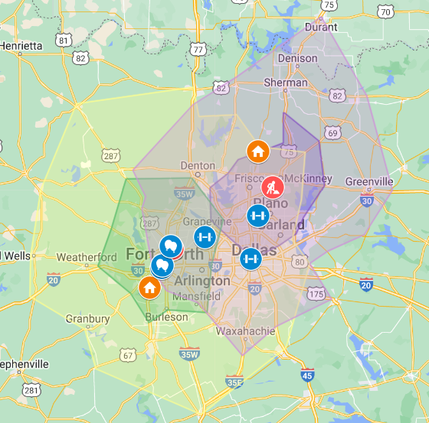
Pictured here is a map with 30min and 1hr drive time zones from each of our locations of work. The purple circles radiate out from Faith’s Star Center while the green shows distance from Lockheed.
From this image, the triangle of Denton, Grapevine and Frisco would be the most obvious choice for housing based on this one heuristic. Of course there are other factors, such as her transferring locations or me driving further since I only go in twice per week or either of us going full wfh.
Brandon and Alden live in the North Fort Worth / Grapevine area, Kyle lives in Weatherford, and my parents live in West Fort Worth. Living just Northeast of 820 would probably be the best solution here.

Slide 9
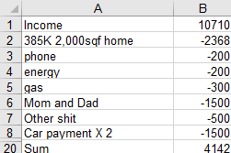
Finances
Estimating Faith’s salary at about 60K, we would have a combined after-tax take home of about $10,710 per year.
This would mean we could afford a comfortable life; I could moderately support my parents to preserve my inheritance; and we could still put back over 4K per month.

Slide 10
Expert CIA Data Gathering
Sister’s Youtube - @gabbyslocmb1452
Faith’s Twitter - @Racingclouds
Mom’s Facebook – Alicia Slocumb
Sister’s Facebook – Gabby Slocumb

Slide 11
Willie Pearl Slocumb 1909-2009
Earl Slocumb
Dorothy Slocumb 1937
Curt Slocumb
Alicia Slocumb
Faith Slocumb
Gabby Slocumb

