Slide 1
Overthinking: Faith Slocumb
By Alexander Parris

Slide 2
Green Flags
Value
High
1. Social and relationship values. She seems totally aligned with me on core values and politics. Even on loyalty, honesty, family structure, eugenics, conspiracy, disgust for the needy, and racial prejudices.
2. Temperamentally stable. Not intent on inserting herself in my activates just to soak up my attention or monopolizing my time just for the sake of it.
3. Not vaccinated. She has a growing distrust of pharmaceuticals.
4. I may get along well with my in-laws. From the sounds of it we are aligned.
5. We are physically attracted to each other.
6. No major debt.
7. Good relationship with father and mother.
8. No history of rampant sexual promiscuity, relationship trauma, or STDs.
High
Mid
Mid
High
Low
High
High

Slide 3

My Own Red Flags
1. Nervous about intimacy. She could intemperate this as rejection and then feel unloved.
2. Overly judgmental. She may see my high standards as unreasonable or arbitrary and destructive.
3. Technically short. She is overlooking my height completely. We are at least the same height, so there is a good chance my kids will be taller than me with her (See top of slide for % chance based on our heights).
4. Not rich. I’m not rich, what else can I say?

Slide 4
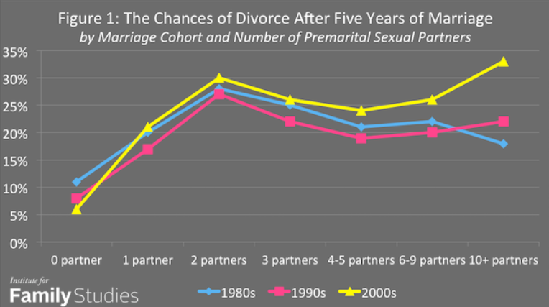
Issues that need to be discussed
Faith’s opinion on children, sex and divorce. I want to ask her opinion on children, sex and divorce in a very open-ended way. Then follow up with maybe a question on what she wants her children to look like and be like.
I want a relationship that abides by “till death due us part” and a parent partnership where we have the same vision for raising our kids, where neither of us undercut the other on important decisions.
What is sex contingent on for me?
Getting through all the hurtles and checks of personality and family.
There being a high possibility we will marry.

Slide 5
Willie Pearl Slocumb 1909-2009
Earl Slocumb
Dorothy Slocumb 1937
Curt Slocumb
Alicia Slocumb
Faith Slocumb
Gabby Slocumb

Slide 6
Prospective Timeline
Mid-October: my house is repaired
Faith Wedding trip
1 month
Sep 8, third date first kiss
Pregnant.
sex
sex
sex
sex
sex
sex
sex
sex
sex
sex
sex
sex
sex
sex
sex
sex
sex
sex
sex
sex
sex
sex
sex
sex
Aug
19
sex
sex
sex
sex
sex
sex
sex
sex
sex
sex
sex
sex
sex
sex
sex
sex
sex
sex
sex
sex
sex
sex
sex
sex
sex
sex
sex
sex
sex
sex
Aug 25, first date
Meet friends
Say “we are dating”
Sep 10, fourth date.
Meet families and
see each other’s houses
Sep 19-24. Canada trip

Slide 7
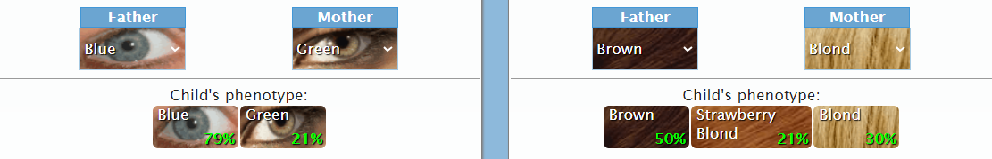
Red Flags
3. Tattoos and vaping. These go together as things that are specific to our generation’s culture. (Acceptable)
It really doesn’t bother me while I’m with her, so this is just something that will fade into the background. I would like to have an understanding on teaching possible kids to be reserved with these two things though. The nicotine from vaping may be killing her appetite, which needs to change probably.
4. Non-virginity. (Acceptable)
According to her, she has a bodycount of six (6) with no hookups. She is certainly satisfied with me physically and doesn’t seem to have any lingering feelings from the past. I have to take her word here and accept that she isn’t traumatized or hung up on the past.
5. Physical Frailty. She inherited hEDS (Ehlers-Danlos Syndrome) which weakens her joints and left her with tooth decay and ultimately tooth implants, POTS, myopia, heart artery late formation. (Acceptable)
Surprisingly, I don’t feel very strongly about this. There is a 50/50 chance that any child we have inherits this with no guarantee that symptoms will surface. The disease isn’t fatal but it means the child would perhaps be forced to rely on their mind rather than take up sports. She will have some problems in childbirth but the chance of mortality is about the same for normal women. I need her to workout and eat a little more.
6. Prescription drugs. She does take a sleeping pill to fall asleep and she uses chemical birth control. (Acceptable)
Really a non-factor. The sleeping pill can probably be replaced with tea or working out, though it may be a symptom from EDS. Ending birth-control is a double-edged sword since we are hot for each other.

Slide 8
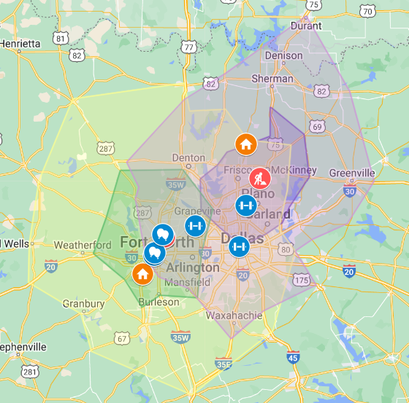
Pictured here is a map with 30min and 1hr drive time zones from each of our locations of work. The purple circles radiate out from Faith’s Star Center while the green shows distance from Lockheed.
From this image, the triangle of Denton, Grapevine and Frisco would be the most obvious choice for housing based on this one heuristic. Of course there are other factors, such as her transferring locations or me driving further since I only go in twice per week or either of us going full wfh.
Brandon and Alden live in the North Fort Worth / Grapevine area, Kyle lives in Weatherford, and my parents live in West Fort Worth. Living just Northeast of 820 would probably be the best solution here.
If we were engaged before next Fall then I would make her quit her job to go to school. In that case we could live within my circle and she would only have to suffer the longer drive for a few months.
Brandon suggests getting a house in his neighborhood or an apartment in the same section of apartments that he and Liz used to live in. The apartment may actually be a good option as it is close to Brandon, close to Gabby, close to my work, and a 30 min drive to UTA, where Faith can get her degree. It’s way cheaper than a house and would give us a year or two to pay off all our debt and save up a down payment. After two years she can work and our income would go way up.
If we choose a house or apt, I should also consider whether there is an existing PC in that precinct.
Option 1: NE 820, Brandon’s location seems to be the most convenient since it is proximal to Brandon, Alden, Gabby and India. The big losers would be Kyle and dad, who I am honestly closer to.
Option 2: SW Fort Worth/Aledo. We coordinate and buy a house in the same neighborhood as Kyle, keeping me close to dad.
If I’m unsure about leaving my dad alone I can get the apt at Courtland Riverside. That wouldn’t bind me to a decision right away and it would give Kyle time to figure out his relationship and living situation, which is less pressing than mine. I could also get a solid year of close time with Bliz like old times.

Slide 9
Prospective Timeline
Beginning of Spring (March 1)
Either decide to propose or break up.
Mid-October: my house is repaired
Faith Wedding trip
1 month
Take a trip together. January.
Sep 8, third date first kiss
6-month anniversary
1 Year Anniversary
3-month anniversary.
2- months:
New Years
9 months.
Aug
19
(first text)
Aug 25, first date
Meet parents
boyfriend girlfriend
Sep 10, fourth date.
Sep 19-24. Canada trip
Earliest for
Engaged and apartment
earliest I would consider sex
2–3-year anniversary: Move into home.
Faith finishes BA. Soonest we have kid.
Faith quits work and goes back to college
Year 5-6: Faith finishes PHD starts work.
Earliest I quit Lockheed.

Slide 10
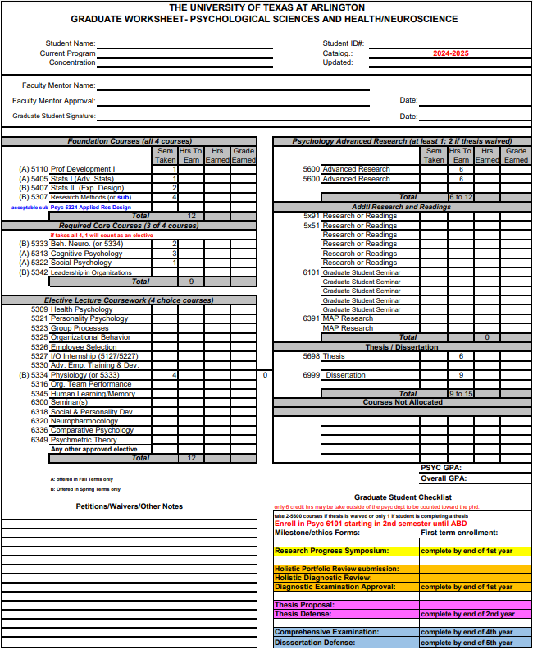
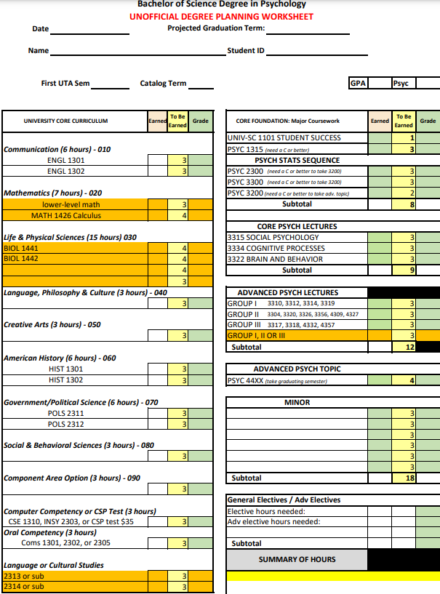
Career Planning
Faith wants to be a phycologist at the VA, which would require a PHD. Since she only has two years of class credit, it would probably take two years to finish her BA then go right into the PHD. Say 3 years to finish the PHD. She would be out of work until 30 (I would be 32). From there she could get her dream job. Doing this would guarantee me another 5 years at Lockheed, unless I found something else that makes just as much.
She would need to start right away to shorten the time to reach her goal and to relieve the stress on me to hold her up for more time than necessary.
On the other hand, I have to question whether she really should go back to college. My concerns are as follows:
It could have a liberalizing influence on her
I would have the sole income for 5 years minimum
It may push us to wait too long to have kids
A job at the VA may come with vaccine requirements
There are pros to it though:
It would raise the pedigree of our family
It would guarantee her good employment no matter what
It would raise her self-esteem
It would mean we could easily the upper-middle class and I may be able to quit Lockheed and do something I enjoy without the stress associated with having no second income.
And what about Alex in the meantime? What am I working toward? Well, I would make it my goal to finish out my language studies by the time she finished her degree. Other than that, I would imbed myself further in the Tarrant County GOP and work on getting my art career off the ground.
The soonest we should have a kid is probably just after she finishes her BS. I would be 30, she 28, and everyone else would be on the same schedule. That gives me just over 2 years to really press into my dilatant activities.

Slide 11
Finance
 | no Faith,mid-home | no 401K, no faith, mid-home | no 401K,no faith,apt | No401K,Faith +35k,apt | No401K,Faith +70k,mid-home | No401K,Faith +120k,country estate
Income | 7,300 | 8,100 | 8,100 | 10,100 | 12,000 | 15,000
385K 2,000sqf home | -3125 | -3125
phone/internet | -200 | -200 | -200 | -200 | -200 | -200
energy | -200 | -200 | -200 | -200 | -200 | -200
gas | -200 | -200 | -200 | -200 | -200 | -200
Mom and Dad | -1500 | 0 | 0
Food/subscriptions | -500 | -500 | -500 | -500 | -500 | -500
Car payment X 2 | -1500
Car payment X 1 |  | -700 | -700 | -700 | -700 | -700
Fun |  | -300 | -300 | -300 | -300 | -300
2bd2bth apt courtland riv |  |  | -1750 | -1750
425K 3Ksqf home |  |  |  |  | -3435
600K 2.5sqf colonial 1acr |  |  |  |  |  | -4800
Pay left over | 75 | 2875 | 4250 | 6250 | 6465 | 8100
The chart to the top-right shows our projected take home pay after expenses. If we use these numbers to extrapolate savings over time, then we get the chart on the bottom.
Clearly I need to cut off my parents as much as I can or completely by the time we move in together.
The projected savings chart assumes the following timeline:
We move into an apartment together in March 2024 and Faith keeps her job.
Faith quits her job and goes to school in August 2024.
Summer break 2025 we move into a $425K house.
When Faith finished her degree in 2026 she may obtain a $70K job to gather work experience in her field. At this point she could go back to school and I would keep bringing home the bacon or she could get pregnant.

Slide 12
My parents could fix and sell the house and probably have 200K-250K left over.

