Slide 1

Introduction to Programing
Group 4
Main Thread
Exercise 15 & 16

Slide 2
CHAR

Slide 3
THE CHAR DATA TYPE IS USED TO STORE A SINGLE CHARACTER. THE CHARACTER MUST BE SURROUNDED BY SINGLE QUOTES, LIKE 'A' OR 'C':

Slide 4
THE CHAR TYPE SIZE IN C++ IS 1 BYTE = 8 BITS WHICH CAN REPRESENT 2 ^ 8 = 256 DIFFERENT NUMBERS

Slide 5
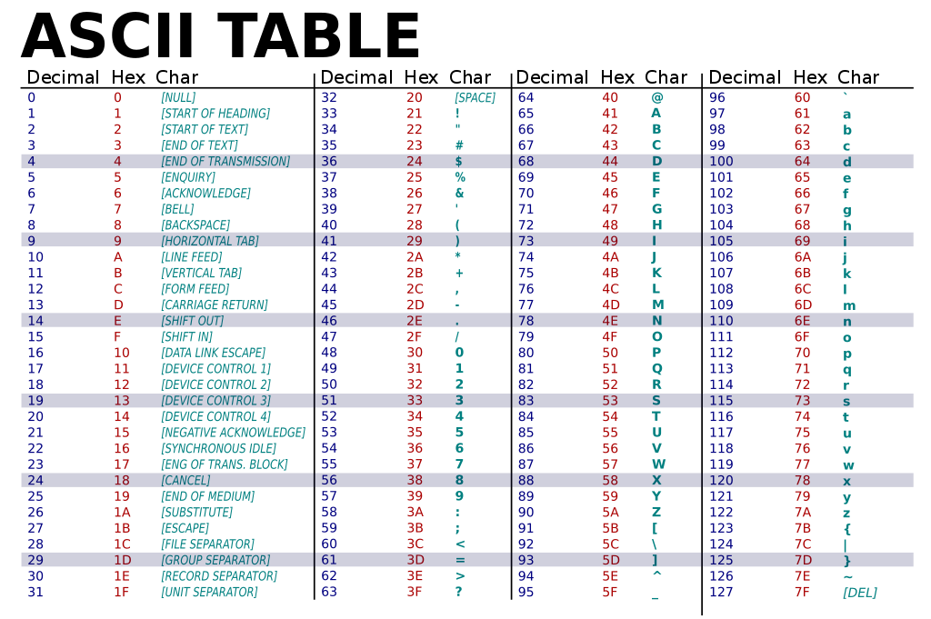

Slide 6
STRING

Slide 7
STRINGS ARE OBJECTS THAT REPRESENT SEQUENCES OF CHARACTERS.

Slide 8
THE SEQUENCES OF CHARACTERS MUST END WITH ‘\0’ NULL TERMINATOR SYMBOL WHICH IS USED THE SIGNALIZE THE END OF CHARACTERS SEQUENCE.

Slide 9
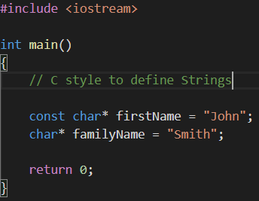

Slide 10
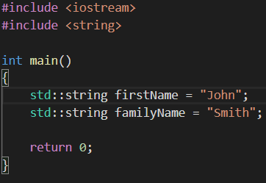

Slide 11
Thank you for watching

