Slide 1

Introduction to Programing
Group 4
Main Thread
Exercise 7 & 8

Slide 2
ARRAY

Slide 3
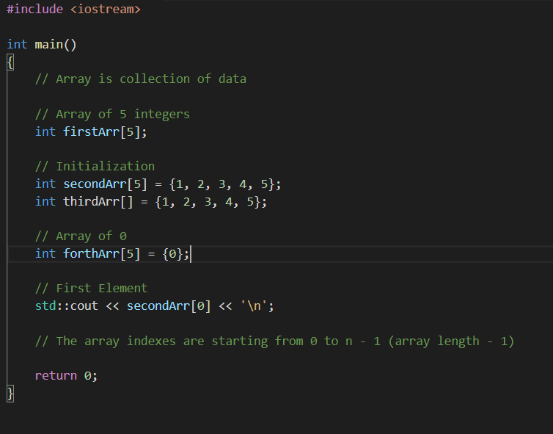

Slide 4
ELEMENTS

Slide 5
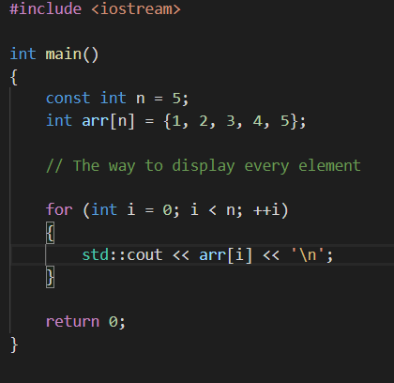

Slide 6
SEARCH ELEMENT

Slide 7
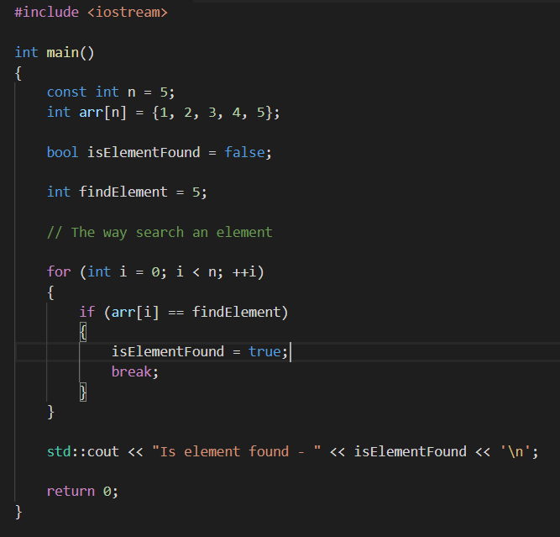

Slide 8
VECTOR
CLASS
Dynamic Array

Slide 9
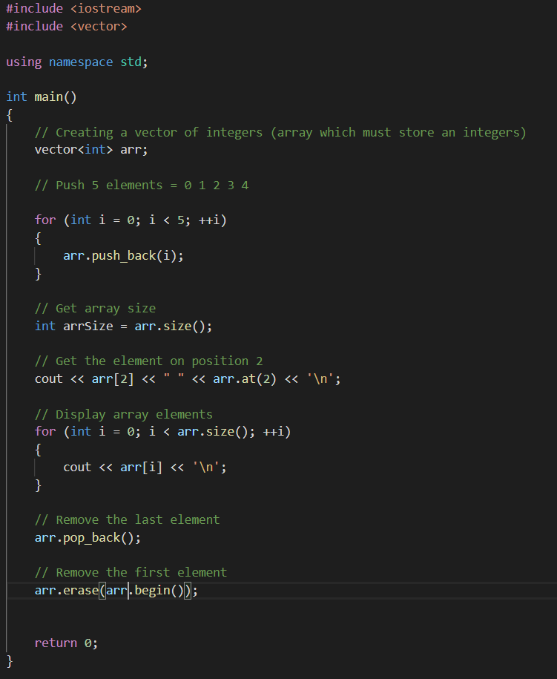

Slide 10
Thank you for watching

