Slide 1

Introduction to Programing
Group 4
Main Thread
Exercise 3 & 4

Slide 2
The main purpose of programing is to manipulate data

Slide 3
The different type of variables in C++
Type | Description
bool | Stores either value true or false.
char | Typically a single octet (one byte). This is an integer type.
int | The most natural size of integer for the machine.
float | A single-precision floating point value.
double | A double-precision floating point value.
void | Represents the absence of type.
wchar_t | A wide character type.

Slide 4
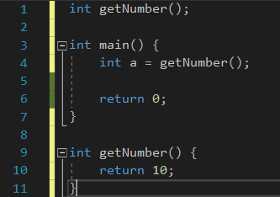
Functions Basics
Function Declaration (Function Prototype)
Function Definition (Function Body)

Slide 5
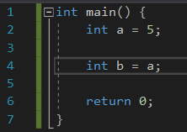
L-value
It refers to location in the memory
Visual Studio allocate guardian memory which prevent accessing the next
memory on mistake. Because the Stack memory is stored sequentially.
It has two side assignment
L-value is initialize with R-value
L-value is initialize with L-value

Slide 6
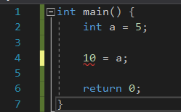
R-value
It is an expression which is not represented in the memory
It can only be placed on the right side of assignment
L-value is initialize with R-value
Error

Slide 7
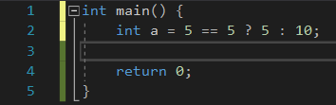
Ternary Operator
(condition) ? (expressionTrue) : (expressionFalse)

Slide 8
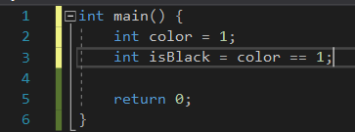
Assignment Condition

Slide 9
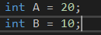
Arithmetic Operators
Operator | Description | Example
+ | Adds two operands | A + B will give 30
- | Subtracts second operand from the first | A - B will give -10
* | Multiplies both operands | A * B will give 200
/ | Divides numerator by de-numerator | B / A will give 2
% | Modulus Operator and remainder of after an integer division | B % A will give 0
++ | Increment operator, increases integer value by one | A++ will give 11
-- | Decrement operator, decreases integer value by one | A-- will give 9

Slide 10
Relational Operators
Operator | Description | Example
== | Checks if the values of two operands are equal or not, if yes then condition becomes true. | (A == B) is not true.
!= | Checks if the values of two operands are equal or not, if values are not equal then condition becomes true. | (A != B) is true.
> | Checks if the value of left operand is greater than the value of right operand, if yes then condition becomes true. | (A > B) is not true.
< | Checks if the value of left operand is less than the value of right operand, if yes then condition becomes true. | (A < B) is true.
>= | Checks if the value of left operand is greater than or equal to the value of right operand, if yes then condition becomes true. | (A >= B) is not true.
<= | Checks if the value of left operand is less than or equal to the value of right operand, if yes then condition becomes true. | (A <= B) is true.

Slide 11

Logical Operators
Operator | Description | Example
&& | Called Logical AND operator. If both the operands are non-zero, then condition becomes true. | (A && B) is false.
|| | Called Logical OR Operator. If any of the two operands is non-zero, then condition becomes true. | (A || B) is true.
! | Called Logical NOT Operator. Use to reverses the logical state of its operand. If a condition is true, then Logical NOT operator will make false. | !(A && B) is true.

Slide 12
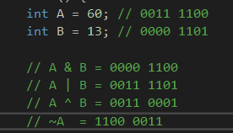
Bitwise Operators
p | q | p & q | p | q | p ^ q
0 | 0 | 0 | 0 | 0
0 | 1 | 0 | 1 | 1
1 | 1 | 1 | 1 | 0
1 | 0 | 0 | 1 | 1

Slide 13
Bitwise Operators
Operator | Description | Example
& | Binary AND Operator copies a bit to the result if it exists in both operands. | (A & B) will give 12 which is 0000 1100
| | Binary OR Operator copies a bit if it exists in either operand. | (A | B) will give 61 which is 0011 1101
^ | Binary XOR Operator copies the bit if it is set in one operand but not both. | (A ^ B) will give 49 which is 0011 0001
~ | Binary Ones Complement Operator is unary and has the effect of 'flipping' bits. | (~A ) will give -61 which is 1100 0011 in 2's complement form due to a signed binary number.
<< | Binary Left Shift Operator. The left operands value is moved left by the number of bits specified by the right operand. | A << 2 will give 240 which is 1111 0000
>> | Binary Right Shift Operator. The left operands value is moved right by the number of bits specified by the right operand. | A >> 2 will give 15 which is 0000 1111

Slide 14
Assignment Operators
Operator | Description | Example
= | Simple assignment operator, Assigns values from right side operands to left side operand. | C = A + B will assign value of A + B into C
+= | Add AND assignment operator, It adds right operand to the left operand and assign the result to left operand. | C += A is equivalent to C = C + A
-= | Subtract AND assignment operator, It subtracts right operand from the left operand and assign the result to left operand. | C -= A is equivalent to C = C - A
*= | Multiply AND assignment operator, It multiplies right operand with the left operand and assign the result to left operand. | C *= A is equivalent to C = C * A
/= | Divide AND assignment operator, It divides left operand with the right operand and assign the result to left operand. | C /= A is equivalent to C = C / A
%= | Modulus AND assignment operator, It takes modulus using two operands and assign the result to left operand. | C %= A is equivalent to C = C % A
<<= | Left shift AND assignment operator. | C <<= 2 is same as C = C << 2

Slide 15
Assignment Operators
Operator | Description | Example
>>= | Right shift AND assignment operator. | C >>= 2 is same as C = C >> 2
&= | Bitwise AND assignment operator. | C &= 2 is same as C = C & 2
^= | Bitwise exclusive OR and assignment operator. | C ^= 2 is same as C = C ^ 2
|= | Bitwise inclusive OR and assignment operator. | C |= 2 is same as C = C | 2

Slide 16
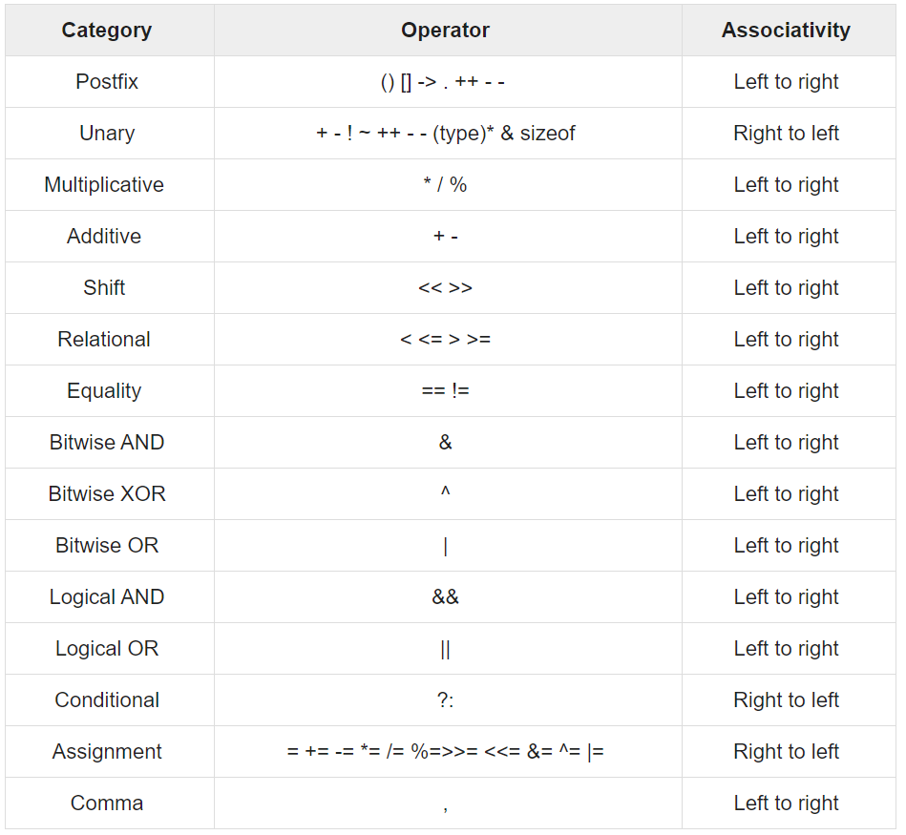

Slide 17
Thank you for watching

