Slide 1

Introduction to Programing
Group 4
Main Thread
Exercise 5 & 6

Slide 2
IF & ELSE

Slide 3
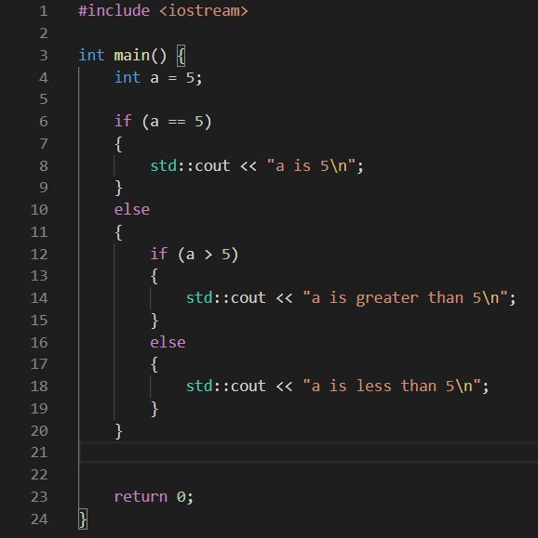

Slide 4
SWITCH

Slide 5
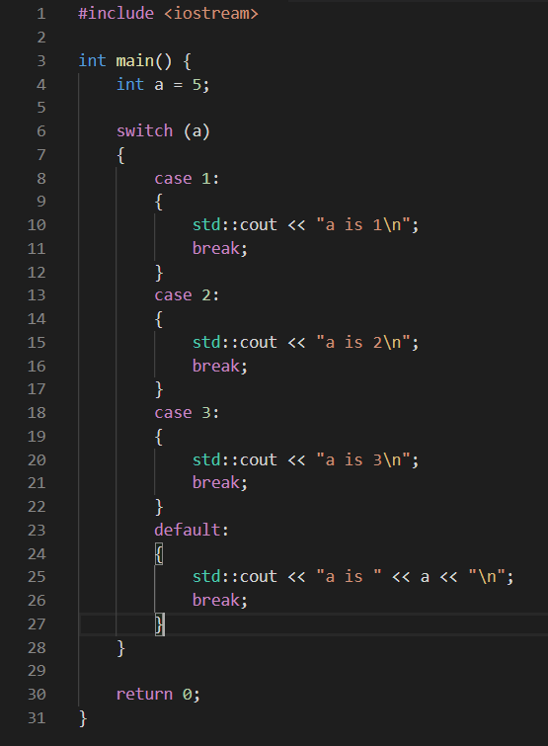

Slide 6
FOR

Slide 7
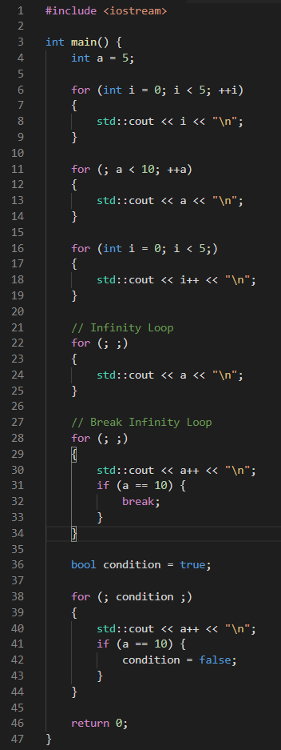

Slide 8
WHILE & DO-WHILE

Slide 9
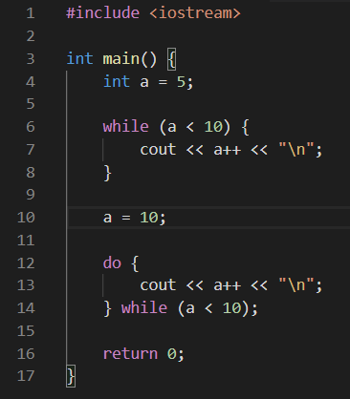

Slide 10
RETURN & BREAK & CONTINUE

Slide 11
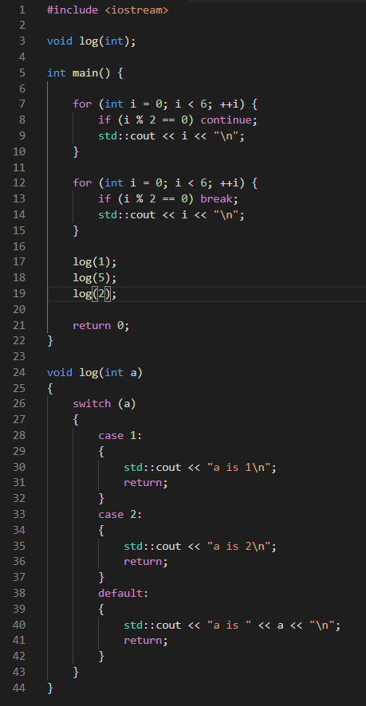

Slide 12
Thank you for watching

