Slide 1

Introduction to Programing
Group 4
Main Thread
Exercise 17 & 18

Slide 2
STRUCT

Slide 3
Structures in C++ are user defined data types which are used to store group of items of non-similar data types

Slide 4
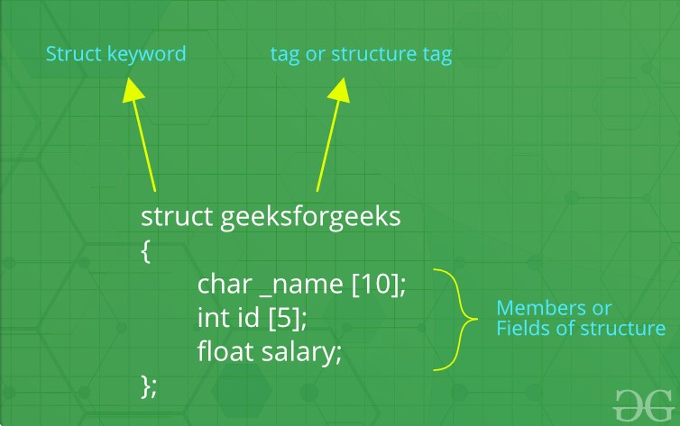

Slide 5
Struct is public by default

Slide 6
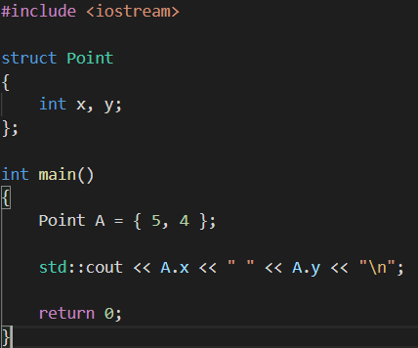

Slide 7
Thank you for watching

