Slide 1
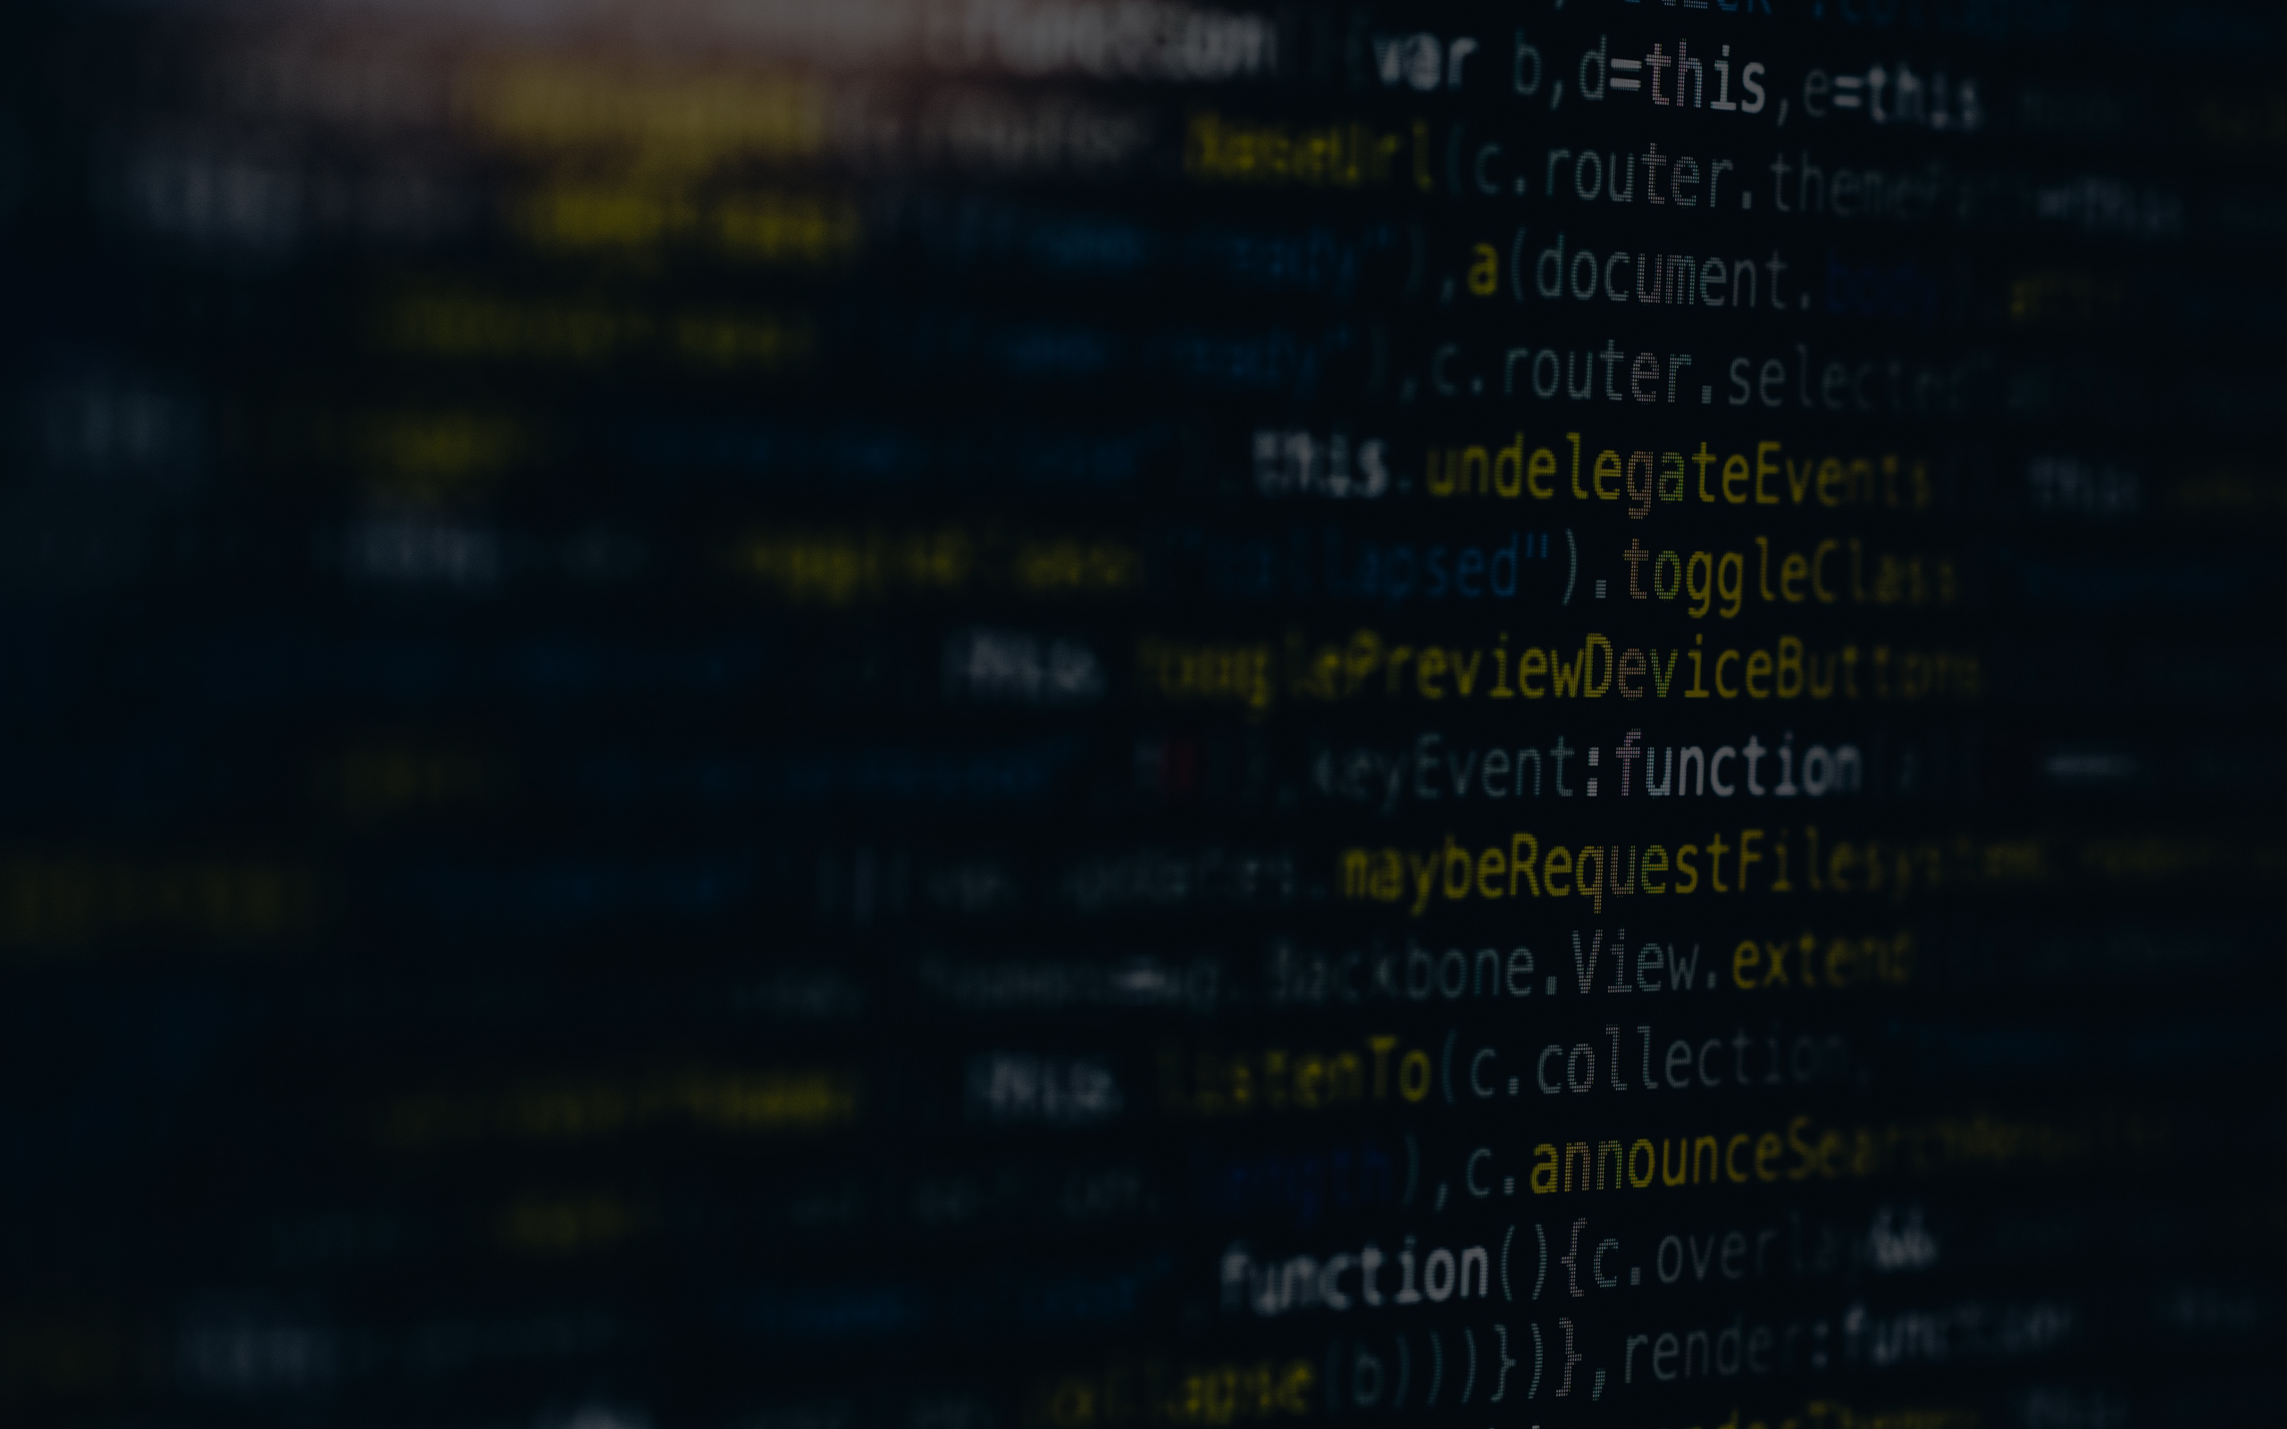
Introduction to Programing
Group 4
Main Thread
Exercise 11 & 12

Slide 2
FUNCTIONS

Slide 3
THE MAIN PURPOSE OF FUNCTION IS TO AVOID CODE DUPLICATION

Slide 4
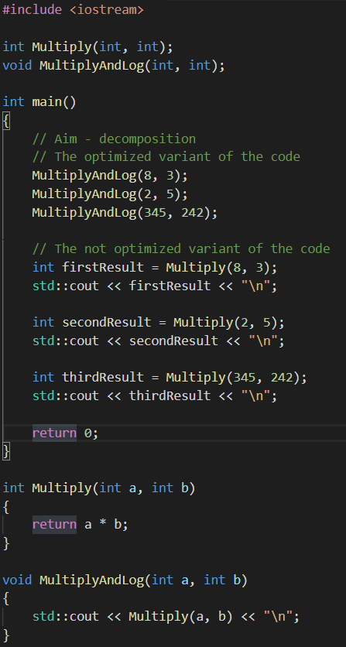

Slide 5
RECURSION

Slide 6
RECURSION IS FUNCTION WHICH CALLS ITSELF

Slide 7
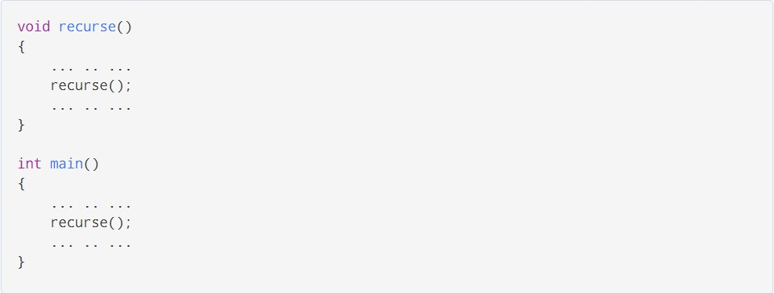

Slide 8
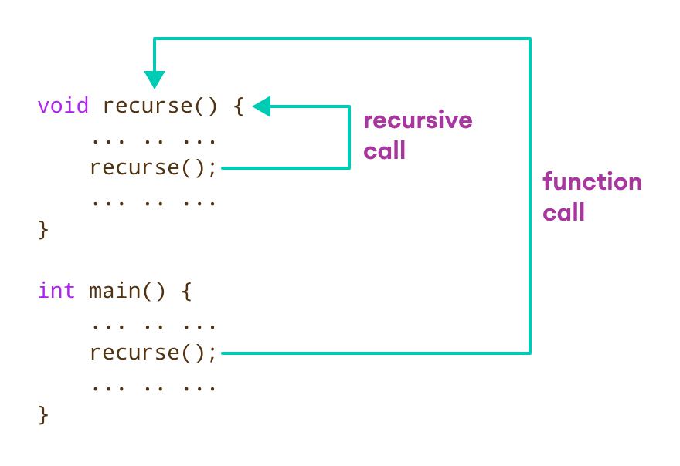

Slide 9
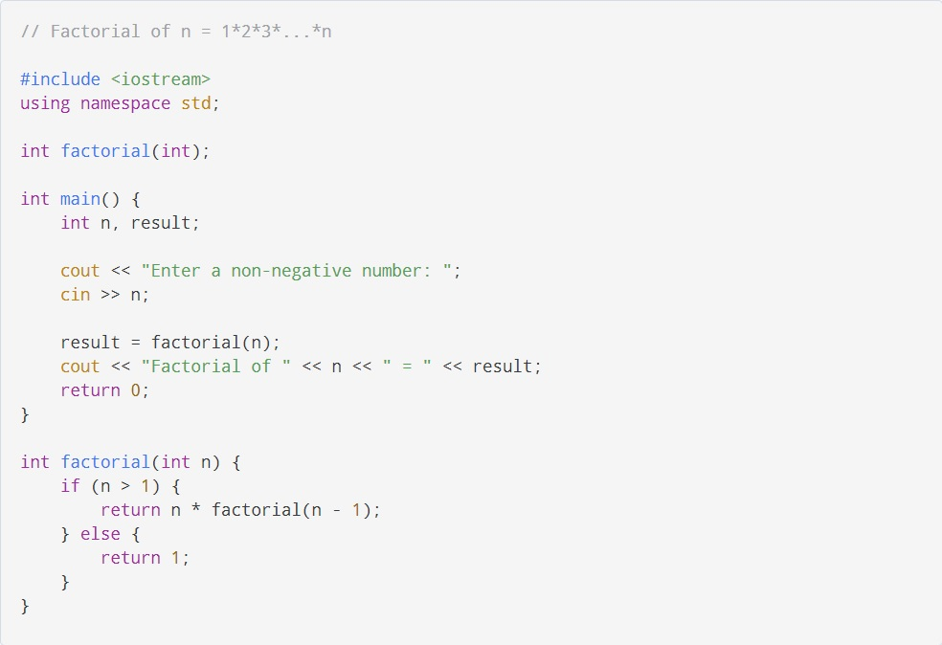

Slide 10
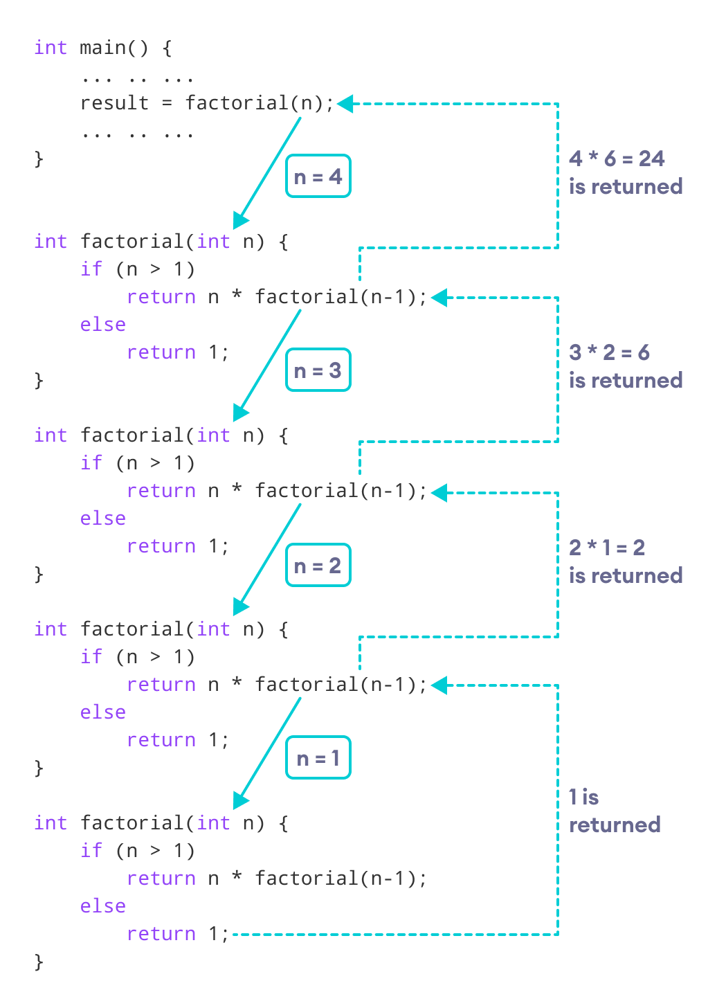

Slide 11
DISADVANTAGEOUS
It takes a lot of stack space compared to an iterative program.
It uses more processor time.

Slide 12
Thank you for watching

