Slide 1

Introduction to Programing
Group 4
Main Thread
Exercise 17 & 18

Slide 2
POINTERS

Slide 3
Pointer is a variable that stores the memory address as its value.

Slide 4
Memory management is the most important key in every program.

Slide 5
The memory itself is like a neighborhood. The building area is limited by the space where the neighborhood can spread. Space will contain properties of different sizes. The limitation of every single property will be inherited from the area which was allocated by the request of its owner and space which is limited by the neighborhood. Therefore, every property will have a unique address which will help to define the location of the exact property. The location will be in help of everything which will be interested in visiting the property like delivery services, family, friends and so on.

Slide 6
The address is used to pinpointing the location of memory

Slide 7
You can extract the address from variable with & operator

Slide 8
You can extract the value stored in the address with * operator which is dereferencing the variable

Slide 9
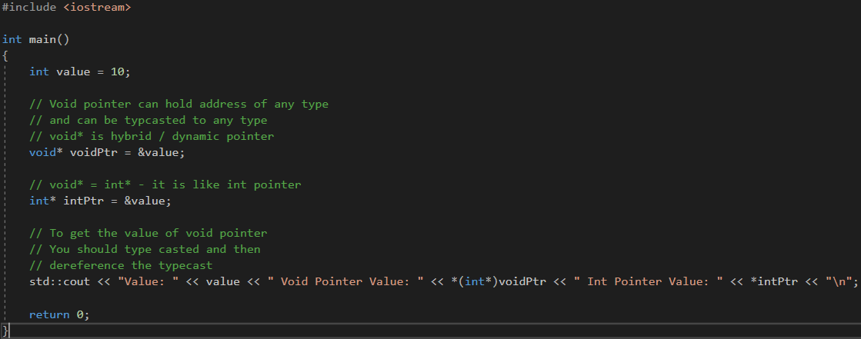

Slide 10
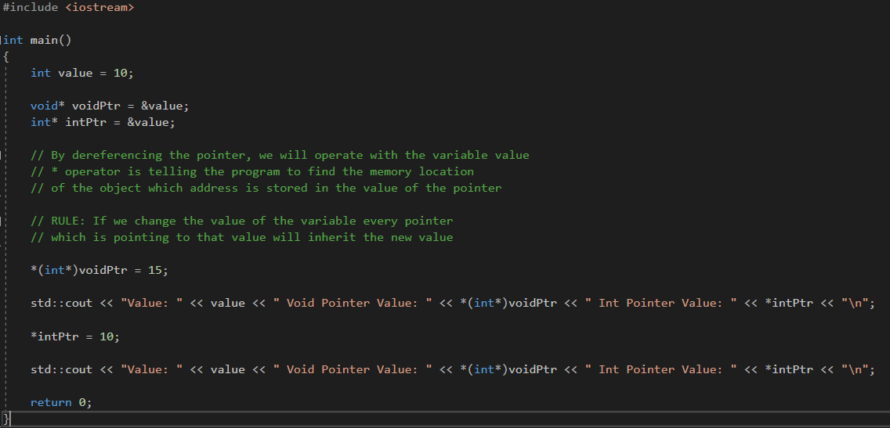

Slide 11
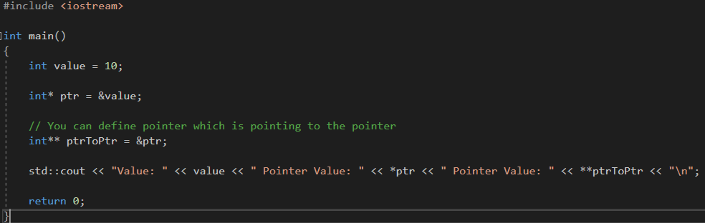

Slide 12
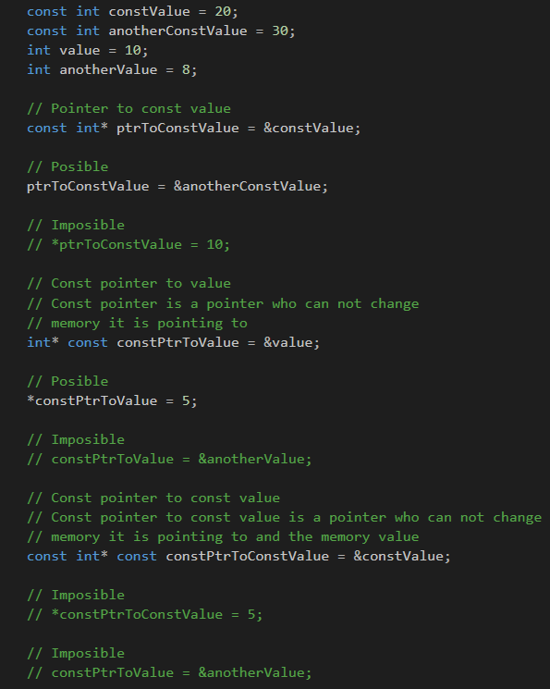

Slide 13
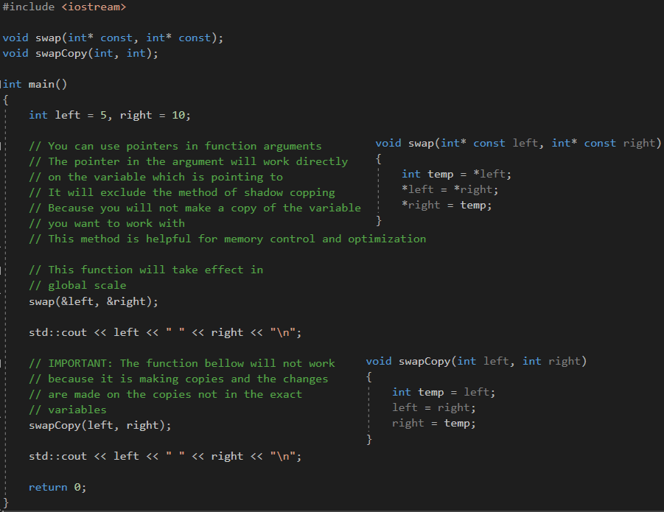

Slide 14
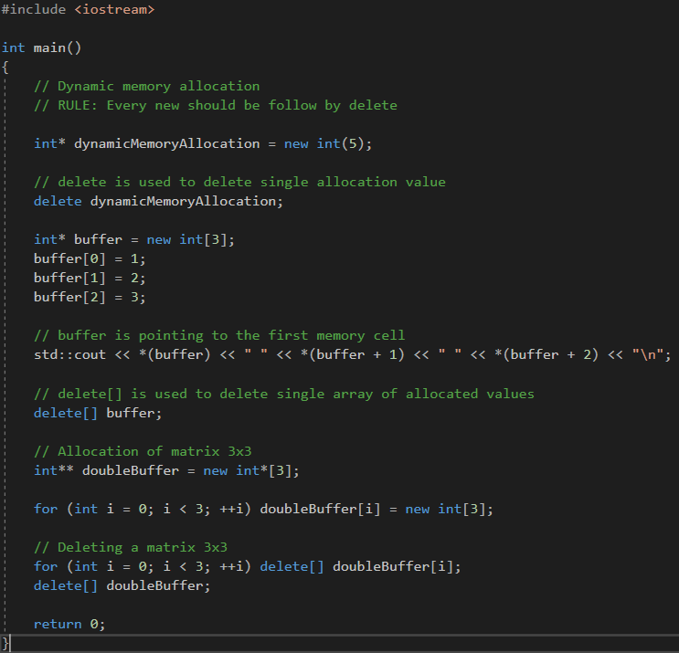

Slide 15
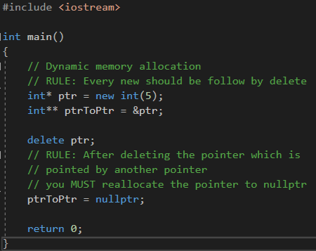

Slide 16
Function Pointers

Slide 17
Function pointer is a variable that stores the address of a function that can later be called through that function pointer

Slide 18
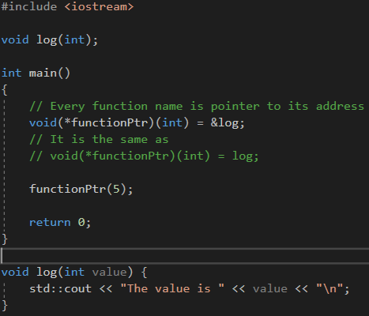

Slide 19
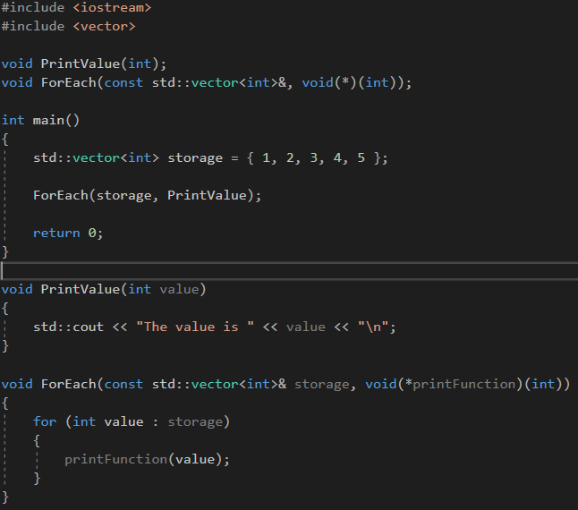

Slide 20
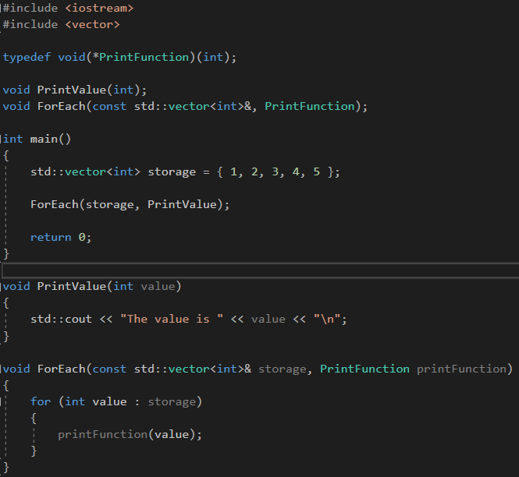

Slide 21
REFERENCE

Slide 22
Reference is alternative name for an existing variable

Slide 23
Reference is extension of pointers. The main difference is that reference will not occupy memory

Slide 24
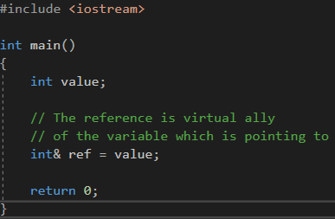

Slide 25
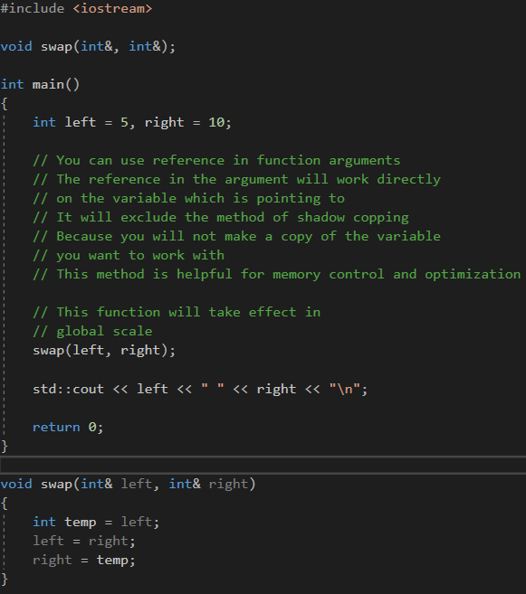

Slide 26
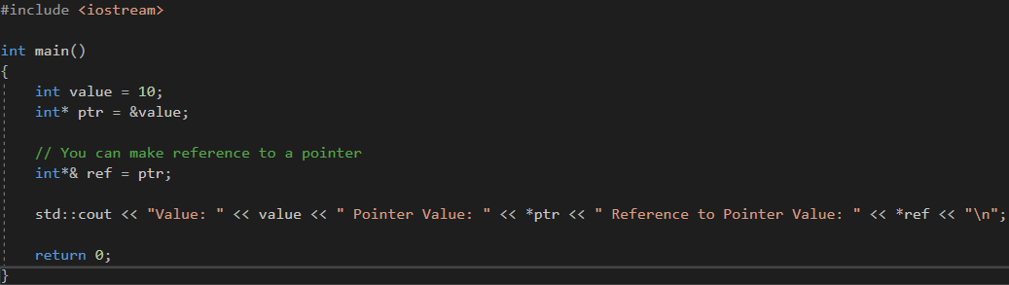

Slide 27
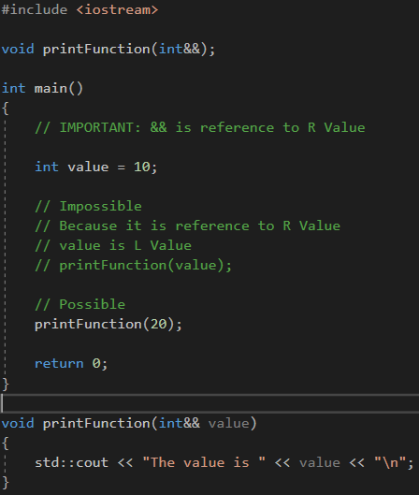

Slide 28
Thank you for watching

