Slide 1

Introduction to Programing
Group 4
Main Thread
Exercise 9 & 10

Slide 2
2-D ARRAY

Slide 3
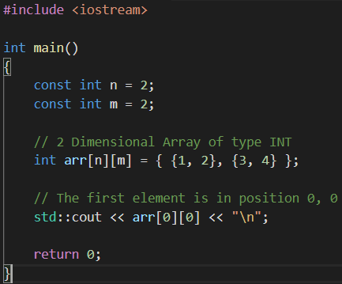

Slide 4
ELEMENTS

Slide 5
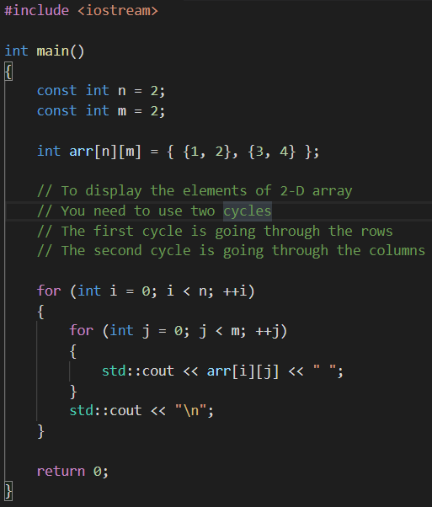

Slide 6
INPUT ELEMENTS

Slide 7
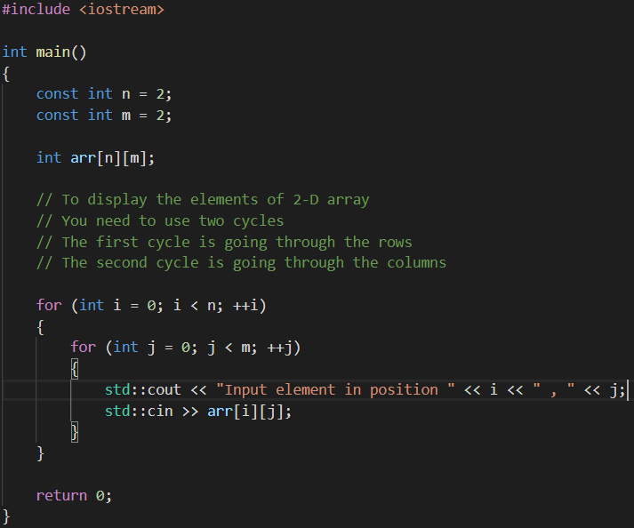

Slide 8
SEARCH ELEMENT

Slide 9
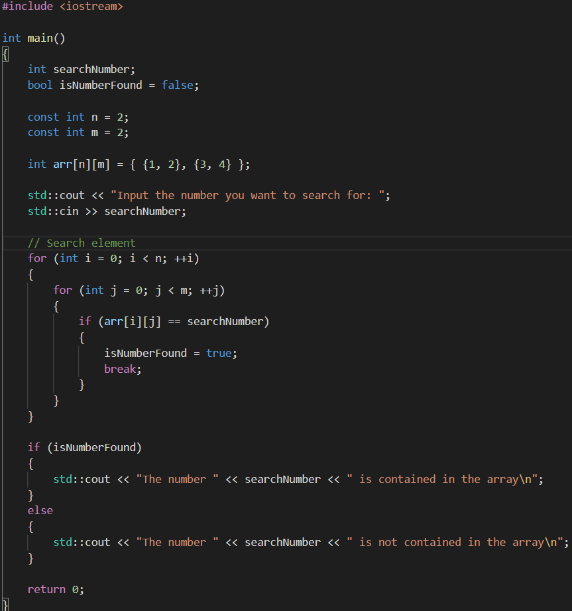

Slide 10
2-D VECTOR
CLASS
Dynamic Array

Slide 11
INPUT ELEMENTS

Slide 12
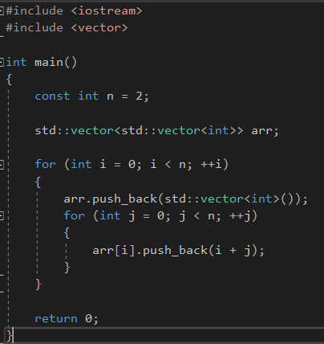

Slide 13
FUNCTIONS

Slide 14
THE MAIN PURPOSE OF FUNCTION IS TO AVOID CODE DUPLICATION

Slide 15
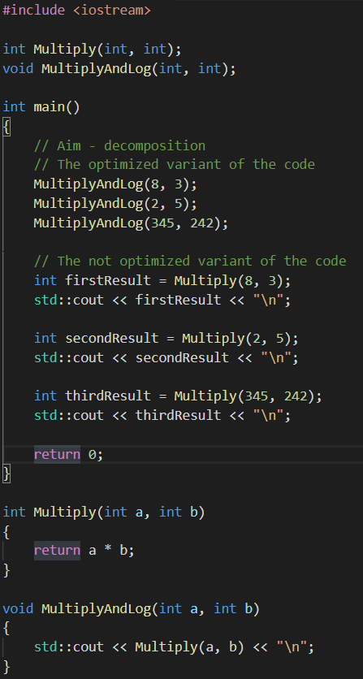

Slide 16
Thank you for watching

