Slide 1
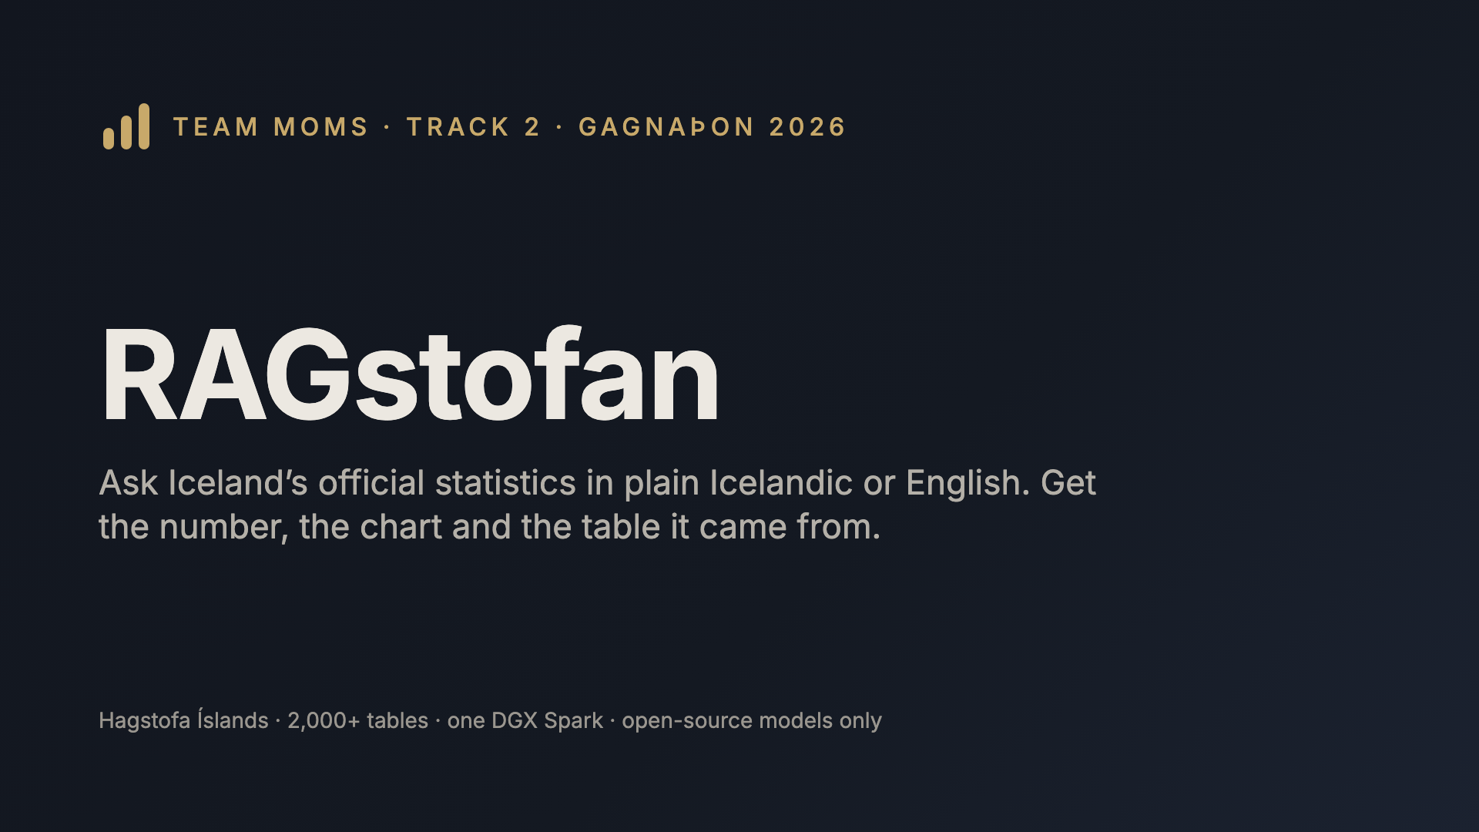
Notes:
Hi, we are team MOMS. RAGstofan answers questions about Iceland from Statistics Iceland’s own tables: every answer comes with the figure, a chart and a link to the exact table, and every number is checked against that table before you see it.

Slide 2
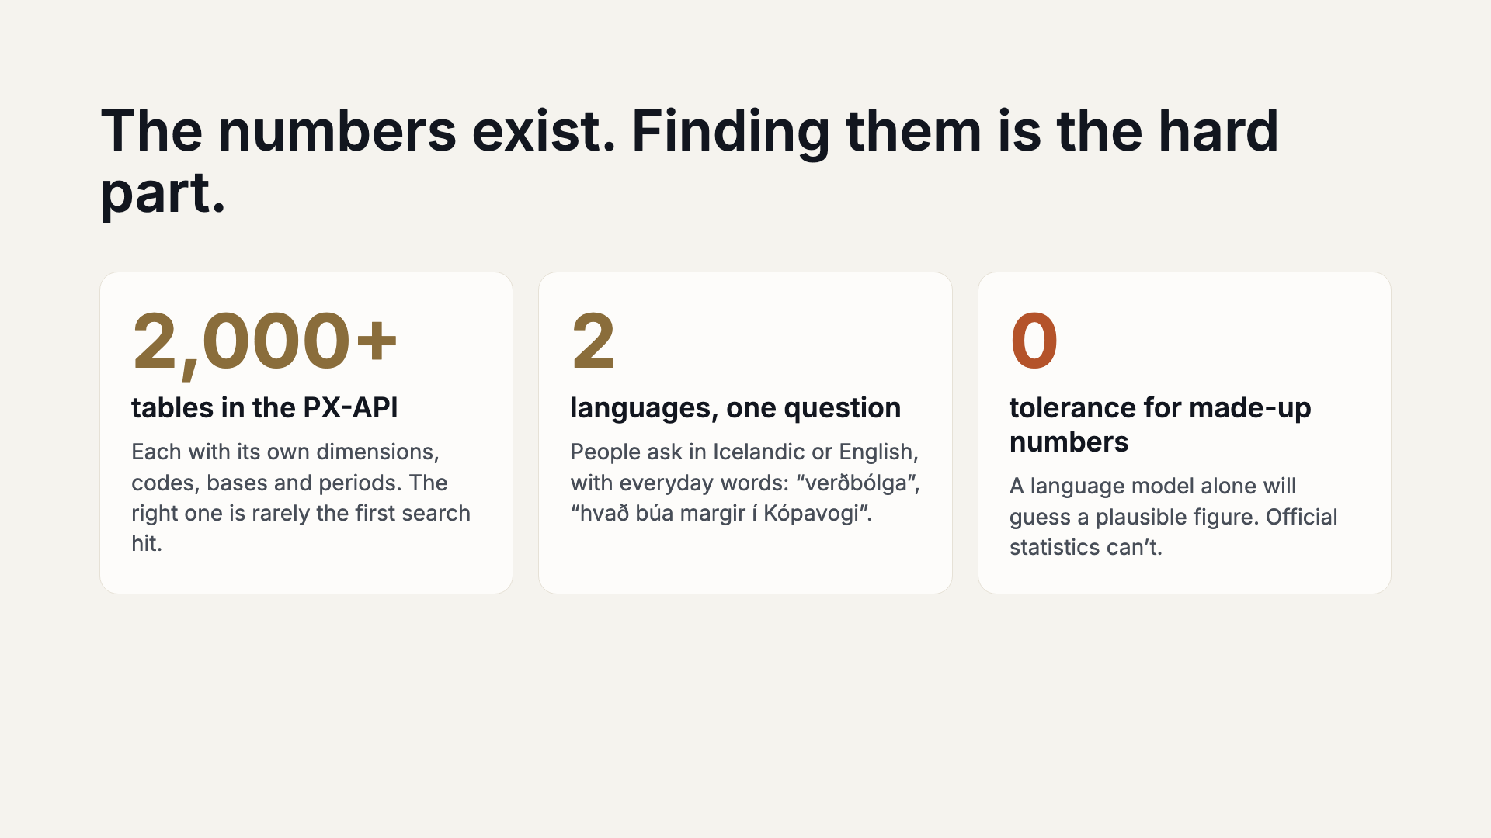
Notes:
Statistics Iceland publishes more than two thousand tables. The hard part isn’t the data, it’s finding the right table, the right breakdown and the right period, and then not inventing anything. That’s the bar we set: every number traceable to a cell in a table.

Slide 3
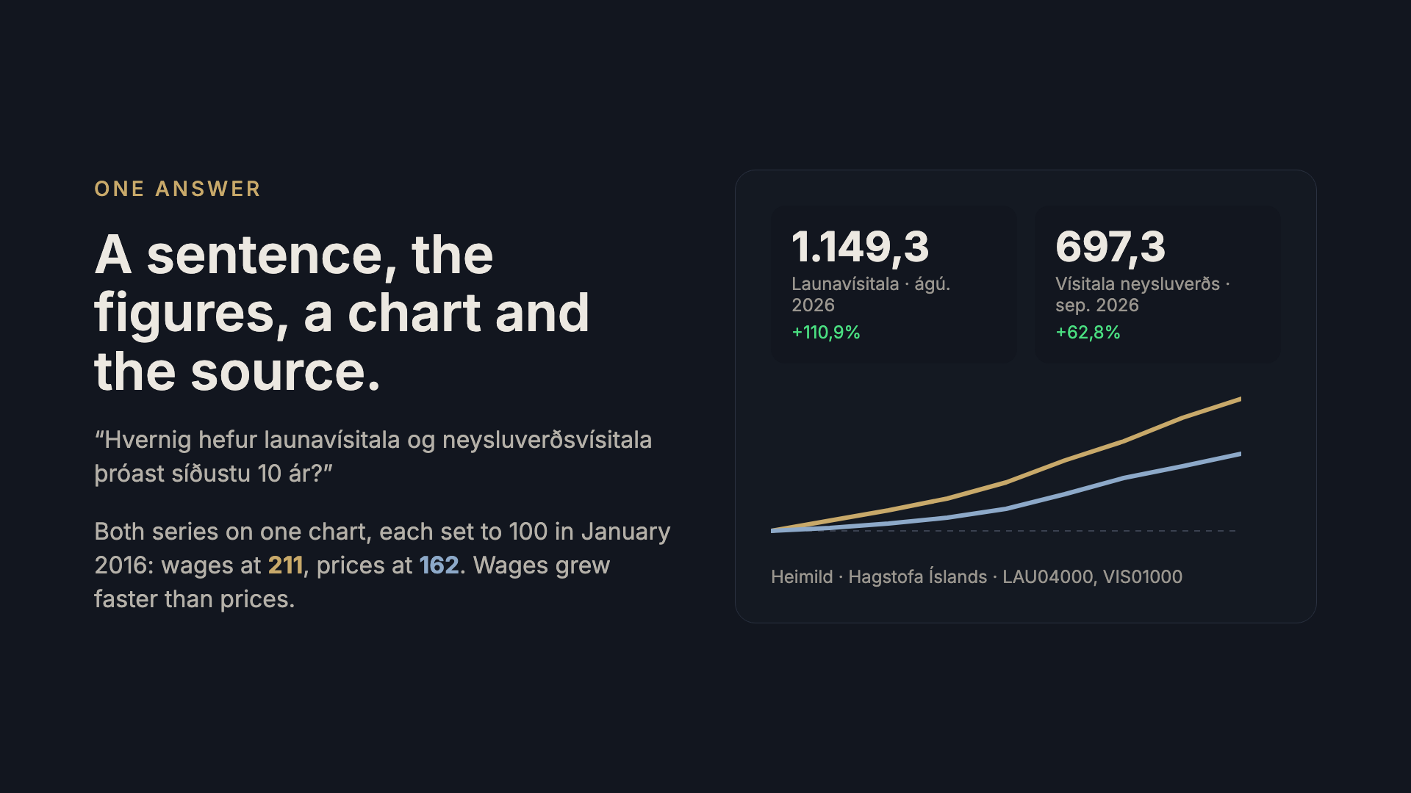
Notes:
This is a real answer from the system. One question in Icelandic, two tables, one chart. The tiles show where each series ended and how much it moved, and the source cards link straight to the tables on px.hagstofa.is.

Slide 4
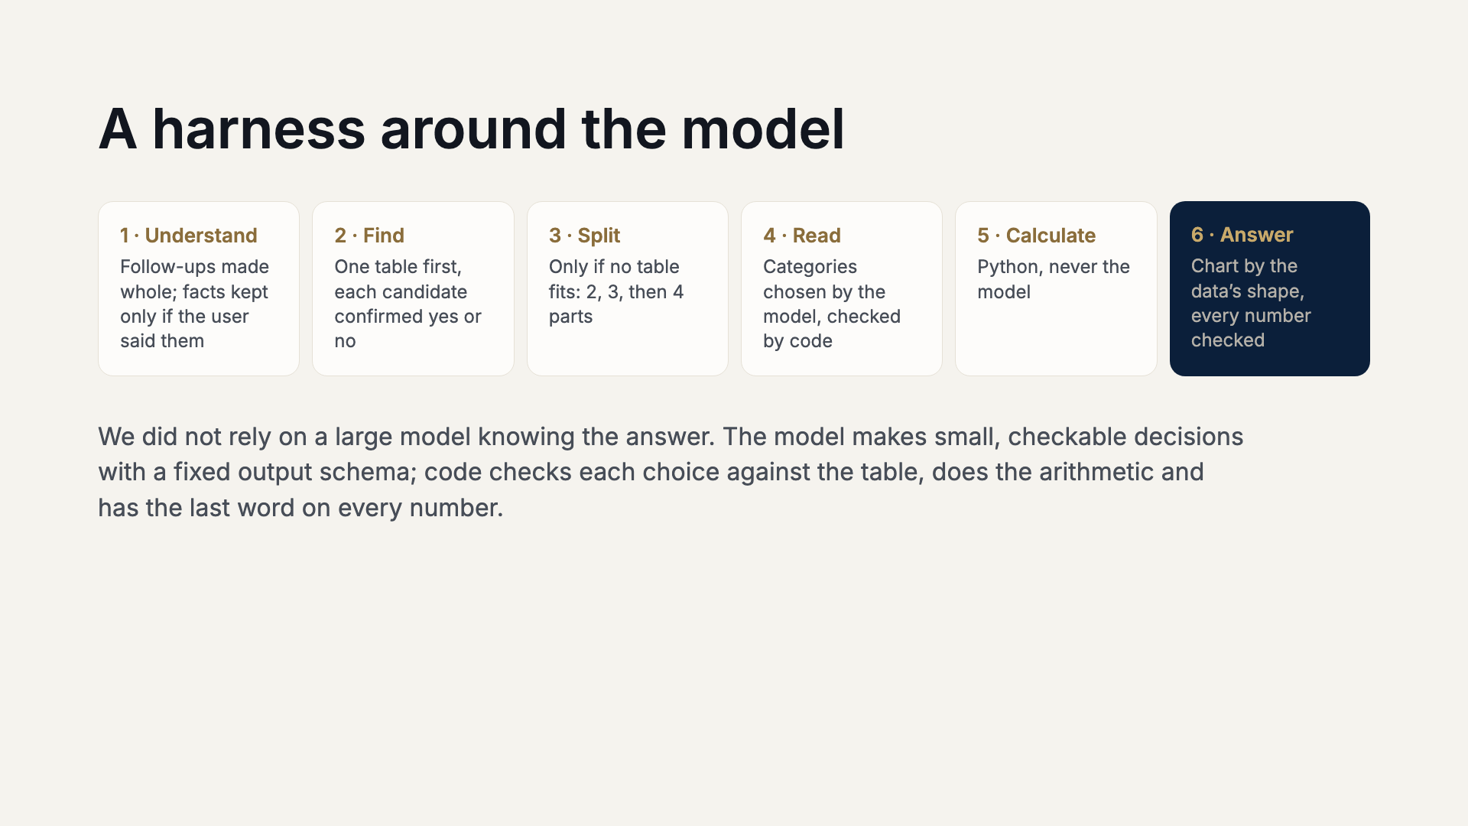
Notes:
Our approach is a harness, not a big model. The model reads, plans and chooses, one small decision at a time, each with a fixed schema. Code checks every choice against the table, does every calculation and compares every number in the written answer with the data before it is shown. The steps stream live to the website and the iPad app, so you watch the answer being built.

Slide 5
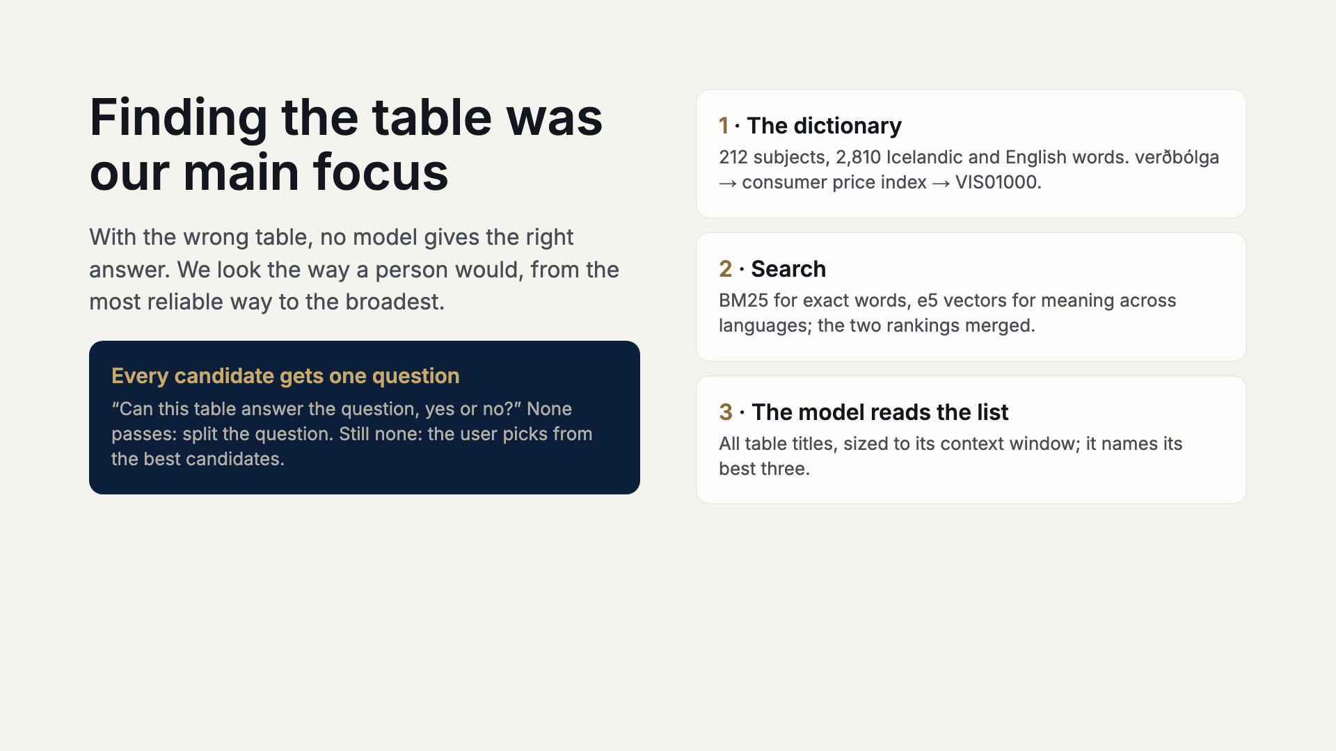
Notes:
Table finding is where most of our work and measuring went. First the dictionary: everyday words in both languages mapped to subjects and tables, checked against the catalogue. If that fails, BM25 keyword search and multilingual e5 vectors, merged by rank. If that fails, the model reads the whole list and names three. Every suggestion is checked with a plain yes or no: can this table answer the question? That catches a table on the right topic with the wrong measure. If nothing passes, the question probably needs more than one table, so we split it into up to four parts.

Slide 6
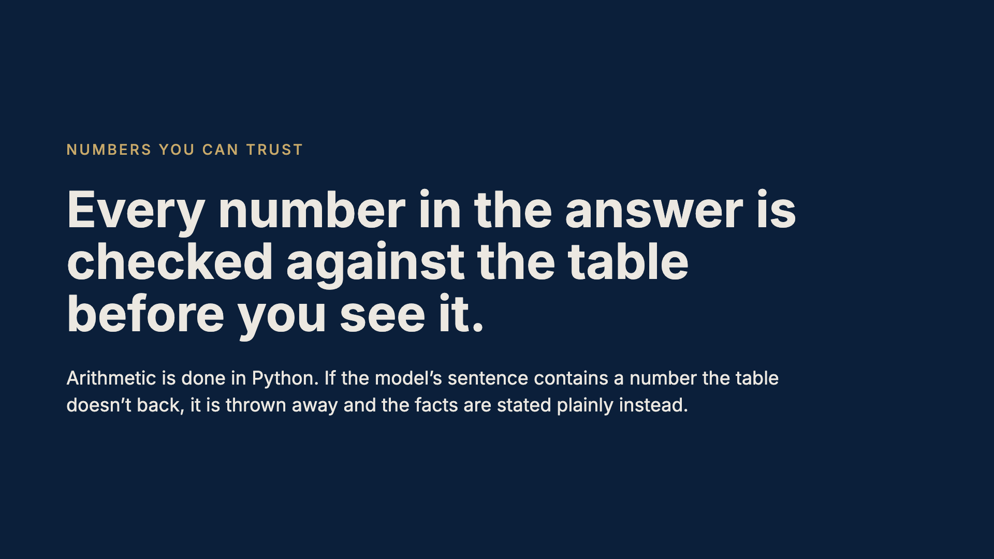
Notes:
This is the core promise. The model never does arithmetic: differences, shares and growth are computed in code. When the model writes the sentence, we extract every number and match it against the table’s values and our computed results. If one doesn’t match, we don’t show the sentence; we fall back to a plain statement of the facts.

Slide 7
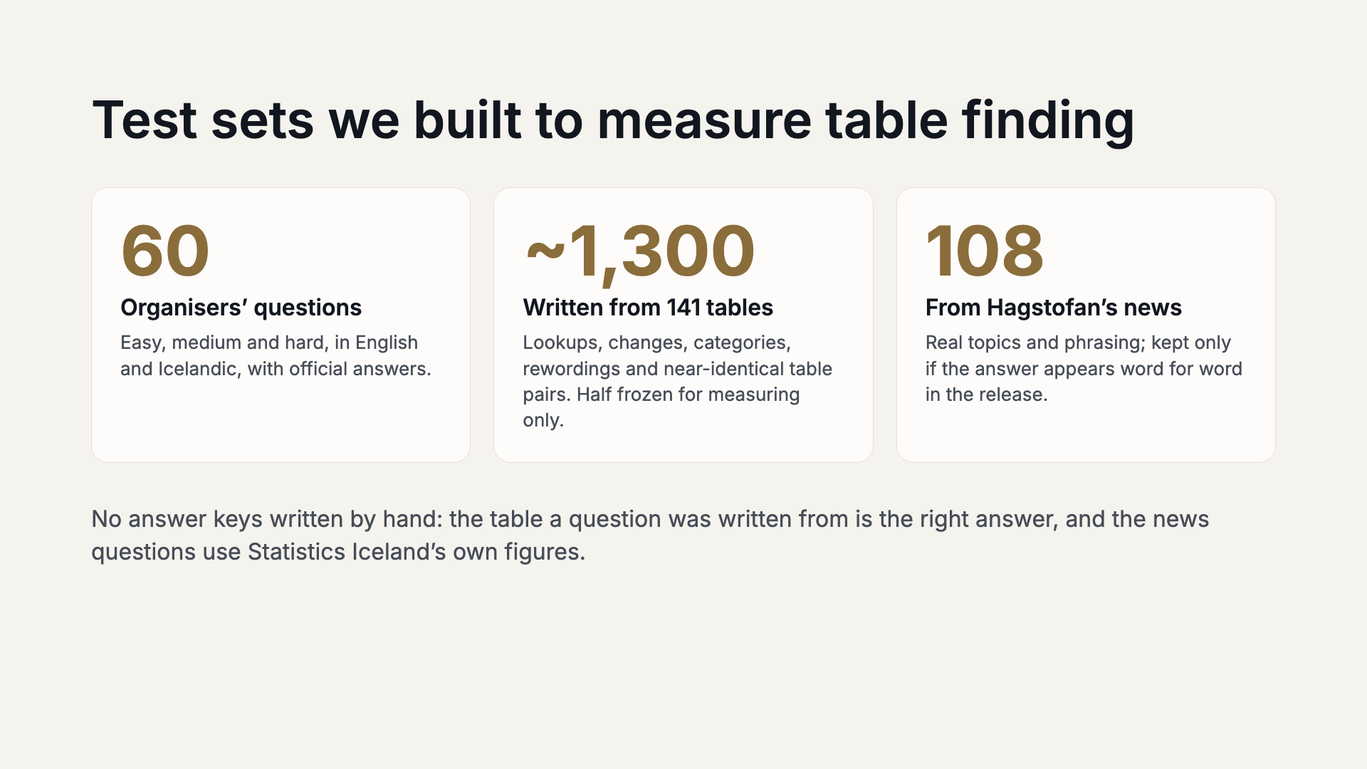
Notes:
Sixty questions is too few to trust, so we built our own. A model read each sampled table’s titles and dimensions and wrote three questions about it in both languages; the source table is the answer key. It also reworded the organisers’ questions and wrote questions only one of two near-identical tables can answer, the confusion behind most of our misses. Split by table into a half we fix against and a frozen half we only measure on. And 108 questions from the newest news releases, kept only when the answer is in the article word for word.

Slide 8
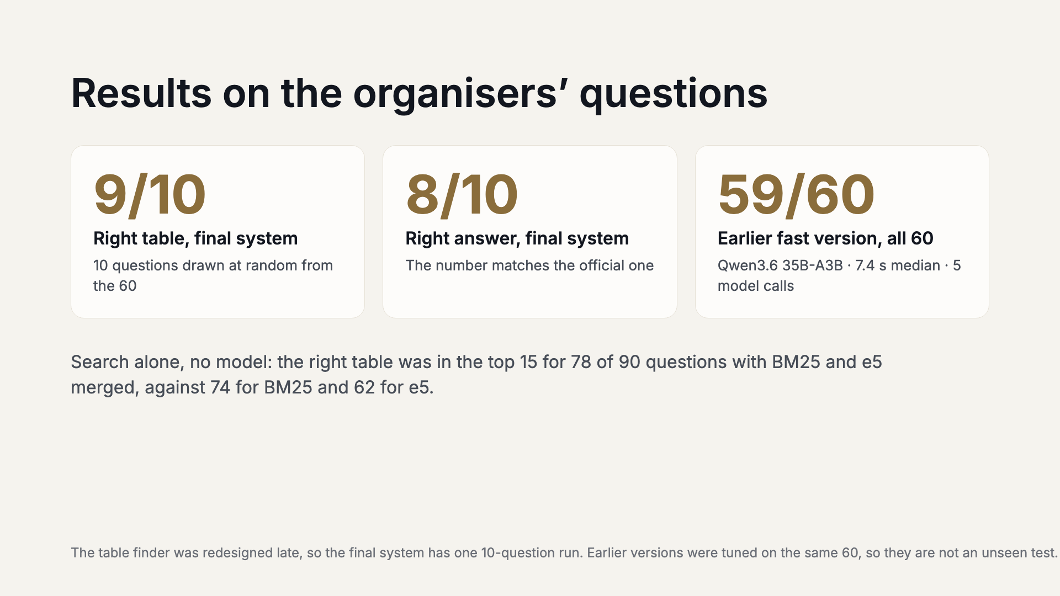
Notes:
Be straight about what each number is. The system we submit was measured once: 10 questions drawn at random from the organisers’ 60, right table for 9, right answer for 8. Before the redesign, the same harness with a different table chooser got 59 of 60 with Qwen 3.6 35B-A3B at 7.4 seconds median, and 60 of 60 with Qwen 3.8 27B, but those versions were developed against these questions. Merging the two searches beats either alone: e5 found the right table for 6 questions BM25 missed.

Slide 9
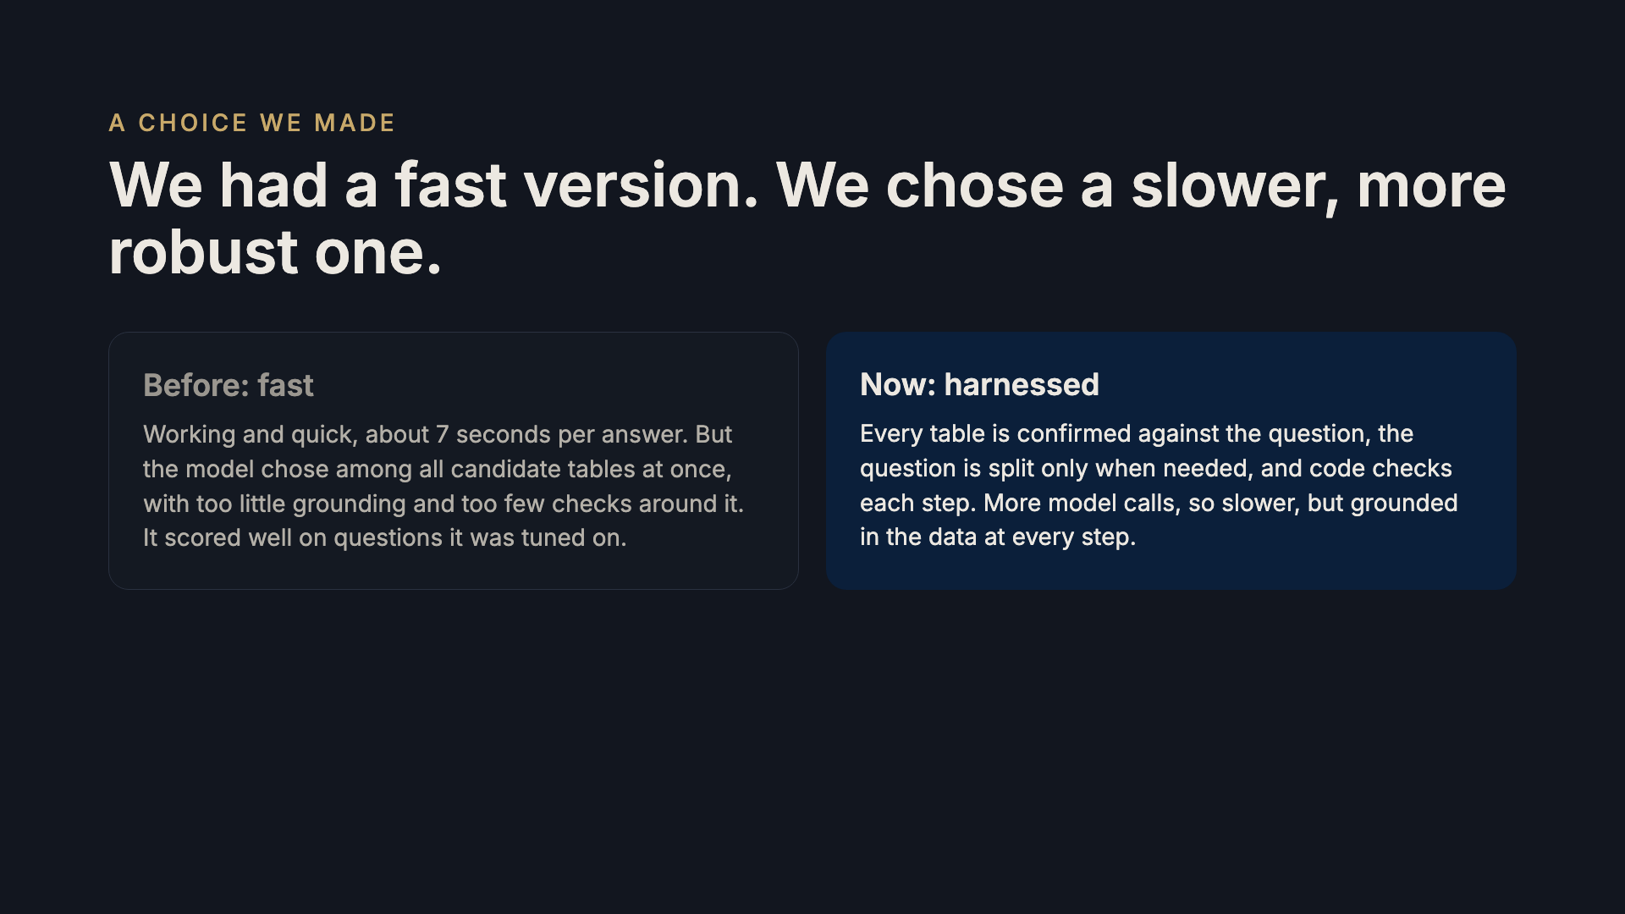
Notes:
We want to be clear about this trade-off. We had a working, fast solution: around seven seconds a question, and it scored well on the organisers' set. But it was not grounded and harnessed enough: the model picked from all candidates at once with too little checking, and it was tuned on the very questions it was scored on. So late in the hackathon we chose a slower, more robust design, where each table must pass a yes-or-no check against the question and code verifies every step. For official statistics we would rather be slower and right for the right reason.

Slide 10
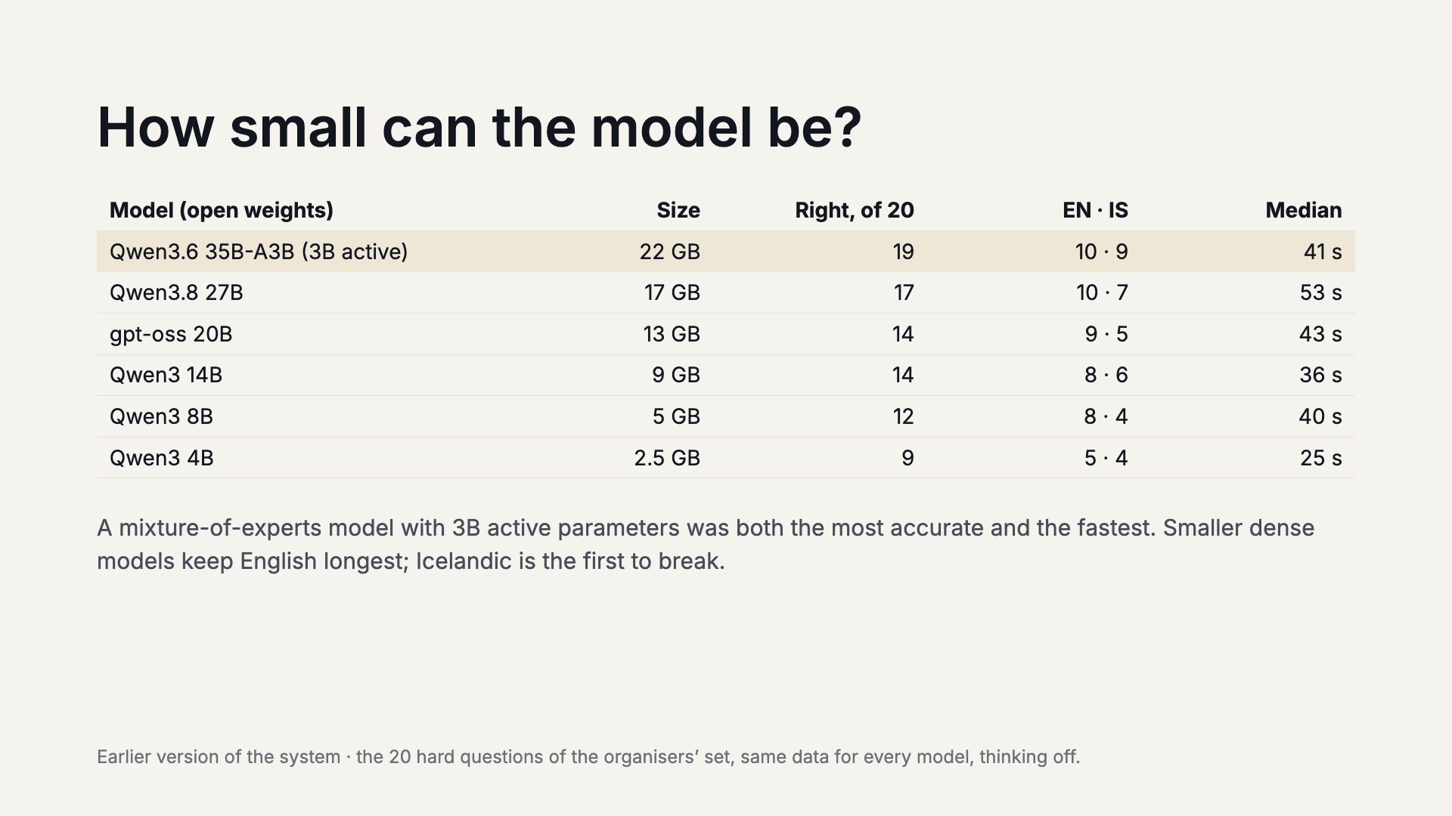
Notes:
Same 20 hard questions, same data, six open models. The surprise: Qwen3.6 35B-A3B, which activates only about 3 billion parameters per token, got 19 of 20 right and was faster than our 27B default, which got 17. Going smaller costs accuracy steadily: 14B and 20B get 14, 8B gets 12, 4B gets 9, and it even fails to find the right table for 7 of the 20. Icelandic questions break first.

Slide 11
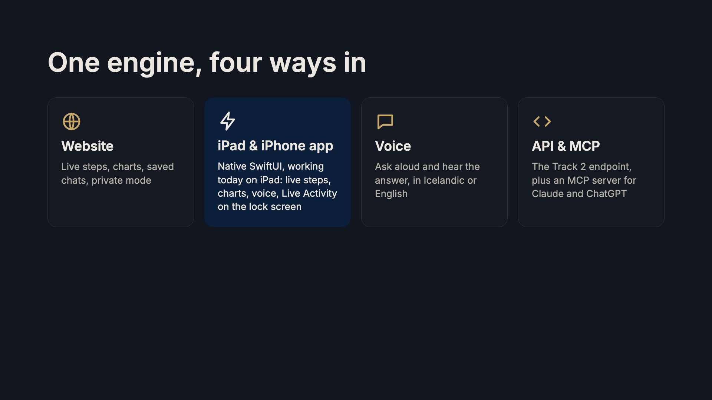
Notes:
Everything talks to the same server on the Spark. The native iOS app runs on iPad and iPhone; we have it working on the iPad and will demo on it. It shows each step live, draws the charts, takes voice, and keeps working when you leave it: a Live Activity shows progress on the lock screen. The same engine is also the Track 2 endpoint and an MCP server, so Claude or ChatGPT can use Statistics Iceland as a tool.

Slide 12
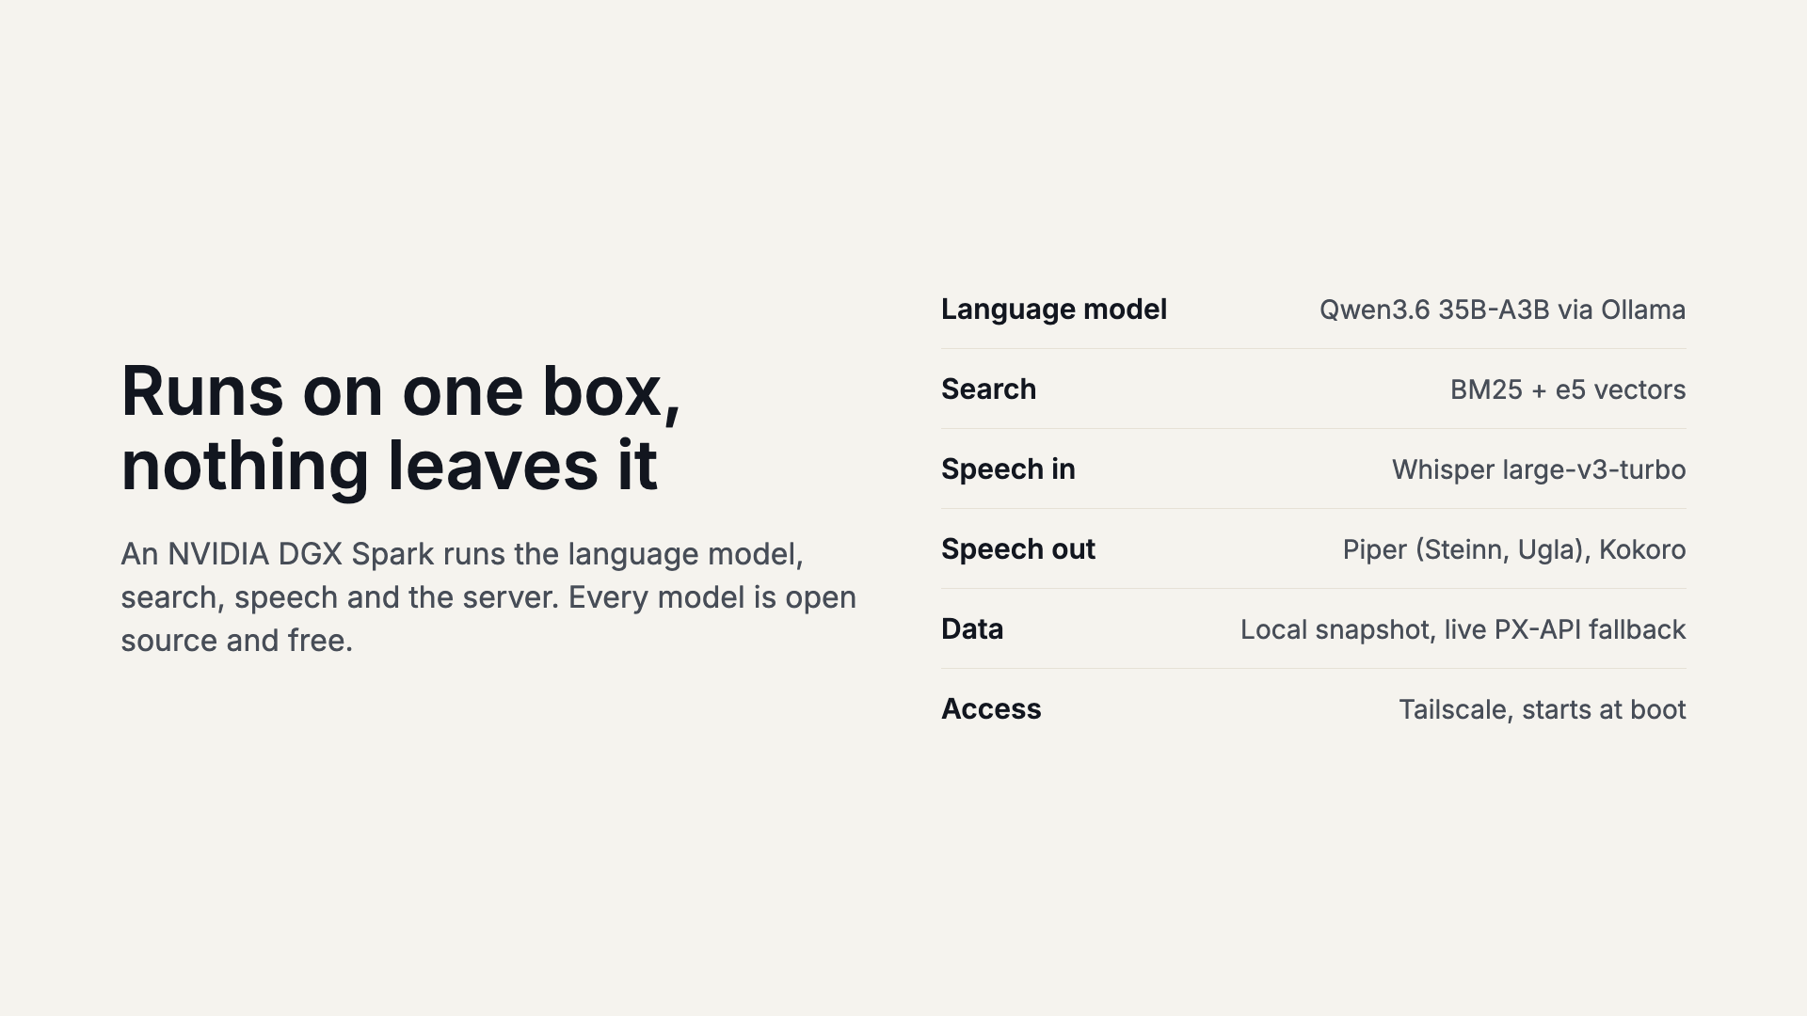
Notes:
No cloud model and no paid API. The whole stack, including Icelandic speech, runs on the team’s DGX Spark. Data comes from a local snapshot of all tables, refreshed from the PX-API, with a live API fallback.

Slide 13
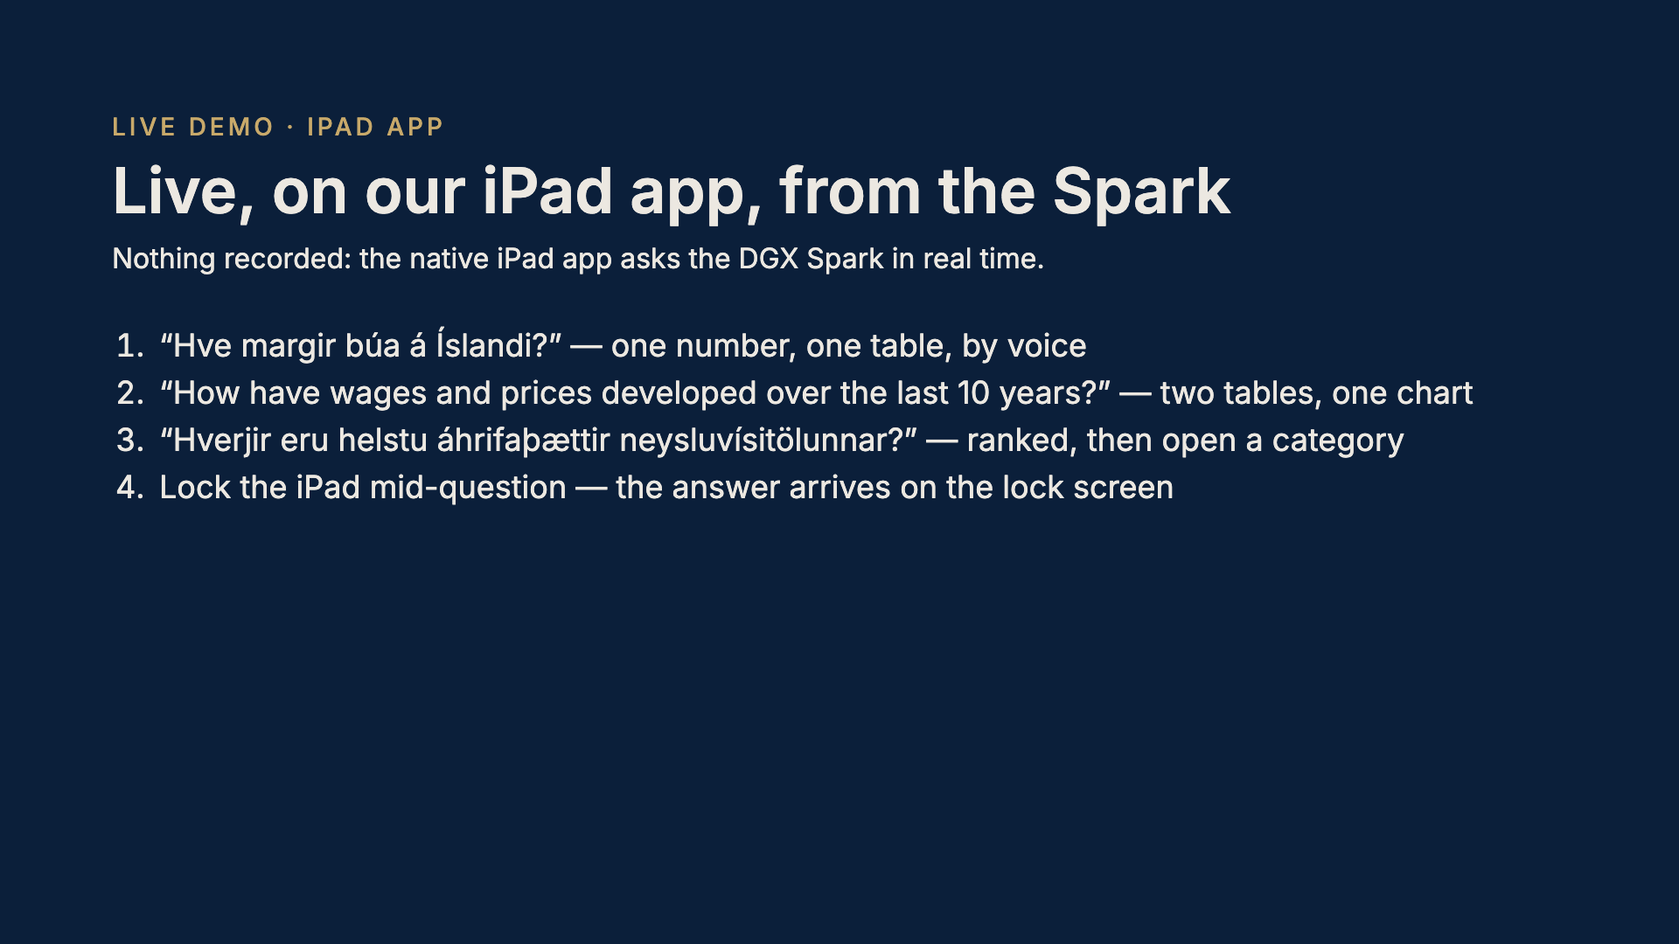
Notes:
Switch to the iPad now. This is the working native app, live against the Spark, not a recording. Start with a voice question, then the two-table comparison with the chart and tiles, then the CPI drivers with the drill-down into a category, and finish by locking the iPad to show the Live Activity. Backup: the same questions on the website if the network misbehaves.

Slide 14
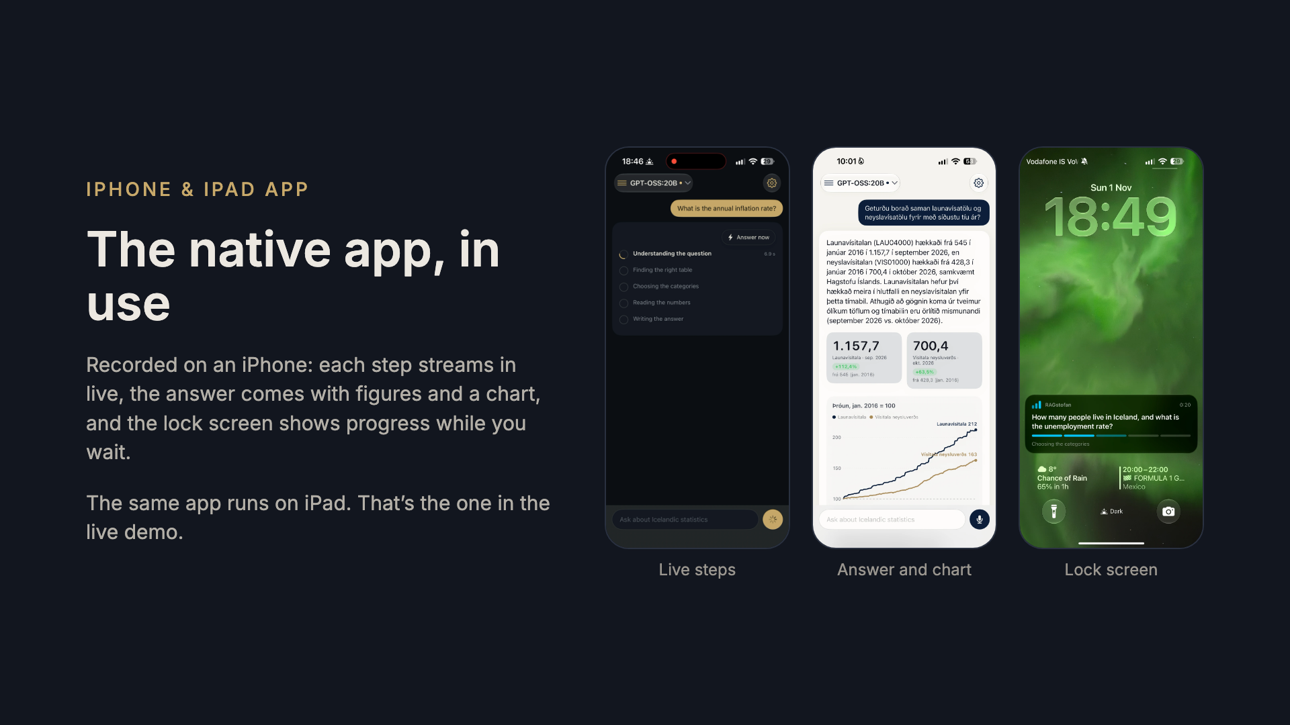
Notes:
A recording from an iPhone, as a backup to the live iPad demo. Left: a question about the annual inflation rate, with each step appearing as it finishes. Middle: an Icelandic answer comparing wages and prices since 2016, with tiles and a chart. Right: the Live Activity on the lock screen, showing the question and which step it is on.

Slide 15
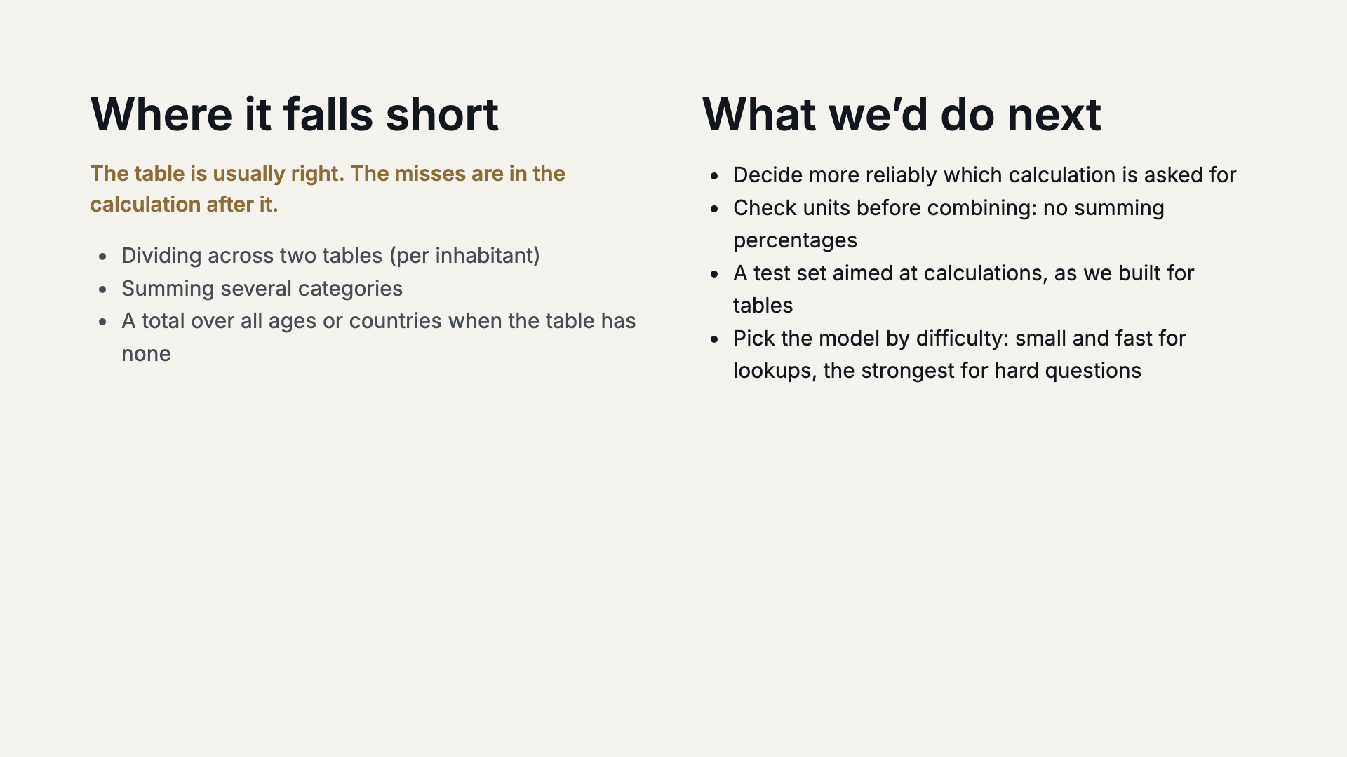
Notes:
Honest limits, from our measurements: the system finds the right table well, 9 of 10 in the final run. What goes wrong is the arithmetic step after it: a part is read but the division by population is never made, or categories are summed that should not be. Next we would make the calculation choice more reliable, check units before combining figures, build a calculation test set like our table-finding sets, and route easy questions to a small fast model and hard ones to the strongest.

Slide 16
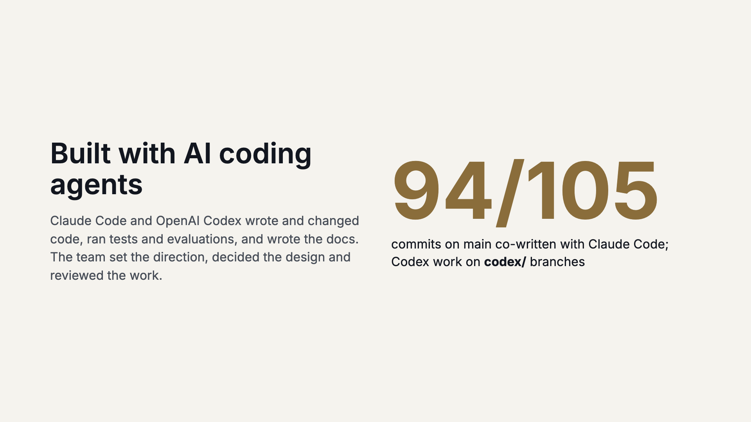
Notes:
We say this openly: the whole project was built with AI coding agents, and the commit history shows it. 94 of the 105 commits on main carry a Co-Authored-By Claude line, and Codex work sits on branches named codex/. The agents did the typing, testing and writing; we decided what to build and reviewed it.

Slide 17
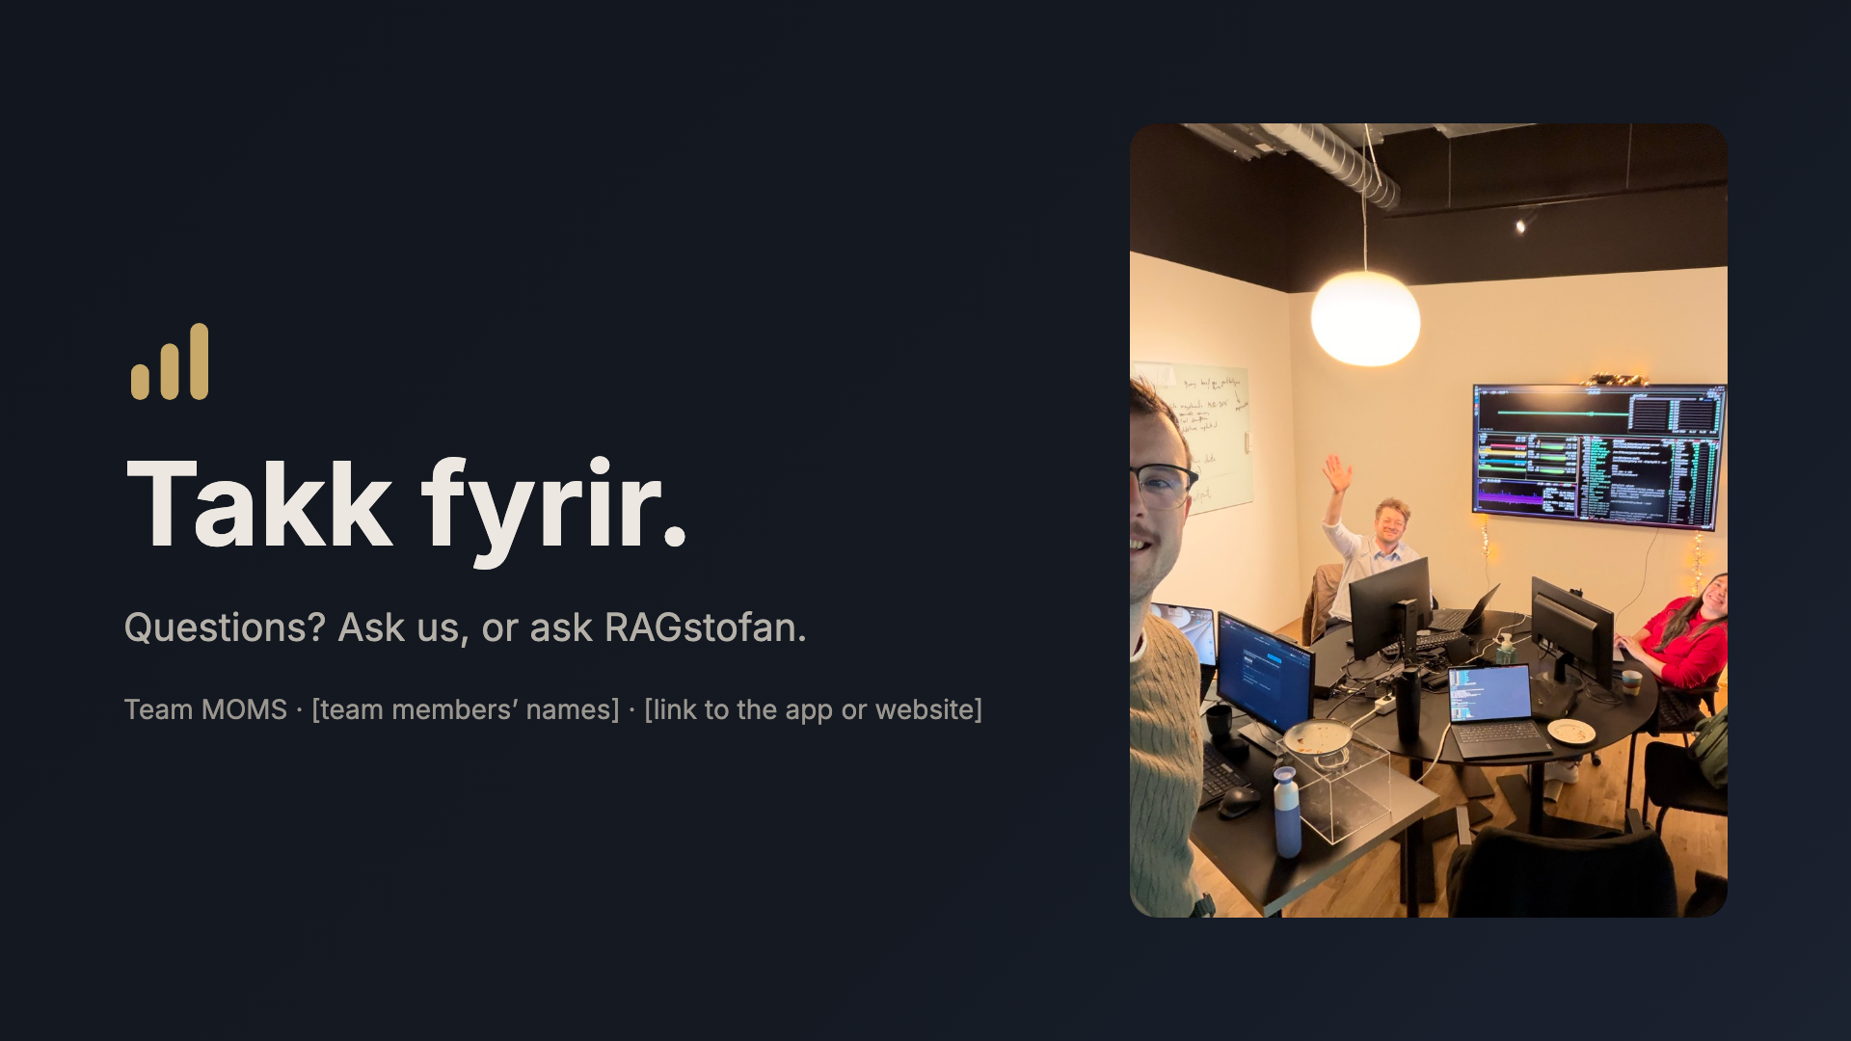
Notes:
Thank you. That's us, team MOMS, in our room at Gróska. Happy to take questions, and happy to hand the iPad over so you can ask it yourselves.

