Slide 1

Movies Database
A Webscraping Story
Alex Tin

Slide 2
Contents
Background
Questions
Workflow
Data Analysis
Takeaways, assumptions
Further Thoughts

Slide 3
Background

Slide 4
Background
Objective:
Explore whether the quality of movies have decreased over time, through analyzing the box office revenues in comparison to their production budget, and cross reference that with the popularity of the film (via RottenTomatoes ratings).
Movie plotholes?
Another remake?
Too many explosions for no reason?
Link

Slide 5
Questions

Slide 6
Questions
What do audiences like?
Have their tastes changed?
What does it take for a movie to be profitable/for them to green light a movie?
It depends on a number of factors, but a rule of thumb seems to be that the film needs to make twice its production budget globally.
Has the quality of movies decreased in response to audience tastes?

Slide 7
Workflow

Slide 8






Workflow
Top 100 movies from 1989 – 2019
Corresponding rottentomatoes rating
Box office numbers
Production Budget
Source
Genre
The-Numbers.com
Data analysis & exploration
Data cleansing
Presentation
RottenTomatoes.com
Critic Reviews
User Reviews

Slide 9
Data Analysis

Slide 10
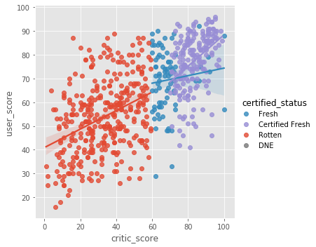
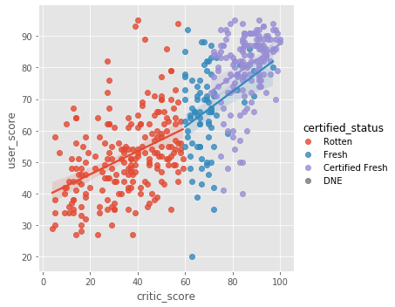
Critic Reviews v. User Reviews
2000-2009
2010-2019

Slide 11
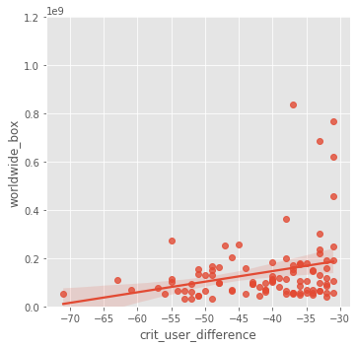

Critic-User Difference v. Worldwide Box Office
2000-2009
2010-2019
Criteria:
> 40 critic reviews
Difference between critic reviews and user reviews > 30% (negative direction)
i.e. User Reviews higher than Critic Reviews

Slide 12
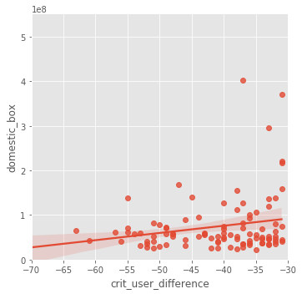

Critic-User Difference v. Domestic Box Office
2000-2009
2010-2019

Slide 13
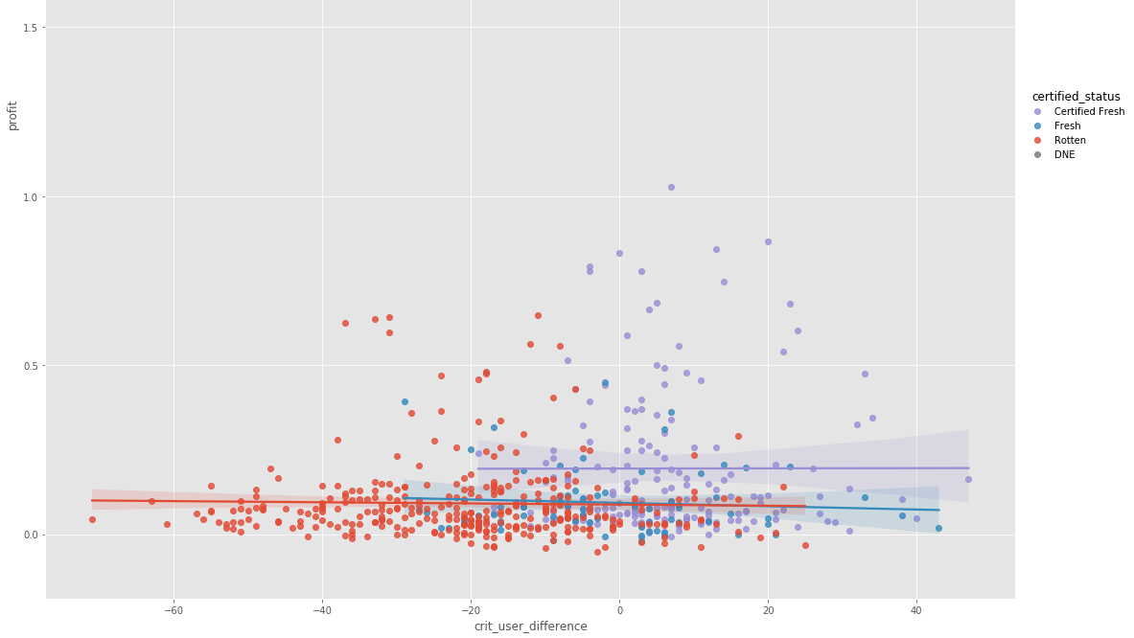
Critic-User Difference v. Worldwide Box Office Profit
2000-2009

Slide 14

Critic-User Difference v. Worldwide Box Office Profit
2010-2019

Slide 15
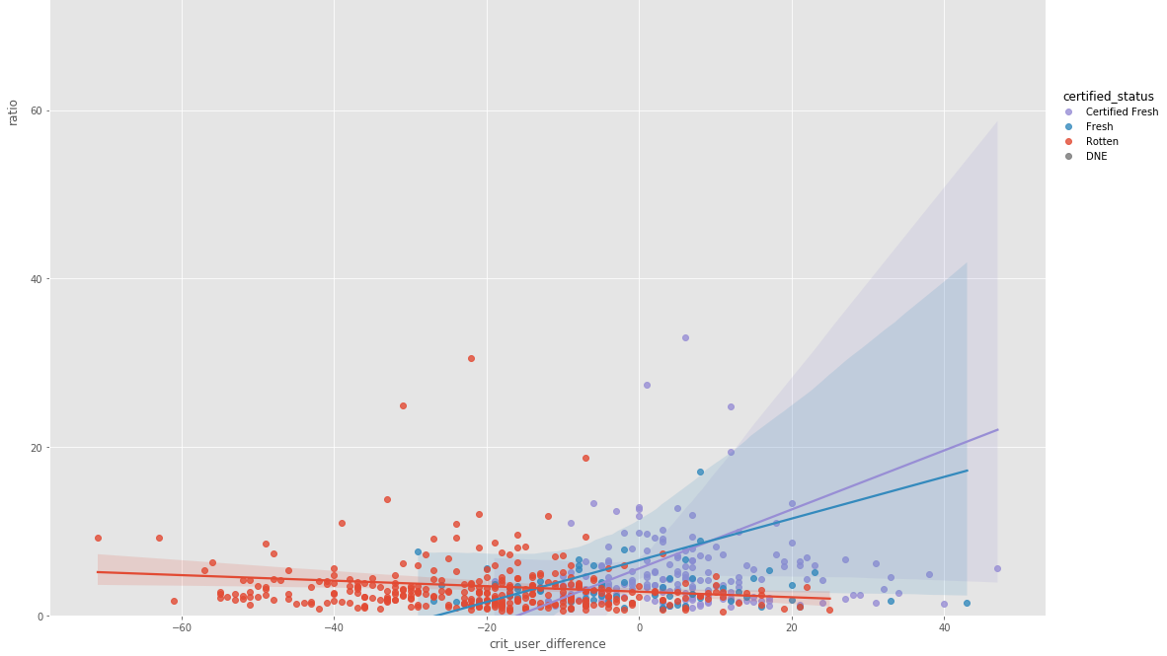
Critic-User Difference v. Worldwide Box Office Profit
2000-2009

Slide 16
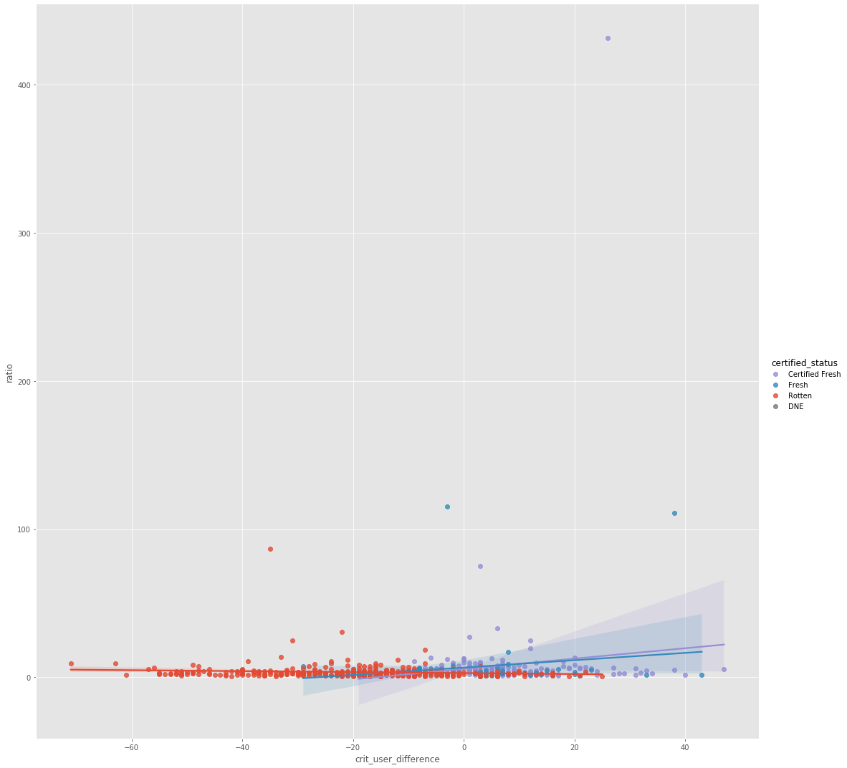
Critic-User Difference v.
Box Office/Budget Ratio

Slide 17

Critic-User Difference v. Worldwide Box Office Profit
2010-2019

Slide 18
Takeaways, Assumptions

Slide 19
Takeaways & Assumptions
Revisit: What conclusion can we draw?
Assumptions
Critic rating consensus are our proxy for determining whether it is a quality movie
Not adjusted for inflation
Printing & Advertising cost unknown
It is at least half the production budget
Notes:
- The Top 100 films per year got better over the years
Colossal failure = colossal loss
Err on the side of caution

Slide 20
Further Thoughts

Slide 21
Thoughts / Areas for Further Deep Dive
Look at the movie reviews for a deeper understanding / sentiment analysis on factors that affect the profitability of the movie
– What motivated them to go watch the movie?
External factors:
Was it because more funds were dedicated to marketing? Could it be explained by when it was released?
Movie factors:
Are there themes/plots that appeal to audiences more? (“Source” attribute)
Comparison of these factors in relation to the rise of Netflix and other streaming services?

Slide 22
Thank you!

Slide 23

Questions?

Slide 24

Appendix

Slide 25
Websites:
https://www.the-numbers.com/box-office-records/worldwide/all-movies/cumulative/released-in-2019
https://www.rottentomatoes.com/
Github Link

Slide 26
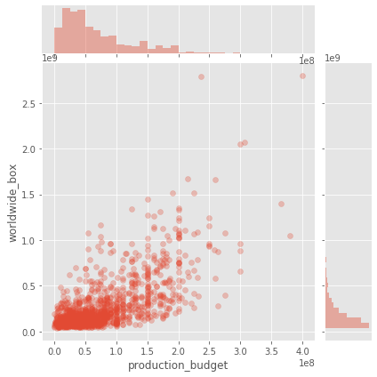
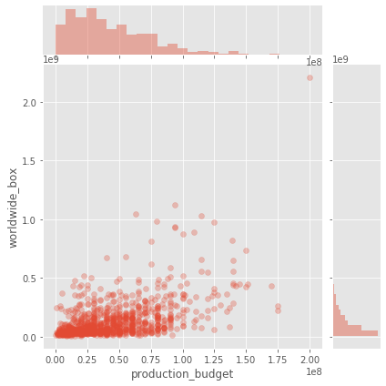
Split before and after 2004

Slide 27
