Slide 1
Wireless MOTION REPLICATING MODULE
Students: CHIVU RARES IOAN, MITILOAGA-CAMBEREA GABRIELA ALEXANDRA, ANGHELUTA ANDREI ALEXANDRU
Scientific coordinator: conf.dr.ing NASTAC DUMITRU IULIAN

Slide 2
Table of contents
Concept of work;
Components;
Bluetooth connection;
Code libraries used;
Conclusions;
References.

Slide 3
Concept of work
Although human and machine presences have their own place in this world when it comes to capabilities, neither can hold the candle to the other in some high-risk.
By putting them together, we can achieve the highest chance of success. One area where this argument is especially applicable is constituted by all the high-risk environments humans must operate in (i.e.: battlefields, fires, high-altitude spaces etc.)

Slide 4
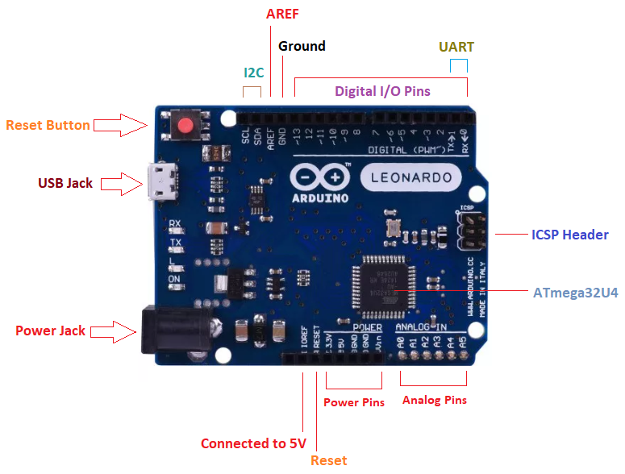
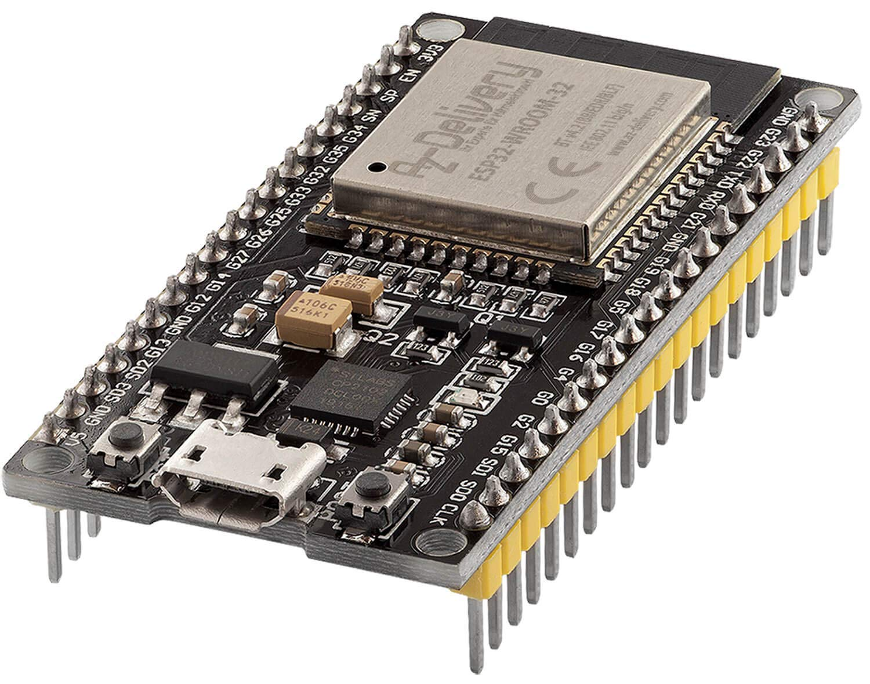
Components
1x Arduino Leonardo microcontroller
1x ESP32 microcontroller

Slide 5
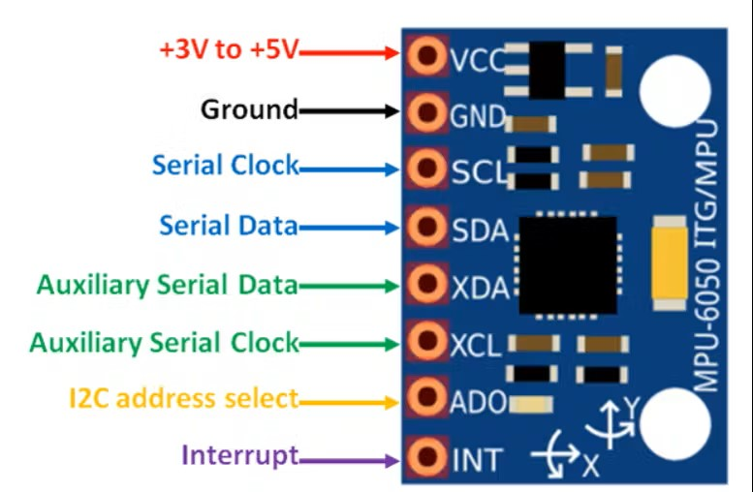
Components
1x MPU 6050 accelerometer/gyroscope;

Slide 6
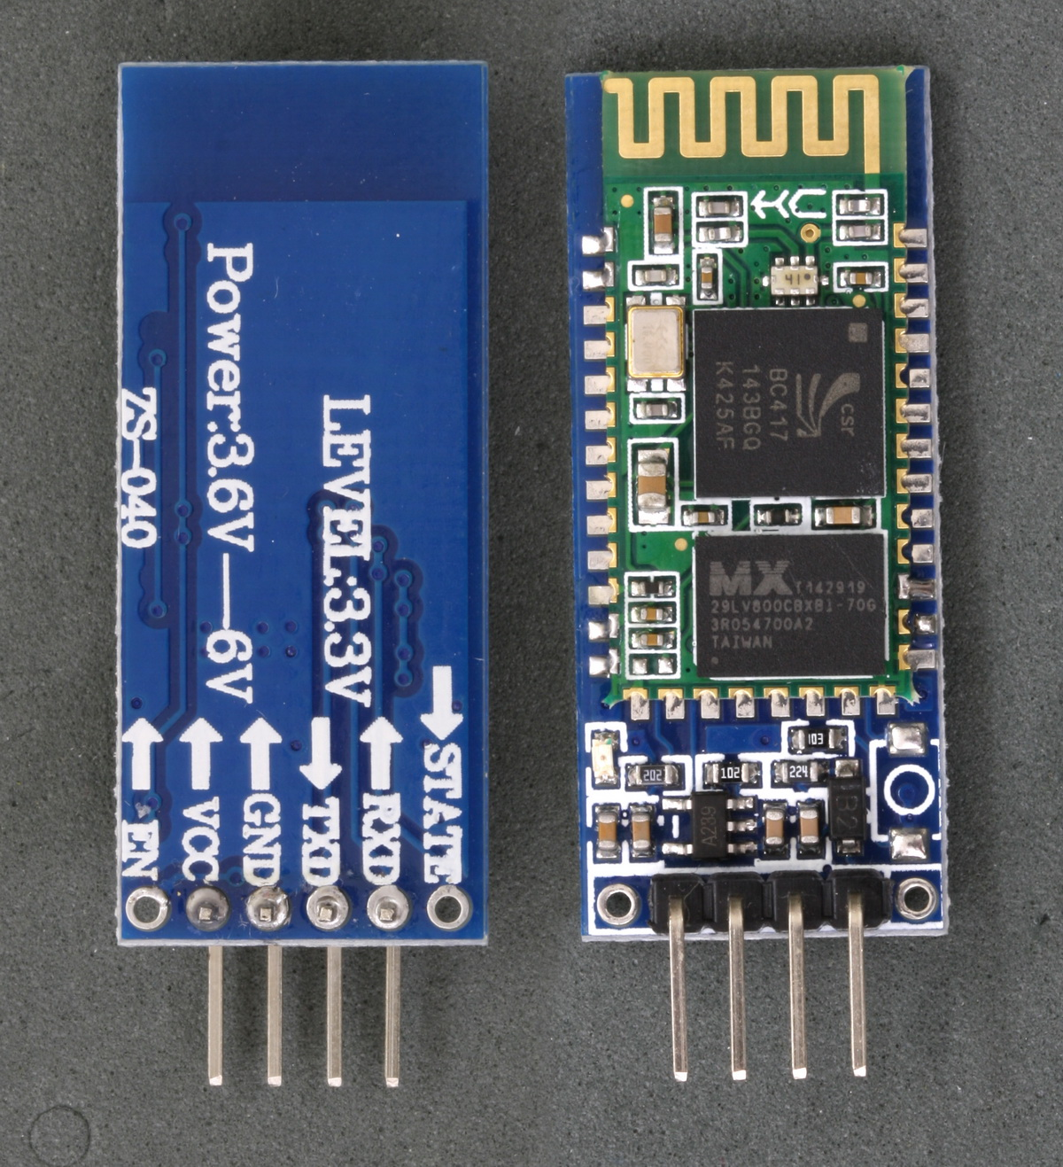
Components
1x ZS-040HC-05/-06 Bluetooth module;

Slide 7
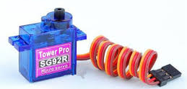
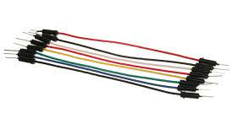
Components
2x SG92R micro servo motors;
Male-male cables;
Male-female jumper cables;
Female-female jumper cables;

Slide 8
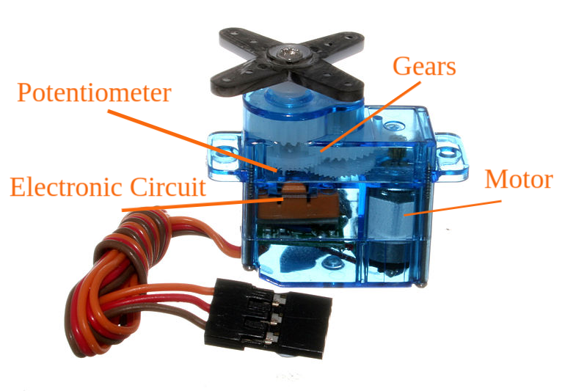
Servo motor vs. dc motor
+: more sensitive to stimuli; can work at any speed;
- : lighter, less rugged; positional ones only rotate180°; 4x more expensive;
Notes:
Slide obligatoriu

Slide 9
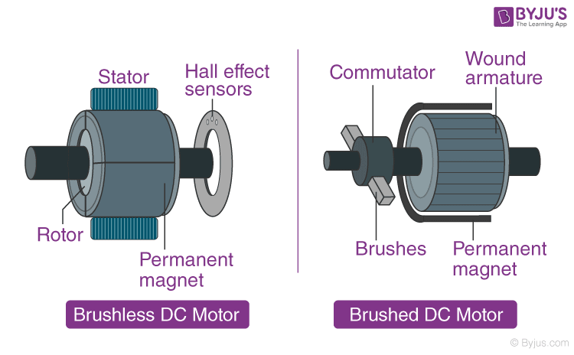
Servo motor vs. dc motor
+ : works at higher speeds; more solid; cheaper
- : needs extra components to control direction and speed; less sensitive to stimuli; lags when powered;

Slide 10
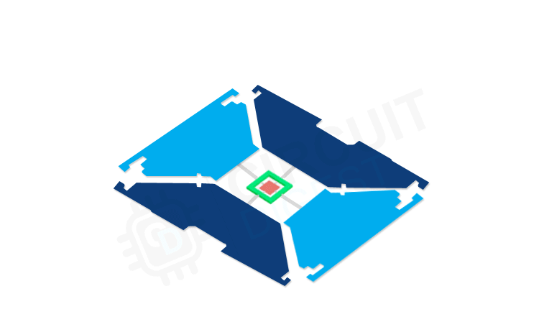
Gathering data using the mpu6050
3-axis accelerometer;
3-axis gyroscope;
Calculates the angle it has on each axis and sends certain data to the motors as degrees;
Uses I2C data bus;

Slide 11
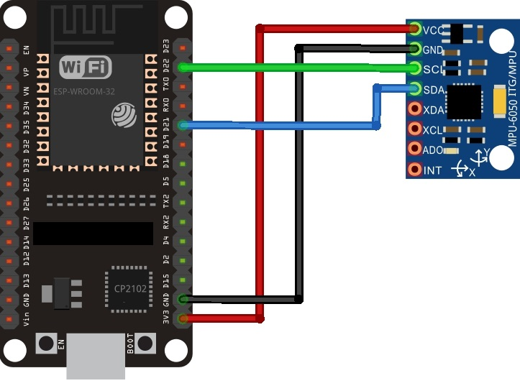
Master microcontroller
ESP32 acts as a ‘master’ in the Bluetooth connection;
ESP32 reads data from MPU6050 and sends said data via the integrated Bluetooth module to the ‘slave’ microcontroller;

Slide 12
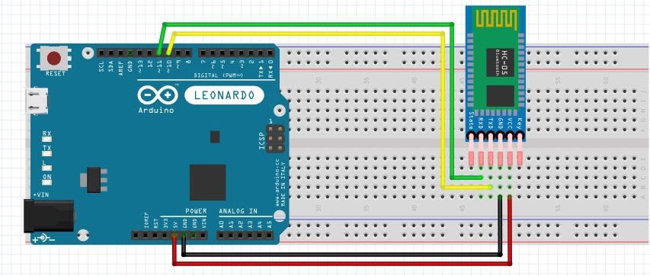
Slave microcontroller
- The Arduino Leonardo microcontroller does not have an integrated Bluetooth module, so we must use a ZS-040 HC-05/-06;
- This microcontroller acts as the ‘slave’ in the Bluetooth connection, as it acts upon the data that it receives from the ‘master’ microcontroller;
Notes:
Slide obligatoriu

Slide 13
Code libraries used
<SoftwareSerial.h> - used in the Arduino Leonardo microcontroller for it to read the data transmitted by the ESP32 microcontroller via Bluetooth;
<Servo.h> - used in the Arduino Leonardo microcontroller in order to command the two servo motors;
<BluetoothSerial.h> - used in the ESP32 microcontroller in order to make it Bluetooth available and transmit data to the Arduino Leonardo microcontroller;
<MPU6050_light.h> - used in the ESP32 microcontroller in order to read and compute the data sent by the MPU6050 accelerometer/gyroscope;

Slide 14
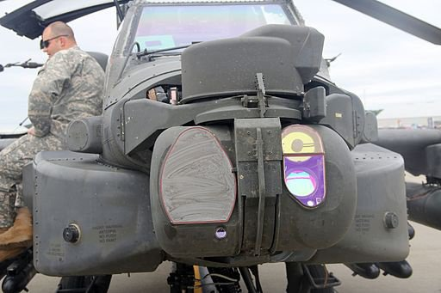
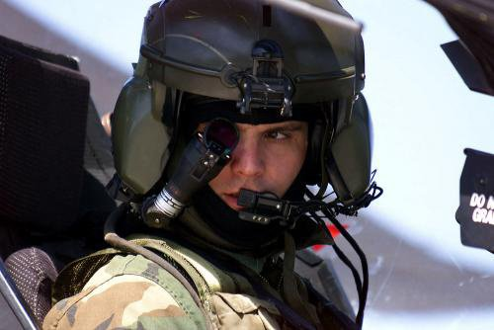
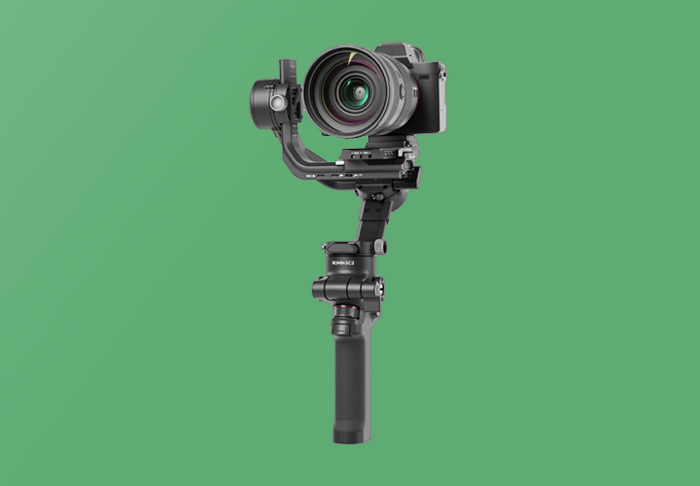
Examples of device already in use
Attack helicopters;
Camera gimbals;

Slide 15
Conclusions
Unfortunately, because of some unexpected technical issues, we are unable to produce a fully wireless prototype (establishing the Bluetooth between the two microcontroller). And so, we decided to bring a wired prototype to demonstrate how the full device was envisioned to look like.
Our further goal is exactly to convert this device to become fully wireless and independent of the distance between the user and the module itself.

