Slide 1
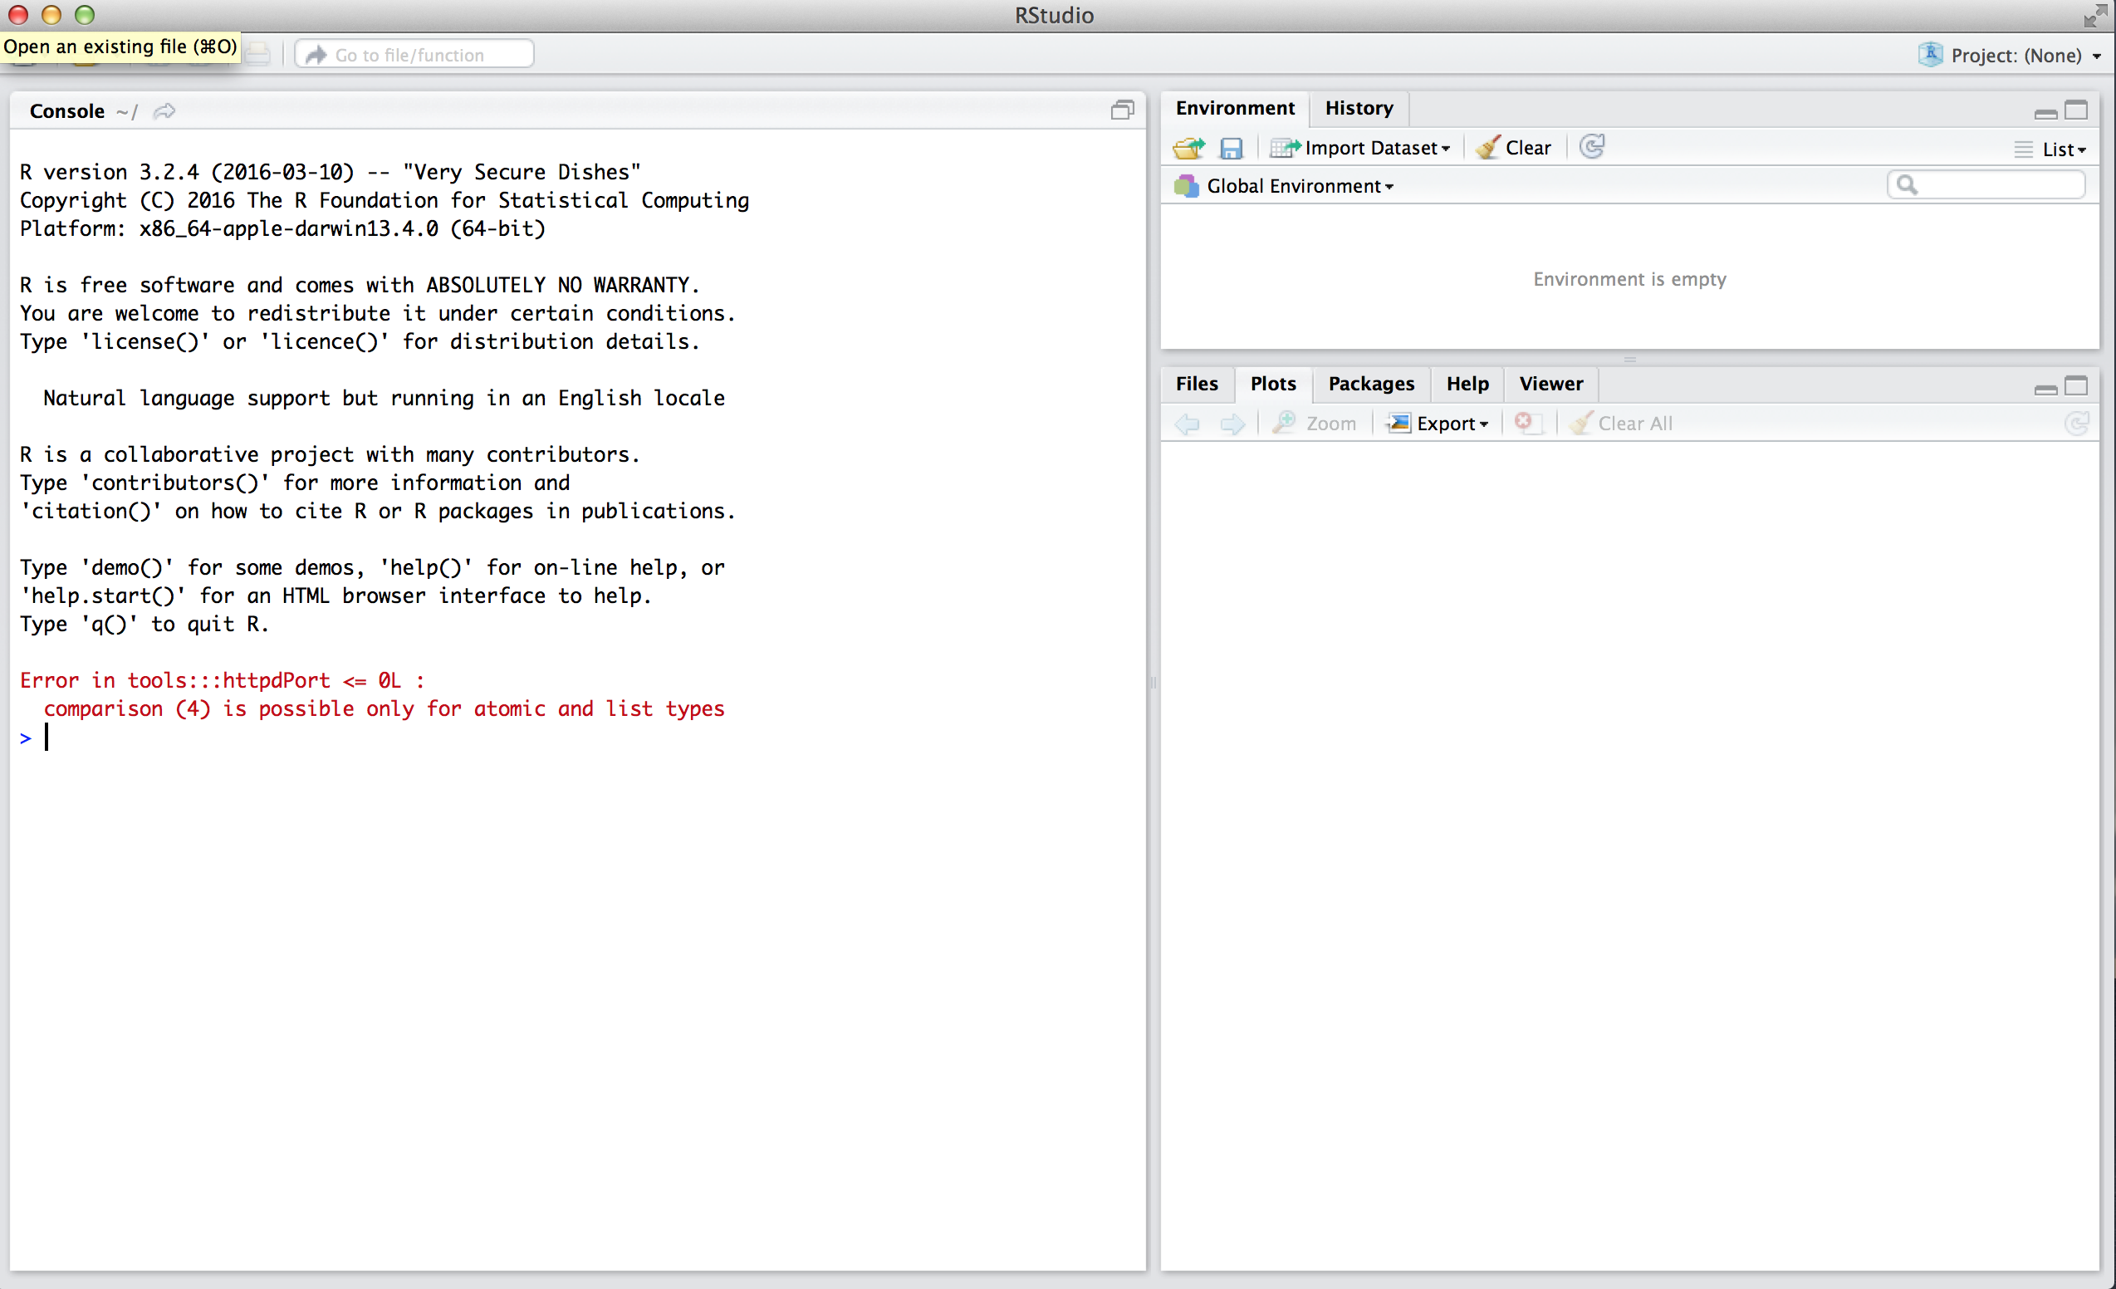
This is the Console. Enter code here for now

Slide 2
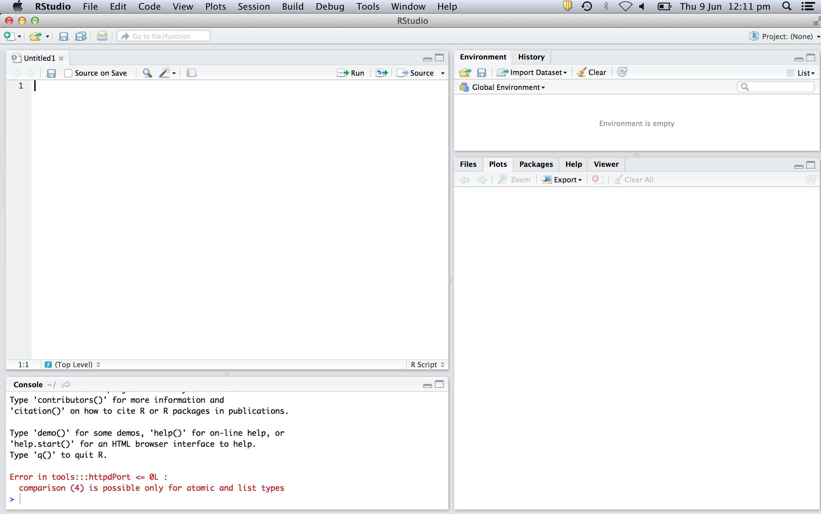
This is your script. Enter code here now and you can save it for later by selecting file > save. Click on a line or select a chunk of code and click ‘Run’ to send it to the Console.

Slide 3
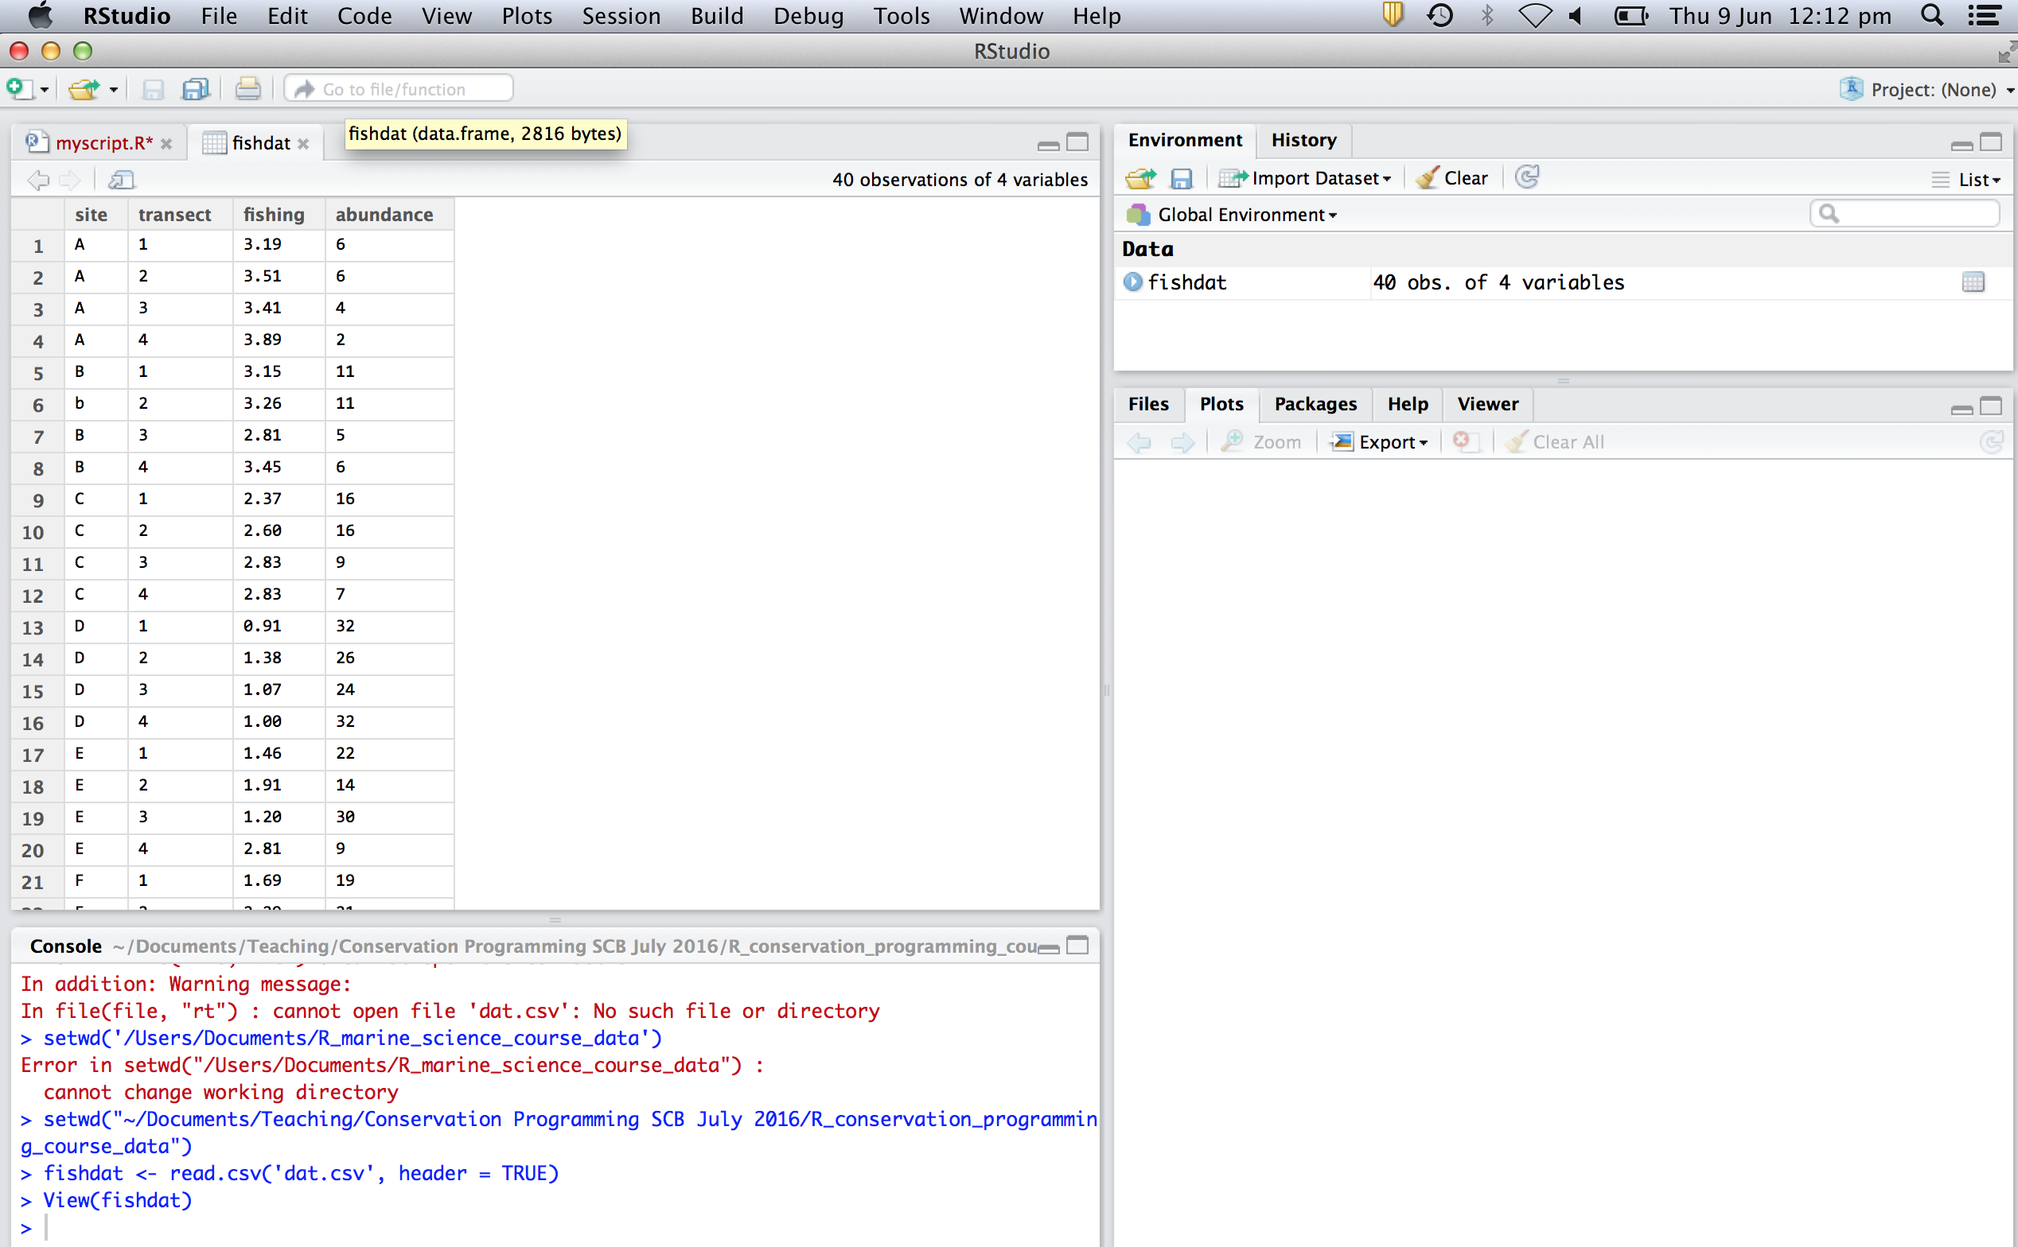
Your data should appear here in the ‘Environment’ window.

Slide 4
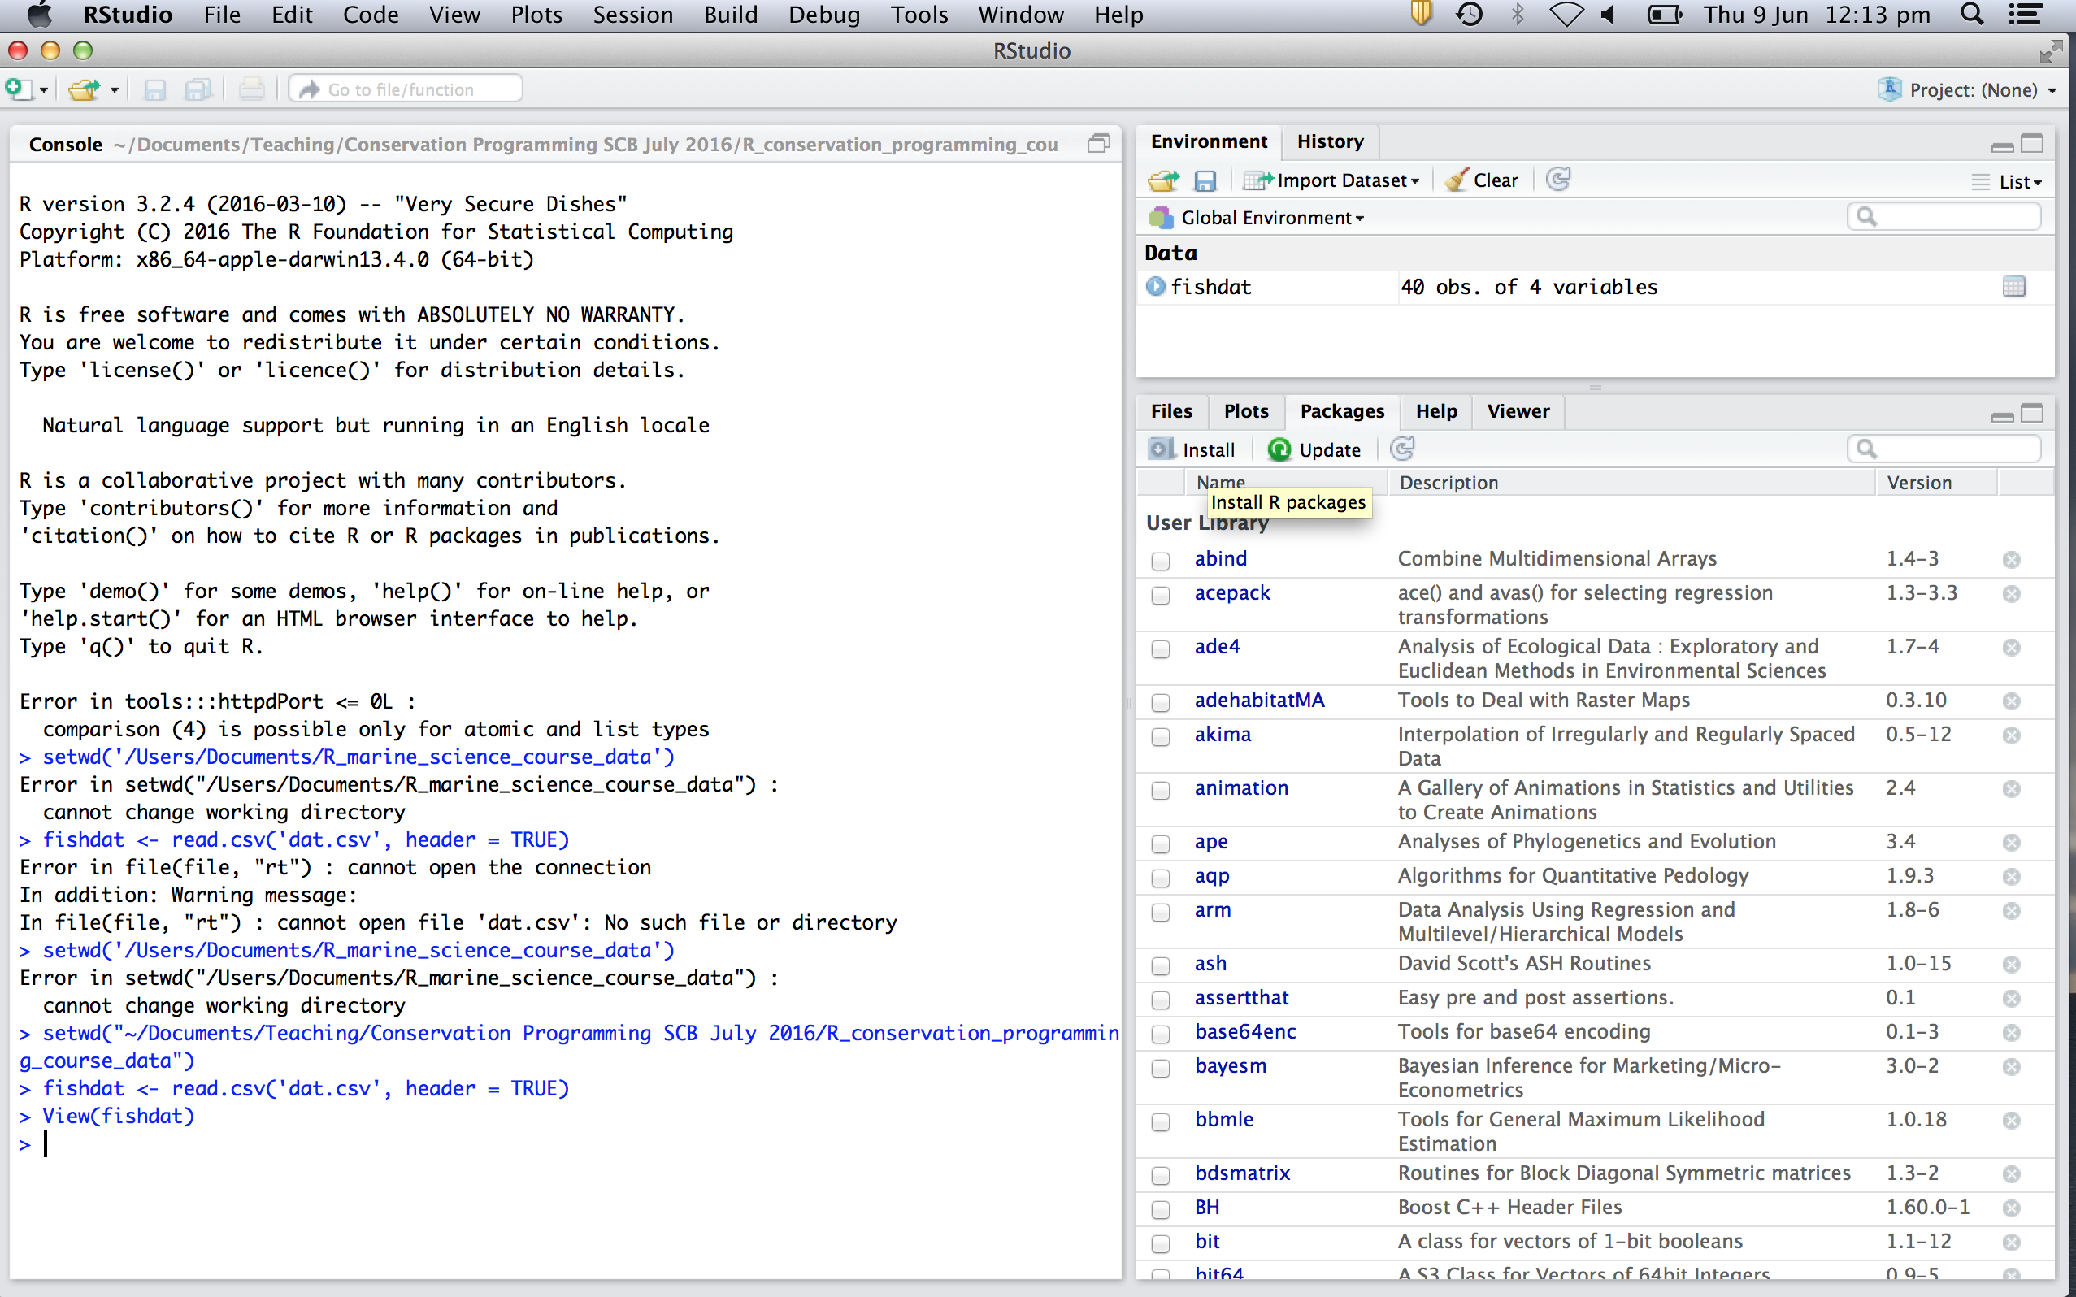
Click Install to download a new package from the internet

