Slide 1
The Battle of Neighborhoods - City-to-City Comparison
Coursera Capstone Project
The Battle of Neighborhoods - City-to-City Comparison
Here you can find the full project behind:
Jupiter Notebook on Github

Slide 2
Introduction of the business problem and Data description
1.1 Introduction of the business problem and who would be interested in this project
1.2 Data description that will be used to solve the problem
2. Used methodology, results and conclusion
2.1 Exploratory data analysis, performed statistical testing, used machine learnings
2.2 Results section
2.3 Noted observations, recommendations based on the results

Slide 3
Description of the Business Problem
The Importance of Internal Mobility - how to keep good employees once they are hired and how to measure Quality-of-living differentials between cities?
How to encourage employment mobility?
In this project we will concentrate on the last point -
- provide employee with reliable information about the host locations to support his decision

Slide 4
What exactly is making a city more attractive to live in and to international business investment?
How to establish quality-of-living differentials between cities and which factors to use for it? Here we need to define the key features (categories) playing the main role for quality of living, which are:
Schools and education
Medical and health considerations
Consumer goods
Cultural environment
Natural environment
Public services and transport
Recreation
Socio-cultural environment
Economic environment
Political and social environment

Slide 5
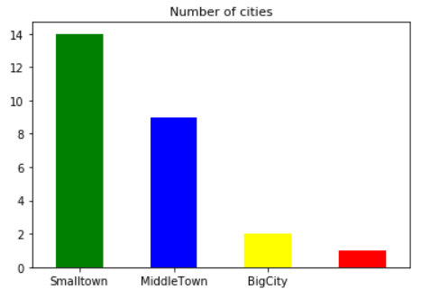
In this project I will be working only with a subset of the world-cities list, where I selected 25 different popular cities, mainly from Europe and some from Canada, to be compaired:
city | lat | lng | country | iso2 | iso3 | capital | population
Paris | 48.8667 | 2.3333 | France | FR | FRA | primary | 9904000
London | 51.5000 | -0.1167 | United Kingdom | GB | GBR | primary | 8567000
Toronto | 43.7000 | -79.4200 | Canada | CA | CAN | admin | 5213000
Montreal | 45.5000 | -73.5833 | Canada | CA | CAN |  | 3678000
Berlin | 52.5218 | 13.4015 | Germany | DE | DEU | primary | 3406000
Stuttgart | 48.7800 | 9.2000 | Germany | DE | DEU | admin | 2944700
Frankfurt | 50.1000 | 8.6750 | Germany | DE | DEU | minor | 2895000
Vienna | 48.2000 | 16.3666 | Austria | AT | AUT | primary | 2400000
Mannheim | 49.5004 | 8.4700 | Germany | DE | DEU | minor | 2362000
Vancouver | 49.2734 | -123.1216 | Canada | CA | CAN |  | 2313328
Birmingham | 52.4750 | -1.9200 | United Kingdom | GB | GBR | admin | 2285000
Manchester | 53.5004 | -2.2480 | United Kingdom | GB | GBR | admin | 2230000
Hamburg | 53.5500 | 10.0000 | Germany | DE | DEU | admin | 1757000
Essen | 51.4500 | 7.0166 | Germany | DE | DEU | minor | 1742135
Leeds | 53.8300 | -1.5800 | United Kingdom | GB | GBR | admin | 1529000
Lyon | 45.7700 | 4.8300 | France | FR | FRA | admin | 1423000
Marseille | 43.2900 | 5.3750 | France | FR | FRA | admin | 1400000
Sheffield | 53.3667 | -1.5000 | United Kingdom | GB | GBR | admin | 1292900
Duisburg | 51.4300 | 6.7500 | Germany | DE | DEU | minor | 1276757
Munich | 48.1299 | 11.5750 | Germany | DE | DEU | admin | 1275000
Dusseldorf | 51.2204 | 6.7800 | Germany | DE | DEU | admin | 1220000
Prague | 50.0833 | 14.4660 | Czechia | CZ | CZE | primary | 1162000
Helsinki | 60.1756 | 24.9341 | Finland | FI | FIN | primary | 1115000
Copenhagen | 55.6786 | 12.5635 | Denmark | DK | DNK | primary | 1085000
Cologne | 50.9300 | 6.9500 | Germany | DE | DEU |  | 1004000
Tallinn | 59.4339 | 24.7280 | Estonia | EE | EST | primary | 394024

Slide 6
I will investigate on 3 subsets of our data to serve different needs: some people might be more interested in cultural life, some in schools and education, for some of them each kind of venue might be helpful for their desicion making. I assume that natural environment and recreation are important for everyone. So those will be our subsets:
Subset 1: Cultural life
Subset 2: Education
Subset 3: Natural environment/ recreation

Slide 7
Results:
80.76 % of the dataset are cities with very good culture
11.53 % of the dataset are cities with a very good education system
3.84 % of the dataset are cities with very good natural environment and recreation
84.61 % of the dataset are cities with very good/good culture
73.07 % of the dataset are cities with a very good/good education system
30.76 % of the dataset are cities with very good/good natural environment and recreation

Slide 8
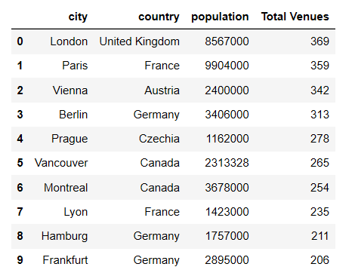
Cultural environment
84% are top with cultural offers. This is not surprising, this is what cities are made for.
Here are top 10:

Slide 9

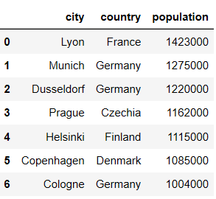
Natural environment/ Recreation
Only 30% of selected cities do have a good green environment, definitely something we have to improve in the future, let us see, who is the best:
And here are another green cities:

Slide 10
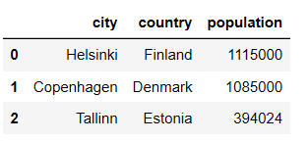
Education
73% do have a good education system and here are the best one:
Here you can find the full project behind:
Jupiter Notebook on Github

