Slide 1
Agenda: Dag 1
Tidspunkt | Emne | Format
9.00-9.10 | Plan for kursus 3 | Oplæg
9.10-9.30 | Opdateringer til EUD Cyber Environment | Oplæg
9:30–10:20 | Detect and Respond (med Wireshark) | Oplæg + øvelse
10:20–10:30 | Pause
10:30–12:00 | Netværkssikkerhed (med NMAP, OpenVAS) | Oplæg + øvelse
12:00–12:45 | Frokost
12:45–14:00 | Log analyse (end points) | Oplæg + øvelse
14:00-14:15 | Pause
14:15–15:30 | Log analyse (fortsat) | Øvelse
15:30–16:00 | Opsummering

Slide 2
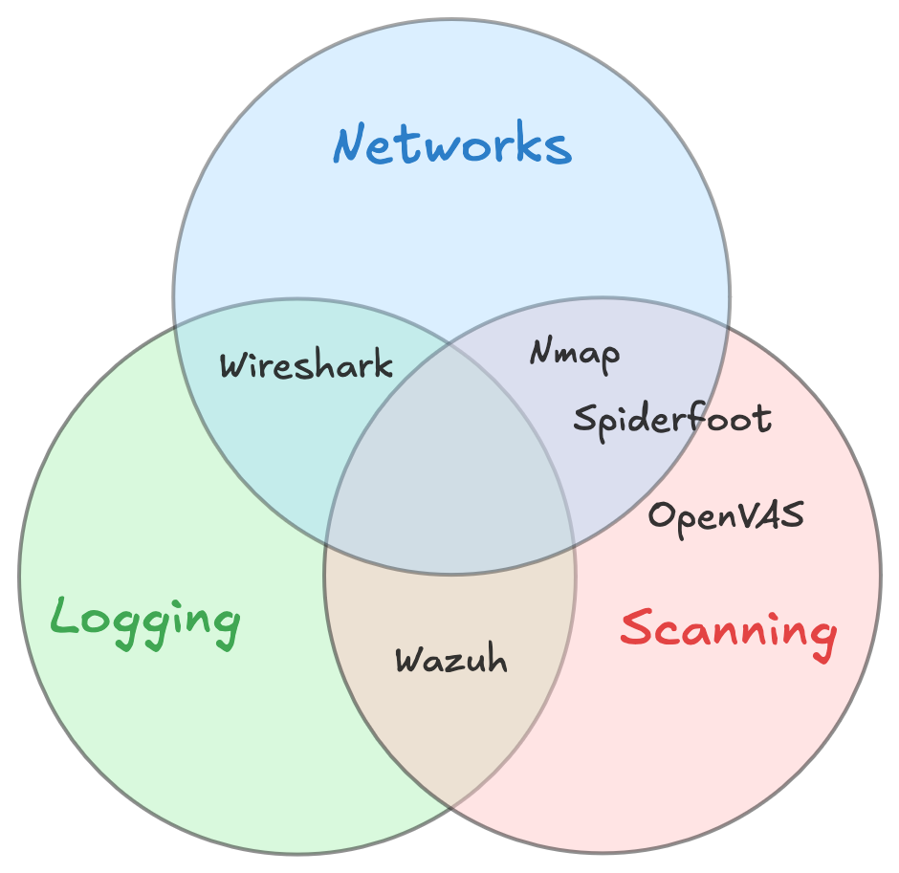

Slide 3
Detect and Response m. Wireshark

Slide 4
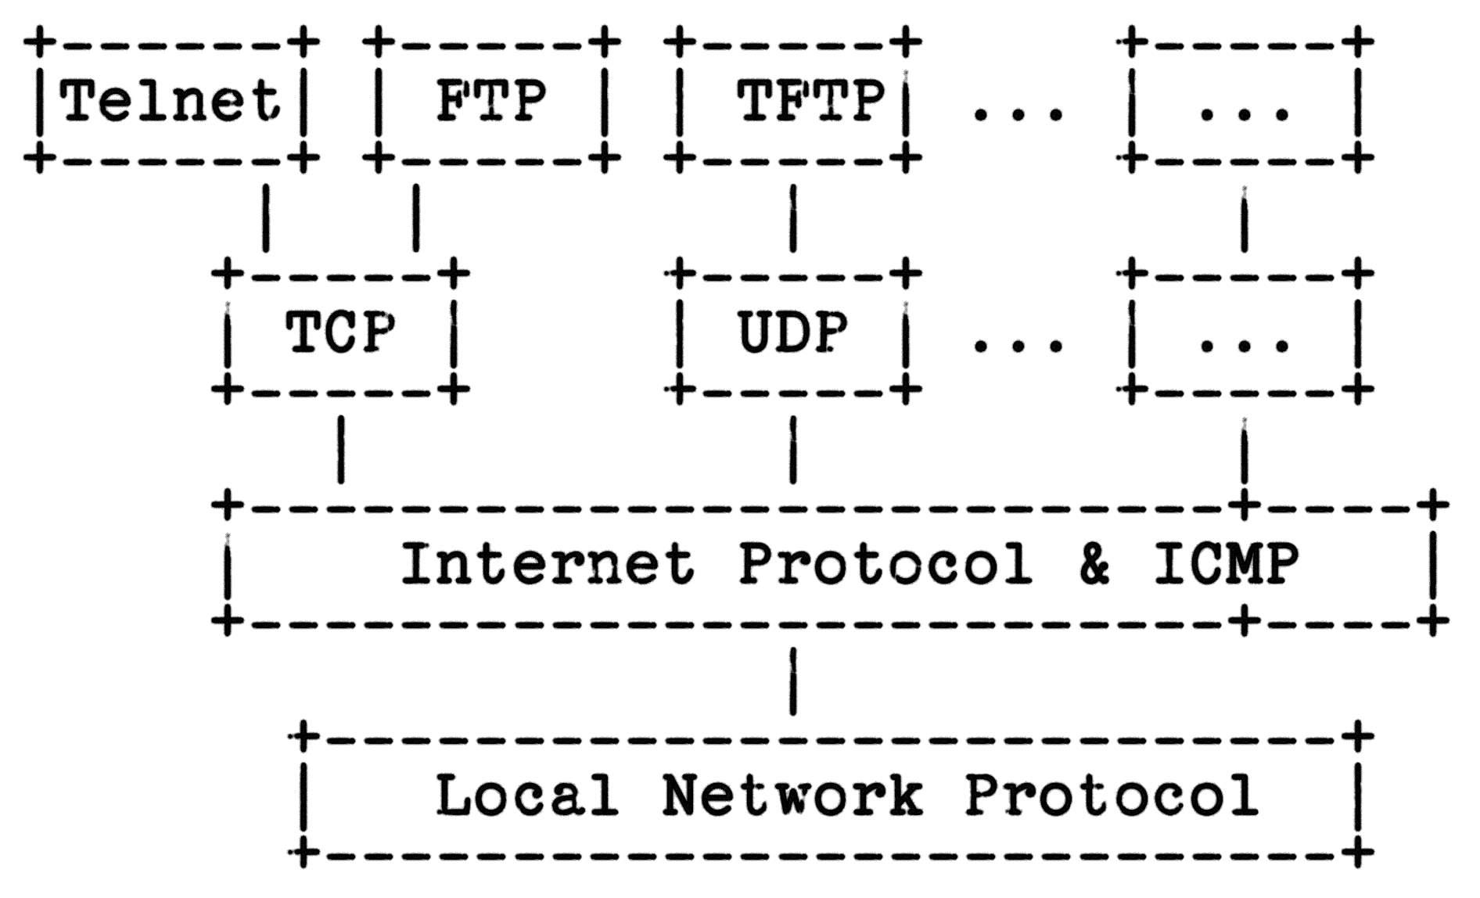
IP Packets

Slide 5

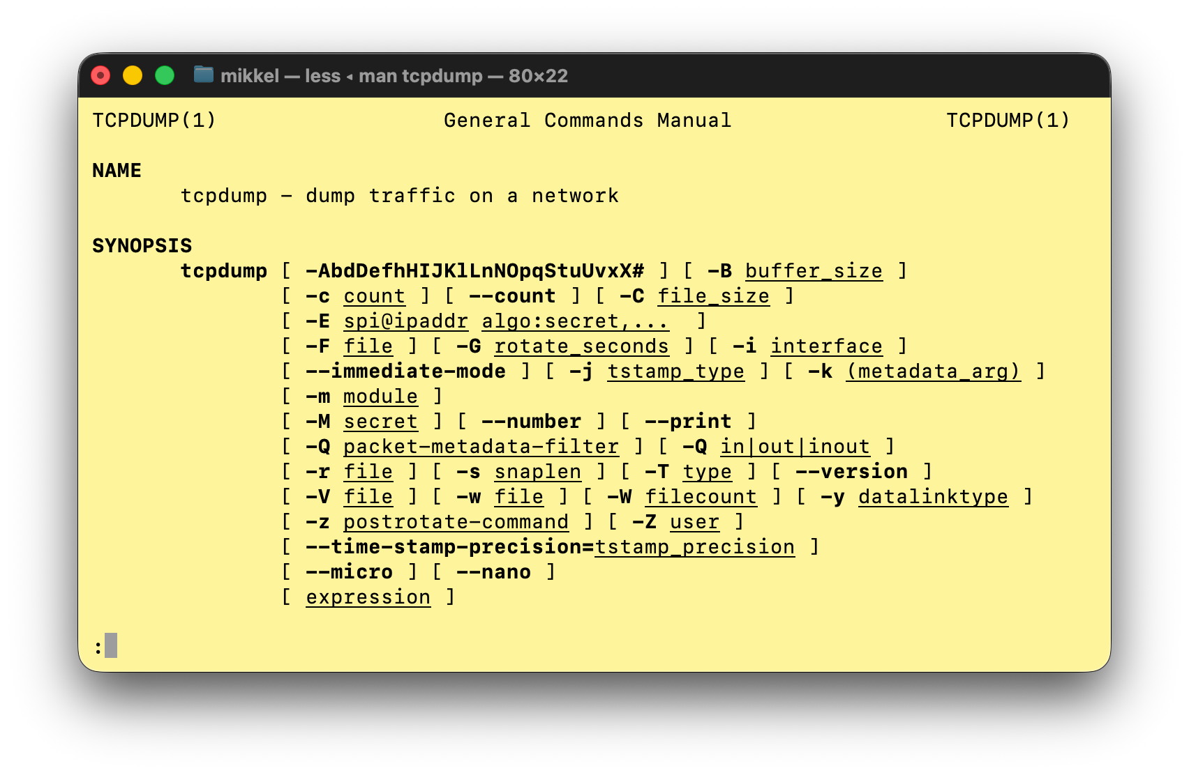
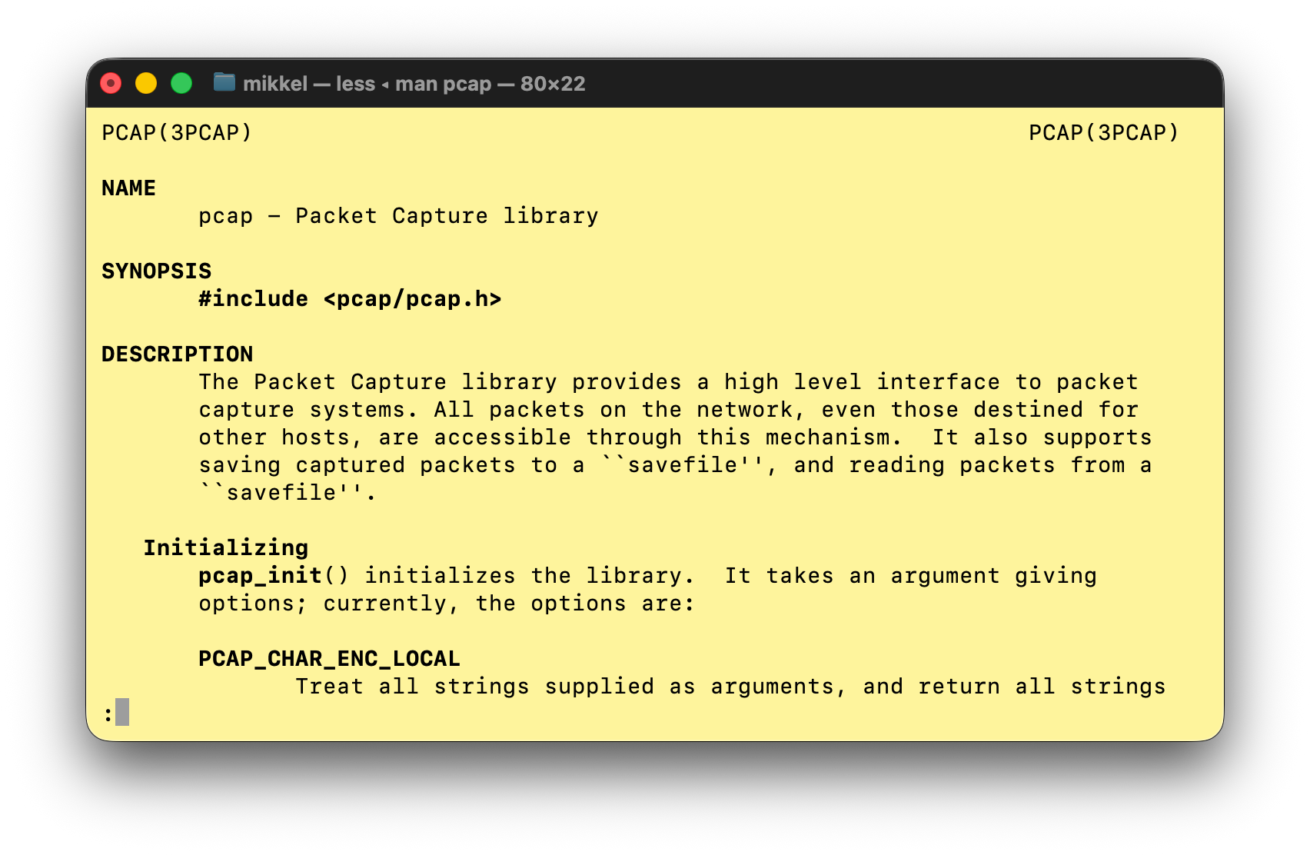

Slide 6
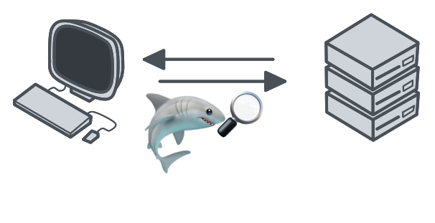
Packet capture
1 0.000000 192.168.1.50 → 192.168.1.100 TCP 54 7970 → 80 [SYN] Seq=0 Win=8192 Len=0
2 0.001000 192.168.1.100 → 192.168.1.50 TCP 54 80 → 7970 [SYN, ACK] Seq=0 Ack=1 Win=8192 Len=0
3 0.002000 192.168.1.50 → 192.168.1.100 TCP 54 7970 → 80 [ACK] Seq=1 Ack=1 Win=8192 Len=0
4 0.010000 192.168.1.50 → 192.168.1.100 HTTP 143 GET /index.html HTTP/1.1
5 0.020000 192.168.1.100 → 192.168.1.50 HTTP 113 HTTP/1.1 200 OK
6 0.030000 192.168.1.50 → 192.168.1.100 TCP 54 7970 → 80 [FIN, ACK] Seq=90 Ack=60 Win=8192 Len=0
7 0.040000 192.168.1.100 → 192.168.1.50 TCP 54 80 → 7970 [ACK] Seq=60 Ack=91 Win=8192 Len=0
8 1.200000 192.168.1.52 → 192.168.1.100 TCP 54 19513 → 80 [SYN] Seq=0 Win=8192 Len=0
9 1.201000 192.168.1.100 → 192.168.1.52 TCP 54 80 → 19513 [SYN, ACK] Seq=0 Ack=1 Win=8192 Len=0
10 1.202000 192.168.1.52 → 192.168.1.100 TCP 54 19513 → 80 [ACK] Seq=1 Ack=1 Win=8192 Len=0

Slide 7

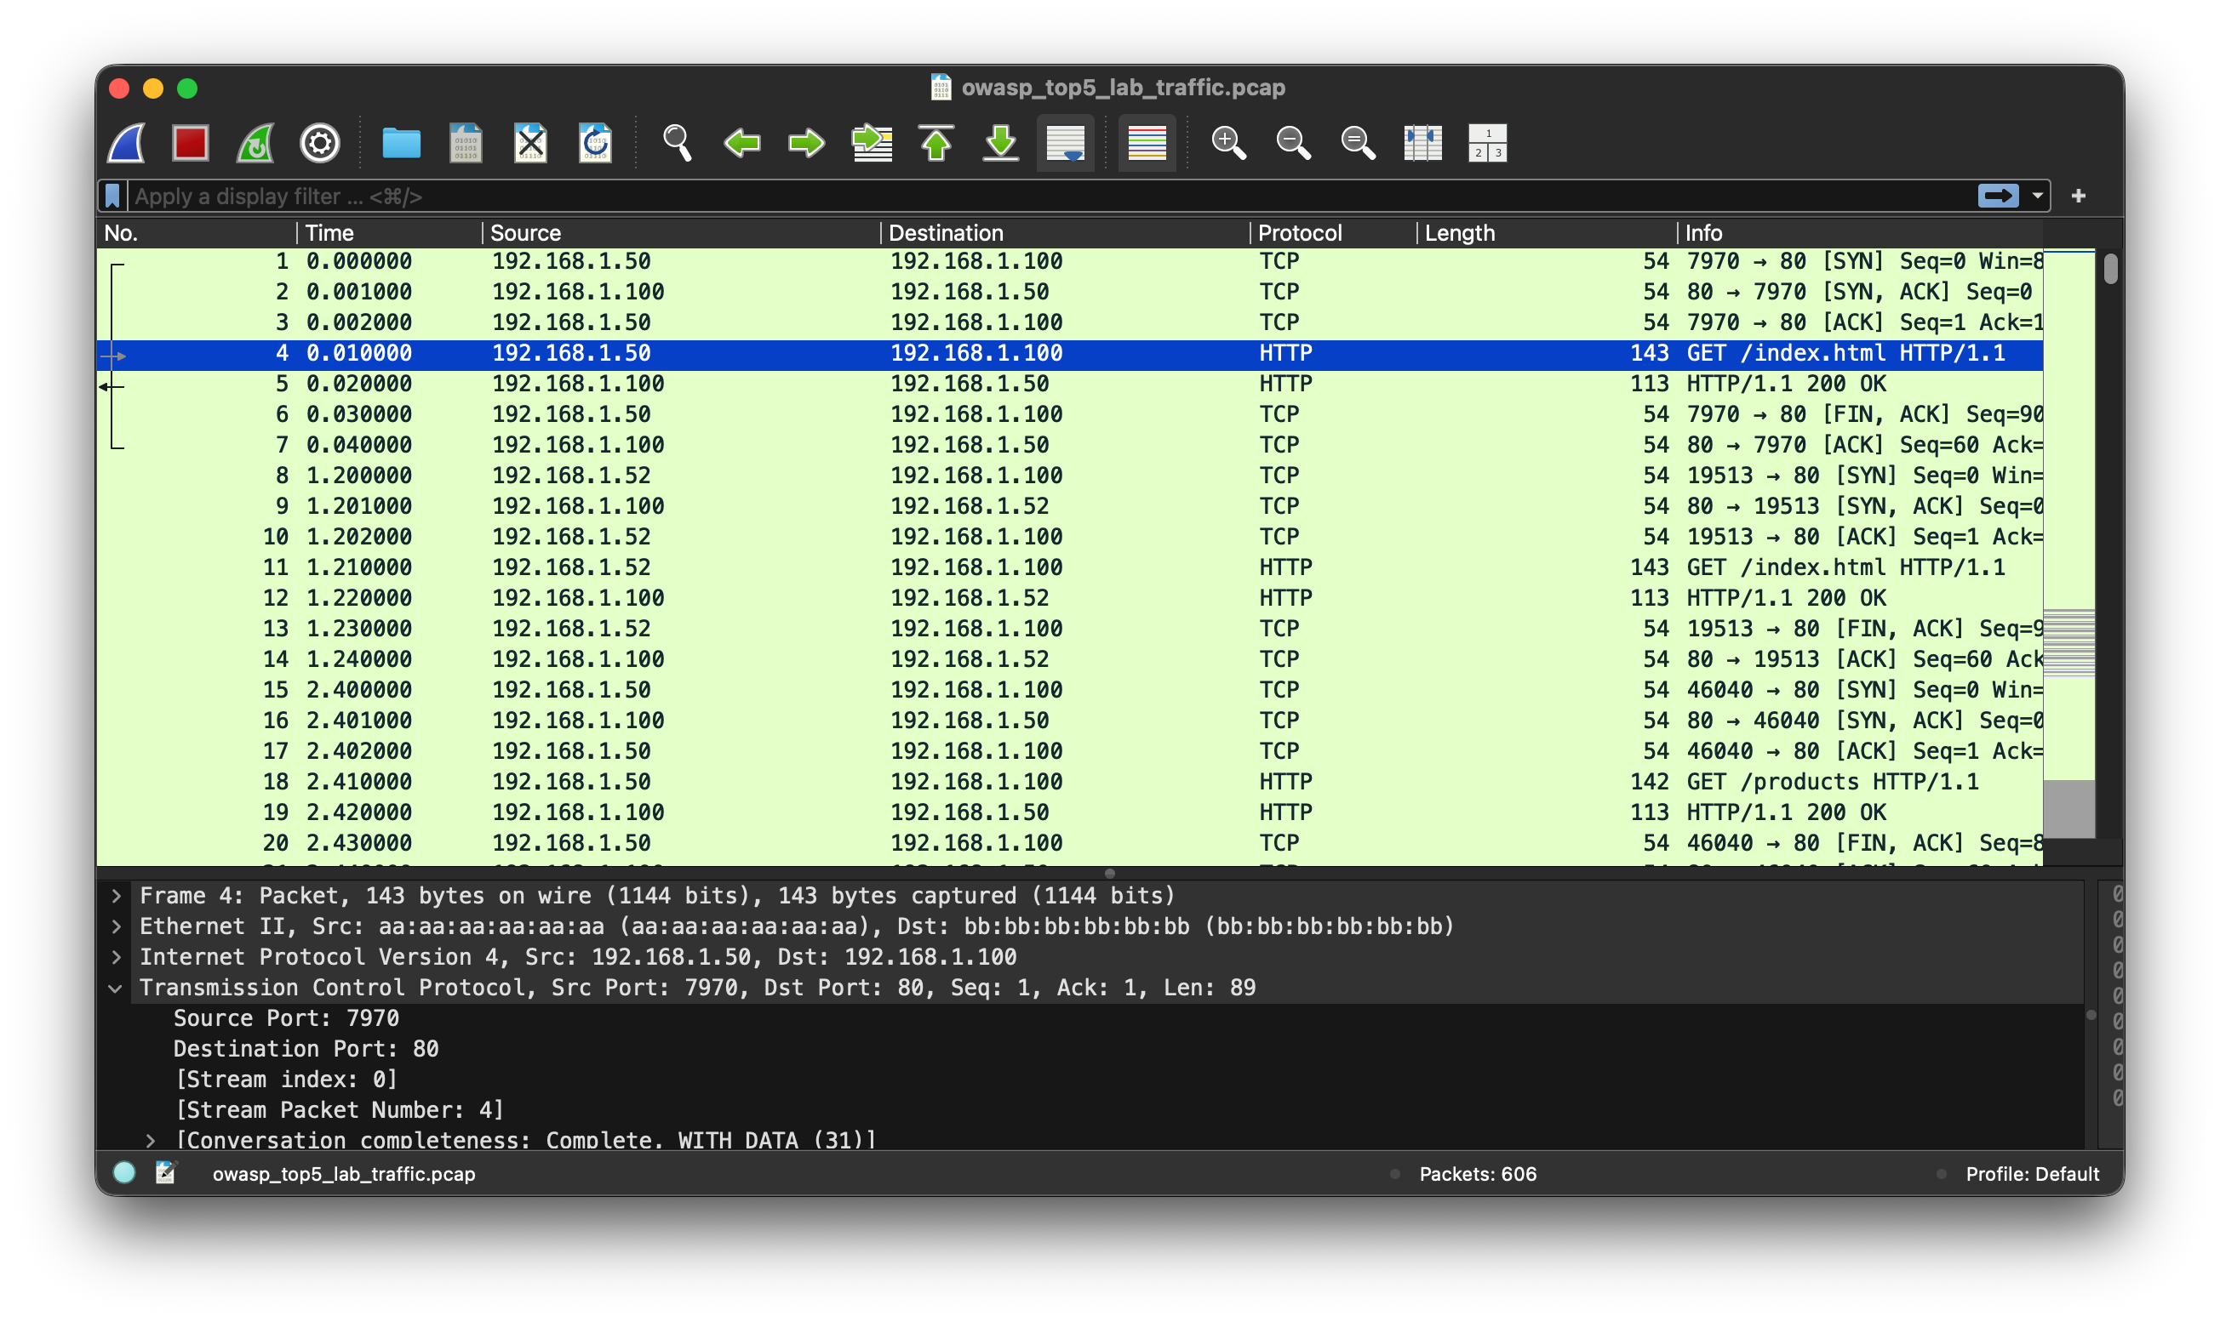

Slide 8
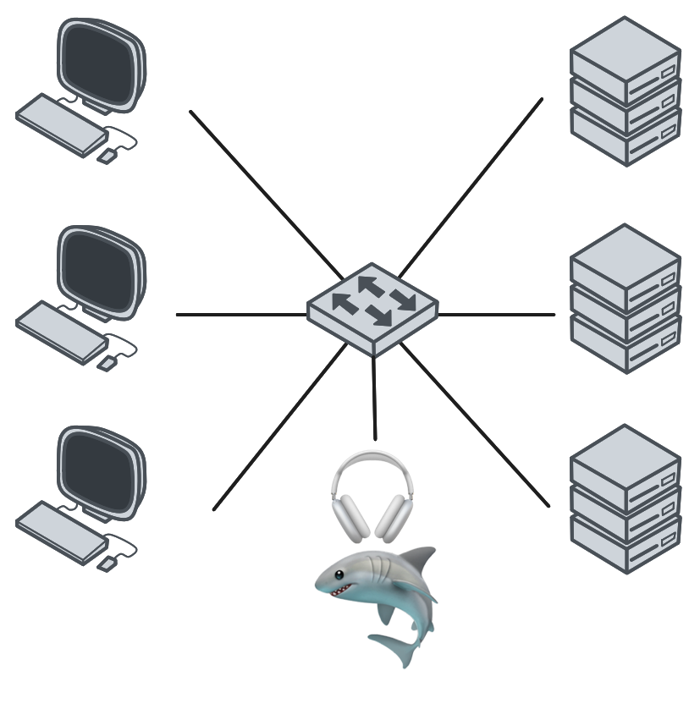

Slide 9
Capture filter:
Samme som ved TCPdump
Sat ved capture
Kan ikke udtrykke komplekse regler
Formål er at indgrænse indsamlingen og reducere størrelsen
Display filter
Filtrerer efterfølgende
Mere komplekse regler
https://wiki.wireshark.org/CaptureFilters#capture-filter-is-not-a-display-filter

Slide 10
Display Filter
> tcp.port eq 25 or icmp
> ip.src==192.168.0.0/16 and ip.dst==192.168.0.0/16
https://wiki.wireshark.org/DisplayFilters
https://www.wireshark.org/docs/wsug_html_chunked/ChWorkBuildDisplayFilterSection.html

Slide 11
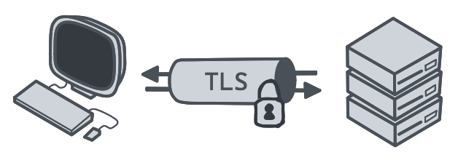
TLS
(eller SSH tunneler, VPN’er, et al.)

Slide 12
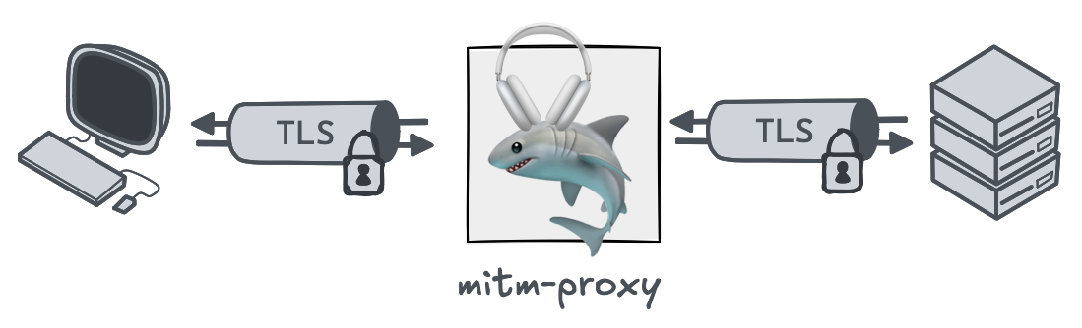
MitM Proxy
Når TLS kommer i vejen
(Mere om det her i morgen)

Slide 13
Øvelse Detect and respond (wireshark)

Slide 14
Pause

Slide 15
Netværkssikkerhed m. Nmap og OpenVAS

Slide 16
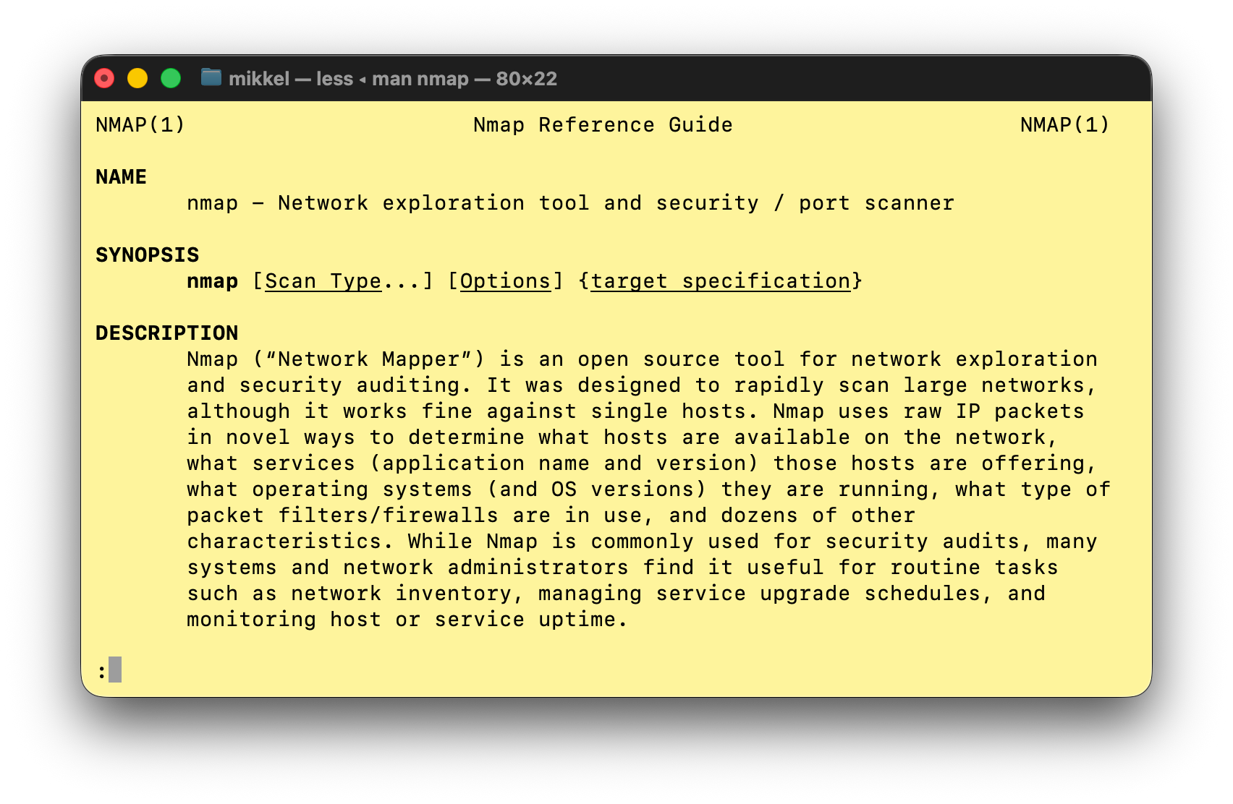
Nmap
Certificeret hackerværktøj ifølge Hollywood
Network Mapper

Slide 17
Nmap
Most important options/flags
Dissection of an nmap invocation
TCP syn <port>
TCP ack <port>
TCP connect <port>
UDP <port>
ICMP echo (ping)
IP Protocol Ping
ARP
https://nmap.org/book/host-discovery-strategies.html

Slide 18
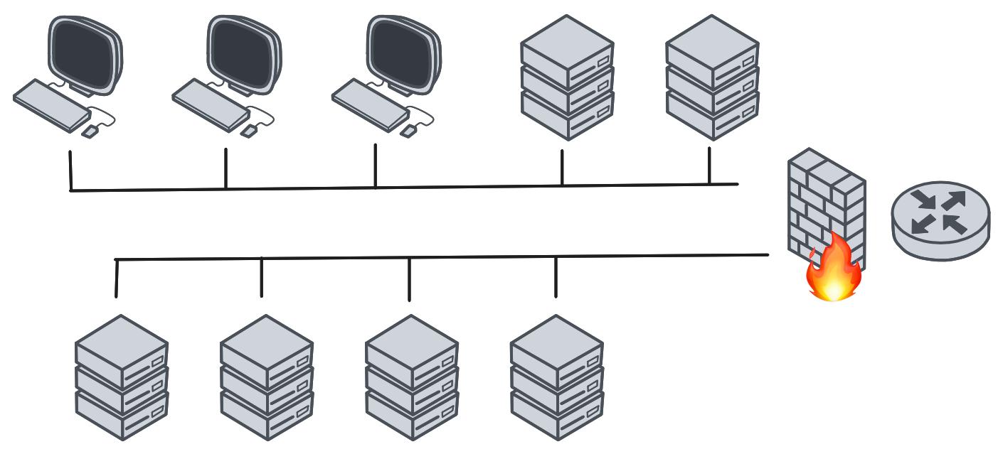
Kortlægning af netværk

Slide 19
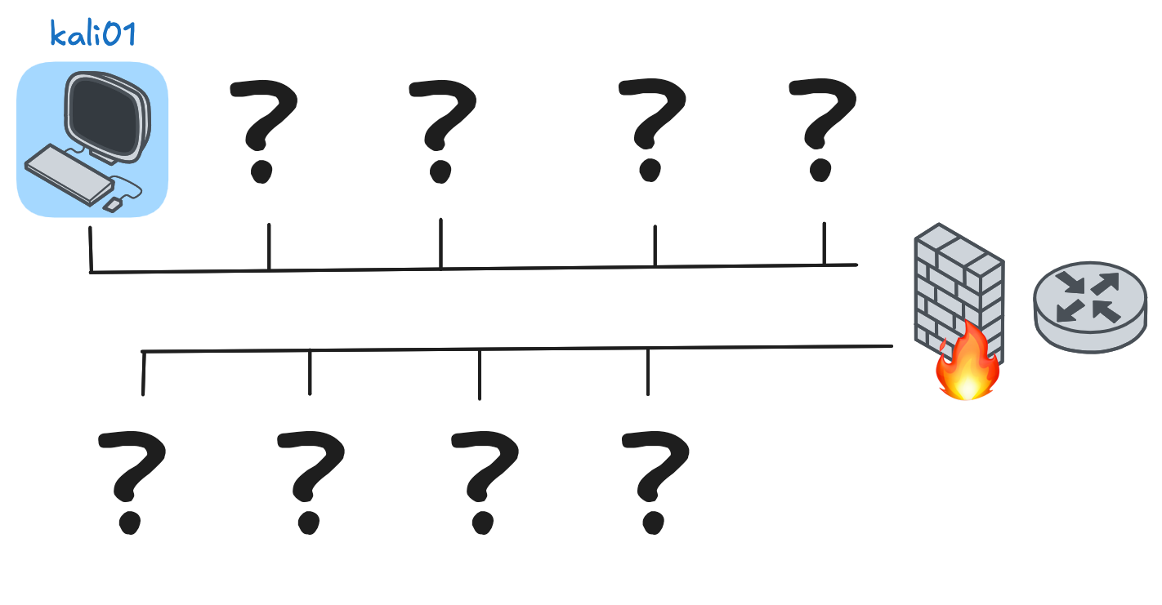
Kortlægning af netværk
nmap –sn <ip ranges to scan>

Slide 20
Discovery
Er en given host oppe?
Det primære trick er at omgå firewalls/filtrering
TCP syn <port>
TCP ack <port>
TCP connect <port>
UDP <port>
ICMP echo (ping)
IP Protocol Ping
ARP
-PE -PS80 -PS443 -PP -PU40125 -PS3389 -PA21 -PU161 --source-port 53
https://nmap.org/book/host-discovery-strategies.html
Notes:
Connect er default (de kursive kræver root)

Slide 21
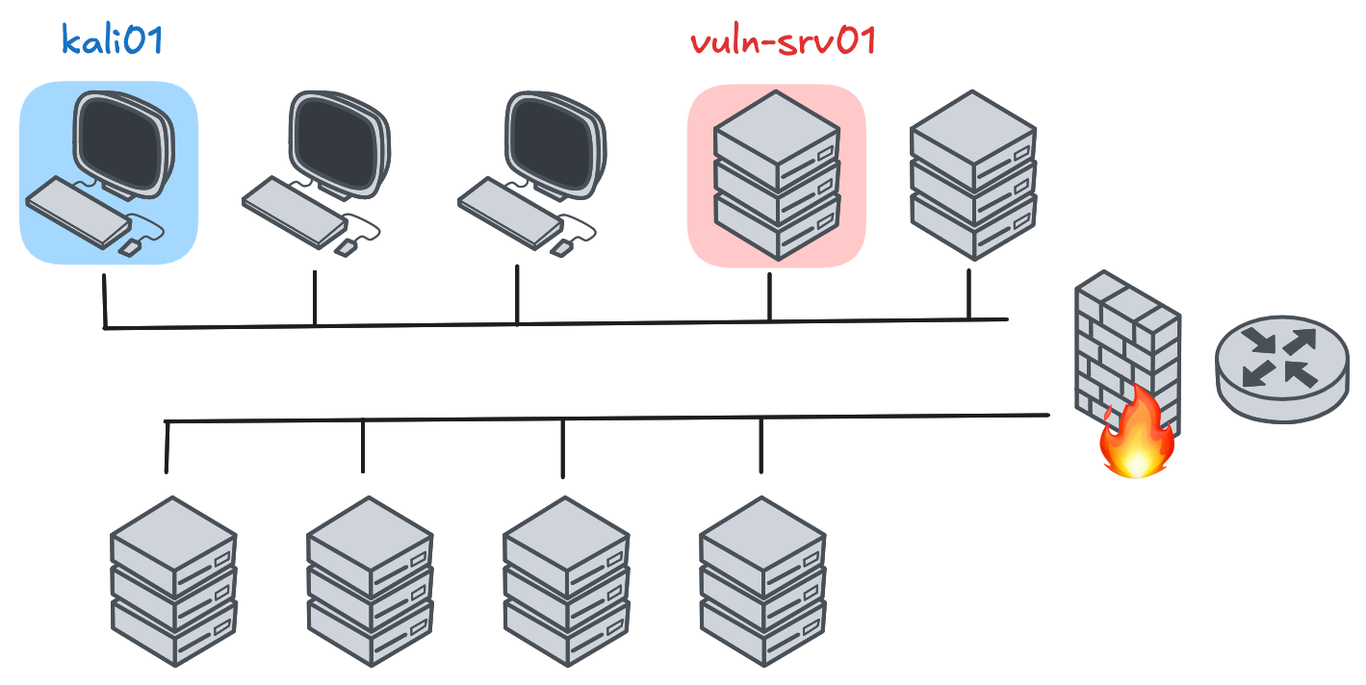
Portskanning

Slide 22

Hvad er en port?
Port | Protokol
20 | FTP (data)
21 | FTP (control)
22 | SSH
23 | Telnet
53 | DNS
80 | HTTP
443 | HTTPS
TCP
Port | Protokol
20 | FTP (data)
21 | FTP (control)
53 | DNS
80 | HTTP (QUIC)
123 | NTP
443 | HTTPS (QUIC)
UDP

Slide 23
Port
TCP Syn
TCP Connect
UDP Scan
Notes:
Connect er default (de kursive kræver root)

Slide 24

OSINT
– eller kunsten at finde offentlig-tilængelig information
OSINT
Open Source Intelligence
Finde underdomæner og andre relaterede ting
Hvad kan internettet fortælle mig om denne organisation?

Slide 25
Eksempler på information:
IP-addressr
Domæner og underdomæner
E-mail-addresser
Telefonnumre
Brugernavne
Eksempler på kilder:
Domæne/IP/DNS-registre
Internettet (sociale medier/github/etc.)
Formål?

Slide 26
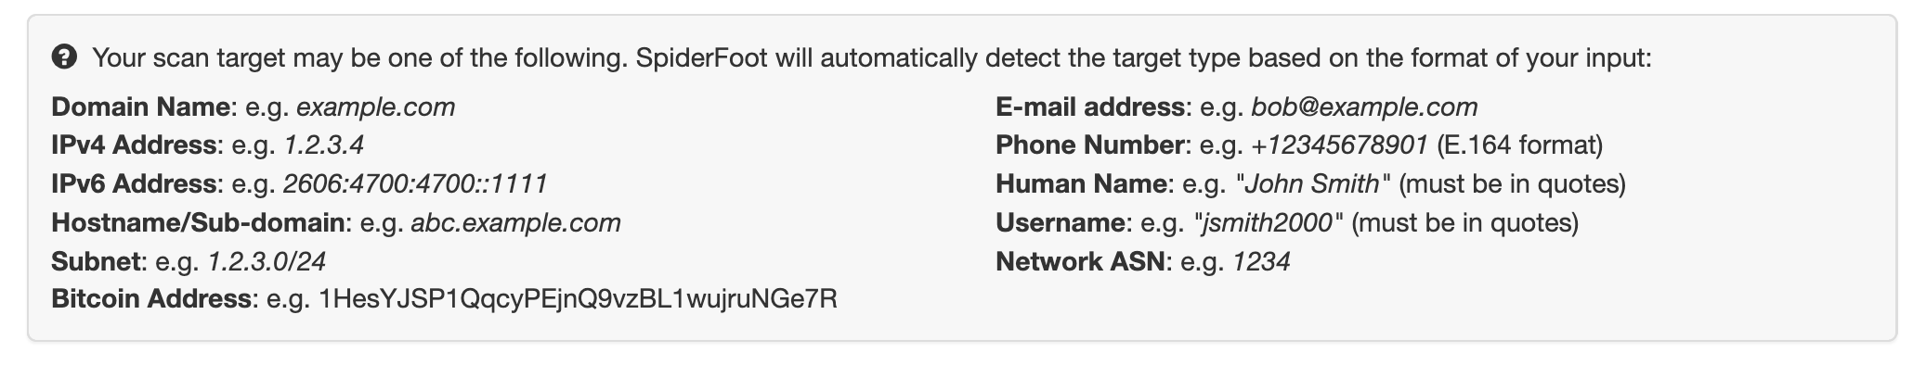
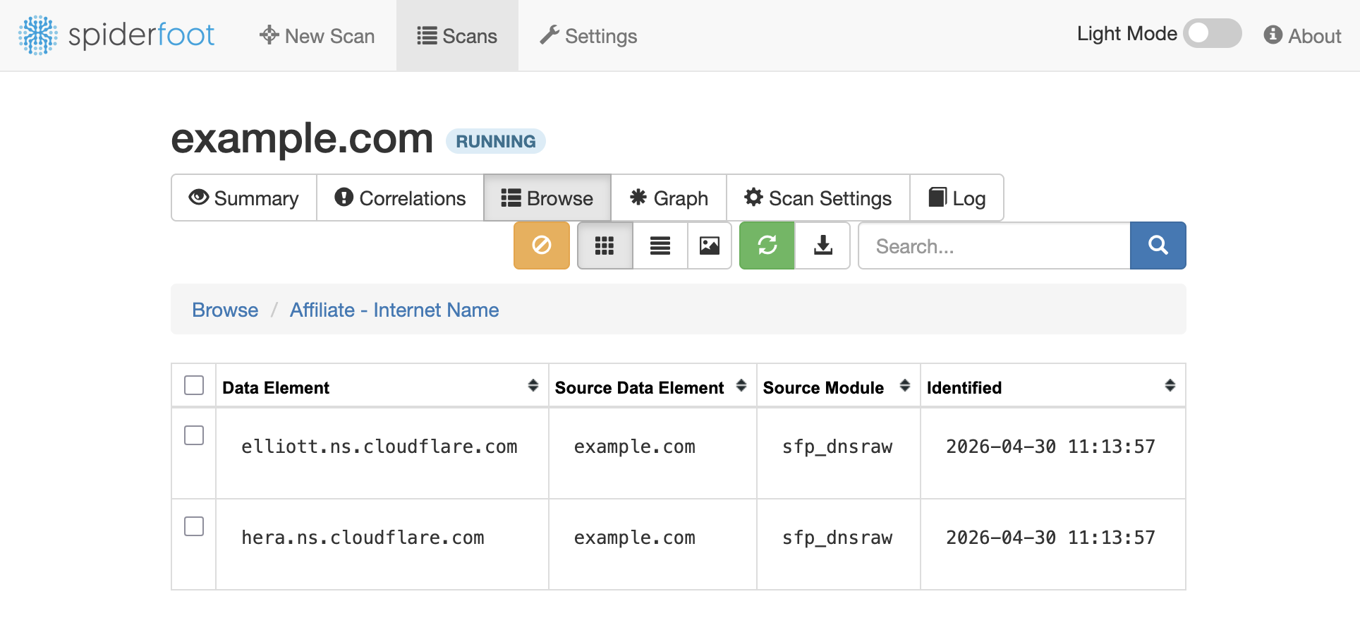

Slide 27
CVEs
Eksempler:
Common
Vulnerability
and
Exposures
HeartBleed (CVE-2014-0160)
EternalBlue (CVE-2017-0144)
Log4Shell (CVE-2021-44228)
xz backdoor (CVE-2024-3094)
Copy Fail (CVE-2026-31431)
Dirty Frag (CVE-2026-43284)

Slide 28
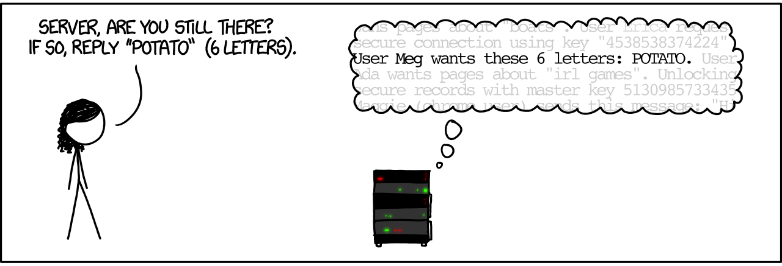
https://xkcd.com/1354/

Slide 29
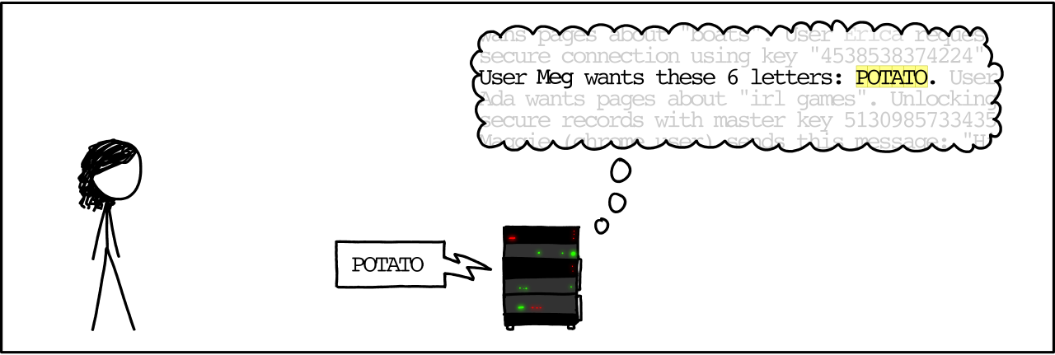
https://xkcd.com/1354/

Slide 30
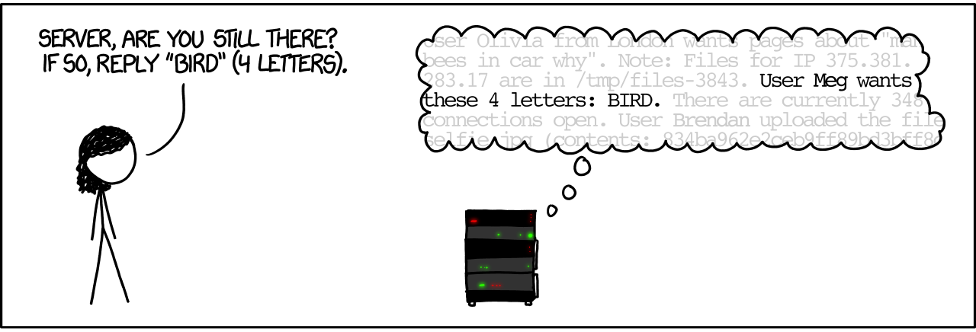
https://xkcd.com/1354/

Slide 31
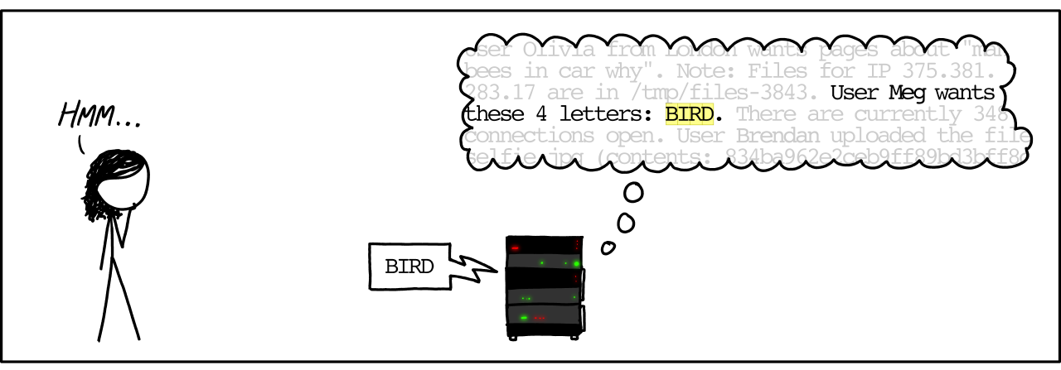
https://xkcd.com/1354/

Slide 32
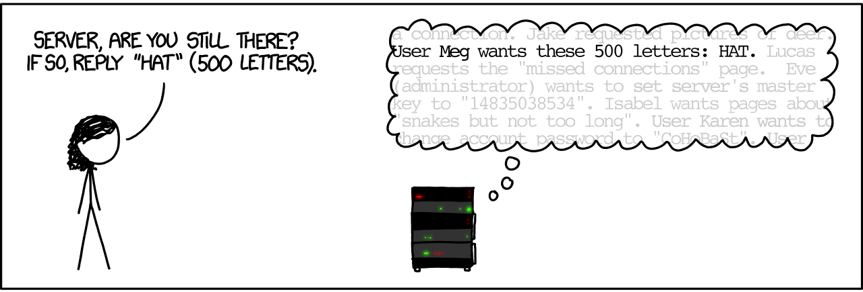
https://xkcd.com/1354/

Slide 33
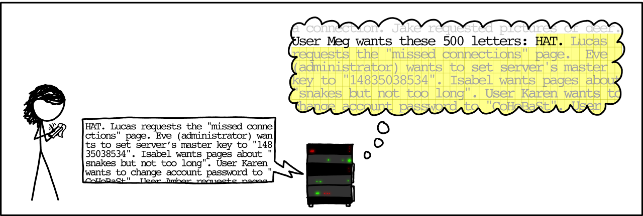
https://xkcd.com/1354/

Slide 34

CVE
HeartBleed (CVE-2014-0160)
OpenSSL 1.0.1 through 1.0.1f (inclusive) are vulnerable
OpenSSL 1.0.1g is NOT vulnerable
OpenSSL 1.0.0 branch is NOT vulnerable
OpenSSL 0.9.8 branch is NOT vulnerable
Debian Wheezy (stable), OpenSSL 1.0.1e-2+deb7u4
Ubuntu 12.04.4 LTS, OpenSSL 1.0.1-4ubuntu5.11
CentOS 6.5, OpenSSL 1.0.1e-15
Fedora 18, OpenSSL 1.0.1e-4
OpenBSD 5.3 (OpenSSL 1.0.1c 10 May 2012) and 5.4 (OpenSSL 1.0.1c 10 May 2012)
FreeBSD 10.0 - OpenSSL 1.0.1e 11 Feb 2013
NetBSD 5.0.2 (OpenSSL 1.0.1e)
OpenSUSE 12.2 (OpenSSL 1.0.1c)

Slide 35
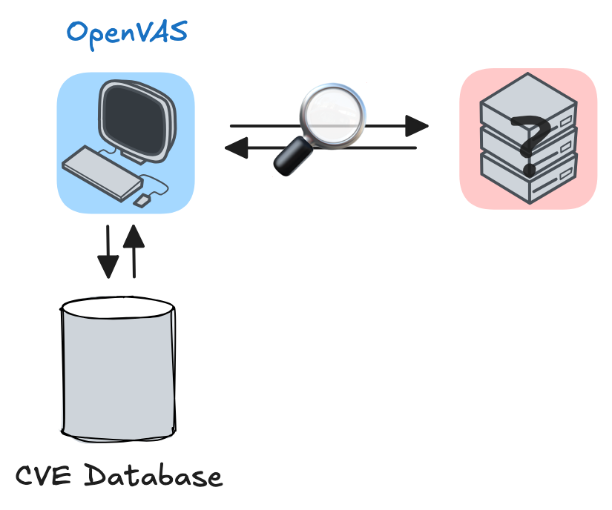
OpenVAS
Kobling mellem endpoints og CVE’er
Open
Vulnerability
Assessment
Scanner

Slide 36
Øvelse Network security (scanning)

Slide 37
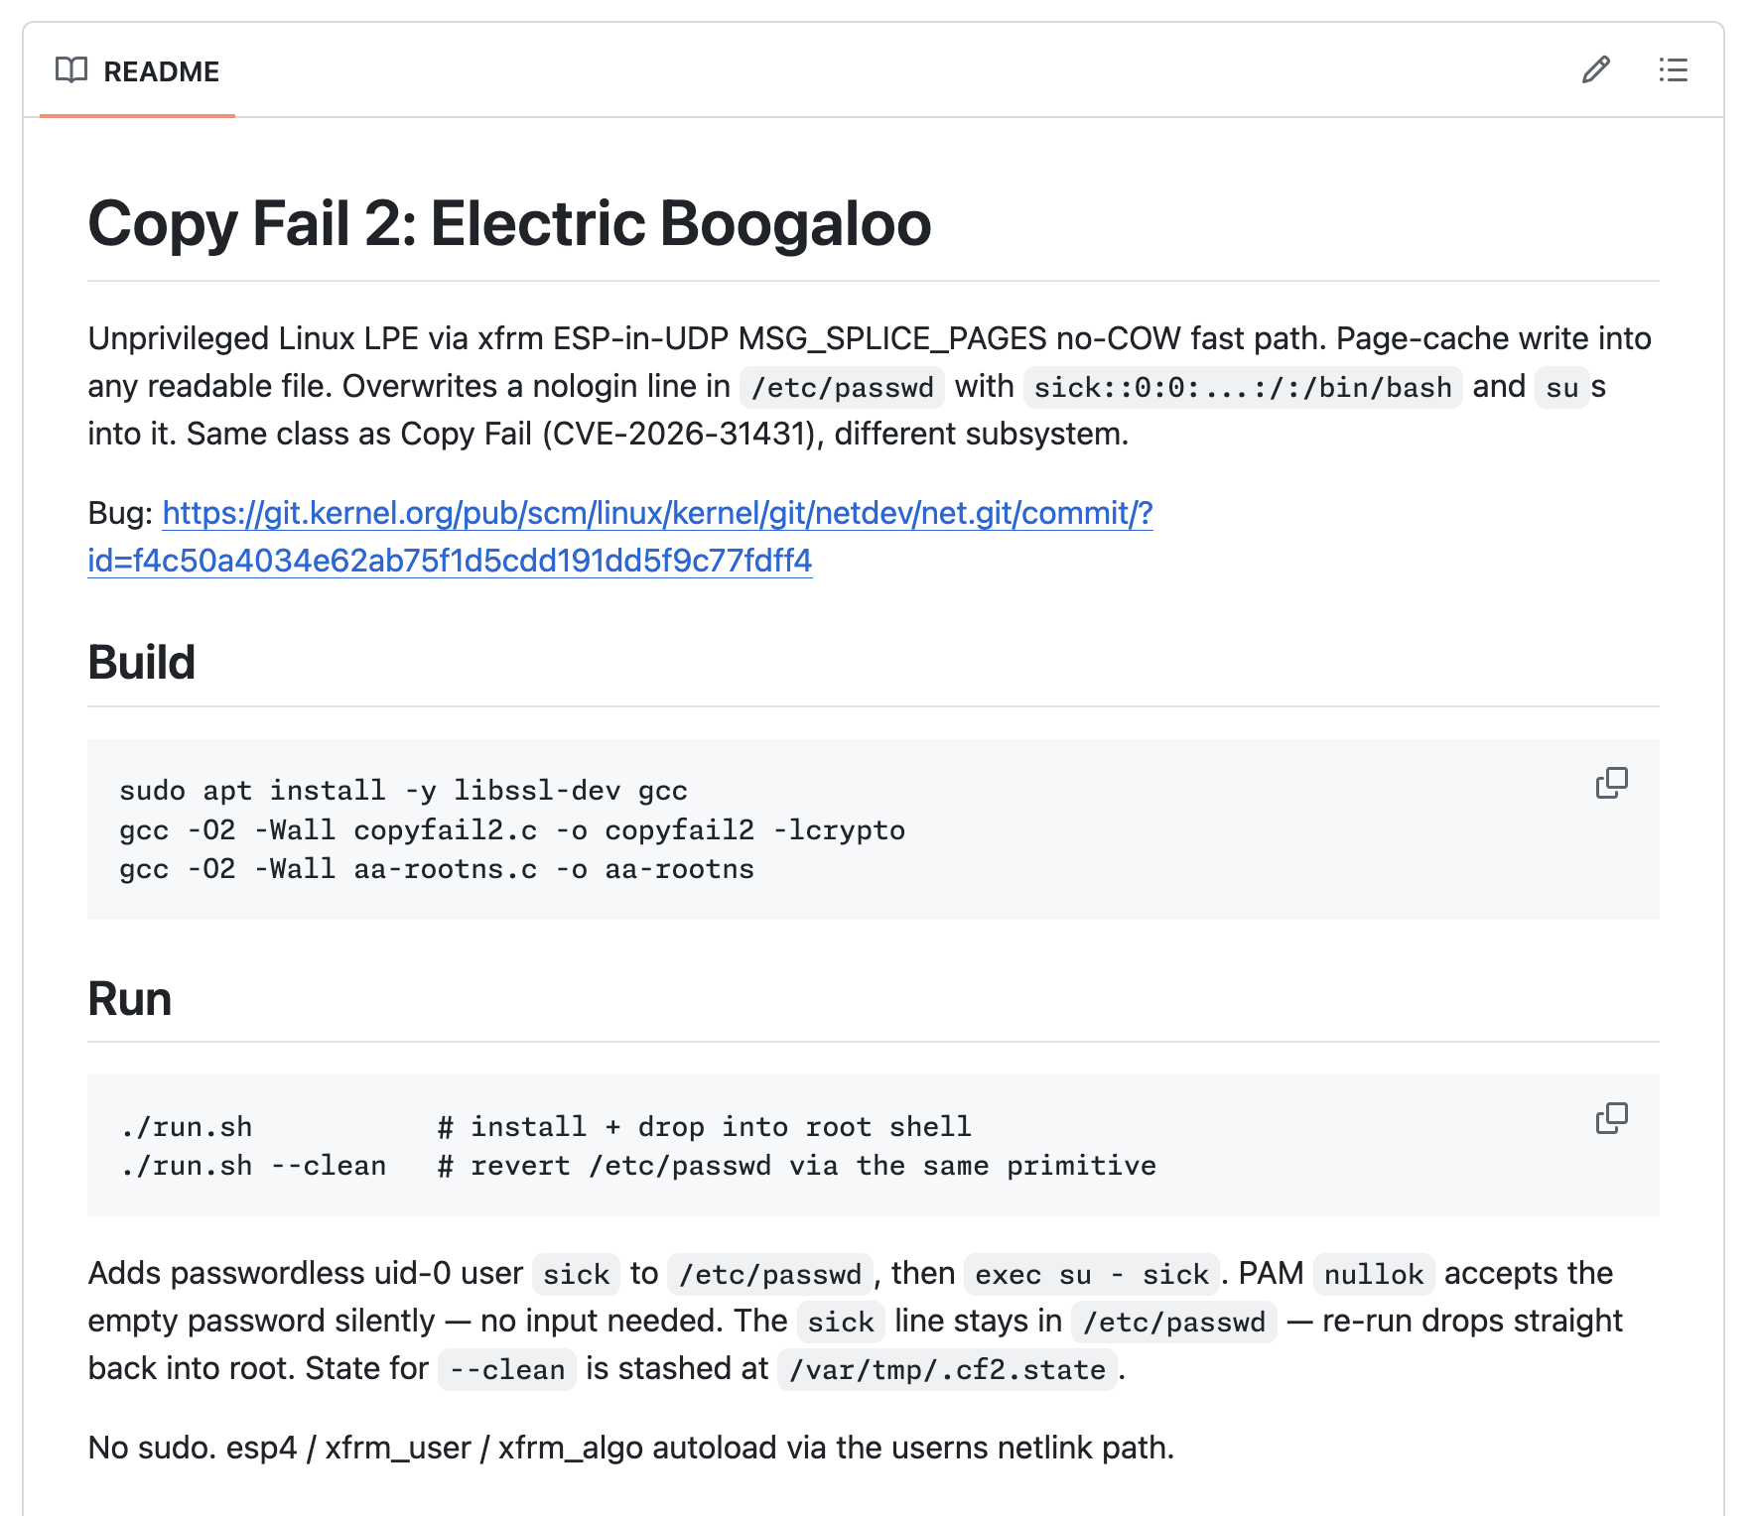

Bonus Opgave
https://github.com/0xdeadbeefnetwork/Copy_Fail2-Electric_Boogaloo

Slide 38
Pause

Slide 39
Loganalyse for Endpoints

Slide 40


Slide 41
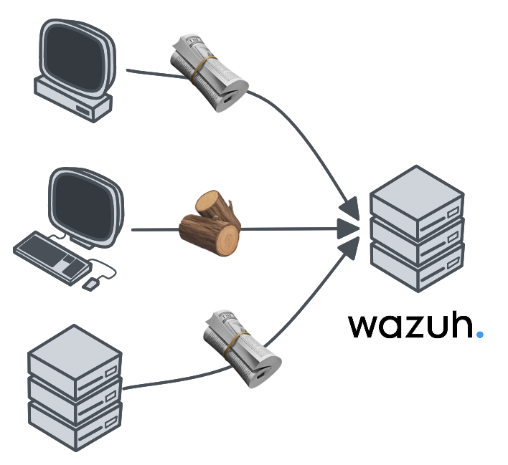

Slide 42
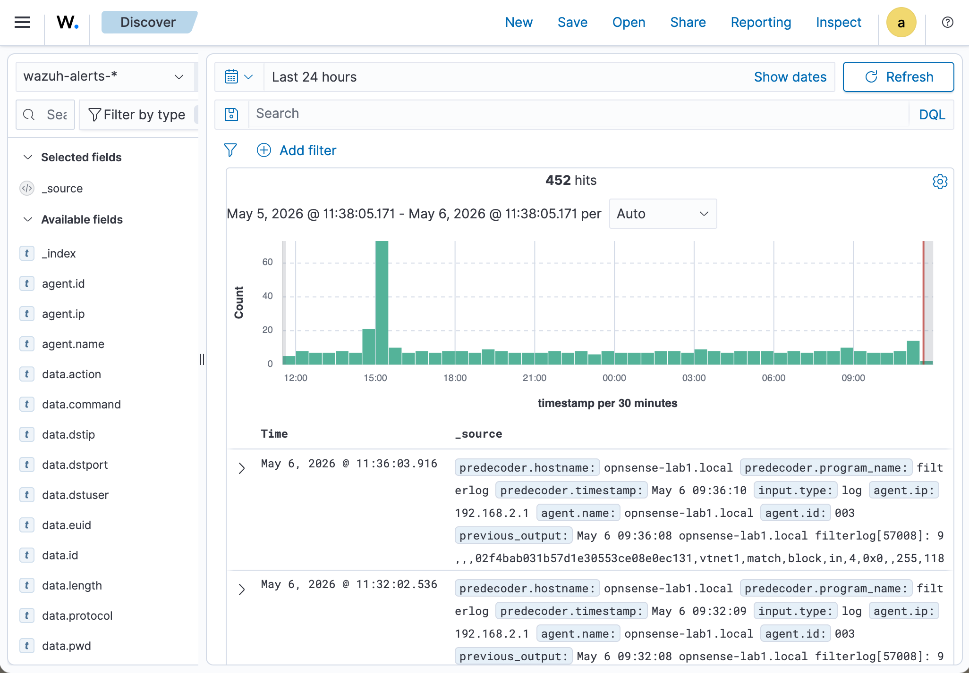

Slide 43
OpenSearch Dashboard Query Language
Query | Matcher
rises wind | Steder med “rises” eller “wind”
“wind rises” | Steder med eksakt “wind rises”
title: wind | Søg i feltet “title” efter “wind”
page_views > 100 and page_views <= 300 | Sider fra 101 til og med 300 visninger
date >= "2013-01-01" | I 2013 og efter

Slide 44
OpenSearch Dashboard Query Language
title: windy or historical
title: wind and description: epic
(media_type: article or title: wind)
and description: epic
patient.name: john

Slide 45
OpenSearch Dashboard Query Language
title: windy or historical
title: wind and description: epic
(media_type: article or title: wind)
and description: epic
patient.name: john

Slide 46
Øvelse Endpoint security (logs analyse)

Slide 47
Pause

Slide 48
Fortsæt med tidligere opgaver Detect and respond (wireshark) Network security (scanning) Endpoint security (logs analyse)

Slide 49
Tak for i dag

