Slide 1
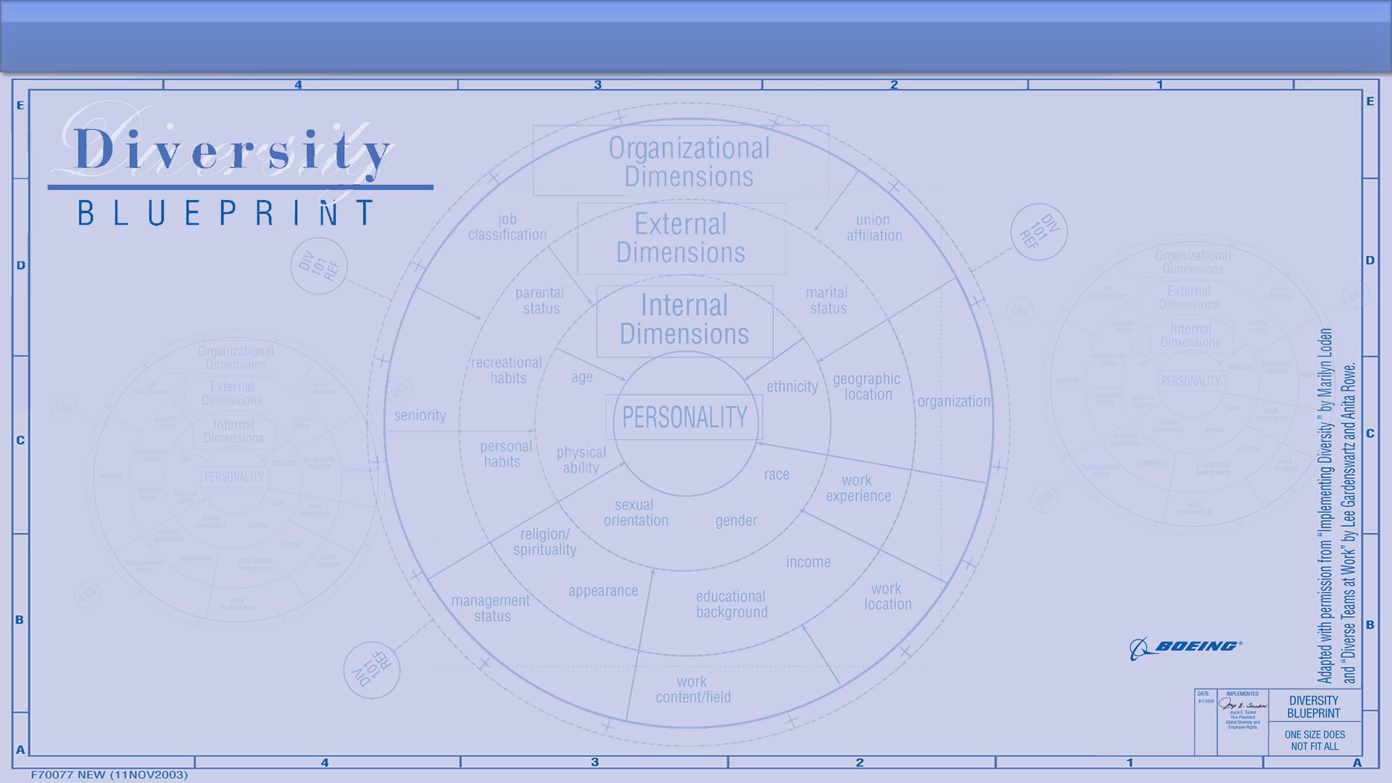
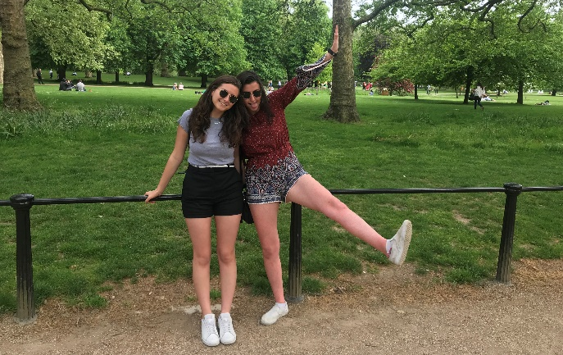
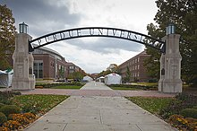


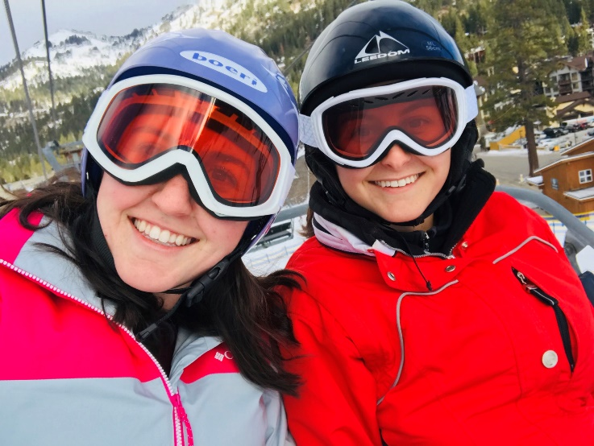
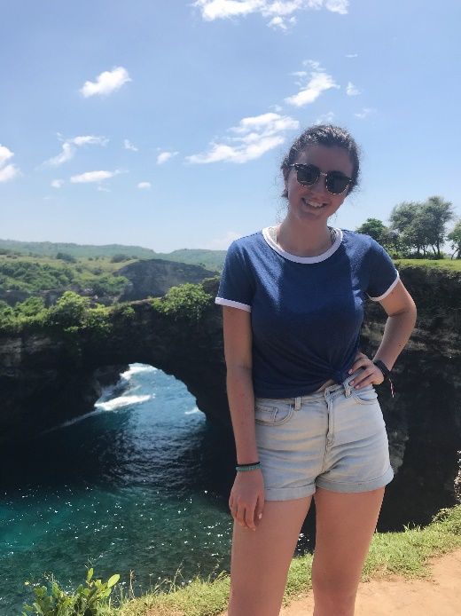
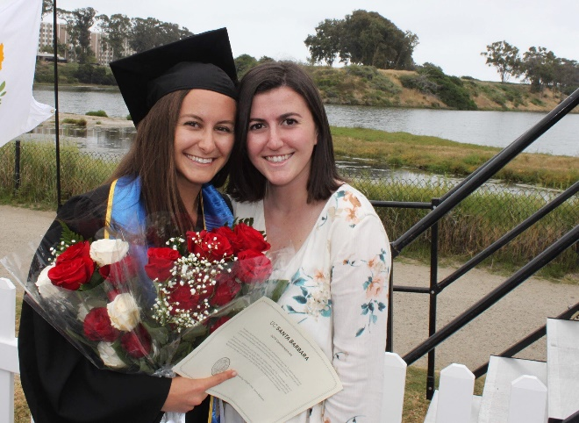
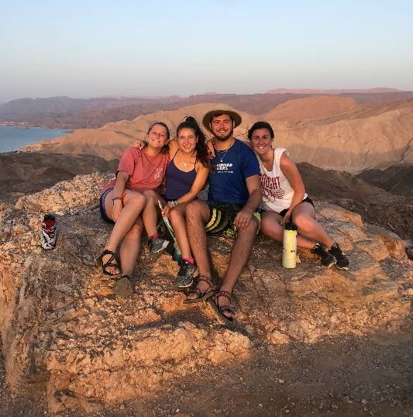
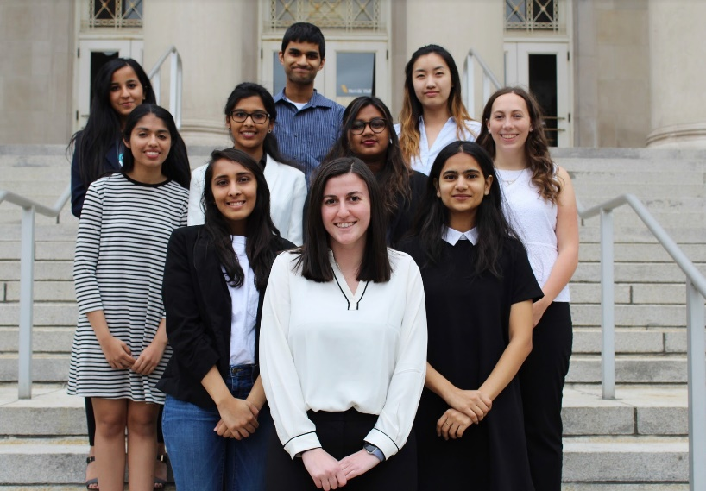
Sasha Kipnis
Sasha (My real name is Alexandra, but I’ve been called Sasha all my life)
  Intern on Robby’s team - Integration Solution Services
Personal Blueprint
  Born and raised in Cupertino, California! I speak Russian fluently and Spanish pretty well.
  My whole family is originally from Russia – me and my sister are the first born in America.
  I played competitive soccer for 8 years and I am a huge fan of the USWNT.
  I love skiing, I’ve been skiing probably since I could walk, my favorite place to ski is Lake Tahoe
  I have had the opportunity to travel a lot, my favorite places were Portugal, London, Israel, and Bali
Anything additional you want others to know about you
  I’m going into my junior year at Purdue University and I’m majoring in Computer Science with a concentration in Machine Learning and minoring in Statistics and Entrepreneurship. I just finished my term as president of the Computer Science Women’s Network and I mentor girls at local high schools each week in basic programming skills.
What Diversity & Inclusion means to me
  If we don’t have diversity in the work force, we won’t make products for a diverse audience. Everyone should have the opportunity to do the things they want regardless of their gender, race, sexual orientation, or race.
Add one or more
Personal
photos

