Slide 1
Lecture 22: Distance Sampling, cont.
Apr 20, 2022

Slide 2
Distance sampling is used to estimate density based on counts of objects along transects plus auxiliary data, the observed distances between objects and the observer on the transect line
Detection probability is modeled from these distances and used to transform counts of objects into an estimate of density

Slide 3
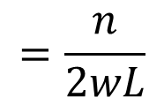
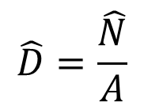
Estimating density
Assuming detection probability = 1
$$\hat{D}=\frac{\hat{N}}{A}$$
$$=\frac{n}{2wL}$$
L
where:
n = number of objects detected
L = transect length
w = distance from transect line to outer edge
w

Slide 4
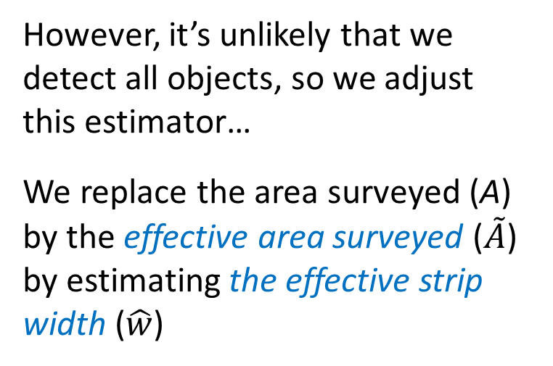
Estimating density
Assuming detection probability = 1
$$\hat{D}=\frac{\hat{N}}{A}$$
$$=\frac{n}{2wL}$$
L
However, it’s unlikely that we detect all objects, so we adjust this estimator…
We replace the area surveyed (A) by the effective area surveyed ($\tilde{A}$) by estimating the effective strip width ($\hat{w}$)
w

Slide 5
How do we establish a detection function?
1.0
g(x)
x
w
First, assess the need for truncation
Notes:
End first hour and 15 minute session

Slide 6
Truncation
What if our detection data looked like this?
Freq
Distance (x)
Observations from extreme distances can be troublesome when fitting a detection function, so we often discard 5-10% of the farthest detections; that point is called the “truncation distance”

Slide 7
Detection function, g(x)
g(x) = probability of detecting an object as a function of distance x from the line
Assume g(0) = 1
i.e., detection
probability = 1
at distance x = 0
1.0
g(x)
Observations of objects at distances between 0 and x₁
x₁
x
w
Distances

Slide 8


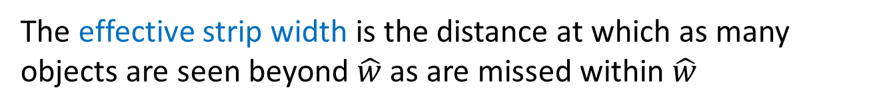
Effective strip width ($\hat{w}$ or ESW)
The effective strip width is the distance at which as many objects are seen beyond $\hat{w}$ as are missed within $\hat{w}$
1.0
g(x)
x
w
$$\hat{w}$$
Notes:
Ended at lab, 18 Oct 2021

Slide 9
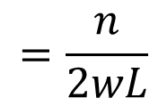
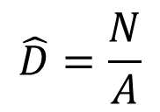
Estimating density
Assuming detection probability = 1
$$\hat{D}=\frac{N}{A}$$
$$=\frac{n}{2wL}$$
L
w

Slide 10
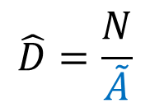

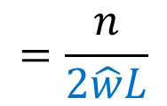
Estimating density
When detection probability < 1
$$\hat{D}=\frac{N}{\tilde{A}}$$
$$=\frac{n}{2\hat{w}L}$$
L
$$\hat{w}$$

Slide 11
Distance measurements
Observer travels the line at constant pace and records the distance to all objects observed
Perpendicular distance (x_{i}), or
Radial distance (r_{i}) and angle (θ_{i})
x
x
x = r*sin(θ)
r
θ

Slide 12
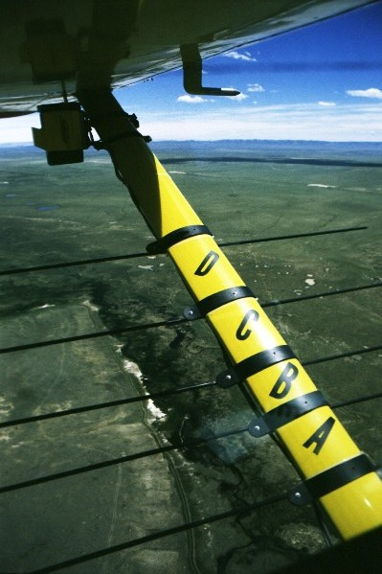
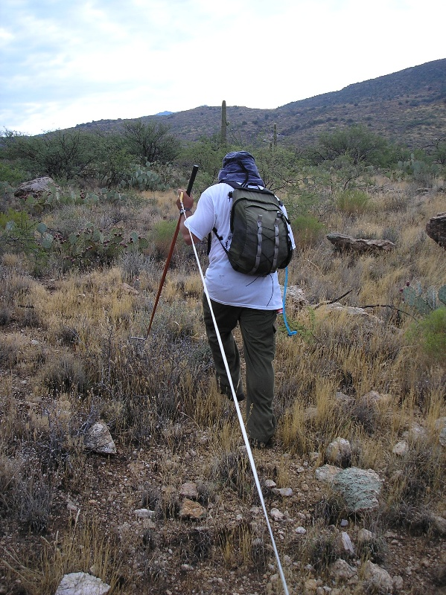
Distance measurements
Either exact or grouped
Distances recorded in intervals (= groups)
Exact distance recorded to each object detected
Photo: Rich Guenzel
Interval boundaries are called cutpoints

Slide 13
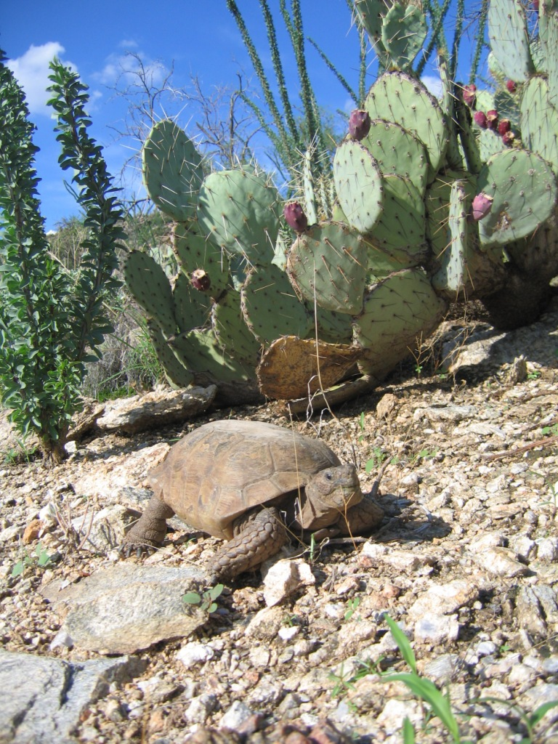
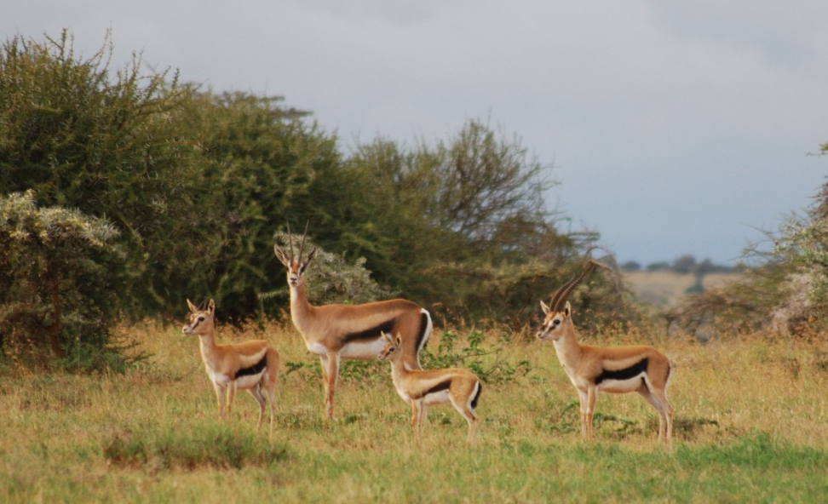

Distance measurements
To individuals or clusters
Each object detected is a single individual
Each object detected is a cluster of individuals
To estimate density of individuals that occur in clusters, we must also estimate cluster size

Slide 14
Distance measurements
Observer travels the line at constant pace and records the distance to all objects observed
Sometimes a maximum distance is established, w, beyond which any objects detected are ignored
w
w

Slide 15
Distance measurements
Observer travels the line at constant pace and records the distance to all objects observed
Sometimes a maximum distance is established, w, beyond which any objects detected are ignored
Aim for at least 60-80 detections

Slide 16
Types of transects
Use line transects or point transects (circular plots):

Slide 17
Types of transects
Use line transects or point transects (circular plots):
Transects are usually established at random, so their location is unrelated to the objects in the area surveyed

Slide 18
Point transects
Observer at a fixed location rather than traversing a line
Often used for surveying birds
Transect length, L = 0
Advantage:
When surveying in complex environments, stationary observer can focus on detecting objects
Disadvantage:
Objects near the center of the plot are more likely to be disturbed by the observer
Creates a challenge for meeting the assumption that all objects on the point (line) are detected with certainty; i.e., g(0) = 1.0

Slide 19
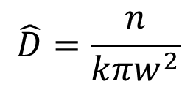
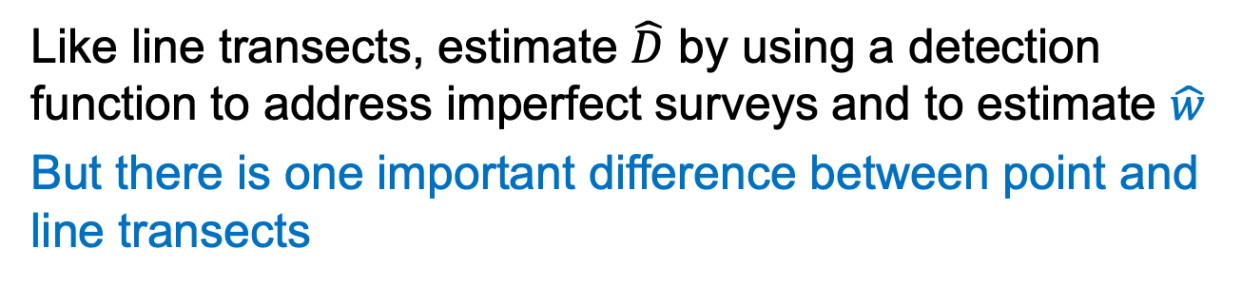
Point transects
Distances are radial (r_{i})
Area sampled = kπw²
k = number of plots
w = radius of plots
w
r₂
r₁
With perfect surveys (p = 1):
$$\hat{D}=\frac{n}{kπw^{2}}$$
Like line transects, estimate $\hat{D}$ by using a detection function to address imperfect surveys and to estimate $\hat{w}$
But there is one important difference between point and line transects

Slide 20
With line transects, we expect a uniform distribution of objects with respect to distance if we establish lines at random
What do we expect for point transects?

Slide 21
Point transects
Because there’s less area near the center of the circular plot, we expect fewer objects to be close to the observer, even though detection probability is higher there
Smaller area = fewer objects
Detections closer to observer are key for determining the detection function

Slide 22
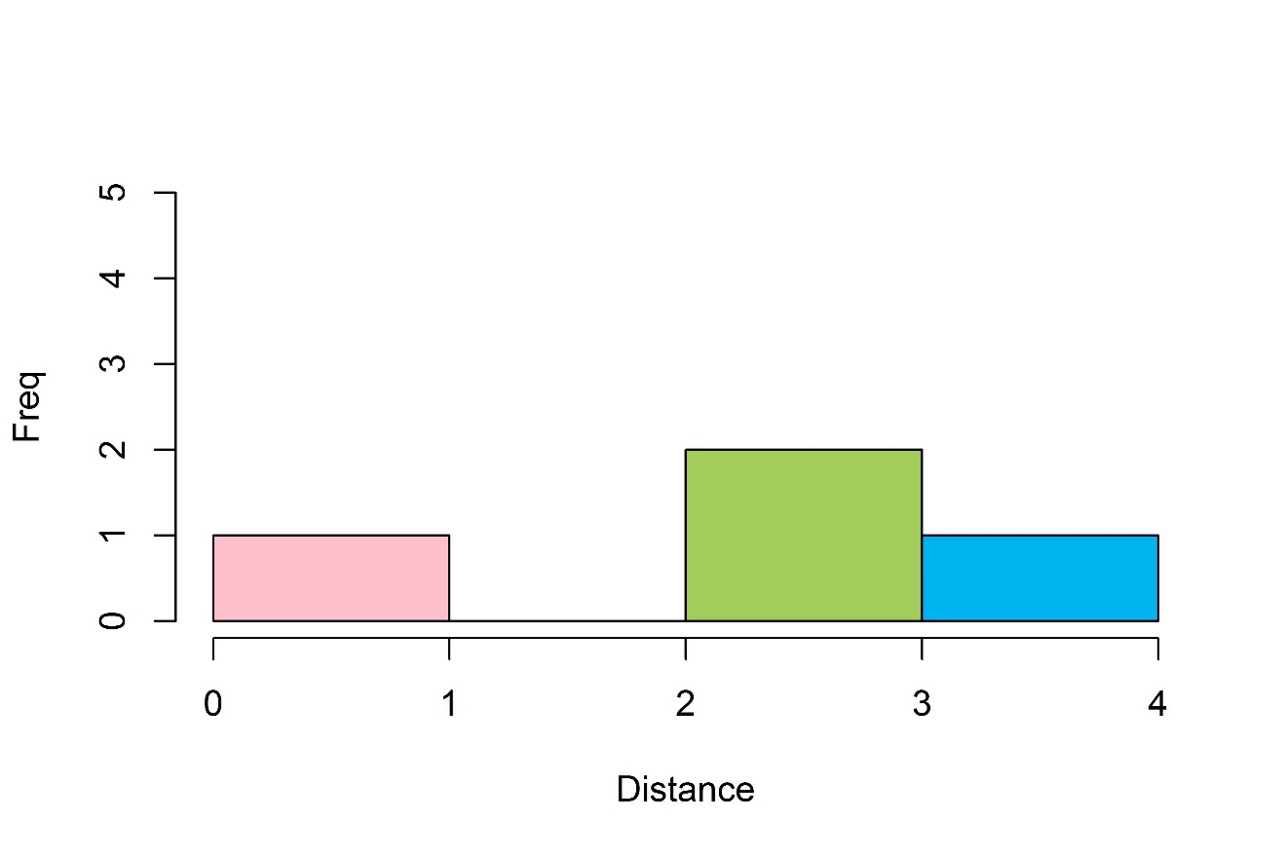

Slide 23

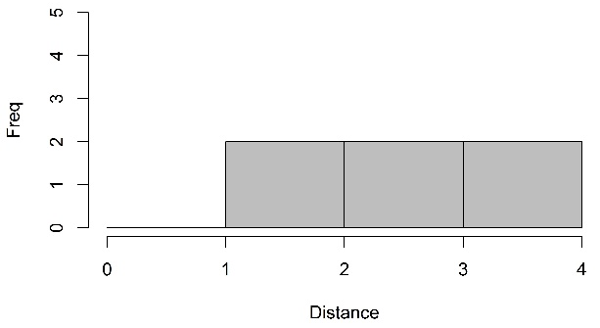
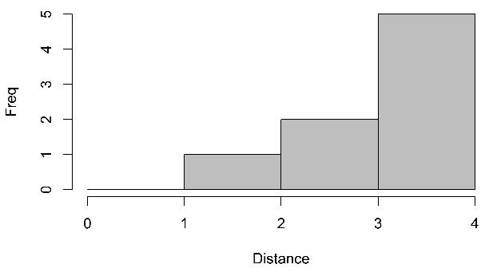

Slide 24
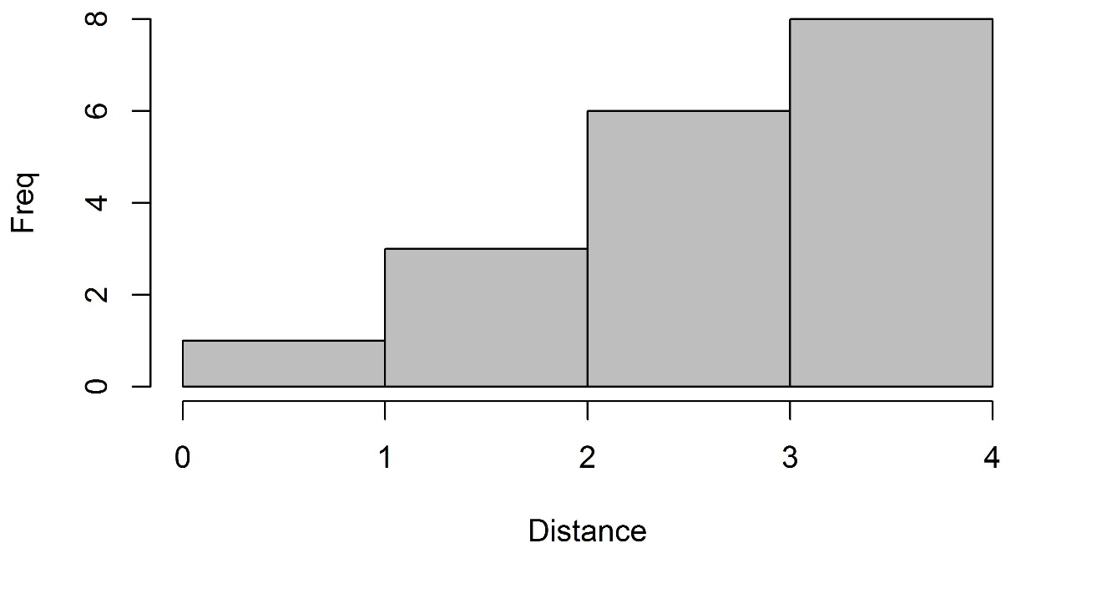
sum

Slide 25
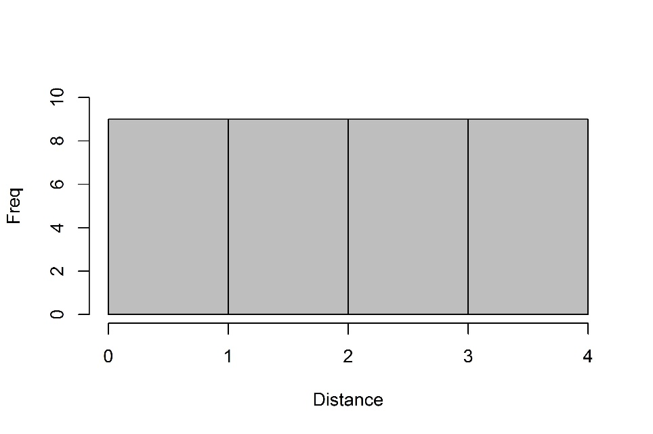

Expected distribution of objects with respect to distance from center line/point:

Slide 26
Line transects
Point transects
True expected distribution of objects
Detection function, g(x)
Observed distribution, f(x)

