Slide 1
Lecture 23: Spatial Patterns
Apr 25, 2022

Slide 2


Slide 3
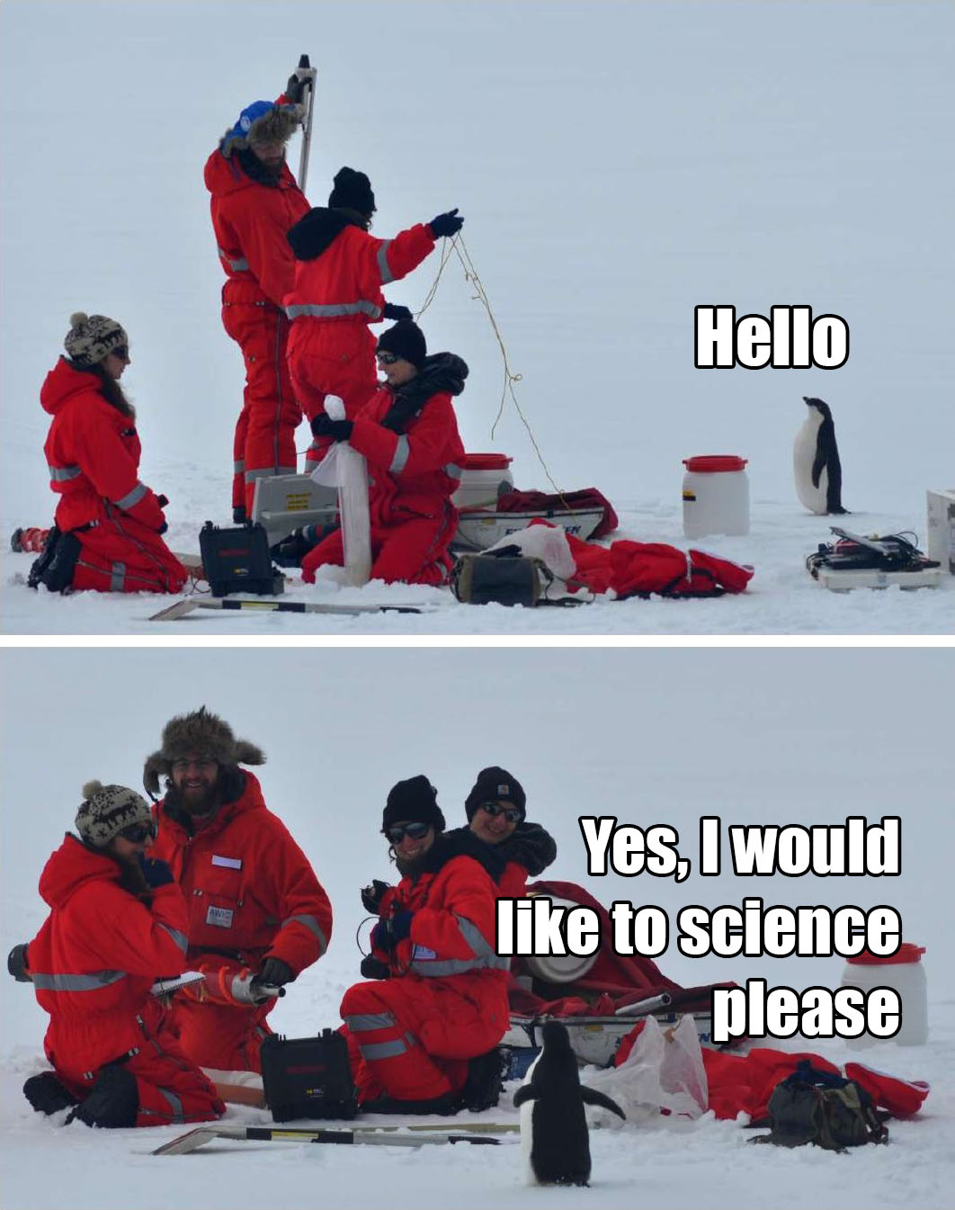
WFSC 223: Dealing with Data in the Wild
GenEd and elective for the major/minor
Learn lots more tidyverse!
Fall 2022, T/Th 4:00-5:15
DATA
^
Notes:
What types of data might we use to make the decision of when to settle Antarctica
Temp data – what is our question and how will we know we have our answer?

Slide 4
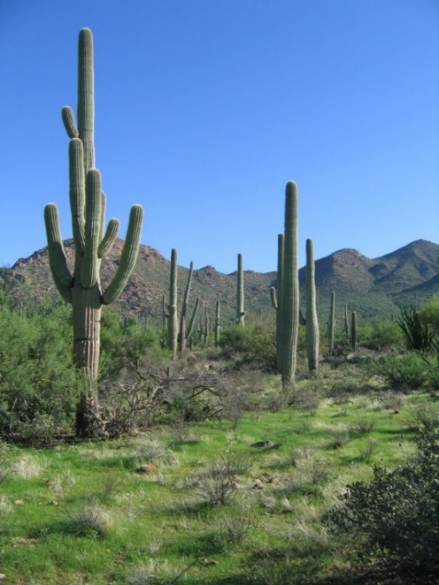
Other distance-based methods
Can be used to estimate density of objects
Like distance sampling, these are based on measured distances to objects; sometimes called ‘plotless estimators’
Unlike distance sampling, these approaches assume:
detection probability = 1
objects distributed at random
Are these reasonable?
Work best when objects are uncommon, easy to observe, stationary, and widely scattered; e.g., trees, saguaros…

Slide 5

Other distance-based methods
Nearest individual – From a random start point, measure the distance to the nearest object
= point-to-object
Nearest neighbor – From a random start point, locate the nearest object, then measure distance from that object to the next closest object
= object-to-object

Slide 6
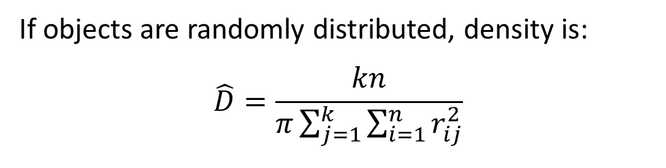
Point-centered quarter
k = no. points surveyed, indexed by j
n = no. distances measured at each point, indexed by i; these are point-to-object distances
r_{ij} = radial distance from the j^{th} random point to the i^{th} nearest object
If objects are randomly distributed, density is:
$$\hat{D}=\frac{kn}{π\sum_{j=1}^{k}{\sum_{i=1}^{n}{r_{ij}^{2}}}}$$
known
Sum of each distance squared
i.e., area of a circle

Slide 7
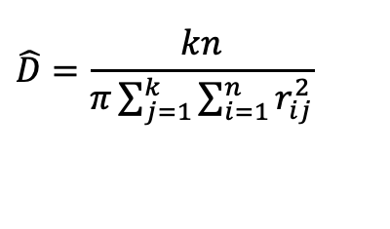
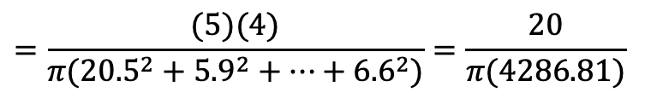
Point-centered quarter
 | Distance r (meters)
Point k | NE | SE | SW | NW
1 | 20.5 | 5.1 | 26.0 | 11.8
2 | 5.9 | 5.5 | 14.1 | 14.6
3 | 17.8 | 6.2 | 12.6 | 10.4
4 | 0.4 | 9.9 | 17.7 | 21.0
5 | 1.7 | 21.9 | 23.4 | 6.6
$$\hat{D}=\frac{kn}{π\sum_{j=1}^{k}{\sum_{i=1}^{n}{r_{ij}^{2}}}}$$
$$=\frac{(5)(4)}{π({20.5}^{2}+{5.9}^{2}+⋯+{6.6}^{2})}=\frac{20}{π(4286.81)}$$
$$\hat{D}=0.001485/m^{2}$$
$$\hat{D}=14.85/ha$$

Slide 8
Which method to estimate density?
Distance sampling
Point-centered quarter
Animate or inanimate objects
Line or point configuration
No assumption about perfect detection
No assumption about the spatial distribution of objects
Inanimate objects
Point configuration
Assume perfect detection
Assume objects distributed randomly

Slide 9
Spatial Pattern Analysis
Density / Abundance is useful, but does not tell the whole story….
Uniform
Random
Clumped
The distribution of organisms in space reflects the underlying processes that explain why organisms occur where they do, including:
Resource availability
Competition

Slide 10
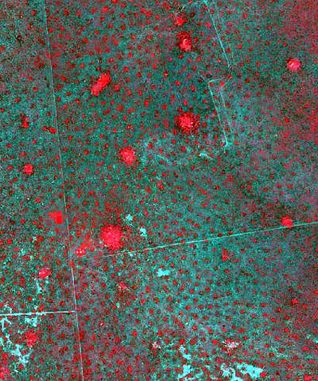
Spatial Pattern Analysis
Uniform

Slide 11
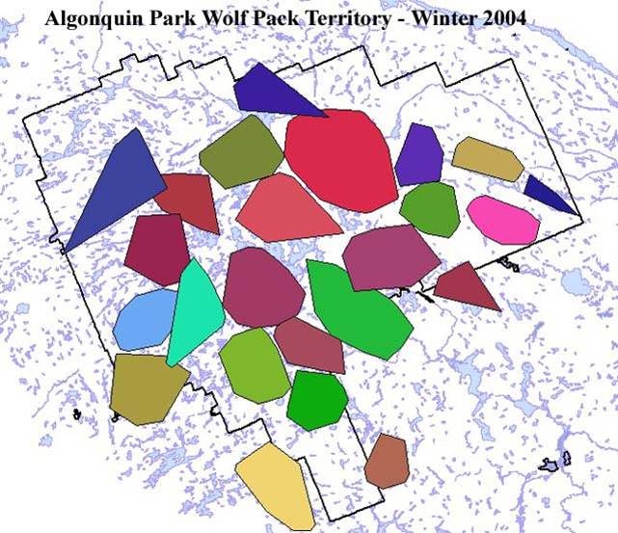

Slide 12
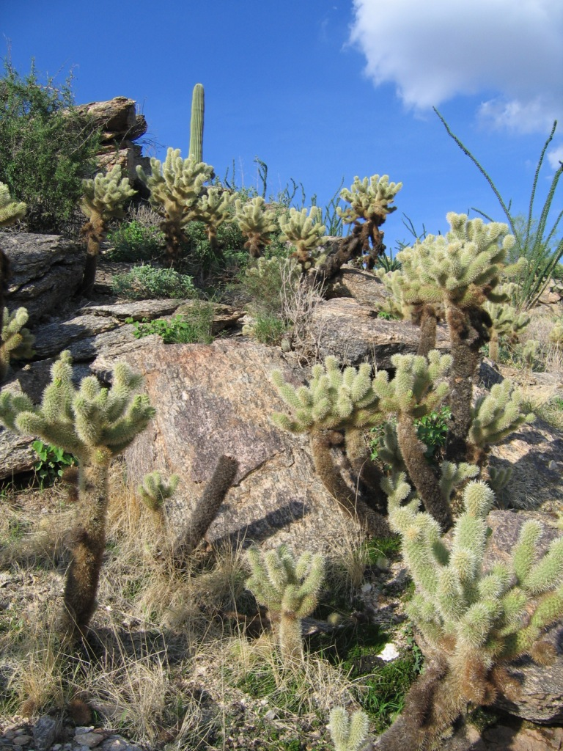
Spatial Pattern Analysis
Clumped

Slide 13
Spatial Pattern Analysis
Uniform
Random
Clumped
A random pattern suggests that a distribution is not dictated by a single, dominant underlying ecological process
Which pattern least common in nature?
Often provides the “benchmark” for describing spatial patterns

Slide 14
Spatial Pattern Analysis
Two main ways to quantify spatial patterning or ‘dispersion’
Distance among objects
Counts of object on a collection of plots

Slide 15
T-Square sampling
Q
y_{i}
Measure 2 distances:
Random point (P) to nearest object (O), x_{i}
Object (O) to nearest neighbor (Q) that is located beyond an imaginary perpendicular line through (O), y_{i}
O
x_{i}
P
Point k | x_{i} | y_{i}
1 | 20.5 | 5.1
2 | 5.9 | 5.5
3 | 17.8 | 6.2
4 | 0.4 | 9.9
5 | 1.7 | 21.9

Slide 16
T-Square sampling
Q
y_{i}
If the pattern is Random, expect the square of the x’s to be approximately equal to ½ of the square of the y’s:
x² = ½y²
Clumped: x² > ½y²
Uniform: x² < ½y²
O
x_{i}
P
Point k | x_{i} | y_{i}
1 | 20.5 | 5.1
2 | 5.9 | 5.5
3 | 17.8 | 6.2
4 | 0.4 | 9.9
5 | 1.7 | 21.9

Slide 17
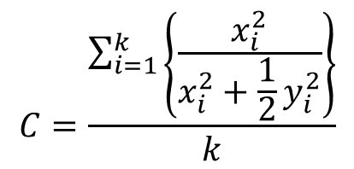
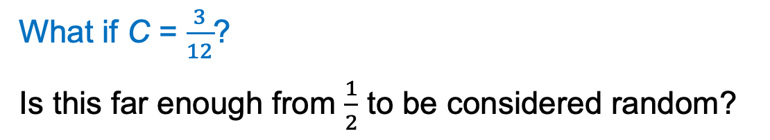
T-Square sampling
Calculate Index of Spatial Pattern (C)
Point k | x_{i} | y_{i}
1 | 20.5 | 5.1
2 | 5.9 | 5.5
3 | 17.8 | 6.2
4 | 0.4 | 9.9
5 | 1.7 | 21.9
$$C=\frac{\sum_{i=1}^{k}{\left\{\frac{x_{i}^{2}}{x_{i}^{2}+\frac{1}{2}y_{i}^{2}}\right\}}}{k}$$
no. survey points
C ≈ ½ for random patterns
C < ½ for uniform patterns
C > ½ for clumped patterns
What if C = $\frac{3}{12}$?
Is this far enough from $\frac{1}{2}$ to be considered random?

Slide 18
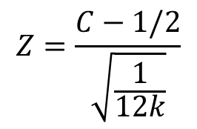
T-Square sampling
Index of Spatial Pattern (C)
C ≈ ½ for random patterns
C < ½ for uniform patterns
C > ½ for clumped patterns
Use a test statistic that maps C to probability distribution to gauge if it is differs “significantly” from ½:
$$Z=\frac{C−\text{1/2}}{\sqrt{\frac{1}{12k}}}$$
P-value = probability of attaining a test statistic as least as extreme as that observed if the null hypothesis of a random distribution is true
P < 0.10 is a common but arbitrary cutoff (α=0.10) we can use to decide whether the pattern is or is not random

Slide 19
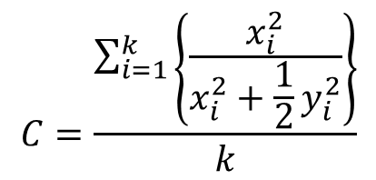

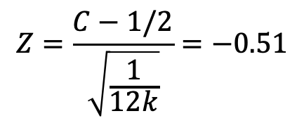
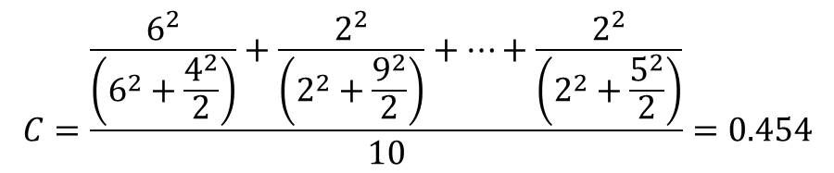
Example: Index of Spatial Pattern (C)
Point k | x_{i} | y_{i}
1 | 6 | 4
2 | 2 | 9
3 | 6 | 3
4 | 5 | 7
5 | 6 | 1
6 | 2 | 8
7 | 1 | 3
8 | 2 | 5
9 | 4 | 6
10 | 2 | 5
$$C=\frac{\sum_{i=1}^{k}{\left\{\frac{x_{i}^{2}}{x_{i}^{2}+\frac{1}{2}y_{i}^{2}}\right\}}}{k}$$
$$C=\frac{\frac{6^{2}}{\left(6^{2}+\frac{4^{2}}{2}\right)}+\frac{2^{2}}{\left(2^{2}+\frac{9^{2}}{2}\right)}+⋯+\frac{2^{2}}{\left(2^{2}+\frac{5^{2}}{2}\right)}}{10}=0.454$$
C < ½; evidence for uniform distribution?
$$Z=\frac{C−1/2}{\sqrt{\frac{1}{12k}}}=−0.51$$
$$P=0.31$$
P > 0.10, so no reason to reject the null and conclude the pattern is non-random

Slide 20
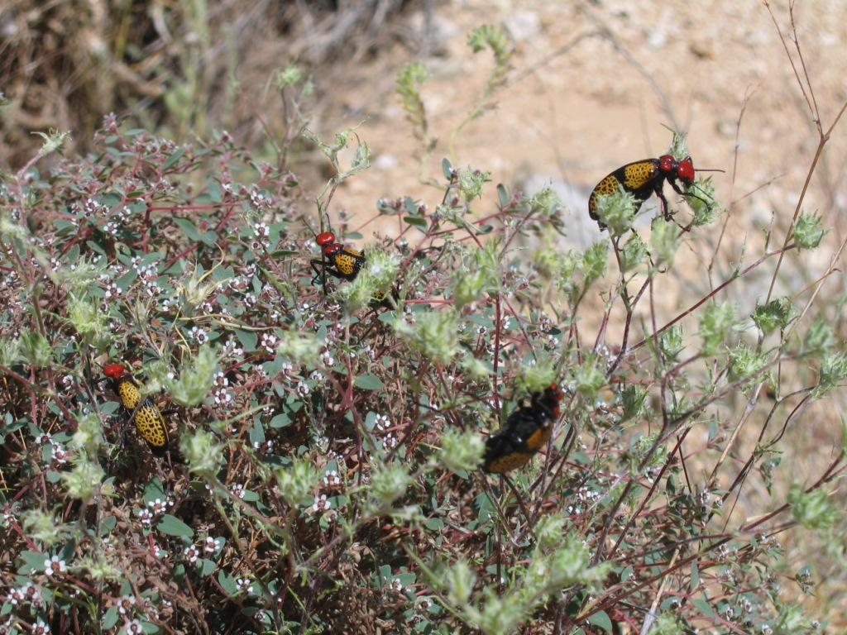
Plot-based estimates of dispersion
Data are counts on sample units, often plots

Slide 21

Plot-based estimates of dispersion
Insect distribution on leaves of a plant
Multiple ways to distribute:
- 30 insects across
- 10 leaves

Slide 22
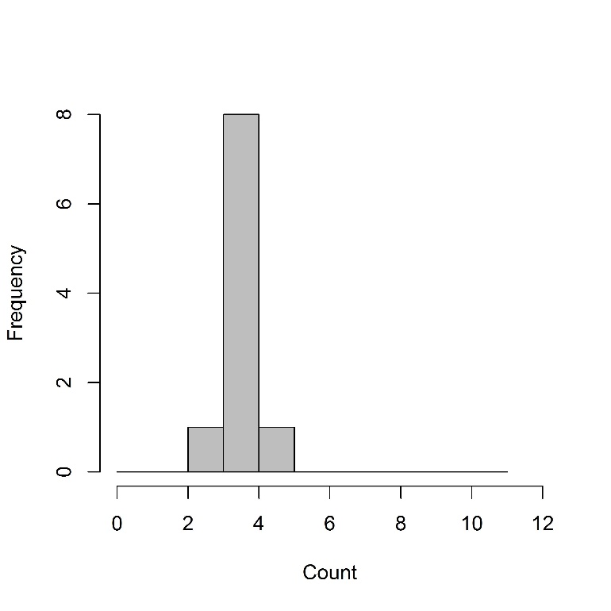
Plot-based estimates of dispersion
Insect distribution on leaves of a plant
Uniform
3
2
3
4
3
3
3
3
3
3

Slide 23
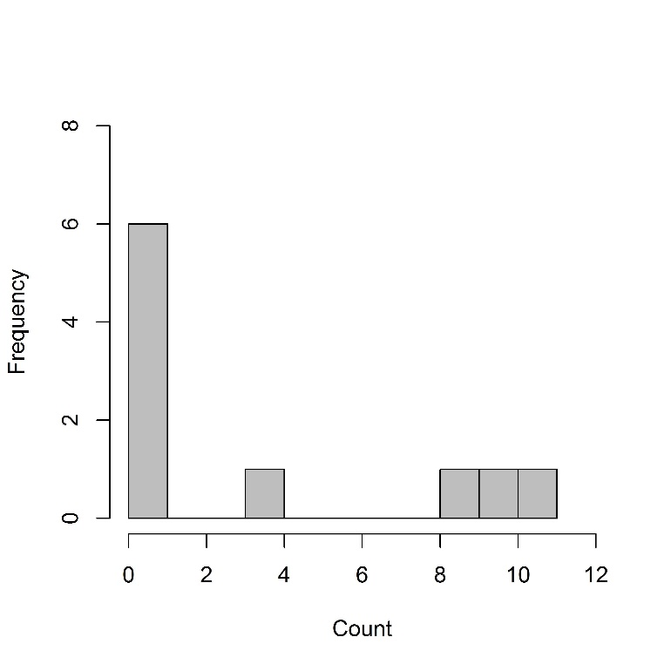
Plot-based estimates of dispersion
Insect distribution on leaves of a plant
Clumped
0
8
0
0
10
9
0
3
0
0

Slide 24
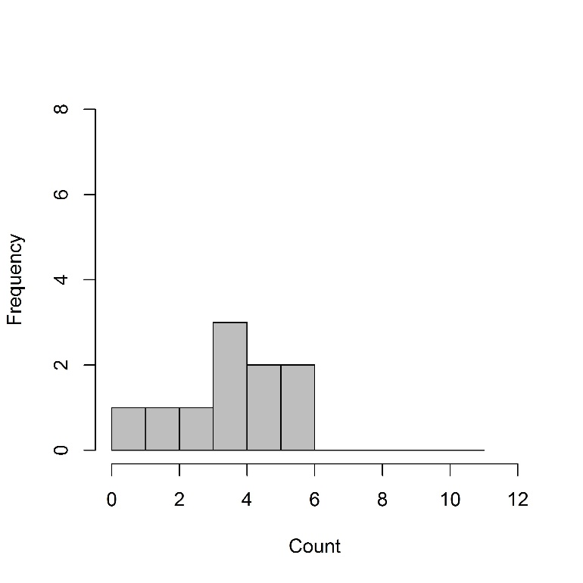
Plot-based estimates of dispersion
Insect distribution on leaves of a plant
Random
0
2
3
4
4
3
5
3
5
1

Slide 25
Mean = 3
Variance = 0.2
Mean = 3
Variance = 2.7
Mean = 3
Variance = 18.2
Uniform
Random
Clumped
Relationship between the mean and the variance distinguishes different spatial patterns
Notes:
Left off 17 Nov 2021

Slide 26
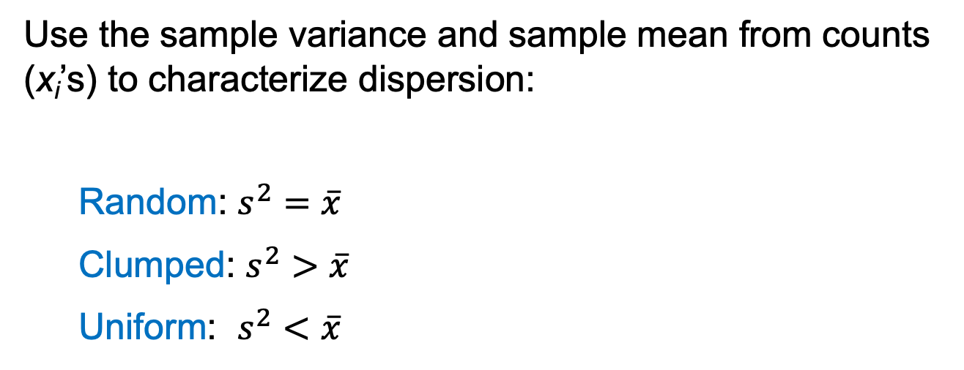
Plot-based estimates of dispersion
Use the sample variance and sample mean from counts (x_{i}’s) to characterize dispersion:
Random: $s^{2}=\overline{x}$
Clumped: $s^{2}>\overline{x}$
Uniform: $s^{2}<\overline{x}$

Slide 27
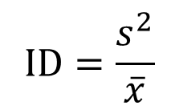
Index of Dispersion (ID)
Ratio of variance to the mean:
$$ID=\frac{s^{2}}{\overline{x}}$$
ID ≈ 1 for random patterns
ID < 1 for uniform patterns
ID > 1 for clumped patterns
ID has a χ² distribution (df = k – 1), so its associated P-value can help us to assess whether the value differs significantly from the null hypothesis that the pattern is random (ID ≈ 1 )
If the P-value associated with the χ² is:
< 0.10, distribution is uniform
≥ 0.10 and ≤ 0.90, distribution is random
> 0.90, distribution is clumped

Slide 28
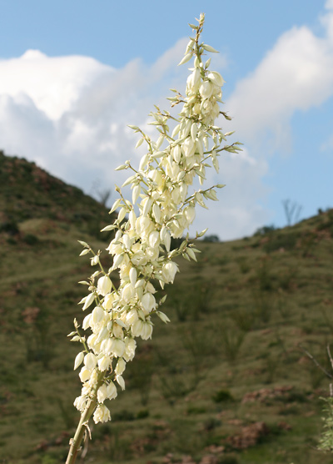
Example: Plot-based estimate of dispersion
Larvae from carpenter bees were counted in 180 different inflorescences of soap-tree yucca
x | 0 | 1 | 2 | 3 | 4 | 5 | 6 | 7 | 8 | 9 | 10
F_{x} | 114 | 25 | 15 | 10 | 6 | 5 | 2 | 1 | 1 | 0 | 1
x = no. larvae per inflorescence
F_{x} = no. inflorescences with x larvae
T. Beth Kinsey

Slide 29
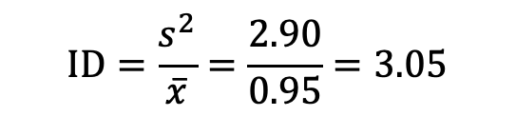
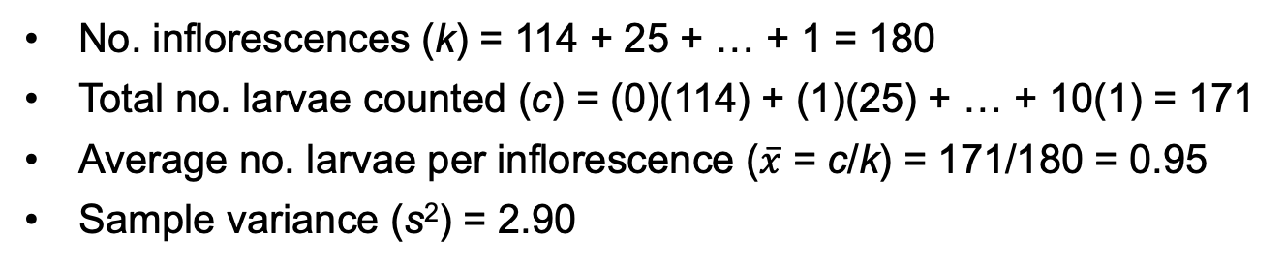
Example: Plot-based estimate of dispersion
x | 0 | 1 | 2 | 3 | 4 | 5 | 6 | 7 | 8 | 9 | 10
F_{x} | 114 | 25 | 15 | 10 | 6 | 5 | 2 | 1 | 1 | 0 | 1
No. inflorescences (k) = 114 + 25 + … + 1 = 180
Total no. larvae counted (c) = (0)(114) + (1)(25) + … + 10(1) = 171
Average no. larvae per inflorescence ($\overline{x}$ = c/k) = 171/180 = 0.95
Sample variance (s²) = 2.90
Is the distribution random, uniform, or clumped?
$$ID=\frac{s^{2}}{\overline{x}}=\frac{2.90}{0.95}=3.05$$
P > 0.99, so evidence the distribution is not random, but clumped
ID ≈ 1 for random patterns
ID < 1 for uniform patterns
ID > 1 for clumped patterns
P < 0.10, distribution is uniform
P ≥ 0.10 and ≤ 0.90, distribution is random
P > 0.90, distribution is clumped

